Slide 1

Welcome Meeting
Welcome to Year 4 at Launde Primary School
2026-2027
Notes:
Heather

Slide 2
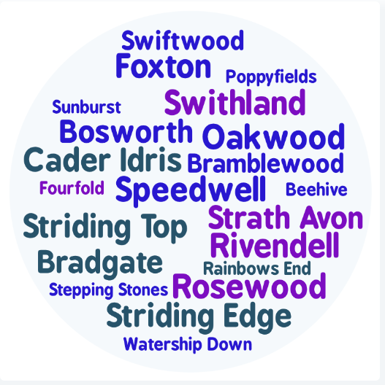
Staff introductions
4JM Mr. Mukadam (Foxton)
4DB Mr. Balhatchet (Rosewood)
4AS Mr. Sattar (Swithland)
Notes:
Everyone

Slide 3
Our School’s Aims
At Launde we create curious minds, kind hearts, bright futures
This statement reflects our commitment to nurturing compassionate individuals, fostering a love of learning and exploration and empowering our children to achieve their full potential.
The staff at Launde look forward to working alongside parents to meet this ambition.
Notes:
Sharn

Slide 4





Our School Values
Recently, our school community identified 5 values that will underpin our school culture, our interactions and empower our pupils to become well-rounded, successful individuals.
Respect
Kindness
Resilience
Curiosity
Confidence
We believe that by working together, parents and school staff can create an environment where these values are not just words, but are integral to everything we do and how we treat each other. These values will be present and discussed within every part of our school’s curriculum.
Notes:
Kindness: Our children show kindness to each other at all times.
Confidence: Our children show confidence in being themselves, to speak up for themselves, try new things and handle adversity.
Resilience: Our children embrace mistakes as learning opportunities and they stay positive in difficult situations.
Respect: Our children treat others kindly, value differences and listen to everyone’s ideas and opinions, even if this is different to their own.
Curiosity: Our children are excited by their learning and are eager to explore new ideas.

Slide 5

Partnership
We hope your child is looking forward to their transition into Year 4.
Your child’s wellbeing is our first priority and we want to ensure that they feel happy and safe coming into school.
You are always welcome to speak with us. We are here to support you and your child.
Please do this via the office or at the end of the school day.
Notes:
Kate

Slide 6

Behaviour Curriculum
Launde has a fully implemented behaviour curriculum to support children in developing good habits and to help foster an inclusive, nurturing environment where every child feels safe and valued.
We achieve this by teaching four fundamental principles:
Be Ready to Learn
Be Kind
Be Respectful
Be Safe
These principles are then rewarded when we see them in school, in a number of different ways.
Notes:
Heather

Slide 7
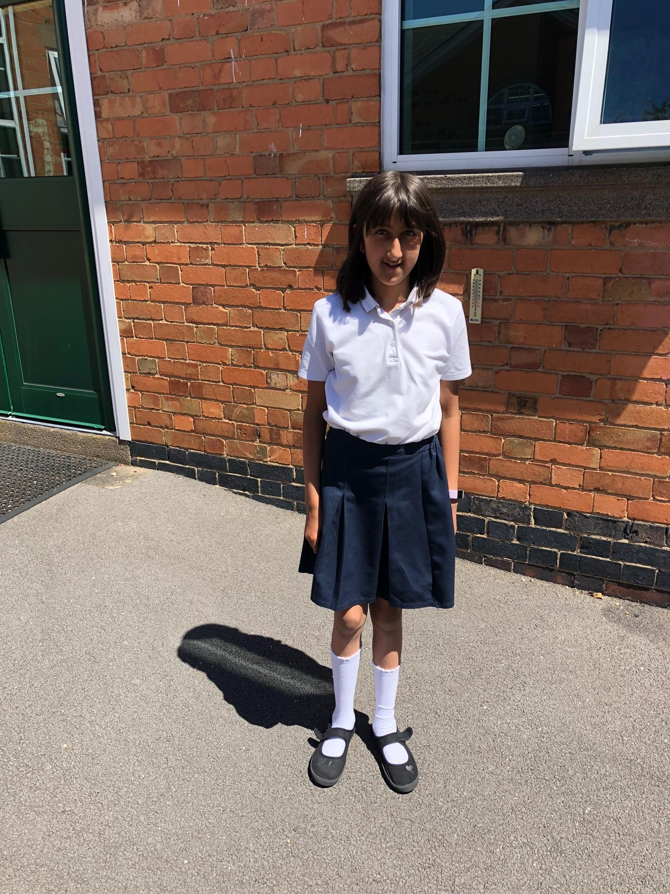
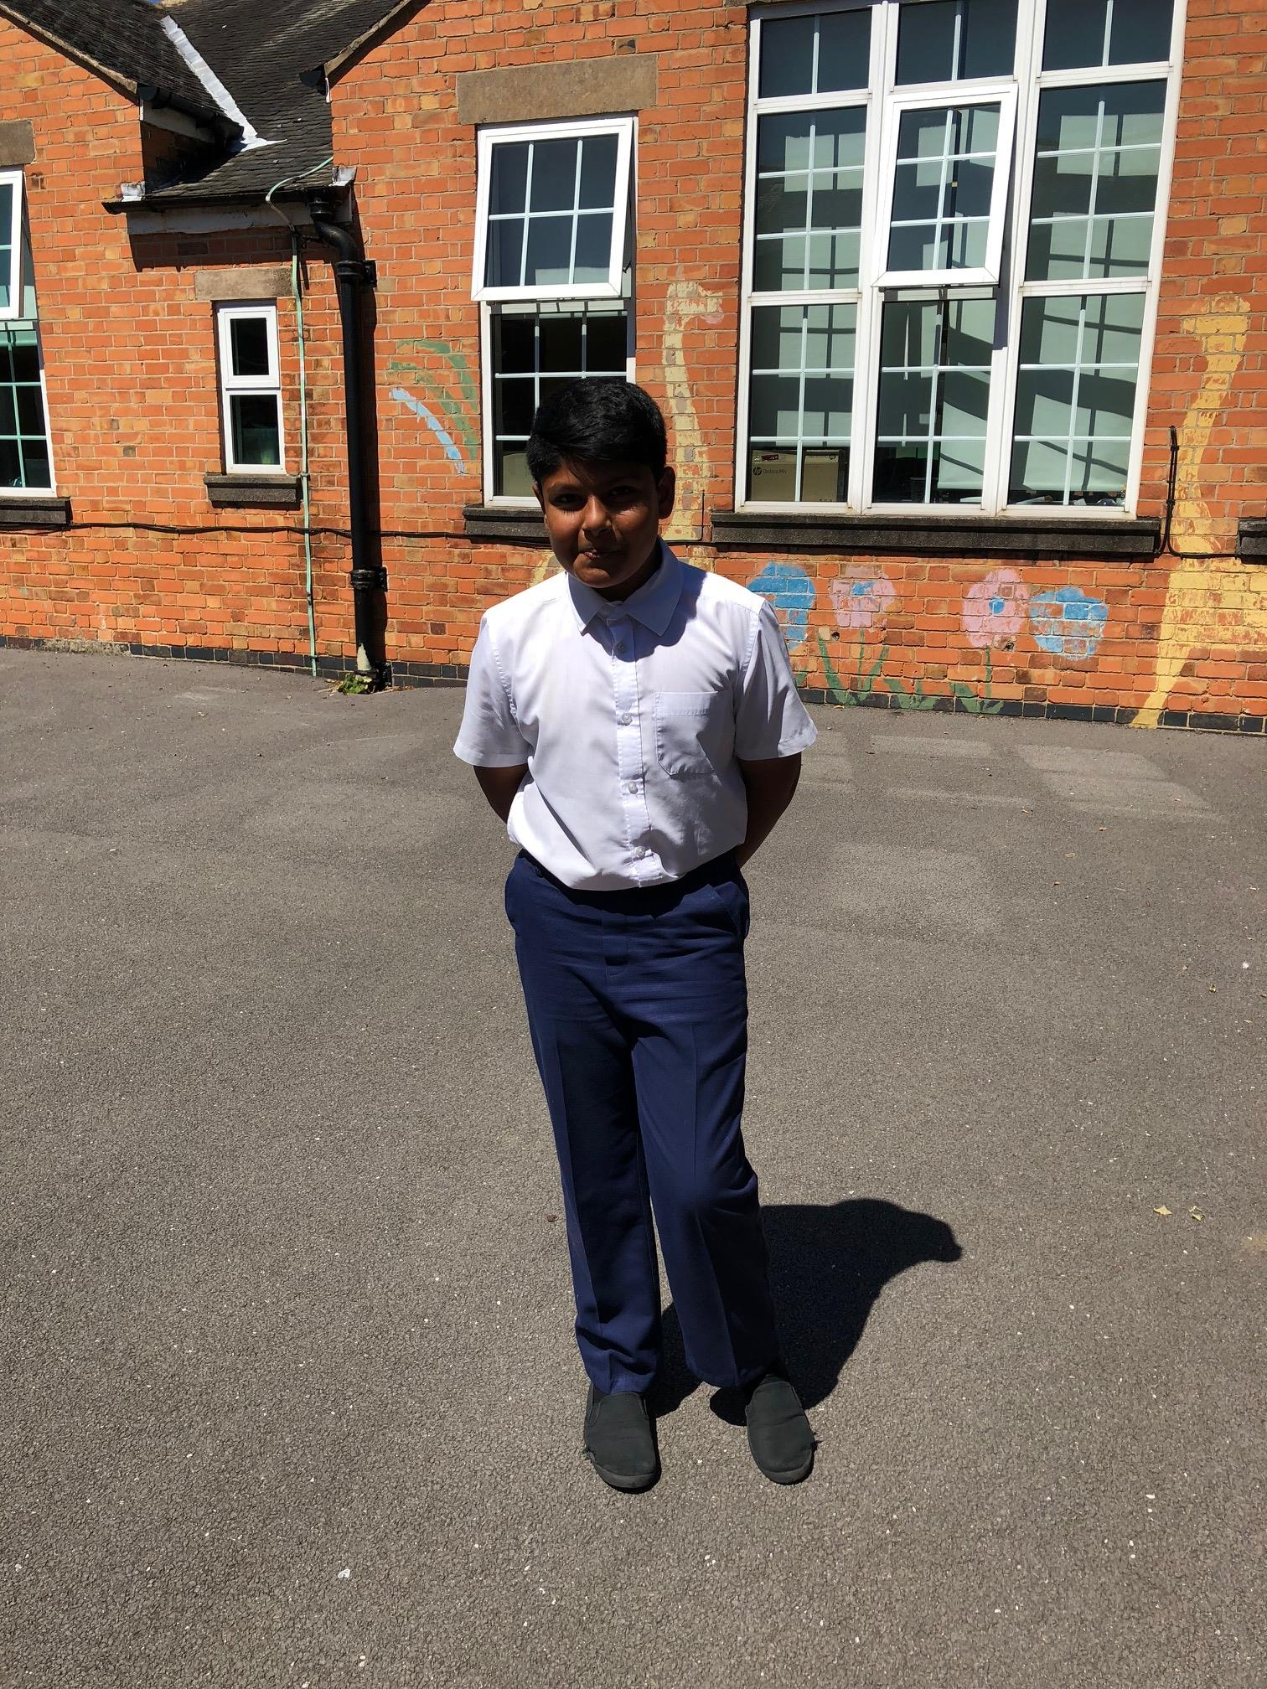
Uniform
White polo shirt
Uniform – please ensure your child conforms to the school uniform rules:
Children will need separate indoor and outdoor pairs of shoes – these need to be completely black.
Red Jumper/Cardigan (logo optional - from School Wear Solutions)
Summer Dresses: Red Gingham
All long hair should be tied up.
No leggings.
Black or grey skirt, trousers or shorts
Plain, black shoes or trainers with black sole and no logo.
Notes:
Jo

Slide 8
PE Kit
P.E. kit to be worn on the day that your child has PE (you will be notified of this at the start of the academic year in August).
Black jogging bottoms or shorts
White t-shirts
Sports trainers (white or black)
Red jumper
No earrings and hair tied back
Please make sure that your child is dressed appropriately for the weather on the day of their PE lesson.
Notes:
Jo

Slide 9

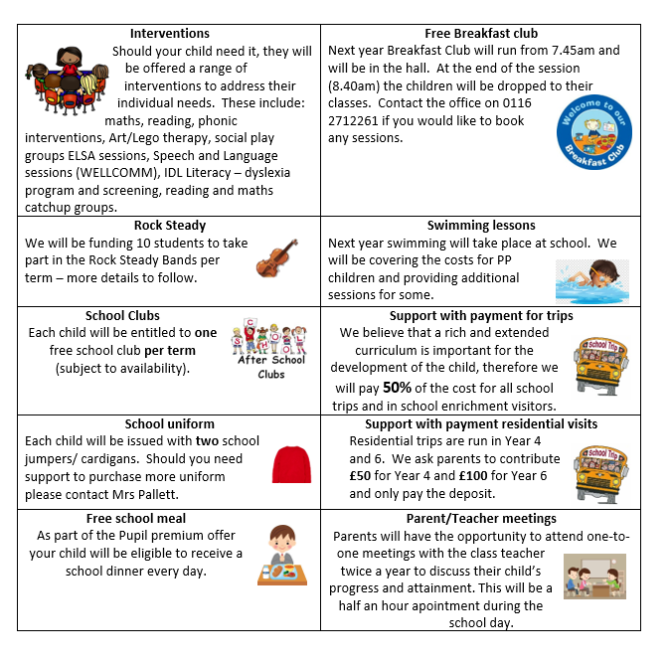
Pupil Premium Offer 2026-2027
We have adapted the pupil premium offer to ensure it is more personalised to provide individual support to each child.
Should you feel that you could be eligible for free school meals then please contact the office
Notes:
As a school, we want all children to be successful, empowered to learn, and happy and excited to come to school. We feel strongly that school should be a place of opportunities and recognise that we can make a significant difference if we individually target the needs of children. To achieve this, we have adapted the pupil premium offer to ensure it is more personalised to provide individual support to each child.
Should you feel that you could be eligible for free school meals then please contact the office

Slide 10
Our school day
Daily timetable
One hour of mathematics
One hour of English
40 minutes of reading
Twenty minutes of spelling (three times a week)
Twenty minutes of handwriting (twice a week)
Enquiry curriculum in the afternoons (more to follow)
8:40am – Meet children
8:45am (gates and doors close) –Register and morning work
10:20am – Morning break
12:15pm – Lunch time
3:15pm – Home time
Notes:
Jo

Slide 11
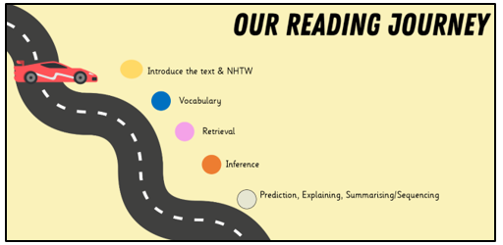
Reading
Daily whole-class reading lessons
Children will read aloud with fluency, pace and expression.
Children are expected to be able to use inference skills to deduce greater understanding from what they have read.
We focus on developing: vocabulary, inference, prediction, explanation, retrieval, summarising and sequencing skills.
Children will have the opportunity to change their reading books daily, and will be expected to change their books at least once a week.
Please read every night with your child and ask questions to check their understanding of the text and any unfamiliar words.
Notes:
Reading records – read three times to improve fluency, expression and comprehension.

Slide 12

Keep reading with the library challenge!
4th July – 12th September (further information can be found online)
Notes:
Kate

Slide 13


Writing
Key skills
Grammar: nouns, adjectives, verbs and adverbs.
Fronted adverbials.
Figurative language.
Writing structured into paragraphs
Text types:
Setting and character descriptions
Recounts (diary)
Letter
Biography
Non-chronological reports
Narratives
Notes:
Heather

Slide 14
Spelling Lessons
Essential Spelling and Word Knowledge
We use the Oxford Essential Spelling and Word Knowledge programme to develop confident, independent spellers. Instead of memorising weekly word lists, children learn the spelling patterns, rules and word structures that help them spell accurately in all their writing.
Taught three times each week through short, engaging lessons.
Children learn spelling patterns, prefixes, suffixes, root words and word origins.
Understanding why words are spelled the way they are leads to stronger long-term spelling, vocabulary and writing than memorising a different list of words each week.
Notes:
Heather

Slide 15

Handwriting
In Year 4, children build on their existing handwriting skills to develop a fluent, consistent and legible joined handwriting style that can be applied across the curriculum.
Regular handwriting lessons develop fluency, presentation and writing stamina.
Children refine letter joins, spacing, size and proportion to improve the quality of their written work.
Teachers monitor handwriting throughout the year to ensure children can write neatly, accurately and at an appropriate speed.
As handwriting becomes more automatic, children are able to focus more fully on the content and quality of their writing.
Notes:
Heather

Slide 16


Maths
We use the Power Maths White Rose curriculum scheme.
5-a-day quick maths questions
Counting, number sequences and place value
The four operations + - x ÷
Recognise fractions and decimal equivalents – ½, ¼, ¾
Use of standard measures
Time - both analogue and digital
Shape properties including angles- 2D and 3D.
Handling data- using e.g. bar, line graphs and pictograms
Weekly Times Table Rock star sessions and homework
Notes:
Jo

Slide 17
Maths
National times table check will take place towards the end of Year 4, the children will need to know all their times tables up to 12 x 12.
Rapid recall and accuracy is required.
Children will be expected to engage regularly with Times Table Rock Stars to improve their speed.
Notes:
Jo

Slide 18

Year 4 Enquiry Curriculum
Following our recent parent questionnaire, we are redesigning our curriculum to inspire curiosity and help children think more deeply as they build and connect their knowledge.
This will include bringing our school community closer together by inviting parents and carers to play a much more active role in school life. We will be sharing the learning, experiences and achievements of our children every step of the way.
Further information and dates will be shared with you.
Notes:
We are incredibly excited to be developing our new enquiry-led curriculum this year, designed to inspire curiosity and help children think more deeply as they build and connect their knowledge. This work has been shaped by the thoughtful feedback from our recent parent questionnaire, alongside our partnership with Flying High, as we strengthen and refine what each year group already offers. A key part of this journey is bringing our school community even closer together—so we will be inviting parents and carers to play a much more active role in school life, sharing in the learning, experiences, and achievements of our children every step of the way.

Slide 19

Year 4 Enquiry Curriculum
Autumn Term – History
Enquiry Question: How do past decisions shape the future?
Using the Roman invasion and occupation of Britain as the central focus, children will investigate the decisions made by individuals and civilisations, considering how these choices influenced life in Britain both at the time and for generations afterwards. They will work as historians by analysing evidence, comparing primary and secondary sources, and evaluating different interpretations of the past.
​
Spring – Geography: How does the land lie?​
Investigating human and physical features, settlements and land use.​
Summer – Art: How can creativity convey a story?​
Drawing inspiration from Vincent van Gogh while developing an understanding of proportion, scale and artistic expression.​
​
By the end of each enquiry, children will be able to confidently answer the overarching question, drawing upon knowledge and evidence from across the curriculum to justify their thinking.​
Notes:
Autumn term – History
Spring term – Geography
Summer term - Art

Slide 20


Other Subjects
Science:
Classifying organisms, food & digestion, states of matter, sound, electricity and properties of materials.
PE:
Indoor: fitness, multi-skills, gymnastics, dance and athletics
Outdoor: basketball, football, rugby, cricket and swimming
RE:
Hinduism in Britain today, the impact of spiritual music, The Trinity and Easter, Sikhism, and how do different people observe significant life events?
Notes:
Jo

Slide 21


Other Subjects
Computing:
The internet, audio production, programming, data logging and photo editing.
Music:
Ukuleles, pulse, voice, rhythm, pitch, 20th century music, and technology, structure & form.
Spanish:
Children will continue and develop to learn Spanish starting with colours, food, drink and how the gender noun changes.
Notes:
Jo

Slide 22

Homework
Read to an adult for 10-15 minutes each day and change their books each week.​
At least three minutes per day on Times Table Rockstars (login details stuck on the inside cover of reading records)​
CGP books – Reading, Grammar and Maths to support the learning that takes place in school: these will be set via Weduc; parents will be given mark schemes to check work with their child.
Top tips​
Provide quiet working space and agree the time beforehand.​
Have suitable equipment to complete homework i.e. pencils not pens, colouring pencils, rulers and rubbers etc. ​
Prioritise: Reading and times tables.​
Don’t let homework become overwhelming or last minute.
Notes:
Kate

Slide 23
Helpful Websites
www.topmarks.co.uk – Interactive, fun maths games.
www.mathsisfun.com - Maths explained in easy language, and puzzles and games
www.teachhandwriting.co.uk – Video demonstrations of how to form letters, and fine motor skill exercises.
www.oxfordowl.co.uk – Online reading and phonics resources.
https://ttrockstars.com/ - Times Table practise
Notes:
Kate

