Slide 1

Welcome Meeting
Welcome to Year 5 at Launde Primary School
2026-2027
Notes:
Sam

Slide 2
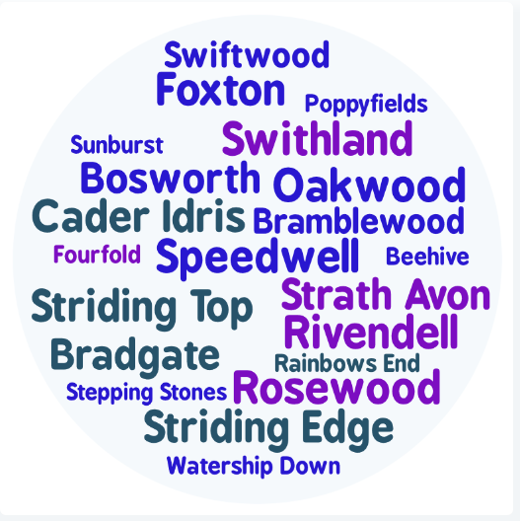
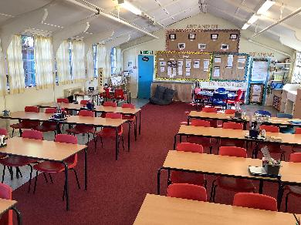
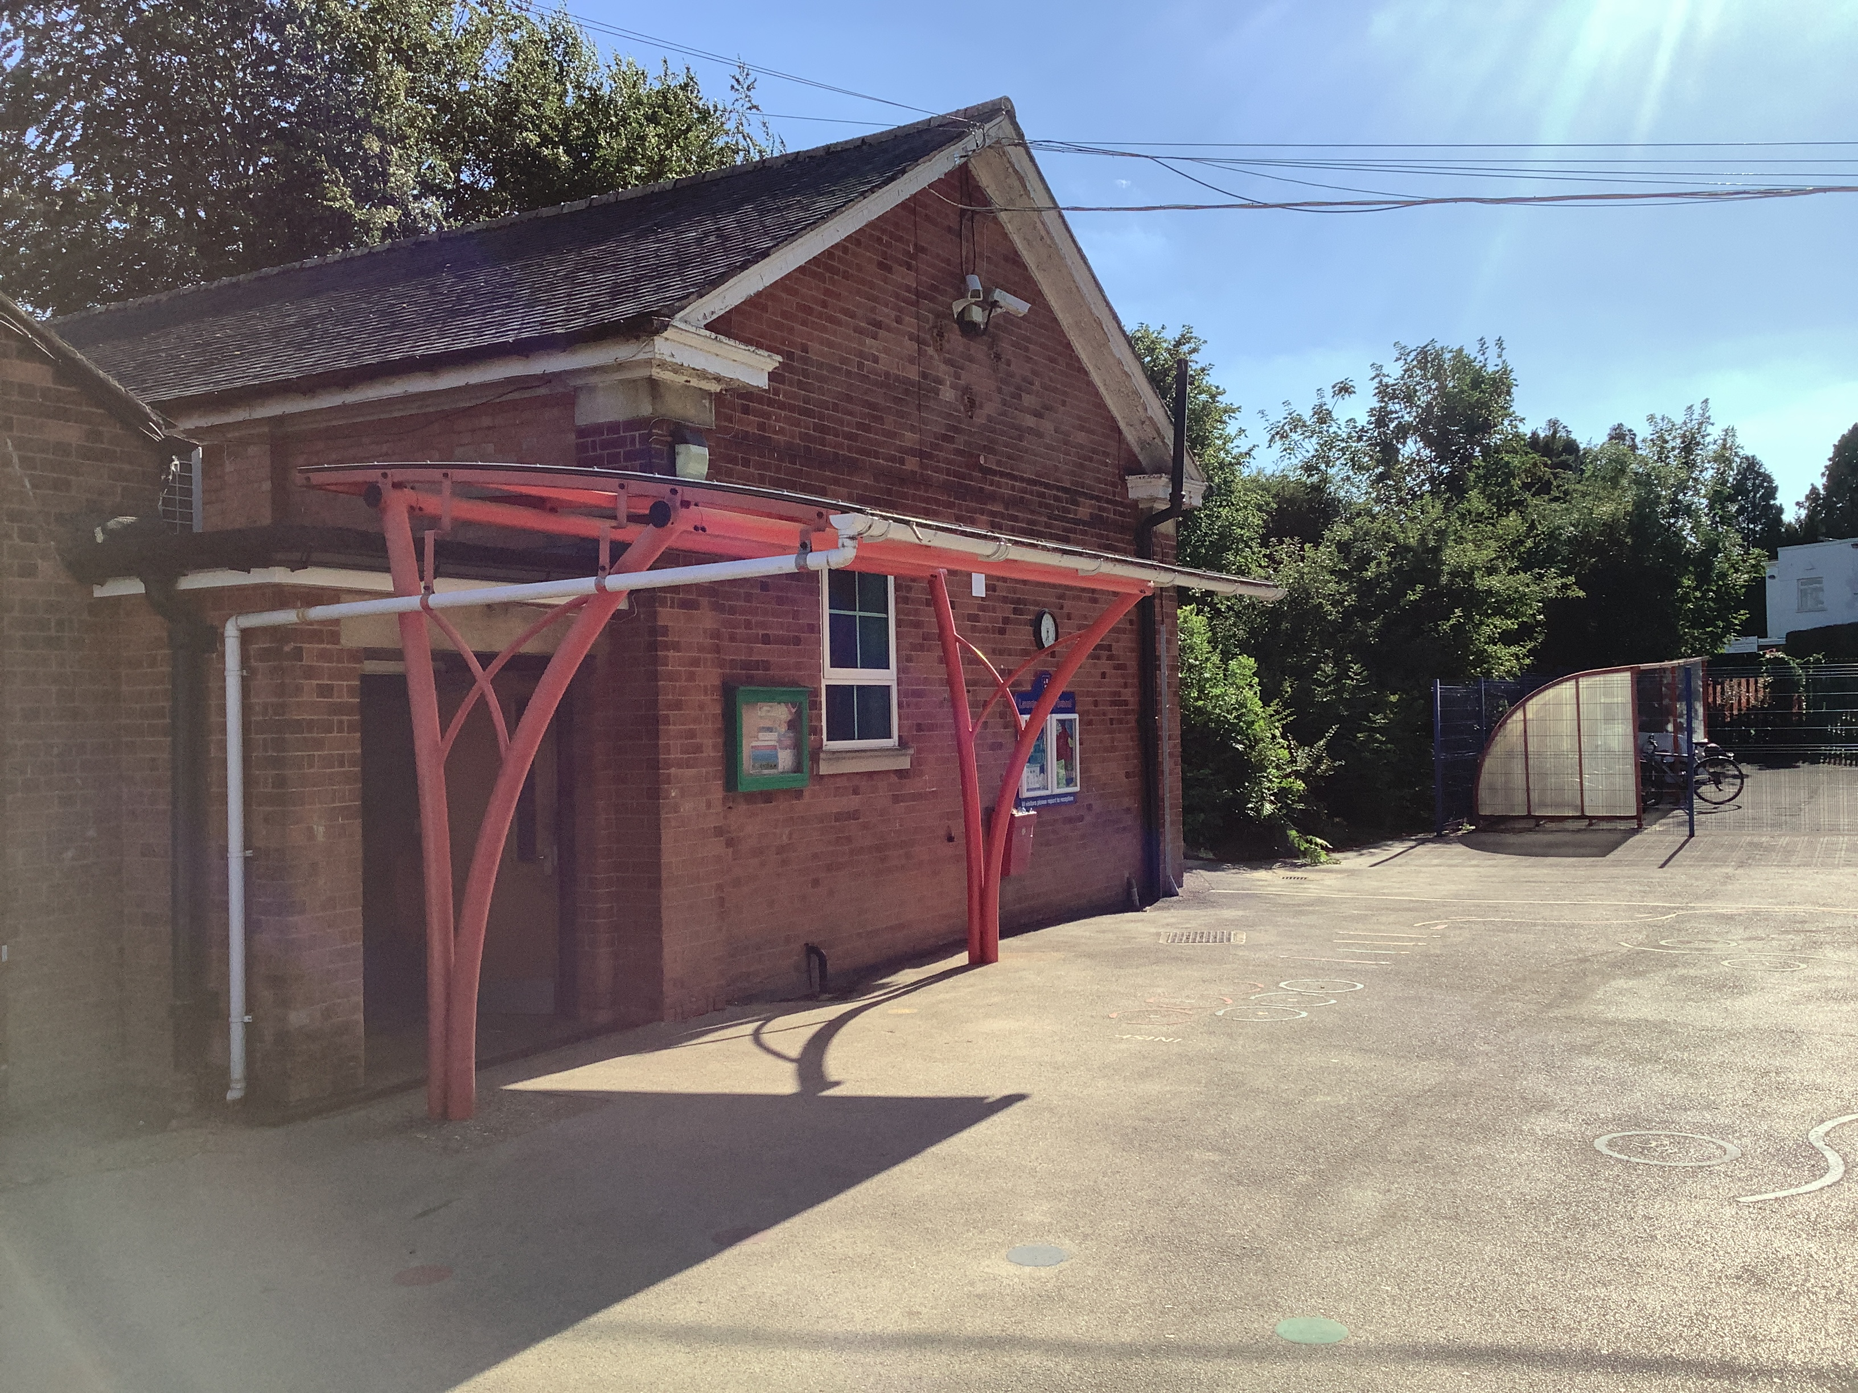
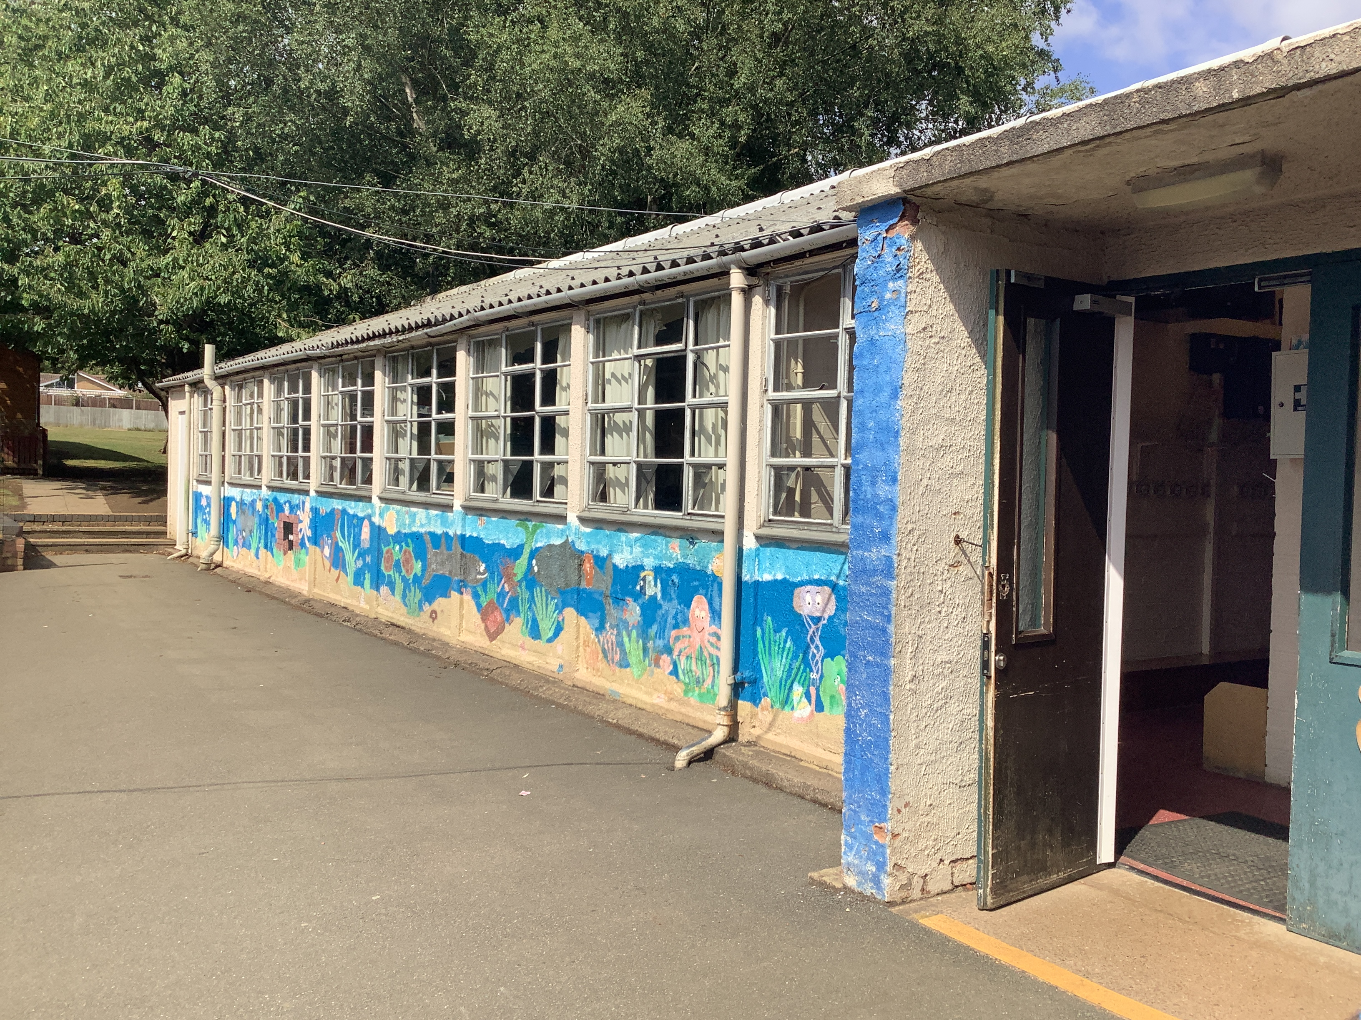
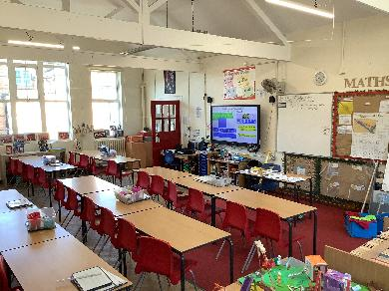
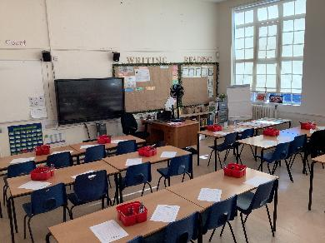
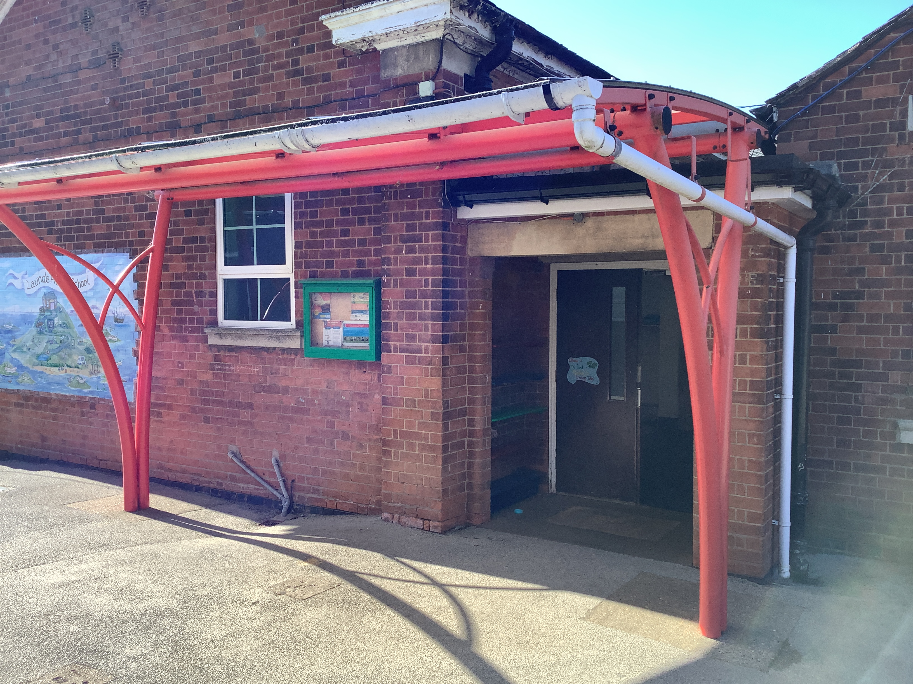
Staff introductions
5KM
Mrs Melody (Rivendell)
5SF
Mr Frost
(Watership Down)
5RP
Miss Patel
(Cader Idris)
Notes:
Everyone

Slide 3
Our School’s Aims
At Launde we create curious minds, kind hearts, bright futures
This statement reflects our commitment to nurturing compassionate individuals, fostering a love of learning and exploration whilst empowering our children to achieve their full potential.
The staff at Launde look forward to working alongside parents to meet this ambition.
Notes:
Sam

Slide 4





Our School Values
Our school community has five values that will underpin our school culture, our interactions and empower our pupils to become well-rounded, successful individuals.
Respect
Kindness
Resilience
Curiosity
Confidence
We believe that by working together, parents and school staff can create an environment where these values are not just words, but are integral to everything we do and how we treat each other. These values will be present and discussed within every part of our school’s curriculum.
Notes:
Kindness: Our children show kindness to each other at all times.
Confidence: Our children show confidence in being themselves, to speak up for themselves, try new things and handle adversity.
Resilience: Our children embrace mistakes as learning opportunities and they stay positive in difficult situations.
Respect: Our children treat others kindly, value differences and listen to everyone’s ideas and opinions, even if this is different to their own.
Curiosity: Our children are excited by their learning and are eager to explore new ideas.
Raheema

Slide 5

Partnership
We hope your child is looking forward to their transition into Year 5.
Your child’s wellbeing is our first priority and we want to ensure that they feel happy and safe coming into school.
You are always welcome to speak with us. We are here to support you and your child.
Please do this via the office or at the end of the school day.
Notes:
Sam

Slide 6

Behaviour Curriculum
Launde has a fully implemented behaviour curriculum to support children in developing good habits and to help foster an inclusive, nurturing environment where every child feels safe and valued.
We achieve this by teaching four fundamental principles:
Be Ready to Learn
Be Kind
Be Respectful
Be Safe
These principles are then rewarded when we see them in school, in a number of different ways.
Notes:
Sam

Slide 7
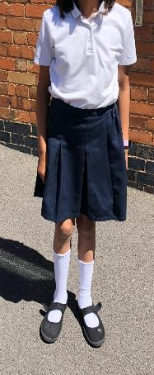
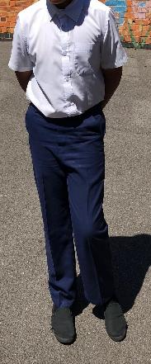
Uniform
White polo shirt
Uniform – please ensure your child conforms to the school uniform rules:
Indoor shoes (plimsoles)
Outdoor shoes (plain black)
Red Jumper/Cardigan (logo optional - from School Wear Solutions)
Summer Dresses: Red Gingham
All long hair should be tied up.
No leggings.
Black or grey skirt, trousers or shorts
Plain, black shoes or trainers with black sole and no logo.
Notes:
Kath

Slide 8
PE Kit
P.E. kit to be worn on the day that your child has PE (you will be notified of this at the start of the academic year in August).
Black jogging bottoms or shorts
White t-shirts
Sports trainers (white or black)
Red jumper
No earrings and hair tied back
Please make sure that your child is dressed appropriately for the weather on the day of their PE lesson.
Notes:
Kath

Slide 9

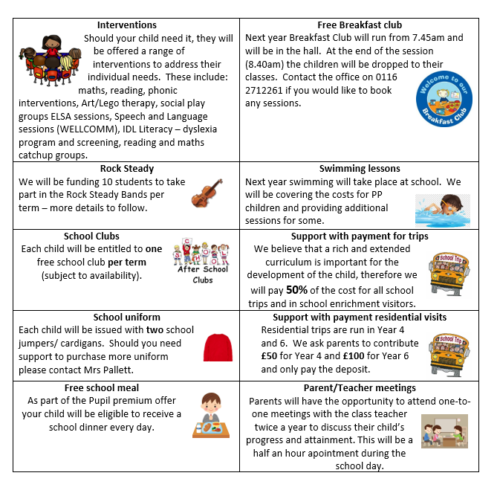
Pupil Premium Offer 2026-2027
We have adapted the pupil premium offer to ensure it is more personalised to provide individual support to each child.
Should you feel that you could be eligible for free school meals then please contact the office
Notes:
As a school, we want all children to be successful, empowered to learn, and happy and excited to come to school. We feel strongly that school should be a place of opportunities and recognise that we can make a significant difference if we individually target the needs of children. To achieve this, we have adapted the pupil premium offer to ensure it is more personalised to provide individual support to each child.
Should you feel that you could be eligible for free school meals then please contact the office
Raheema

Slide 10
Our school day
Daily timetable
One hour of mathematics
Fifteen minutes of Handwriting
One hour of English
Thirty minutes reading lesson
Twenty minutes spelling lesson (three times a week)
Enquiry curriculum in the afternoons (more to follow)
8:40am – Meet children
8:45am (gates and doors close) –Register and morning work
11.00am – Morning break
12:15pm – Lunch time
3:15pm – Home time
Notes:
Sam

Slide 11
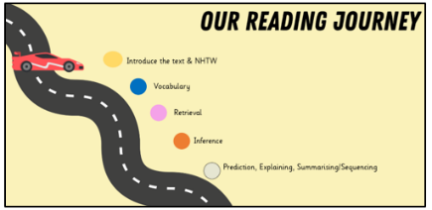
Reading
Daily whole class reading following our reading journey
Ask questions to check their understanding
Children are expected to read aloud with fluency, pace and expression.
Children will be expected to read independently outside of school
Notes:
Reading records – read three times to improve fluency, expression and comprehension.
Sam

Slide 12

Keep reading with the library challenge!
4th July – 12th September (further information can be found online)
Notes:
Sam

Slide 13
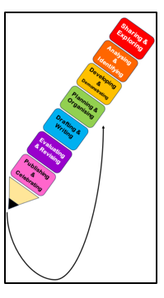
Writing
Text types:
Setting and character descriptions
Recounts (diary)
Letter
Non-chronological reports
Action scenes
Balanced arguments
Poems- cinquain and prepositional poetry
Key skills
A variety of sentence starters (fronted adverbials)
Relative clauses
Subordinate clauses
Parentheses
Semi colons
Past tense forms
Hyphenated adjectives
Modal verbs and adverbs of possibility
Notes:
Raheema

Slide 14
Spelling Lessons
Children are taught how to add prefixes and suffixes onto root words and how this may change the meaning.
Children learn common and irregular spelling patterns to apply in their writing.
Children rehearse transcriptional fluency through dictated sentences that include or feature the spelling focus of that week.
Target spellings as part of English lessons.
Notes:
Raheema

Slide 15


Maths
Place value up to one million
Addition and subtraction with 6 digit numbers
Long multiplication and short division
Fractions (equivalent fractions, adding, subtracting and multiplying, converting between mixed and improper fractions)
Decimals and percentages
Area and perimeter
Negative numbers
Angles
Unit conversions
Notes:
Kath

Slide 16

Year 5 Enquiry Curriculum
Next year, the school will be introducing a new curriculum which we are describing as an enquiry curriculum.
This will pose an interesting, challenging question for children to answer and give them a variety of engaging lessons to inspire curiosity and deepen their knowledge.
As part of the enquiry curriculum, children will draw on a range of experiences, expert guidance and real world application. This will also include increased engagement with parents, families and the local community to both support children’s learning and act as an audience for their incredible outcomes.
Notes:
We are incredibly excited to be developing our new enquiry-led curriculum this year, designed to inspire curiosity and help children think more deeply as they build and connect their knowledge. This work has been shaped by the thoughtful feedback from our recent parent questionnaire, alongside our partnership with Flying High, as we strengthen and refine what each year group already offers. A key part of this journey is bringing our school community even closer together—so we will be inviting parents and carers to play a much more active role in school life, sharing in the learning, experiences, and achievements of our children every step of the way.
Sam

Slide 17

Year 5 Enquiry Curriculum
Does everybody leave a legacy?
We can explore this question by learning about:
  The legacy of the Anglo Saxons
  The legacy of the Vikings
  Martin Luther King Jnr
  Mahatma Gandhi
  William Booth
  Malala Yousafzai
  Mother Theresa
Notes:
Autumn term – History
Spring term – Geography
Summer term – Art
Sam

Slide 18


Other Subjects
Science:
Chemistry- Separating Mixtures
Physics- Forces, Energy and Space
Biology- Reproduction in plants and animals and Human development
RE:
Islam
Christianity
Atheism and Humanism
Notes:
Raheema

Slide 19


Other Subjects
Computing:
Programming
Databases
Media Production
Computing Systems and Networks
E-safety
Music:
Pulse
Voice
Rhythm- Djembe drums
Pitch
Notes:
Kath

Slide 20

Homework
Children should be reading at home independently on a regular basis
Times Table Rockstars
CGP books – Reading, Grammar and Maths: these will be set via Weduc to complete each week and will relate to and support lessons taught throughout the week.
Top tips​
Provide quiet working space and agree the time beforehand.​
Ensure it is part of your regular routine
Have suitable equipment to complete homework
Be prepared to support your child if they need it
Make sure there is time with the family exploring, discovering, building relationships with others outside of school.​
Notes:
Sam

