Slide 1

Welcome Meeting
Welcome to Year 3 at Launde Primary School
2026-2027

Slide 2
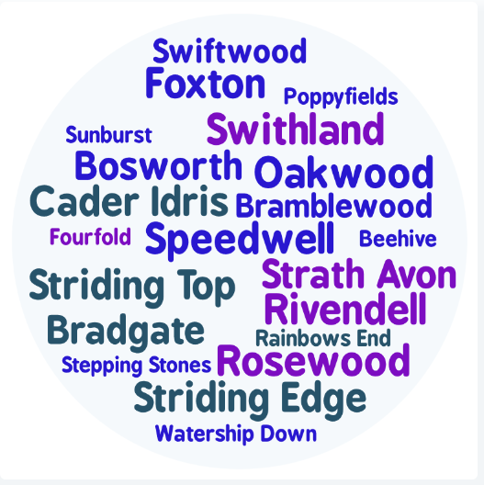
Staff introductions
3FS Mrs Frost and Mrs Spencer (Striding Top)
3SG Miss Garcha (Striding Edge)
3AM Mrs Smith and Mrs Majid (Bradgate)

Slide 3
Our School’s Aims
At Launde we create Curious Minds, Kind Hearts, Bright Futures
This statement reflects our commitment to nurturing compassionate individuals, fostering a love of learning and exploration and empowering our children to achieve their full potential.
The staff at Launde look forward to working alongside parents to meet this ambition.

Slide 4





Our School Values
Recently, our school community identified 5 values that will underpin our school culture, our interactions and empower our pupils to become well-rounded, successful individuals.
Respect
Kindness
Resilience
Curiosity
Confidence
We believe that by working together, parents and school staff can create an environment where these values are not just words, but are integral to everything we do and how we treat each other. These values will be present and discussed within every part of our school’s curriculum.
Notes:
Kindness: Our children show kindness to each other at all times.
Confidence: Our children show confidence in being themselves, to speak up for themselves, try new things and handle adversity.
Resilience: Our children embrace mistakes as learning opportunities and they stay positive in difficult situations.
Respect: Our children treat others kindly, value differences and listen to everyone’s ideas and opinions, even if this is different to their own.
Curiosity: Our children are excited by their learning and are eager to explore new ideas.

Slide 5

Partnership
We hope your child is looking forward to their transition into Year 3.
Your child’s wellbeing is our first priority and we want to ensure that they feel happy and safe coming into school.
You are always welcome to speak with us. We are here to support you and your child.
Please do this via the office or at the end of the school day.
Notes:
Katie

Slide 6

Behaviour Curriculum
Launde has a fully implemented behaviour curriculum to support children in developing good habits and to help foster an inclusive, nurturing environment where every child feels safe and valued.
We achieve this by teaching four fundamental principles:
Be Ready to Learn
Be Kind
Be Respectful
Be Safe
These principles are then rewarded when we see them in school, in a number of different ways.
Notes:
Sharn

Slide 7
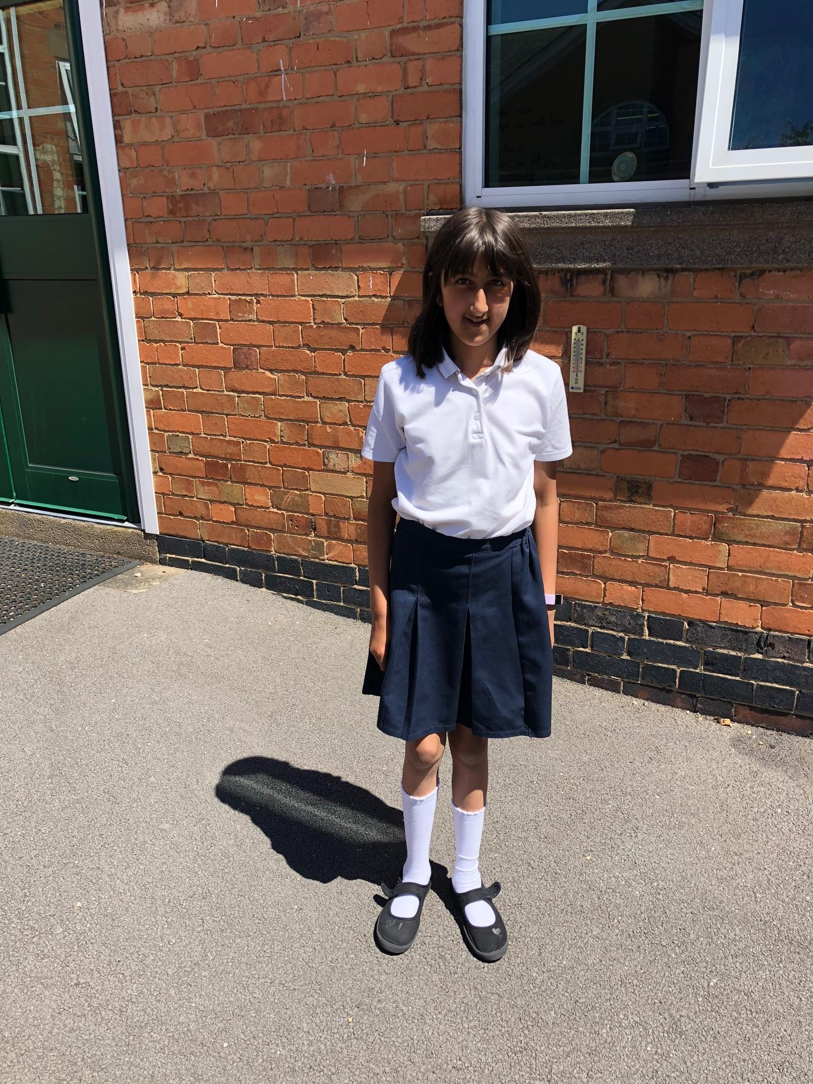
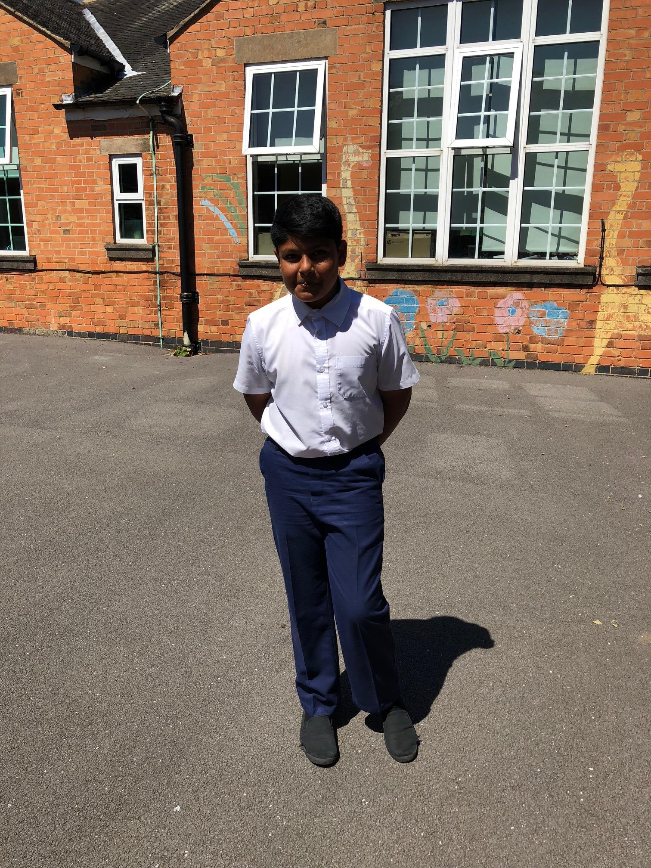
Uniform
White polo shirt
Uniform – please ensure your child conforms to the school uniform rules:
Children will need separate indoor and outdoor pairs of shoes – these need to be completely black.
Red Jumper/Cardigan (logo optional - from School Wear Solutions)
Summer Dresses: Red Gingham
All long hair should be tied up.
No leggings.
Black or grey skirt, trousers or shorts
Plain, black shoes or trainers with black sole and no logo.
Notes:
Jasmin

Slide 8
PE Kit
P.E. kit to be worn on the day that your child has PE (you will be notified of this at the start of the academic year in August).
Black jogging bottoms or shorts
White t-shirts
Sports trainers (white or black)
Red jumper
No earrings and hair tied back
Please make sure that your child is dressed appropriately for the weather on the day of their PE lesson.
Notes:
Katie

Slide 9

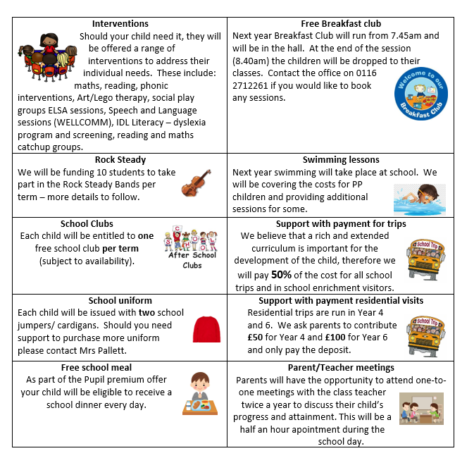
Pupil Premium Offer 2026-2027
We have adapted the pupil premium offer to ensure it is more personalised to provide individual support to each child.
Should you feel that you could be eligible for free school meals then please contact the office
Notes:
As a school, we want all children to be successful, empowered to learn, and happy and excited to come to school. We feel strongly that school should be a place of opportunities and recognise that we can make a significant difference if we individually target the needs of children. To achieve this, we have adapted the pupil premium offer to ensure it is more personalised to provide individual support to each child.
Should you feel that you could be eligible for free school meals then please contact the office

Slide 10
Our school day
Daily timetable
One hour of mathematics
One hour of English
Thirty minutes reading lesson
Twenty minutes spelling lesson (three times a week)
Enquiry curriculum in the afternoons (more to follow)
8:40am – Meet children
8:45am (gates and doors close) –Register and morning work
10:20am – Morning break
12:15pm – Lunch time
3:15pm – Home time
Notes:
Jasmin

Slide 11
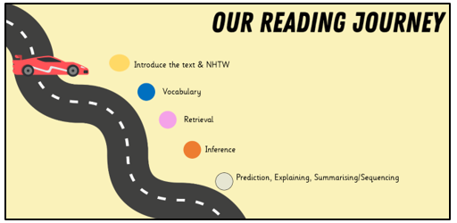
Reading
Daily whole class reading following our reading journey
Please read every day with your child, reading books are given each week
Ask questions to check their understanding
Children are expected to read aloud
with fluency, pace and expression.
Notes:
Reading records – read three times to improve fluency, expression and comprehension.

Slide 12


Keep reading with the library challenge!
4th July – 12th September (further information can be found online)

Slide 13
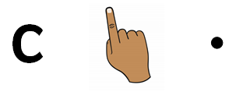

Writing
Text types:
Setting and character descriptions
Recounts (diary)
Letter
Instructions
Non-chronological reports
Action scenes
Key skills
Sentence punctuation (. ! , ?)
Grammar: nouns, adjectives, verbs and adverbs.
Conjunctions.
Sequencing and organisation.

Slide 14
Spelling Lessons
Children will continue to develop their phonological awareness through three weekly spelling lessons.
Revising Phase 3, 4 and 5 including the alternative spellings and split digraphs.
Introducing Phase 6: suffixes, plurals and homophones.
Common exception words (“tricky” words) e.g. would, improve, many, wild.
Target spellings as part of English lessons.

Slide 15

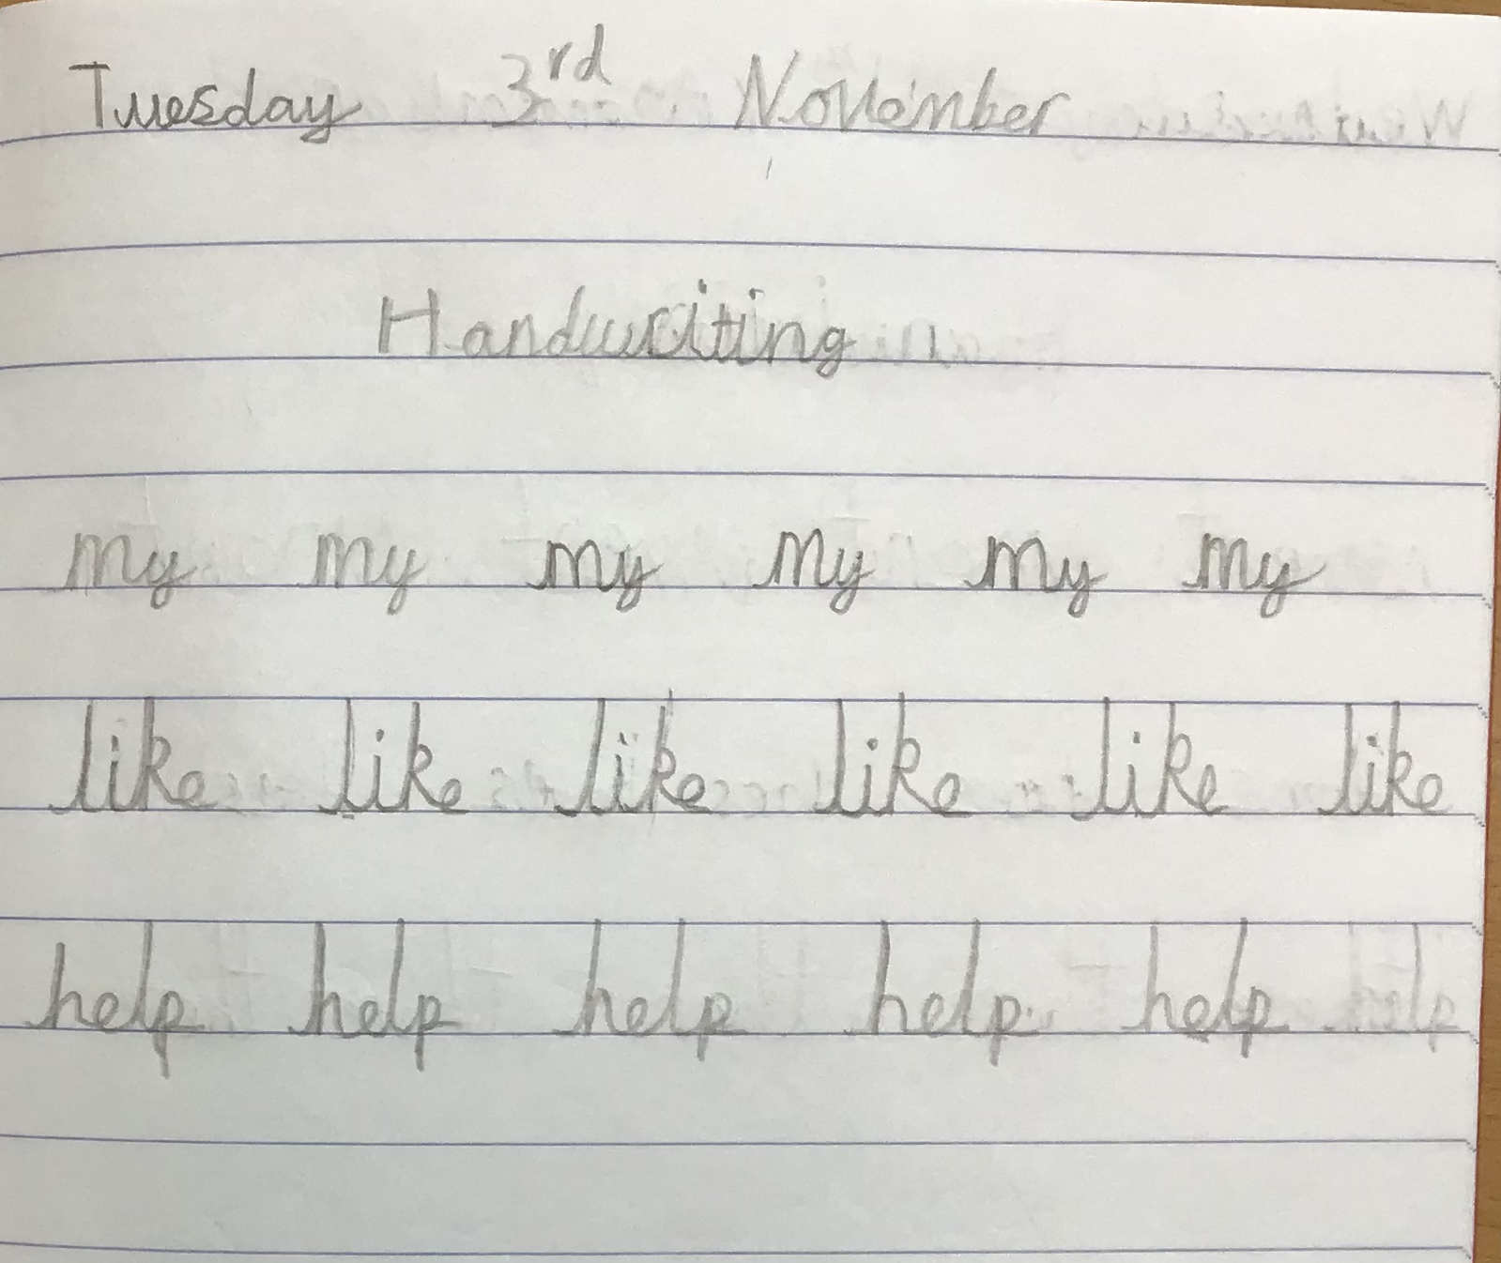
Handwriting
Focus
Continue to develop continuous cursive handwriting
Focus on lowercase and capital letters
Show clear ascenders and descenders
Introduce the different letter joins
Encourage children to join when they are ready

Slide 16


Maths
Counting and number sequences to 1000
Place value of any 3-digit number
+ - x ÷
Times tables – 2, 5,10, 3, 4, 8 times tables
Fractions – counting fractions on a number line and equivalent fractions.
Measuring length, height, mass, capacity, volume, time and temperature.
Telling the time – o'clock, half past, quarter to, quarter past and 5-minute intervals.
2D and 3D shapes
Handling data
Problem solving relating to all areas.
Notes:
Jasmin

Slide 17

Year 3 Enquiry Curriculum
Following our recent parent questionnaire, we are redesigning our curriculum to inspire curiosity and help children think more deeply as they build and connect their knowledge.
This will include bringing our school community closer together by inviting parents and carers to play a much more active role in school life. We will be sharing the learning, experiences and achievements of our children every step of the way.
Further information and dates will be shared with you.
Notes:
We are incredibly excited to be developing our new enquiry-led curriculum this year, designed to inspire curiosity and help children think more deeply as they build and connect their knowledge. This work has been shaped by the thoughtful feedback from our recent parent questionnaire, alongside our partnership with Flying High, as we strengthen and refine what each year group already offers. A key part of this journey is bringing our school community even closer together—so we will be inviting parents and carers to play a much more active role in school life, sharing in the learning, experiences, and achievements of our children every step of the way.
Katie

Slide 18

Year 3 Enquiry Curriculum
Do things get better with time?
To explore this big idea, children will journey back to Prehistoric Britain, discovering how life changed and developed throughout the Stone Age, Bronze Age and Iron Age. They will investigate how people lived, the inventions they created and consider whether life really improved over time. Our enquiry will bring together learning from a range of subjects. In Science, children will study plants, rocks and soils, exploring how change happens naturally over long periods of time. In Art, they will examine and create their own cave paintings, inspired by some of the earliest forms of human expression. By connecting learning across subjects, children will build their knowledge, ask thoughtful questions and develop their own ideas as they work towards answering our enquiry question.
Notes:
Autumn term – History
Spring term – Geography
Summer term - Art

Slide 19


Other Subjects
Science:
Rocks and Plants (enquiry curriculum)
Light
Organisms
Forces and Motion
Magnetism
RE:
Hinduism in Britain today and what do Hindus believe about God
Christianity –What do Christians learn from the creation story?
How do people try to make the world a better place?
Notes:
Jo

Slide 20


Other Subjects
Computing:
Computing systems
Stop-frame animation
Programming and sequencing sounds
Databases
E-Safety
Music:
Looking at rhythm (steady heartbeat)
Pitch (high and low notes as well as long and short notes)
Using graphic notation to show pitch
To sing fluently in unison

Slide 21

Homework
Read to an adult every night and change their books each week.​
Times Table Rockstars (daily practice)
Top tips​
To read books from different genres
To practice maths in everyday life- money, time, measurements etc.
To recall learning from the day and using knowledge organisers

Slide 22
Helpful Websites
www.topmarks.co.uk – Interactive, fun maths games.
www.teachhandwriting.co.uk – Video demonstrations of how to form letters, and fine motor skill exercises.
www.phonicsplay.co.uk – Interactive phonics games for phases 3-5.
www.oxfordowl.co.uk – Online reading and phonics resources.

