Slide 1

Welcome Meeting
Welcome to Year 2 at Launde Primary School
2026-2027

Slide 2
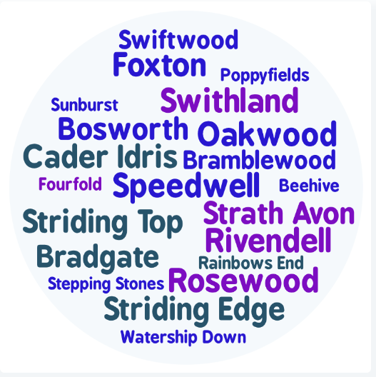
Staff introductions
2IW Miss Watkins (Bramblewood)
2RG Mrs Gandwan (Swiftwood)
2SN Mrs Nerney (Bosworth)
Notes:
Everyone

Slide 3
Our School’s Aims
At Launde we create Curious Minds, Kind Hearts, Bright Futures
This statement reflects our commitment to nurturing compassionate individuals, fostering a love of learning and exploration and empowering our children to achieve their full potential.
The staff at Launde look forward to working alongside parents to meet this ambition.

Slide 4





Our School Values
Recently, our school community identified 5 values that will underpin our school culture, our interactions and empower our pupils to become well-rounded, successful individuals.
Respect
Kindness
Resilience
Curiosity
Confidence
We believe that by working together, parents and school staff can create an environment where these values are not just words, but are integral to everything we do and how we treat each other. These values will be present and discussed within every part of our school’s curriculum.
Notes:
Kindness: Our children show kindness to each other at all times.
Confidence: Our children show confidence in being themselves, to speak up for themselves, try new things and handle adversity.
Resilience: Our children embrace mistakes as learning opportunities and they stay positive in difficult situations.
Respect: Our children treat others kindly, value differences and listen to everyone’s ideas and opinions, even if this is different to their own.
Curiosity: Our children are excited by their learning and are eager to explore new ideas.

Slide 5

Partnership
We hope your child is looking forward to their transition into Year 2.
Your child’s wellbeing is our first priority and we want to ensure that they feel happy and safe coming into school.
You are always welcome to speak with us. We are here to support you and your child.
Please do this via the office or at the end of the school day.

Slide 6

Behaviour Curriculum
Launde has a fully implemented behaviour curriculum to support children in developing good habits and to help foster an inclusive, nurturing environment where every child feels safe and valued.
We achieve this by teaching four fundamental principles:
Be Ready to Learn
Be Kind
Be Respectful
Be Safe
These principles are then rewarded when we see them in school, in a number of different ways.

Slide 7
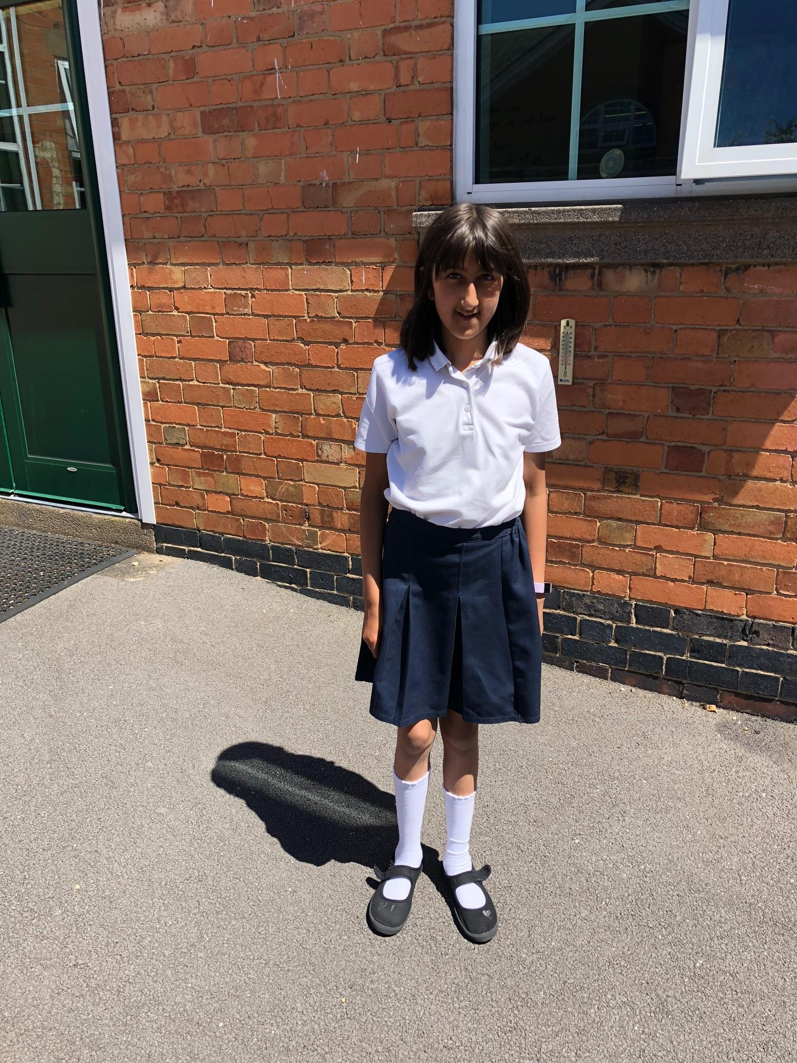
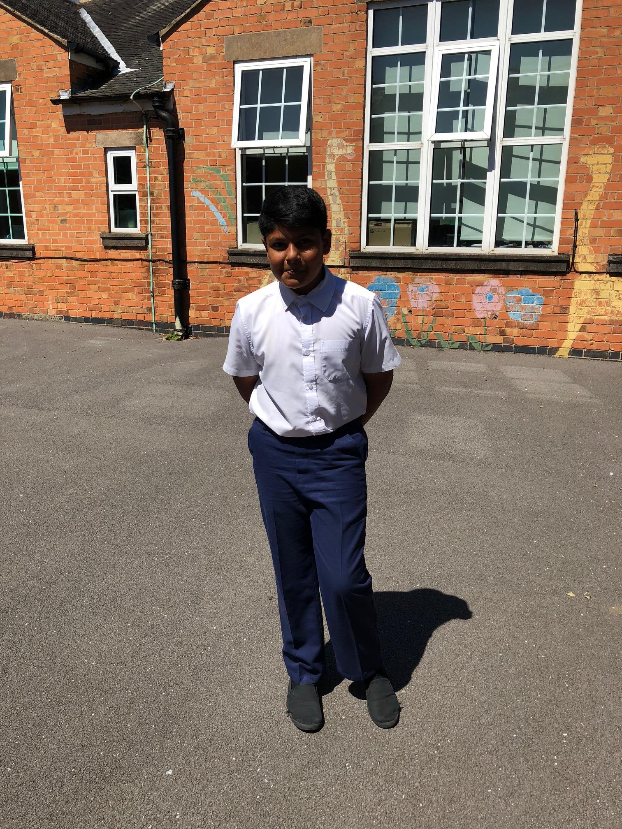
Uniform
White polo shirt
Uniform – please ensure your child conforms to the school uniform rules:
Children will need separate indoor and outdoor pairs of shoes – these need to be completely black.
Red Jumper/Cardigan (logo optional - from School Wear Solutions)
Summer Dresses: Red Gingham
All long hair should be tied up.
No leggings.
Black or grey skirt, trousers or shorts
Plain, black shoes or trainers with black sole and no logo.

Slide 8
PE Kit
P.E. kit to be worn on the day that your child has PE (you will be notified of this at the start of the academic year in August).
Black jogging bottoms or shorts
White t-shirts
Sports trainers (white or black)
Red jumper
No earrings and hair tied back
Please make sure that your child is dressed appropriately for the weather on the day of their PE lesson.

Slide 9

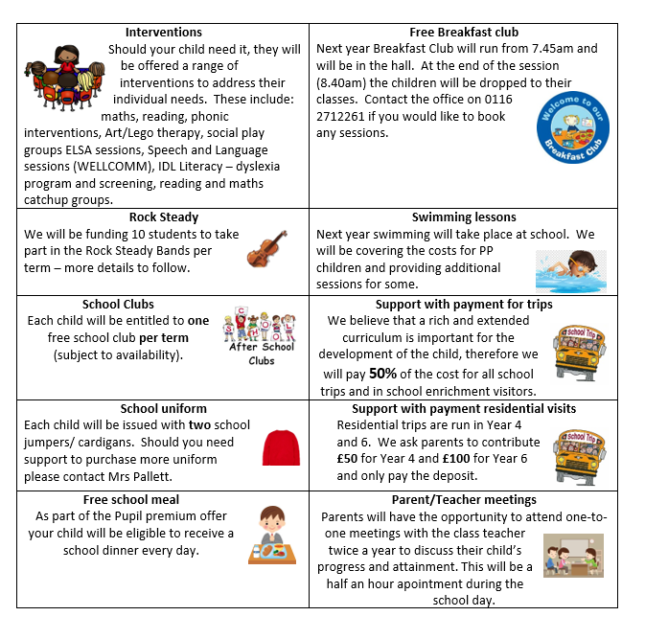
Pupil Premium Offer 2026-2027
We have adapted the pupil premium offer to ensure it is more personalised to provide individual support to each child.
Should you feel that you could be eligible for free school meals then please contact the office
Notes:
As a school, we want all children to be successful, empowered to learn, and happy and excited to come to school. We feel strongly that school should be a place of opportunities and recognise that we can make a significant difference if we individually target the needs of children. To achieve this, we have adapted the pupil premium offer to ensure it is more personalised to provide individual support to each child.
Should you feel that you could be eligible for free school meals then please contact the office

Slide 10
Our school day
Daily timetable
One hour of mathematics
Fifteen minutes of ‘Mastery of Number’
One hour of English
Thirty minutes reading lesson
Twenty minutes spelling lesson (three times a week)
Enquiry curriculum in the afternoons (more to follow)
8:40am – Meet children
8:45am (gates and doors close) –Register and morning work
10:20am – Morning break
12:15pm – Lunch time
3:15pm – Home time
Notes:
Jo

Slide 11
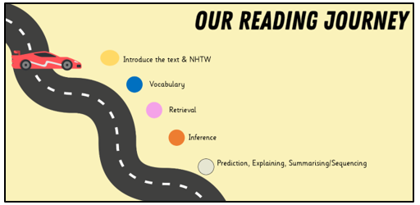
Reading
Daily whole class reading following our reading journey
Please read every day with your child, two reading books are given each week
Ask questions to check their understanding
Children are expected to read aloud
with fluency, pace and expression.
Notes:
Reading records – read three times to improve fluency, expression and comprehension.

Slide 12

Keep reading with the library challenge!
4th July – 12th September (further information can be found online)

Slide 13
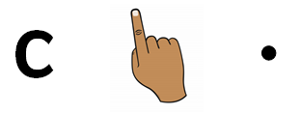

Writing
Text types:
Setting and character descriptions
Recounts (diary)
Letter
Instructions
Non-chronological reports
Action scenes
Key skills
Sentence punctuation (. ! , ?)
Grammar: nouns, adjectives, verbs and adverbs.
Conjunctions.
Sequencing and organization.

Slide 14
Spelling Lessons
Children will continue to develop their phonological awareness through three weekly spelling lessons.
Revising Phase 3, 4 and 5 including the alternative spellings and split digraphs.
Introducing Phase 6: suffixes, plurals and homophones.
Common exception words (“tricky” words) e.g. would, improve, many, wild.
Target spellings as part of English lessons.

Slide 15

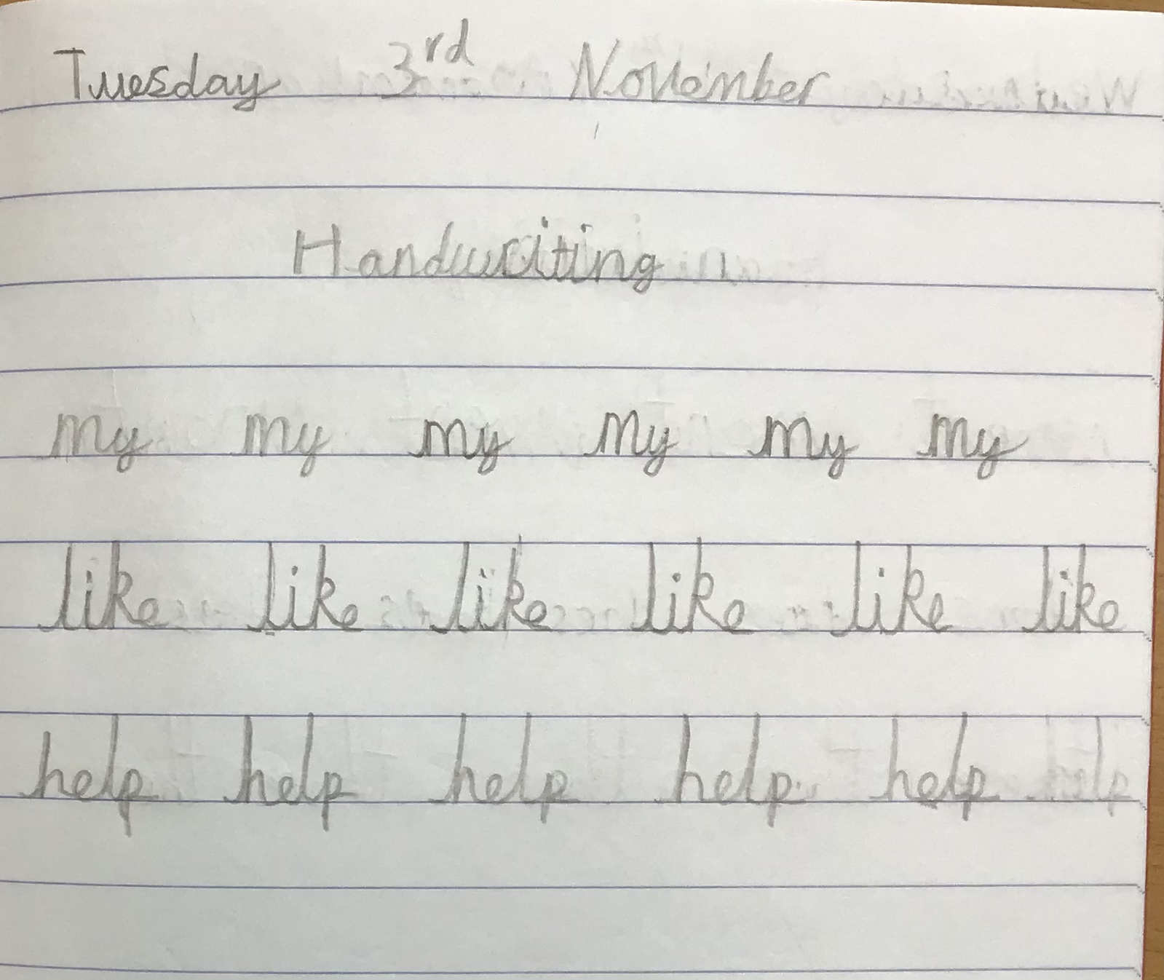
Handwriting
Focus
Continue to develop continuous cursive handwriting
Focus on lowercase and capital letters
Show clear ascenders and descenders
Introduce the different letter joins
Encourage children to join when they are ready

Slide 16


Maths
Counting and number sequences to 100
Place value of any 2-digit number
+ - x ÷
Times tables – 2, 5 and 10 times tables
Fractions – ½, ¼, 1/3, ¾
Measuring length, height, mass, capacity, volume, time and temperature.
Telling the time – o'clock, half past, quarter to and quarter past.
2D and 3D shapes
Handling data
Problem solving relating to all areas.

Slide 17

Year 2 Enquiry Curriculum
Following our recent parent questionnaire, we are redesigning our curriculum to inspire curiosity and help children think more deeply as they build and connect their knowledge.
This will include bringing our school community closer together by inviting parents and carers to play a much more active role in school life. We will be sharing the learning, experiences and achievements of our children every step of the way.
Further information and dates will be shared with you.
Notes:
We are incredibly excited to be developing our new enquiry-led curriculum this year, designed to inspire curiosity and help children think more deeply as they build and connect their knowledge. This work has been shaped by the thoughtful feedback from our recent parent questionnaire, alongside our partnership with Flying High, as we strengthen and refine what each year group already offers. A key part of this journey is bringing our school community even closer together—so we will be inviting parents and carers to play a much more active role in school life, sharing in the learning, experiences, and achievements of our children every step of the way.

Slide 18

Year 2 Enquiry Curriculum
Do hard times develop strength?
We explore this question by learning about the Great Fire of London and its impact upon the city and beyond.
In addition to this, we will be learning about the determination of nurses like Florence Nightingale, Mary Seacole and Edith Cavell who faced many challenges.
As we learn about these events, we can think about whether difficult times helped people grow stronger and make positive changes.
Notes:
Autumn term – History
Spring term – Geography
Summer term - Art

Slide 19


Other Subjects
Science:
Living things and their habitats
Solids, liquids and gases
Materials and their properties
Plants
RE:
Exploring the five pillars of Islam and learning from stories such as Prophet Muhammad and the ants.
Christianity – Easter and the Christmas story (nativity).
How do Jews celebrate Hannukah and Shabbat. As well as looking at items that may be found in their homes.

Slide 20


Other Subjects
Computing:
Digital photography
Robot algorithms (using Beebots)
Digital music
Music:
Looking at rhythm (steady heartbeat)
Pitch (high and low notes as well as long and short notes)
Using graphic notation to show pitch
Notes:
Jo

Slide 21

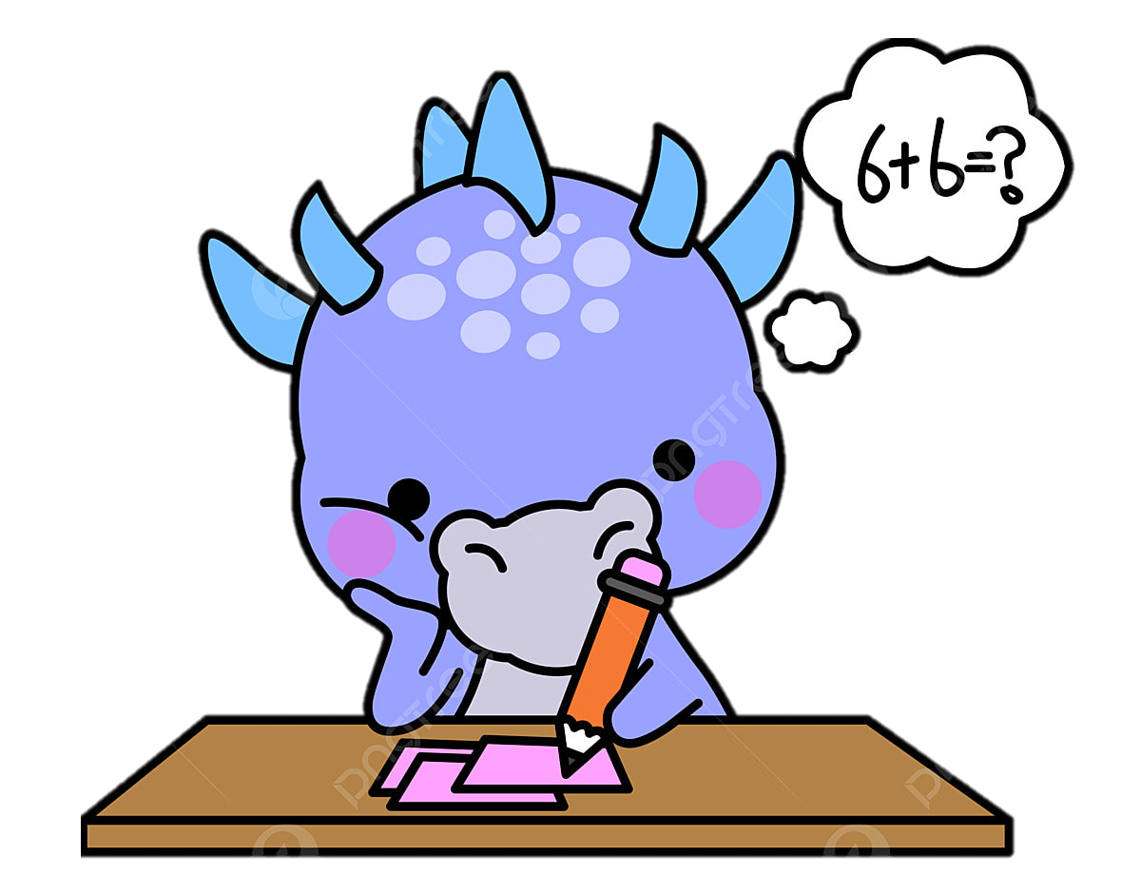
Homework
Read to an adult every night and change their books each week.​
Times Table Rockstars (login details stuck on the inside cover of reading records)​
CGP books – Reading, Grammar and Maths: these will be set via Weduc to complete each week and will relate to and support lessons taught throughout the week.
Make sure homework doesn't become a battle.​
Provide quiet working space and agree the time beforehand (not last minute!).​
Have suitable equipment i.e. pencils not pens, colouring pencils, rulers, rubbers etc. ​
Prioritise: Reading and times tables.​
...and family time, exploring, discovering, building relationships with others outside of school.​
Notes:
Kate

Slide 22
Helpful Websites
www.topmarks.co.uk – Interactive, fun maths games.
www.teachhandwriting.co.uk – Video demonstrations of how to form letters, and fine motor skill exercises.
www.phonicsplay.co.uk – Interactive phonics games for phases 3-5.
www.oxfordowl.co.uk – Online reading and phonics resources.
Notes:
Kate

