Slide 1

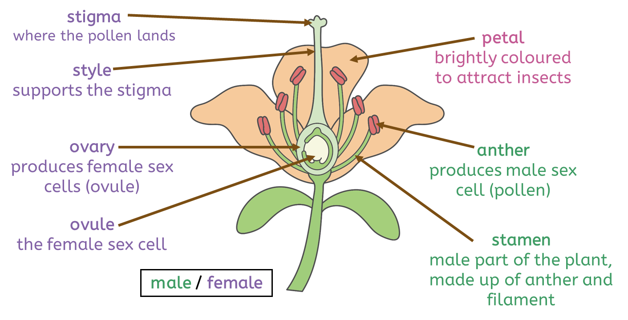
Life cycles
What is a life cycle?
A life cycle is the series of changes that plants and animals go through during their lifetime.
Animals and plants all grow, develop and reproduce in a life cycle.
In a life cycle, reproduction creates new life (offspring), and the life cycle continues.
An animal’s life cycle
In internal fertilisation, the male sex cell and female sex cell join inside the body. In external fertilisation, the male sex cell and female sex cell join outside of the body.
adult
mating
(fertilisation)
Sexual reproduction in plants
growth
In oviparous animals, the females lay eggs and the embryo develops outside the body. In viviparous animals, the embryo develops inside an animal’s body.
gestation
Key vocabulary
asexual reproduction (noun): When the offspring (the young) gets its genome from only one parent. The young will have the same genome as that parent (they are genetically identical).
cell (noun): The smallest building block of all living things.
embryo (noun): The first stage of development after fertilisation.
metamorphosis/metamorphose (noun/verb): The process where the young of some animals go through physical changes to turn into the adult form.
sexual reproduction (noun): When the offspring (the young) gets its genome from both parents. outside the body
gestation (noun): The period of time between fertilisation and birth.
genome (noun): The information that controls how an individual organism will develop.
Biology | Year 5 – Spring Term | Knowledge Organiser
Notes:
All images – United Curriculum

Slide 2
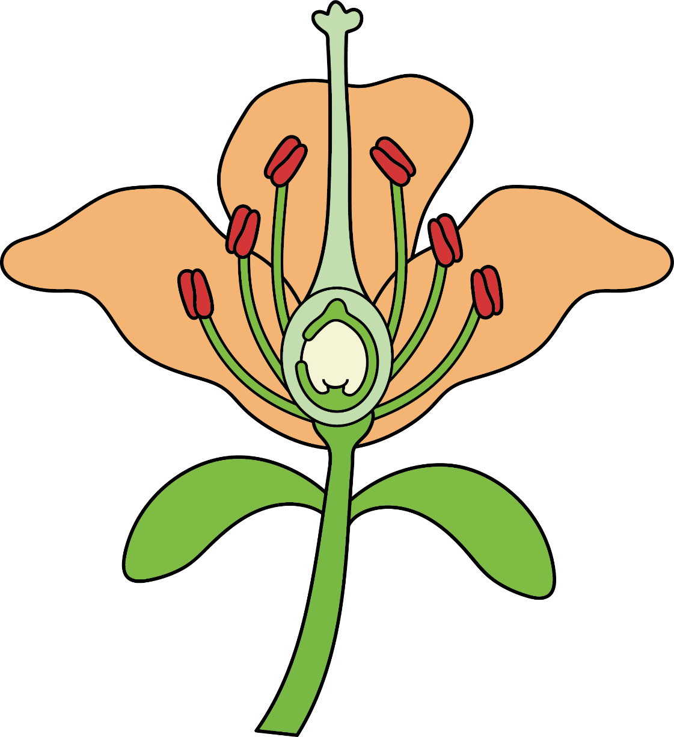
Editable version for teachers
stigma
where the pollen lands
petal
brightly coloured to attract insects
style
supports the stigma
ovary
produces female sex cells (ovule)
anther
produces male sex cells (pollen)
ovule
the female sex cell
stamen
male part of the plant, made up of the anther and filament
male / female
Notes:
UL image

