Slide 1

Welcome Evening
Welcome to Year 5 at Launde Primary School
2024-25
Notes:
Sam

Slide 2

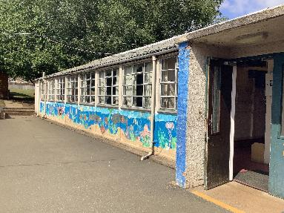
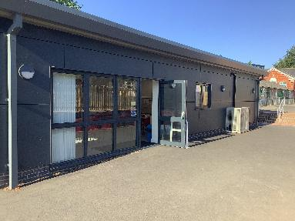
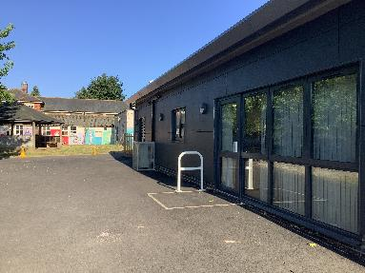
Staff Introductions
Rivendell
Mr Balhatchet
Strath Avon
Mr Frost
Speedwell
Miss Patel
Notes:
All

Slide 3
Our School’s Aims
At Launde we create Curious Minds, Kind Hearts, Bright Futures
This statement reflects our commitment to nurturing compassionate individuals, fostering a love of learning and exploration and empowering our children to achieve their full potential.
The staff at Launde look forward to working alongside parents to meet this ambition.
Notes:
Dan

Slide 4
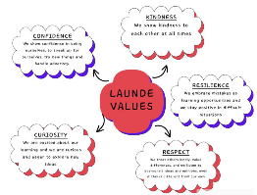





Our School Values
Recently, our school community identified 5 values that will underpin our school culture, our interactions and empower our pupils to become well-rounded, successful individuals.
Respect
Kindness
Resilience
Curiosity
Confidence
We believe that by working together, parents and school staff can create an environment where these values are not just words, but are integral to everything we do and how we treat each other. These will values will be present and discussed within every part of our school’s curriculum.
Notes:
Dan
Kindness: Our children show kindness to each other at all times.
Confidence: Our children show confidence in being themselves, to speak up for themselves, try new things and handle adversity.
Resilience: Our children embrace mistakes as learning opportunities and they stay positive in difficult situations.
Respect: Our children treat others kindly, value differences and listen to everyone’s ideas and opinions, even if this is different to their own.
Curiosity: Our children are excited by their learning and are eager to explore new ideas.

Slide 5
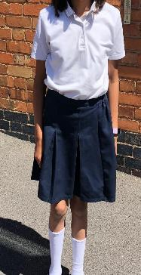
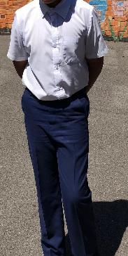
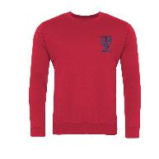
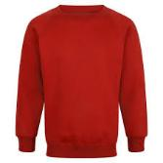
Equipment and Uniform
School uniform has been updated – white polo t-shirts, red jumpers or cardigans and trousers/skirts can be black, grey or navy.
Each child will have access to equipment and resources at school, nothing needs to be brought in from home
Please ensure all clothes are labelled with your child’s name – very important!
Book bags (not backpacks please)
Black shoes - branded trainers are not to be worn
There should be no jewellery, nail varnish or hair accessories worn
All long hair should be tied up with a simple bobble
Notes:
Raheema

Slide 6
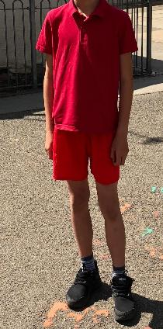

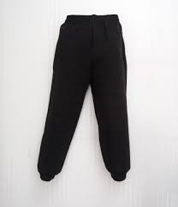

PE Kit
P.E. kit will need to be worn on the days that your child has PE.
The children should come to school in their PE kits:
Red/white T/polo shirt, sweat shirt
Red/black joggers or shorts
White or black trainers (not school shoes or branded trainers)
Earrings to be removed or earring tape to be worn
Please make sure that your child is dressed appropriately for the weather on the day of their PE.
Notes:
Raheema

Slide 7

Year 5 Curriculum Content
In Year 5 we have selected a variety of fun, interesting and exciting topics for our lessons.
We will teach a variety of subjects including Reading, Writing, Maths, Science, Geography, History, RE, PE, Art, D&T, Computing and Music.
The curriculum is balanced to give all of these subjects equal importance. Core subjects are taught daily (reading, writing, maths) while foundation subjects are taught weekly.
Notes:
Sam

Slide 8
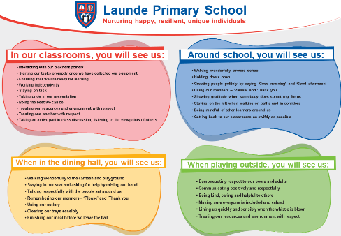
Behaviour Curriculum
Launde has a fully implemented behaviour curriculum to support children in developing good habits and to help foster an inclusive, nurturing environment where every child feels safe and valued.
We achieve this by teaching three fundamental principles:
Be Ready
Be Respectful
Be Brave
These principles are then rewarded when we see them in school, in a number of different ways.
Notes:
Sam

Slide 9
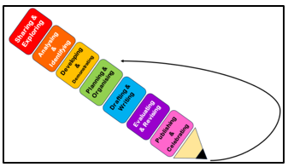








Writing
Throughout the year, the children will write setting and character descriptions, non-chronological reports, comparative reports, diary entries, newspaper reports, biographies and letters.
We will teach the children to write in these styles by also teaching them a variety of skills, such as prepositional phrases, relative clauses, figurative language, semi colons and varied sentence openers amongst others.
Every unit is taught through a familiar sequence, from sharing and exploring to publishing and celebrating.
Notes:
Sam

Slide 10







Writing
Our writing lessons will take inspiration from a diverse collection of stories, that represent a wide range of different backgrounds, cultures and styles.
Autumn
The Golden Horsemen of Baghdad by Saviour Pirotta
Shackleton’s Journey by William Grill
Race to the Frozen North by Catherine Johnson
Spring
The Explorer by Katherine Rundell
Coraline by Neil Giaman
Summer
The Girl Who Stole and Elephant by Nirzana Farook
The Boy in the Tower by Polly Ho-Yen
Notes:
Sam

Slide 11
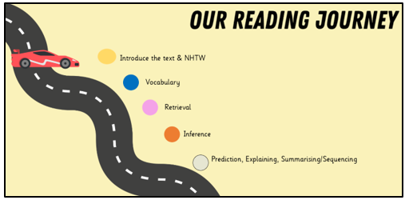
Reading
Daily whole class reading lessons.
Builds fluency.
Answer questions related to the key areas of comprehension (VIPERS).
New vocabulary is explicitly taught.
Includes themed weeks such as graphic organiser week and POP week.
Notes:
Raheema

Slide 12


Maths
Place value of numbers up to 6-digits, including decimals
Written methods of the four operations, including long multiplication
Recall of times tables (practised through 100 club)
Fractions, decimals and percentages
Converting between units of measure
Telling the time – 24 hour clock, time tables, time intervals
2D and 3D shapes, including angles, translation, symmetry and coordinates
Handling data – interpreting line graphs and pie charts
Arithmetic (weekly)- speed, fluency and accuracy
Daily retrieval- 5 a Day to sharpen skills
Notes:
Dan

Slide 13

Deepening Mathematical Reasoning
Reasoning and problem solving
Applying their knowledge and strategies
Explaining how they have calculated an answer
Explaining why an answer is correct or incorrect and how they know that
Notes:
Dan

Slide 14

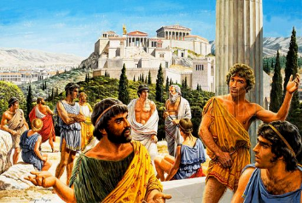
Wider Curriculum
Science – Earth and Space, Forces, Seperating Mixtures, Energy, Life Cycles and Human Development
History – What was life like in Tudor England? What did the Greeks ever do for us? How did the Were the Vikings raiders, traders or something else?
Geography – What is life like in the Alps? Why do oceans matter? Would you like to live in the desert?
Notes:
Raheema

Slide 15
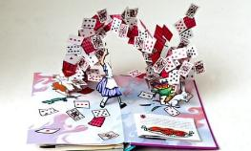
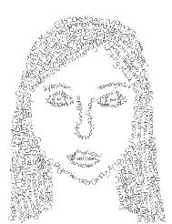
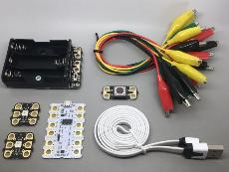
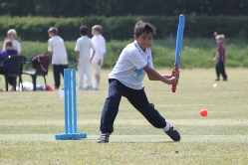
Wider Curriculum
Design and Technology – Electrical Systems: Doodlers, Developing a Recipe: Bolognese, Mechanical Systems: Pop Up Books
Art – Sculpture and 3D: Interactive Installations, Craft and Design: Architecture, Drawing: I Need Space, Mixed Media: Portraits
Computing – Programming, creating media, computing systems and networks, data and information
RE – Christianity, Islam and Rites of Passage
PE – Outdoor: Quicksticks, Netball, Tennis, Football, Kwik Cricket, Athletics. Indoor: Gymnastics, Fitness, Dance, Mini Muay Thai and Swimming.
Notes:
Dan

Slide 16


Homework
Expectations for homework next year includes the following:
10-15 minutes of reading daily
20 minutes of TTRS
Annual Presentation Project
Our school is moving away from setting weekly paper-based homework to support our children build a healthier, more balanced life style.
We want the children in our school to enjoy their childhoods and not be overwhelmed by a mountain of extra school work.
Notes:
Sam
Maths Fluency: 20 minutes of TTRS per week, based onr esearch by TTRS
Annual Presentation Project: each year group will undertake one subject-specific project per year, culminating in a presentation. This allows for deeper engagement in a chosen area and the development of presentation skills.

Slide 17

Pupil Premium offer 2025-6
As a school, we want all children to be successful, empowered to learn and happy and excited to come to school. We feel strongly that school should be a place of opportunities and recognise that we can make a significant difference if we individually target the needs of children. To achieve this, we have adapted the pupil premium offer to ensure it is more personalised to provide individual support to each child.
Next year, each class will have a TA during the morning sessions to support the children in their class. In the afternoon, we plan to use these TAs to run sessions to target the needs of any child that needs support.
Should you feel that you could be eligible for free school meals then please contact the office.
Notes:
Sam

Slide 18
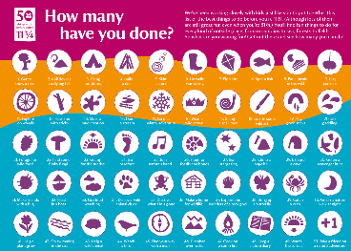


Over the holidays you could…
Things to practise over the holidays….
Try to read together with your child from a variety of sources (books- fiction/non-fiction, comics, newspapers, poems, etc.)
Regularly practise times tables up to 12 x 12 through online games or flash cards - TTRS.
Take part in the Summer Reading Challenge- https://summerreadingchallenge.org.uk/
Complete as many objectives from the list of “50 things to do before you’re 11$\frac{3}{4}$”.
Write a post card to your new teacher from an exciting location or keep a diary of how you have spent your summer holidays.
Notes:
Dan

