Slide 1
At Launde we create Curious Minds, Kind Hearts and Bright Futures

Slide 5
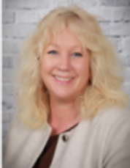
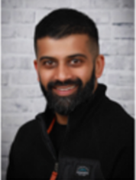

The Opal Play Team
The Play Team (they make
the play happen and ensure
you have fun.
Mrs Johnston is the
Curriculum Lead (in charge
of Opal and making things
happen and deciding what
fun we have).
Mr Mukadam and Mrs Barker are the
Play Coordinators (in charge
of the play and decides
what fun we have).

Slide 6
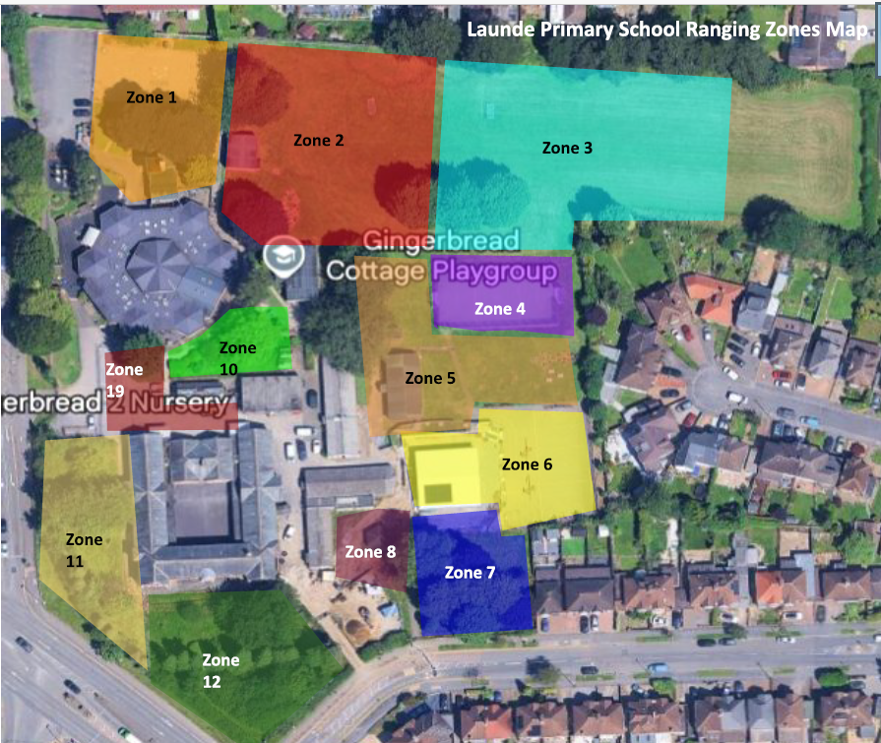

Slide 7
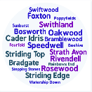





Our School Values
Respect
Kindness
Curiosity
Resilience
Confidence
Notes:
Kindness: Our children show kindness to each other at all times.
Confidence: Our children show confidence in being themselves, to speak up for themselves, try new things and handle adversity.
Resilience: Our children embrace mistakes as learning opportunities and they stay positive in difficult situations.
Respect: Our children treat others kindly, value differences and listen to everyone’s ideas and opinions, even if this is different to their own.
Curiosity: Our children are excited by their learning and are eager to explore new ideas.

Slide 8
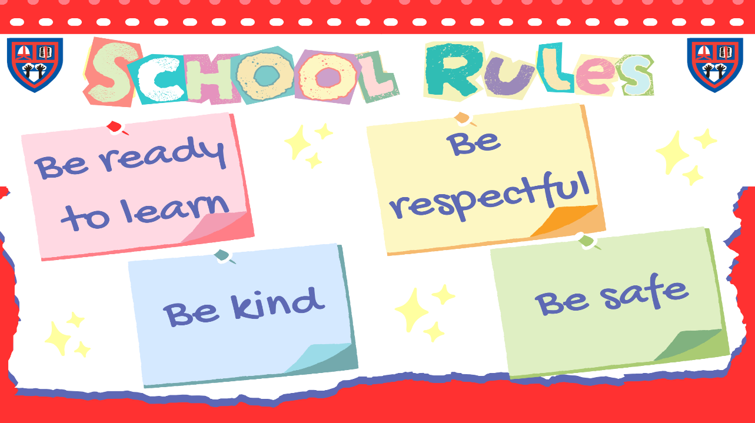

Slide 9
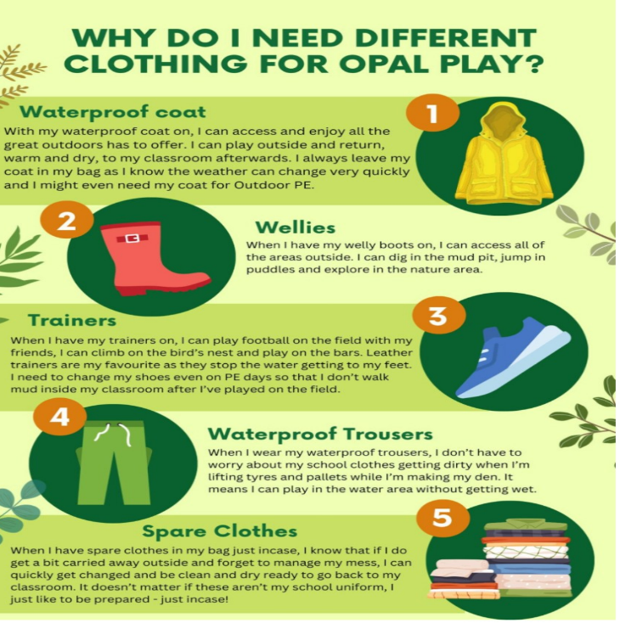

Slide 10
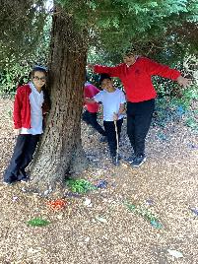
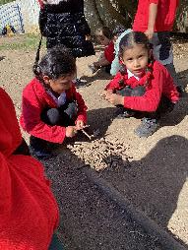
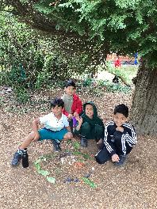
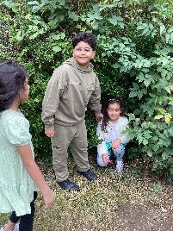
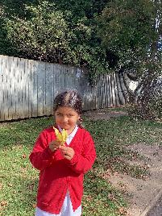
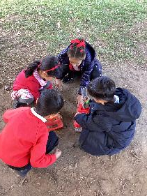
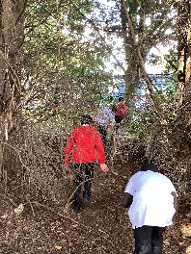
Photos of play

Slide 11
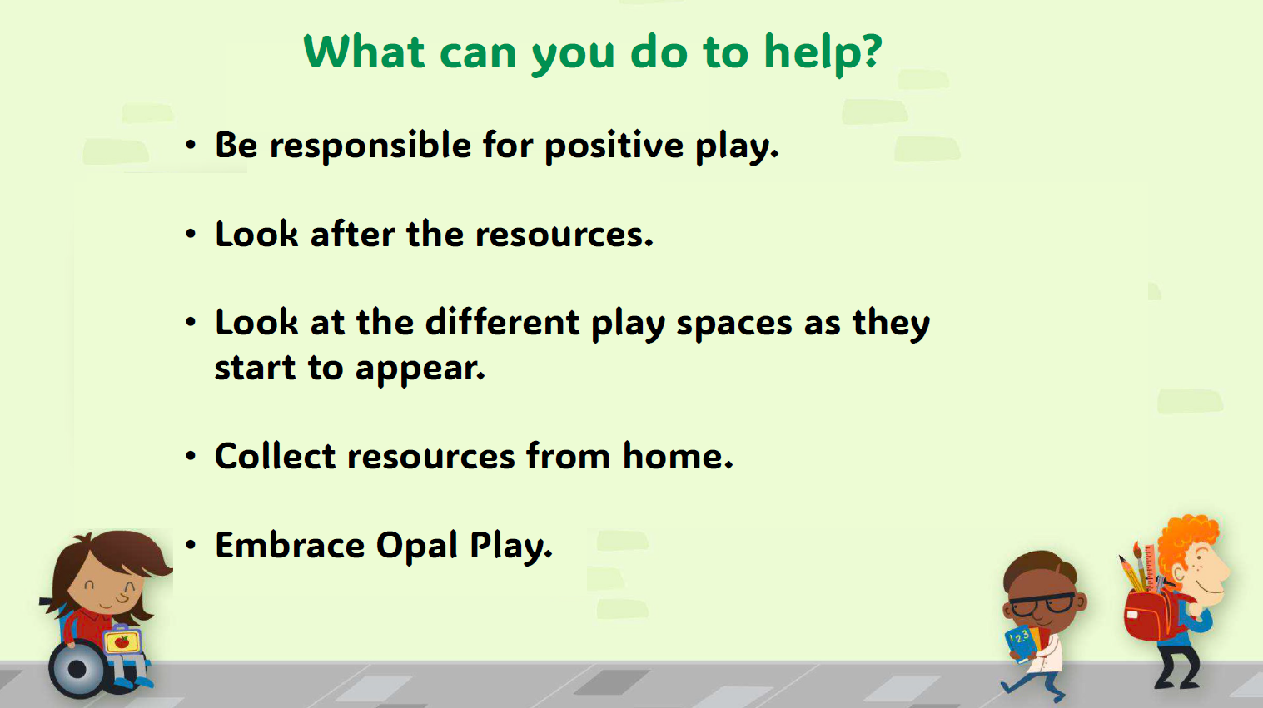

Slide 12
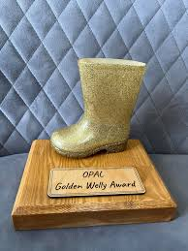
The Golden Welly Awards
The "Golden Welly Award" is going to be introduced alongside the launch of OPAL, after half term. It will celebrate children who demonstrate outstanding behaviour, imagination, and a positive attitude during lunchtime play. Awarded weekly, the trophies (one for Key Stage One and one for Key Stage Two) will be displayed in the winner's classroom for the week to recognise their great play and the positive contributions they have made to the playground.

Slide 13
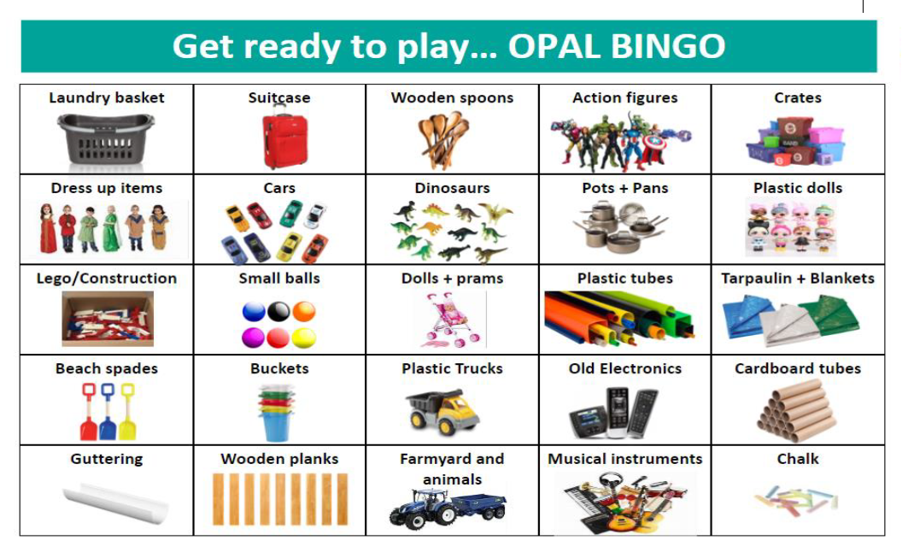

Slide 14
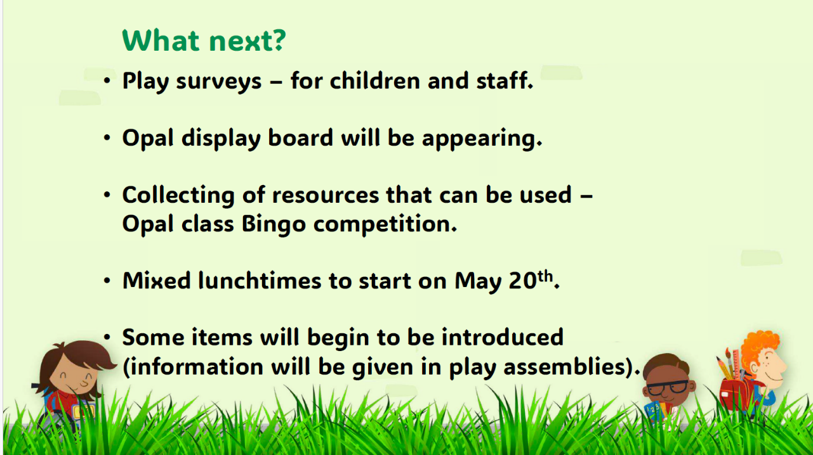
Sand Pits to be dug on weekend of 5th October

