Slide 1
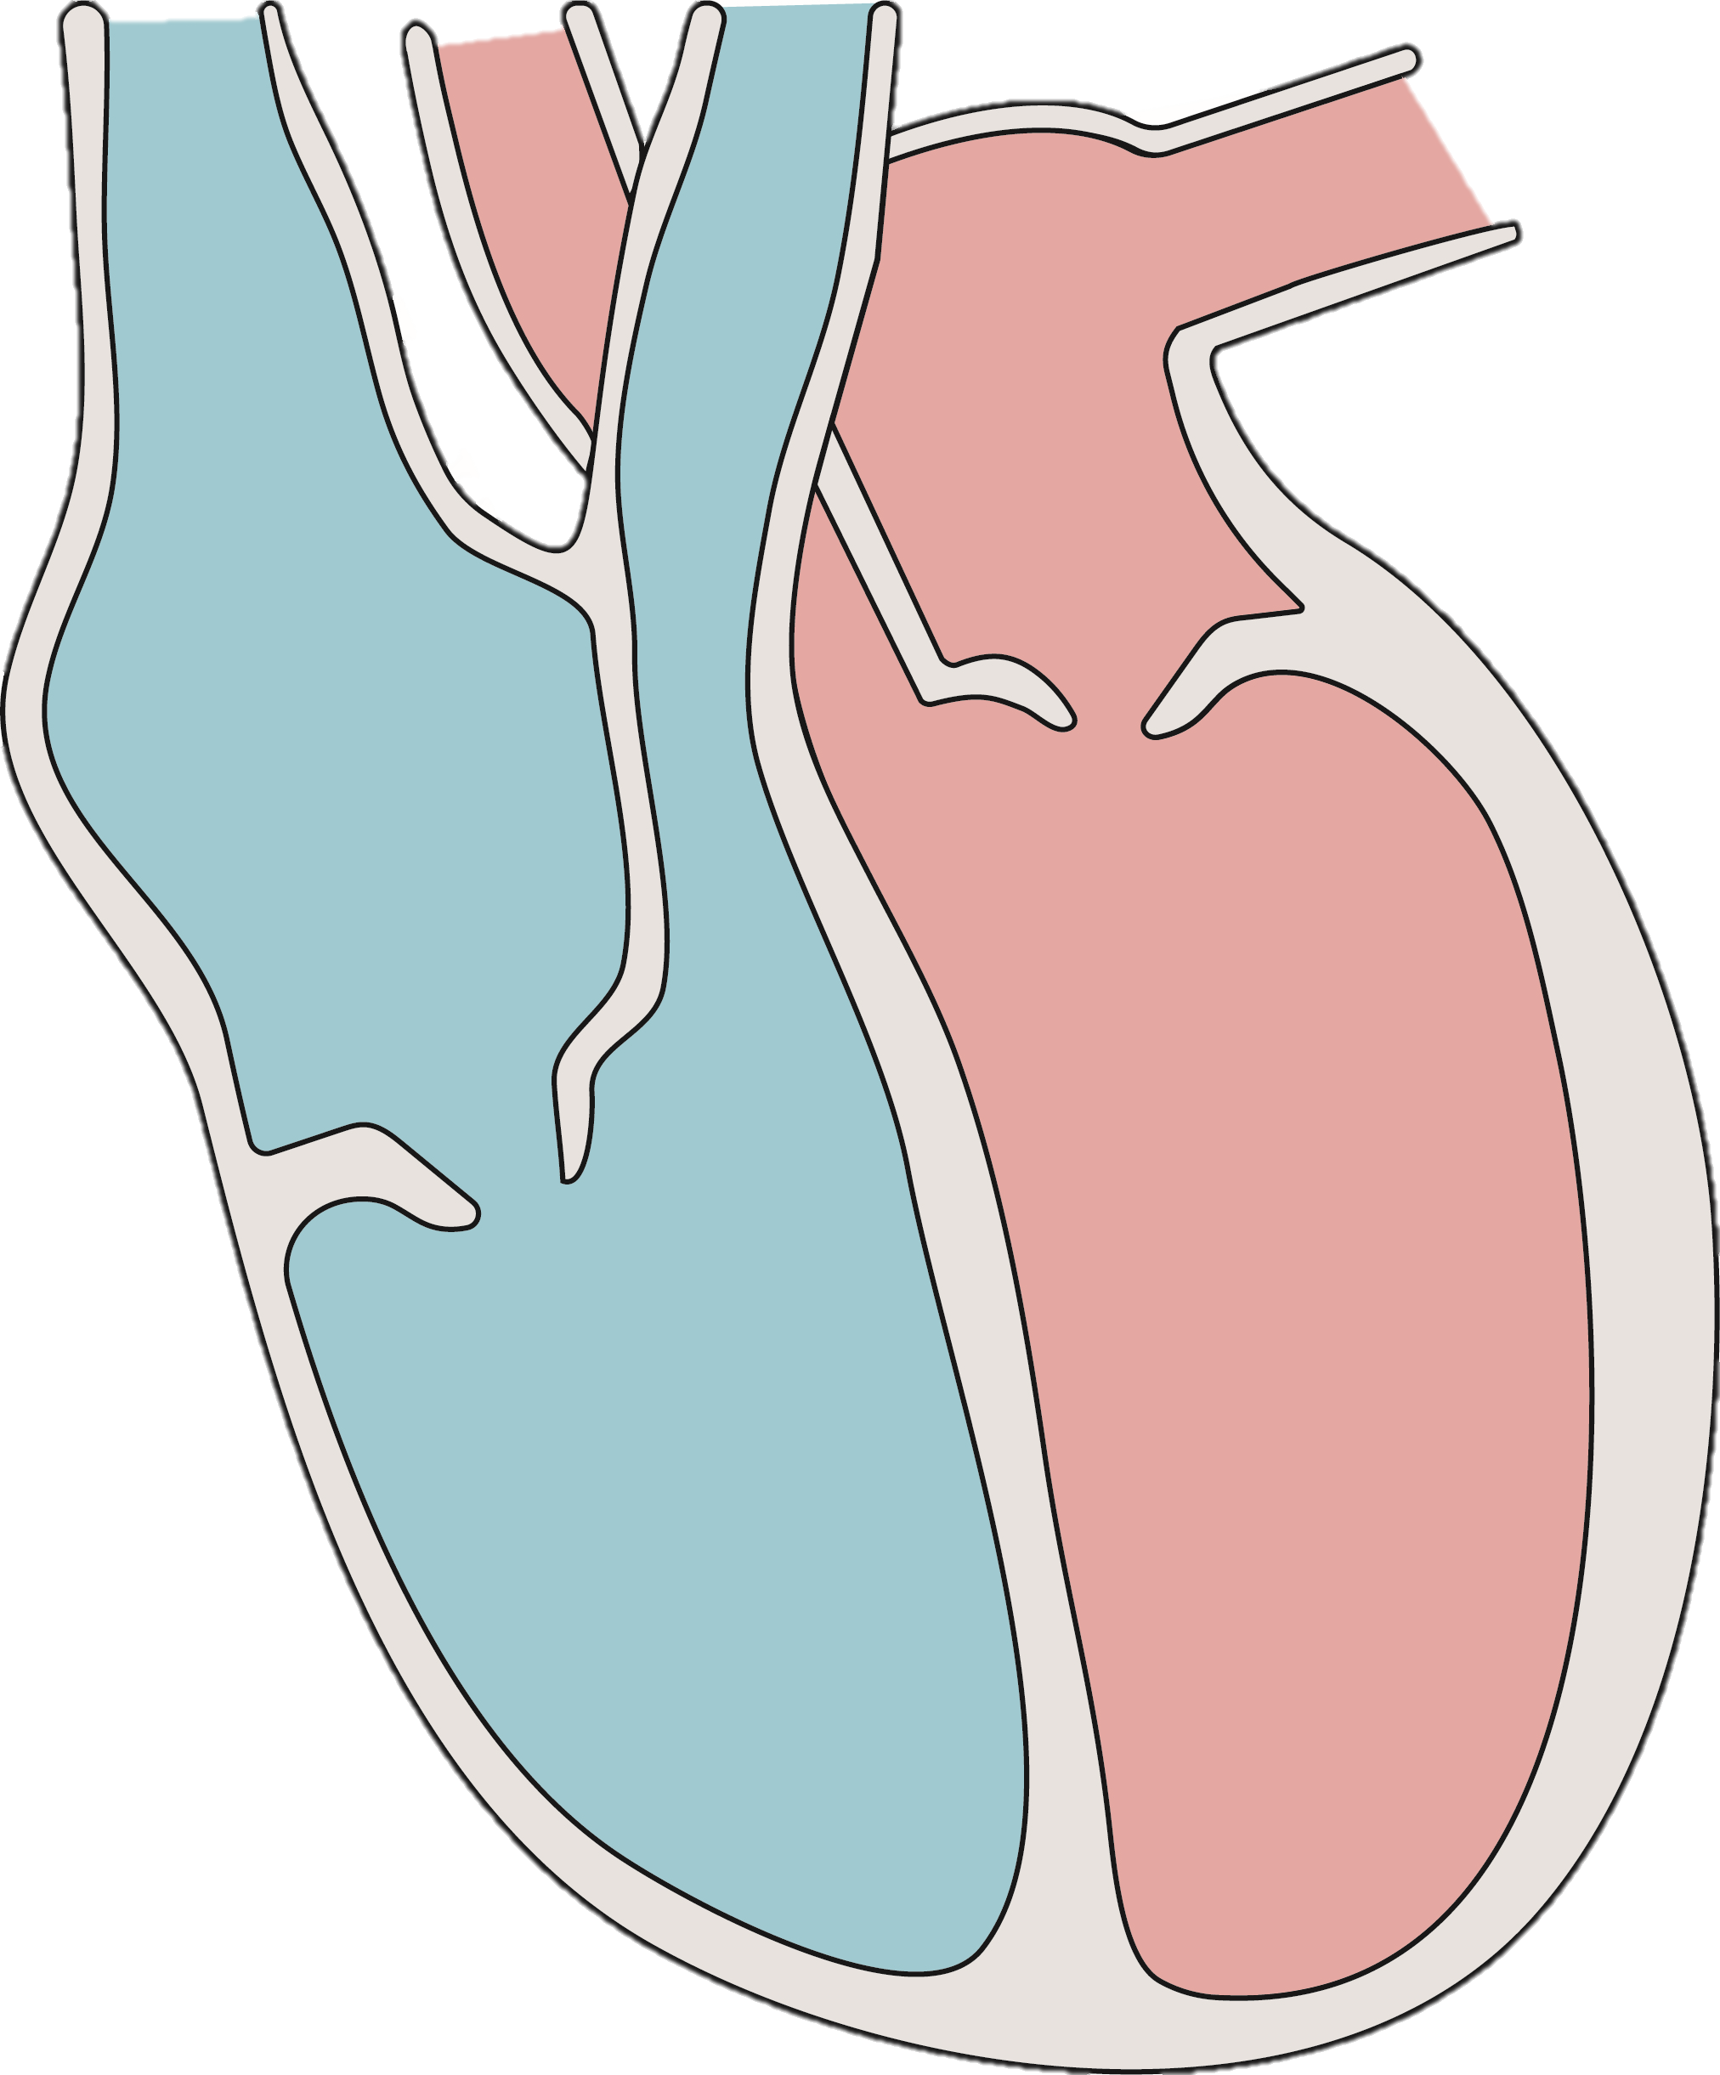
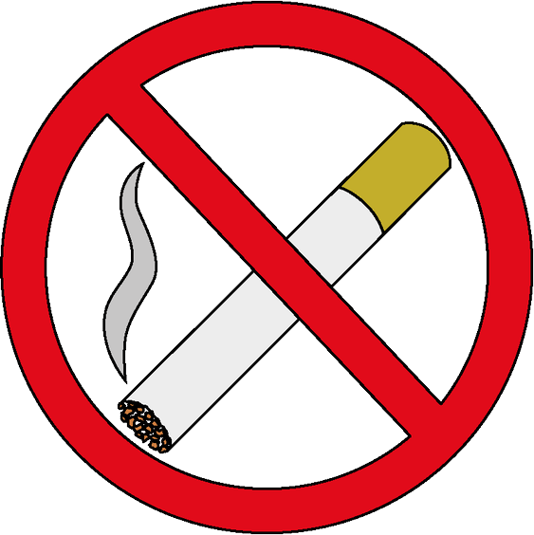
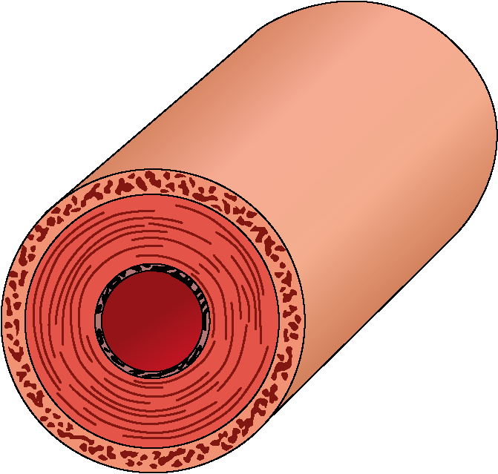
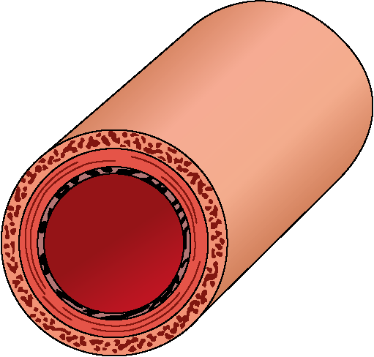
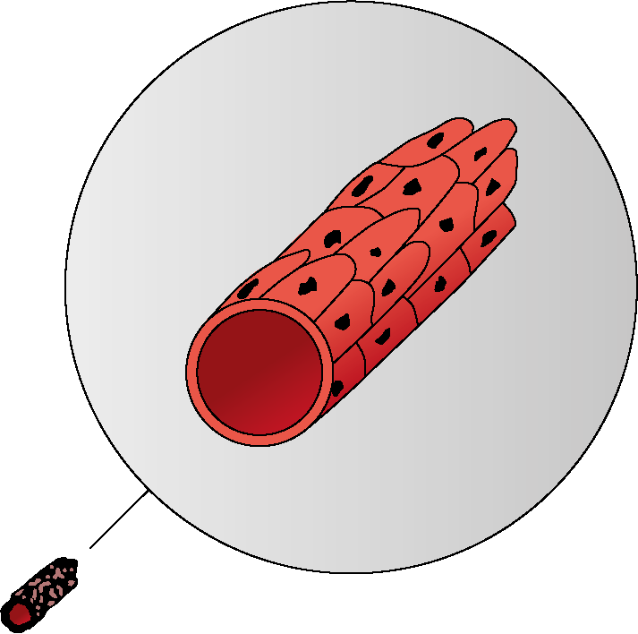
Functions of the Human Body
Key vocabulary
The big picture
artery: (noun) an artery is a type of blood vessel that transports blood away from the heart to the organs and other tissues in the body.
capillary: (noun) a capillary is a very small blood vessel with thin walls. They exchange materials between the blood and cells of the tissues and organs
deoxygenated blood: (noun) blood that is high in carbon dioxide and low in oxygen.
excretion: (noun) the process of removing waste products.
oxygenated blood: (noun) blood that is high in oxygen and low in carbon dioxide.
vein: (noun) a type of blood vessel that transports blood from the capillaries back to the heart.
Living things need a source of energy to carry out their life processes.
The digestive system breaks down food into small molecules, such as glucose. This glucose, alongside the oxygen that the lungs bring into the body, is used in a process called respiration. Respiration releases energy.
The circulatory system is responsible for moving the glucose and the oxygen to the cells so they can respire.
The circulatory system
The circulatory system is made up of the heart and blood vessels.
The heart is an organ that pumps blood around the body. It has 4 chambers.
Blood enters the heart through blood vessels.
The right side of the heart pumps deoxygented blood to the lungs where oxygen is collected.
The left side of the heart pumps oxygenated blood to the rest of the body.
Arteries are big blood vessels with thick walls.
Veins are big blood vessels with thin walls and valves.
Capillaries are very small blood vessels that can get deep into organs.
Blood entering the heart
Blood leaving the heart
Blood entering the heart
Smoking
artery
vein
Tobacco contains three substances that are bad for your health.
tar: (noun) a substance found in tobacco smoke that causes throat, mouth and lung cancer.
nicotine: (noun) a substance found in tobacco smoke that causes heart disease.
carbon monoxide: (noun) a gas found in tobacco smoke that reduces the amount of oxygen that can be carried by red blood cells.
capillary
Biology | Year 6 – Summer Term | Knowledge Organiser
Notes:
Heart – United Learning
Blood vessels –United Learning
No smoking – United Learning

