Slide 1
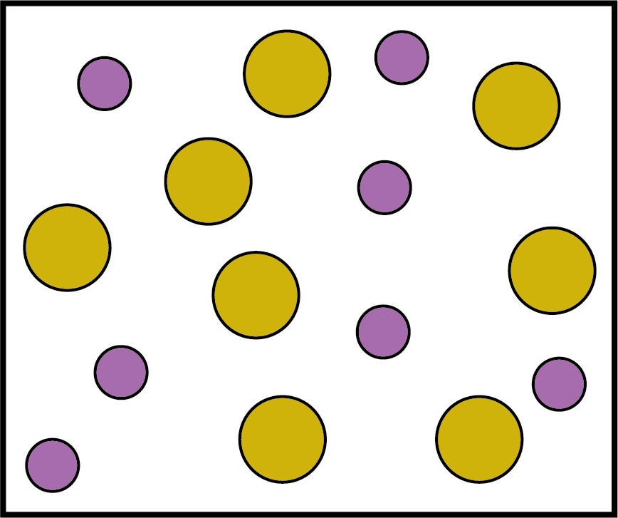
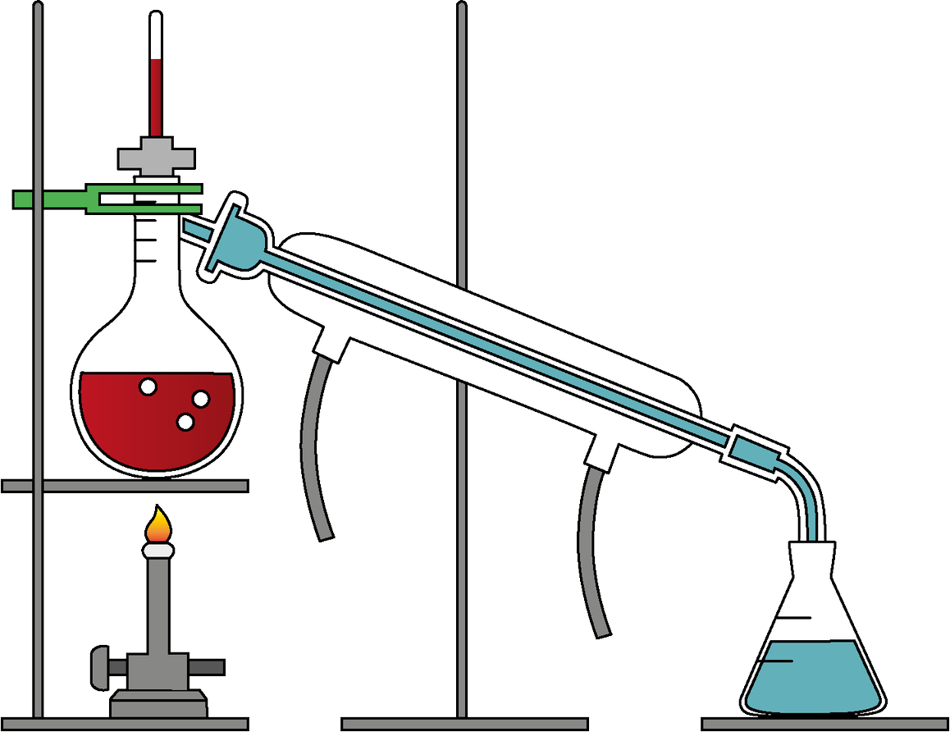


Physical and Chemical Changes
Key vocabulary
Mixtures
irreversible changes (noun) – changes that we cannot undo
reversible changes (noun) – changes that we can undo, such as freezing water and then melting it again.
A mixture is two or more substances that are mixed but not chemically joined together.
Chemical changes
We can separate a solvent from a solution using a technique called simple distillation. The solvent is heated so it evaporates and is then cooled so it condenses.
A new substance is formed when there is a chemical change.
Some chemical changes are reversible, some are irreversible.
When iron rusts, a chemical change happens. The new chemical formed is called iron oxide.
A chemical change has usually taken place if: gas bubbles appear; a new solid appears; it changes colour; or there is a change in temperature.
Physical changes
When a physical change happens, the substance changes its properties, but it does not become a different substance.
Water turning to ice and wood being changed into shavings are both physical changes.
Some physical changes are reversible, some are irreversible.
Chemistry | Year 6 – Summer Term | Knowledge Organiser
Notes:
Distillation equipment – United Learning
Diagram representing a mixture – United Learning
Evidence of chemical change – solid forming and gas bubbles – United Learning

