Slide 1
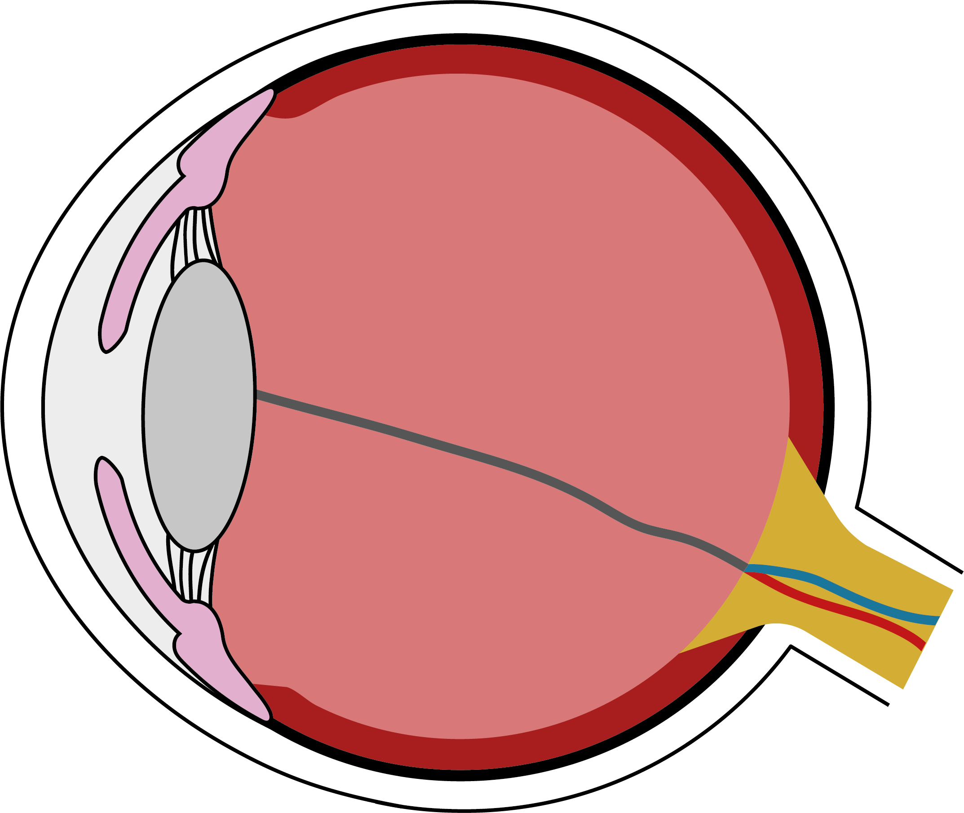
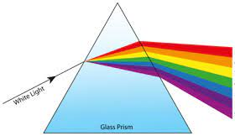
Light
Why do shadows form?
The eye
Light travels in straight lines.
A shadow forms because the object blocks the light rays and prevents them from passing through the object.
The shadow that forms will be the same shape as the object that casts it. Ray diagrams explain how shadows form.
Light enters the eye through the pupil.
The size of the pupil – and so how much light can enter – is controlled by the iris, which is the coloured part of the eye.
pupil
iris
lens
Reflection
As the iris gets bigger, the pupil gets smaller.
Light is focused onto the back of the eye by the lens, which is a transparent disc.
When light bounces off the surface of an object, this is called reflection.
On a flat surface, all light meeting a surface from one direction will be reflected in the same direction. This is known as specular reflection.
On a rough surface, light will be reflected in all directions. This is known as diffuse reflection.
Colour vision
Humans can see in colour because white light is made up of a spectrum of colours.
We can see these colours if we pass white light through a prism.
Other vocabulary
long-sighted (adjective): being able to see things that are far away clearly, but not things that are near
short-sighted (adjective): being able to see things close to you clearly, but not things that are far away
A coloured object appears coloured because it reflects that light and absorbs the others.
Black objects absorb all light and white objects reflect all light.
Dispersions by Jibin 184040, CC BY-SA 4.0, via Wikimedia Commons
Physics | Year 6 – Spring Term | Knowledge Organiser
Notes:
Reflection – United Learning
Eye – United Learning
Pyramid diagram (CC BY-SA 4.0) – https://upload.wikimedia.org/wikipedia/commons/2/25/Dispersions.png

