Slide 1
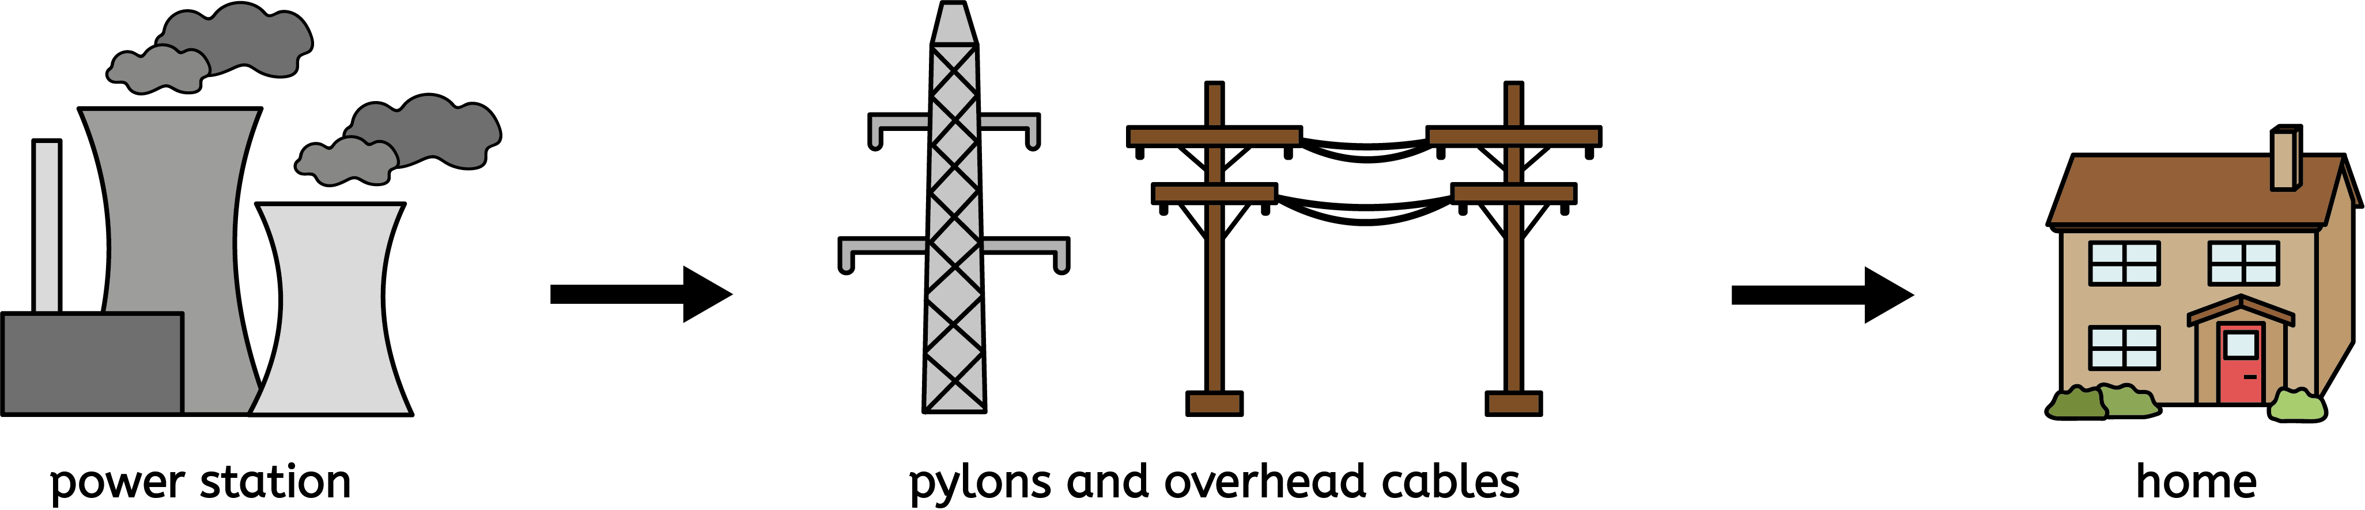

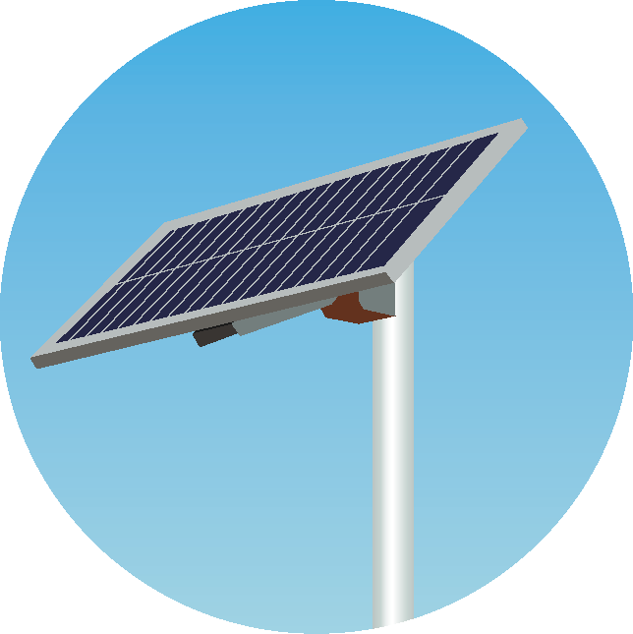

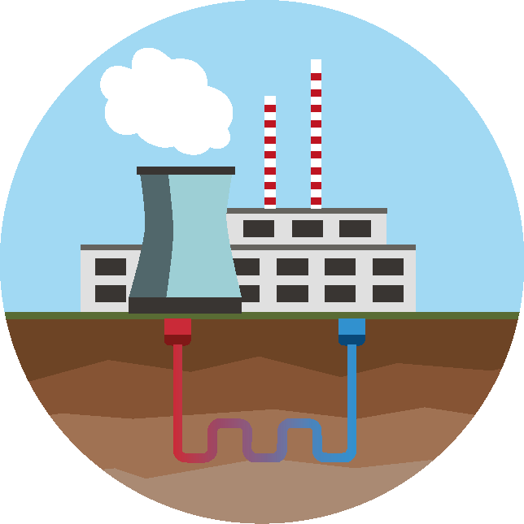

Electricity
Circuit symbols and diagrams
When drawing an electrical circuit, use straight lines and symbols to represent the components of the circuit.
M
motor
buzzer
wire
switch
battery (which is formed when we connect two or more cells. Adding more cells increases the voltage of the circuit.
lamp
cell
Series and parallel circuits
More than one lamp (or other component) can be placed in a circuit.
If the lamps are placed in one continuous loop, it is a series circuit.
If lamps are placed in separate loops that both connect to the cell, it is a parallel circuit.
Generating electricity
Power stations generate mains electricity.
The electricity is transferred to our homes and school by overhead cables.
Some power stations burn fossil fuels (coal, oil and gas) to generate electricity. These are non-renewable sources of energy.
Renewable sources of energy include:
solar | wind | geothermal | tidal
Physics | Year 6 – Autumn 1 | Knowledge Organiser
Notes:
Circuit symbols – United learning
Circuit diagrams – United Learning
Energy source diagrams – United learning
Power station, grid and home – United Learning

