Slide 1
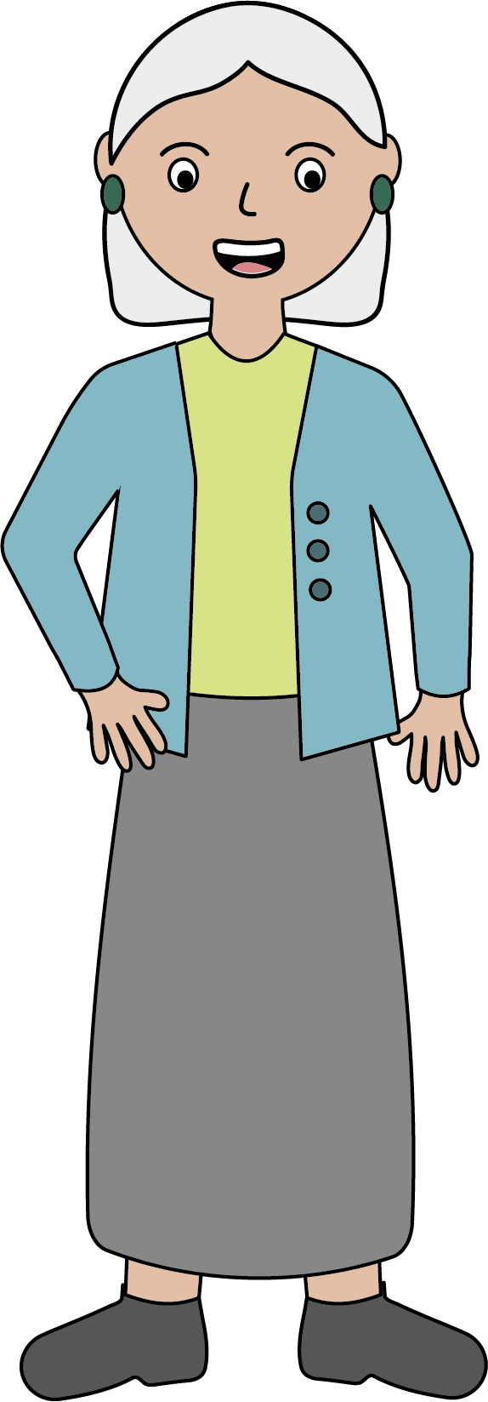
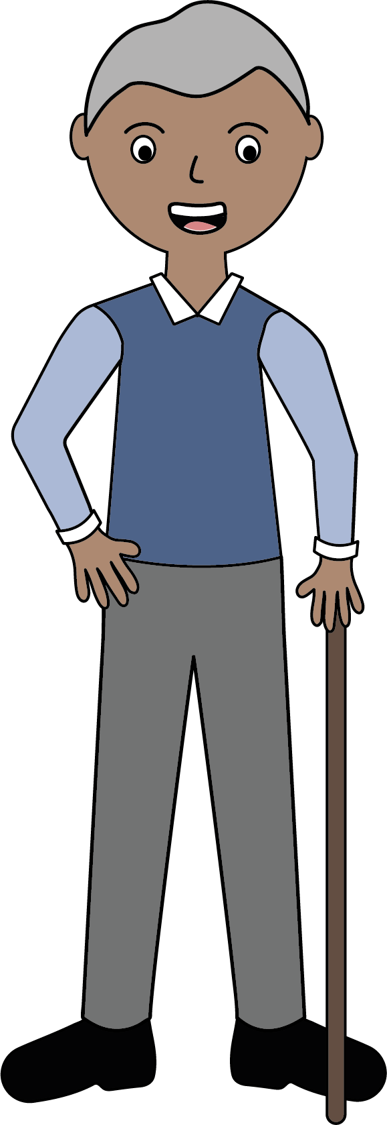
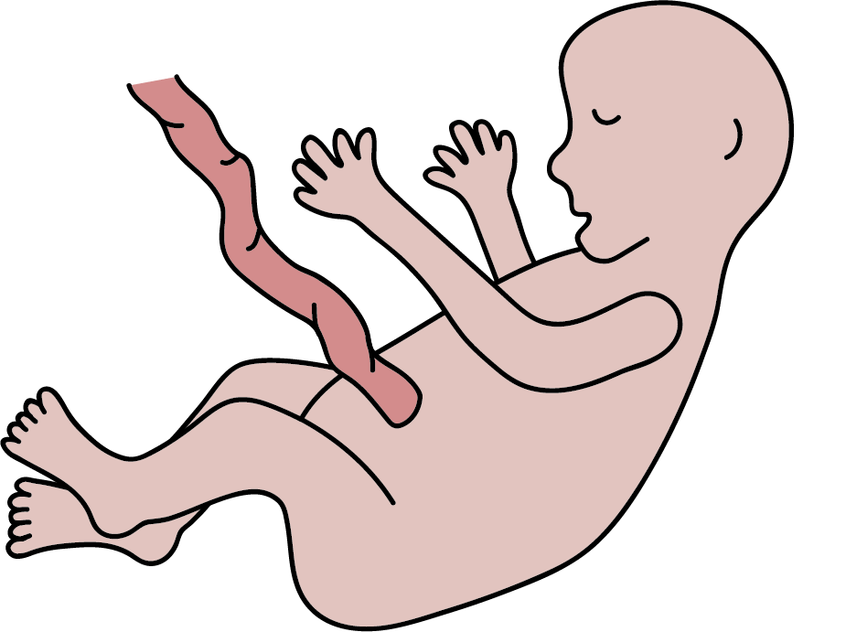
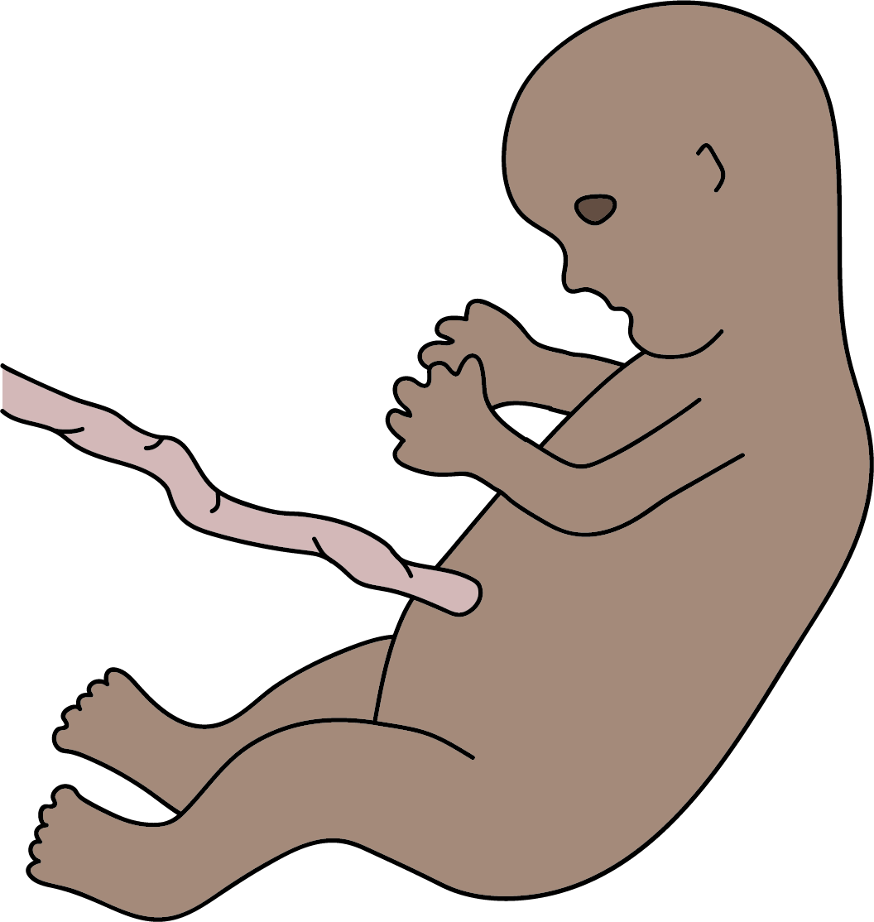
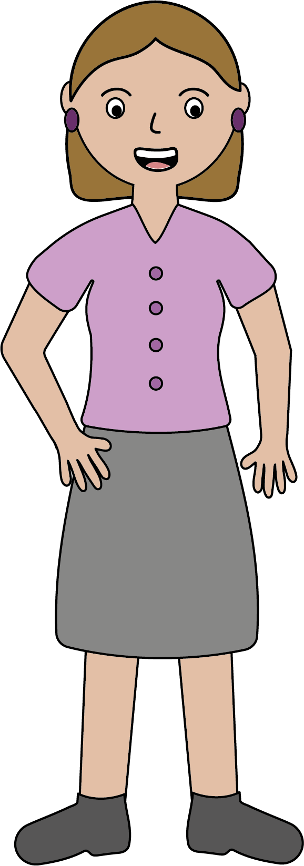
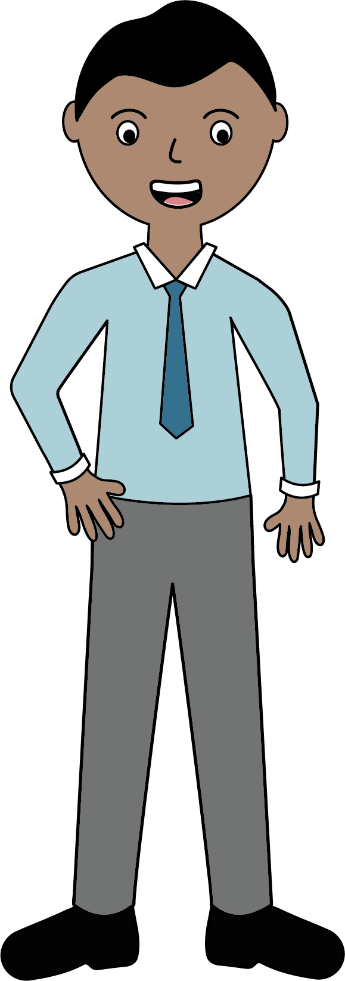

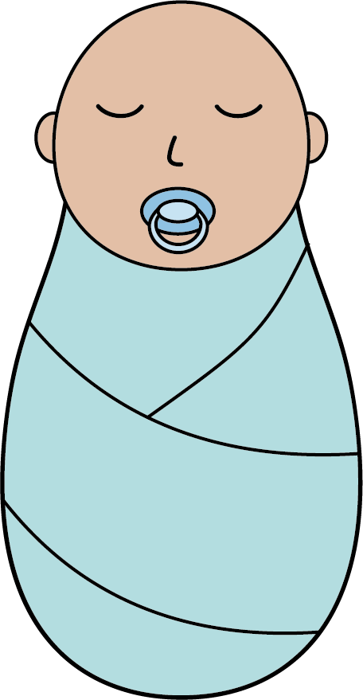
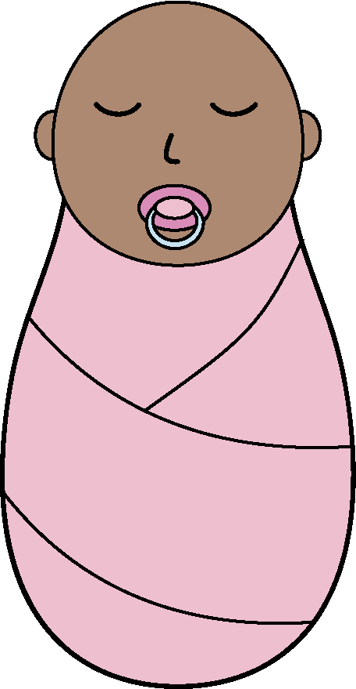
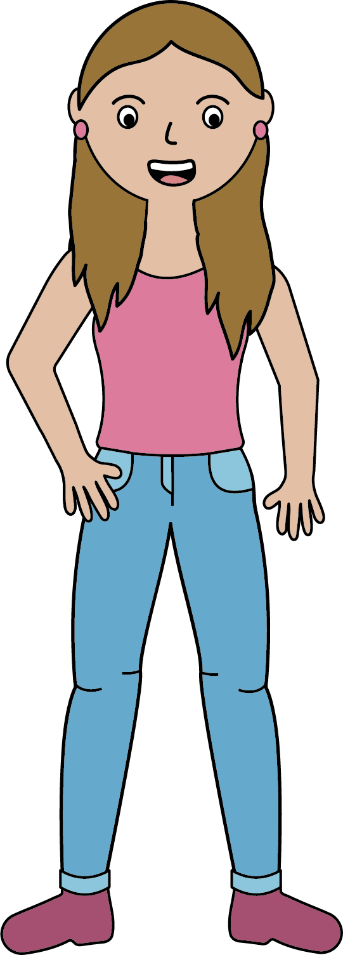
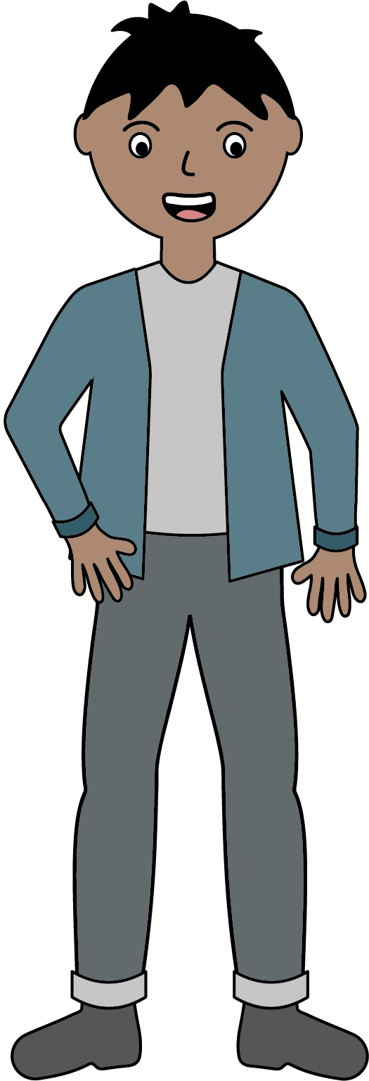
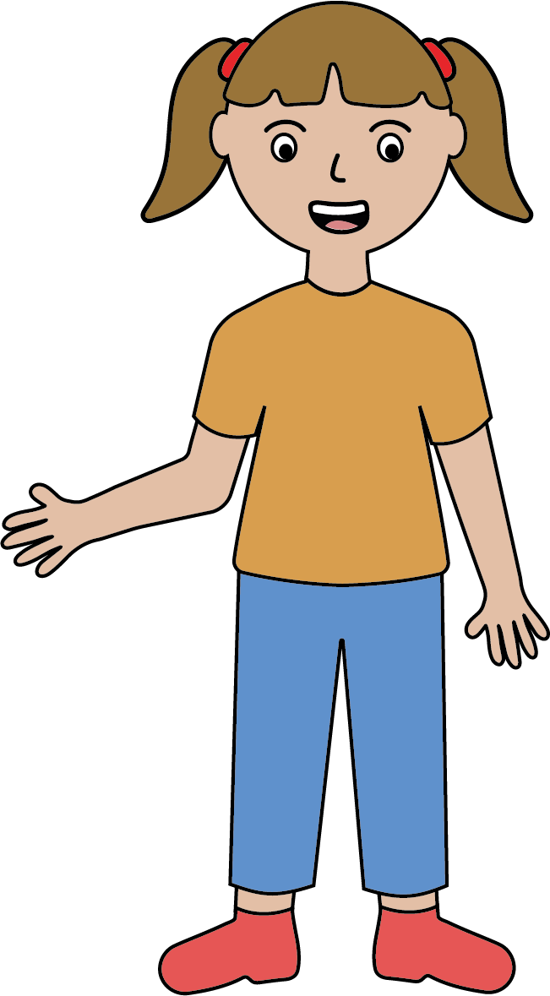
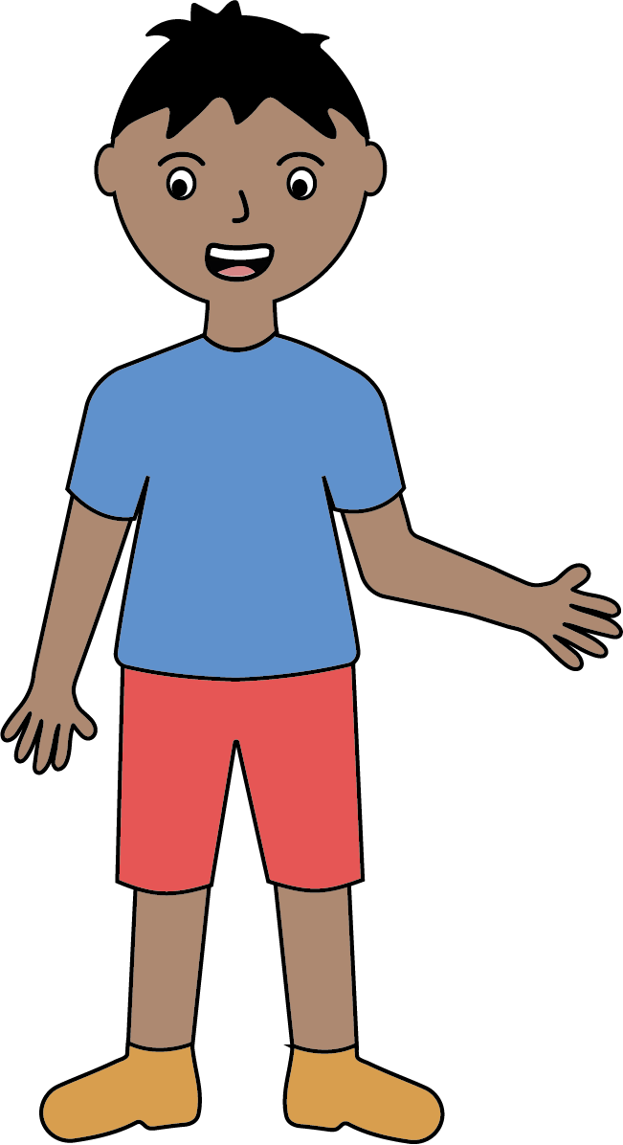
Human Development
The human life cycle
Gestation is the period from conception to birth. In humans, this is often 40 weeks. During this time, a ball of cells called an embryo develops into a foetus.
Humans are viviparous animals. This means the foetus develops inside the female.
During adulthood, we age. Primary ageing is a natural process that happens as our bodies get older. Our reaction times slow and our hearing gets worse. If we smoke, eat a bad diet and don’t exercise, this accelerates how much we age. This is called secondary ageing.
old age
Adults can reproduce, and their offspring continue the life cycle.
foetus
foetus
At birth, a baby is born and will grow into a child. The child begins to develop and grow bigger. Children start to walk at about 1 year old and will begin to use words from about 18 months. Their speech becomes more advanced as they get older.
adult
adult
baby
Puberty occurs during adolescence and is a period of time when the male and female body undergoes change. Pubic hair grows, breasts develop, males produce sperm and females begin to menstruate.
baby
teenager / adolescent
teenager / adolescent
child
child
Key vocabulary
embryo – (noun) an unborn baby that is under 8 weeks old.
foetus – (noun) an unborn baby that is over 8 weeks old.
uterus – (noun) the organ in which offspring are conceived and grow before they are born.
Biology | Year 5 – Spring Term | Knowledge Organiser
Notes:
Human life cycle – United Learning

