Slide 1
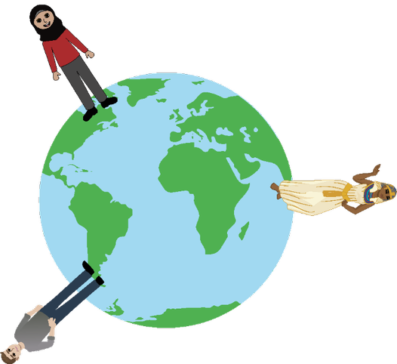
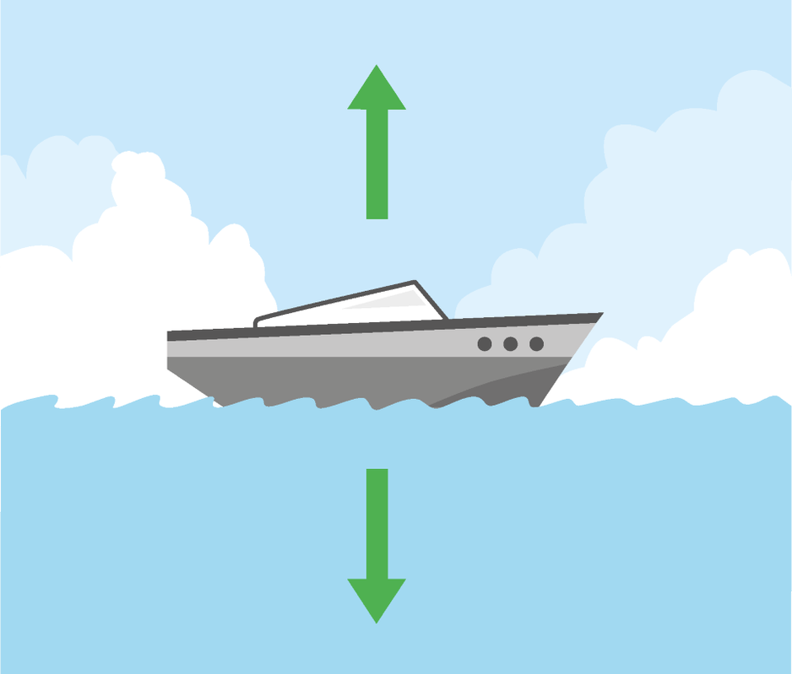
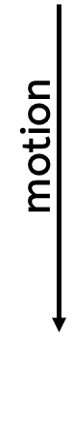
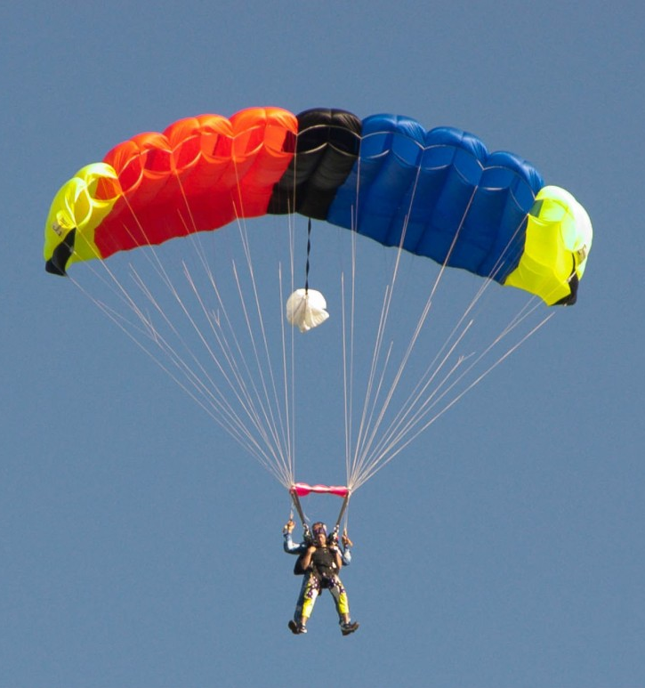
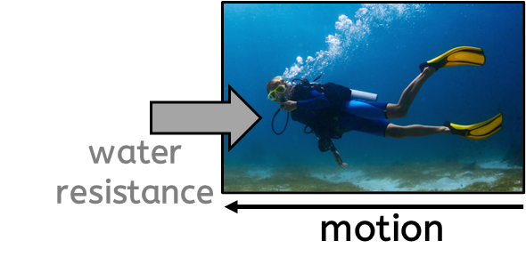
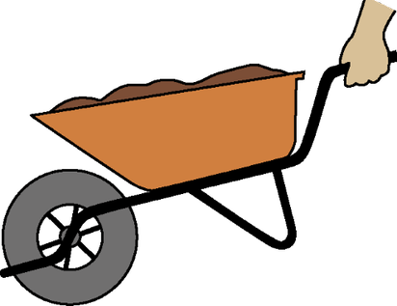
Forces
Key vocabulary
friction: (noun) a force that acts to slow a moving object down, or to prevent an object from moving.
mass: (noun) the amount of matter an object is made from. It is measured in kg.
upthrust: (noun) an upwards force that a liquid (and a gas) exerts on an object floating in it.
load: (noun) the weight (the force) that is being moved.
pivot: (noun) the point at which something turns.
Gravity
Gravity is a non-contact force that pulls all objects towards each other.
Objects with a greater mass will have a greater gravitational pull.
Weight is a force and is measured in newtons (N).
The weight of the object depends on the gravitational pull. So, objects on the Moon will have a smaller weight than the same object on the Earth.
Floating and sinking
Frictional forces
Air resistance and water resistance are both examples of frictional forces. Both forces act to slow objects down.
Increasing the surface area of an object will increase the impact of these forces on the object.
When upthrust (an upwards force in a liquid) is equal to the weight of the object in the liquid, the object will float.
Levers, pulleys and gears
Levers, pulleys and gears are simple machines that allow a smaller force to have a greater effect.
air resistance
Physics | Year 5 – Summer Term | Knowledge Organiser
Notes:
Globe, wheelbarrow , boat –United Learning
Diver, parachute (CC0) - https://pxhere.com/en/photo/1239548

