Slide 1
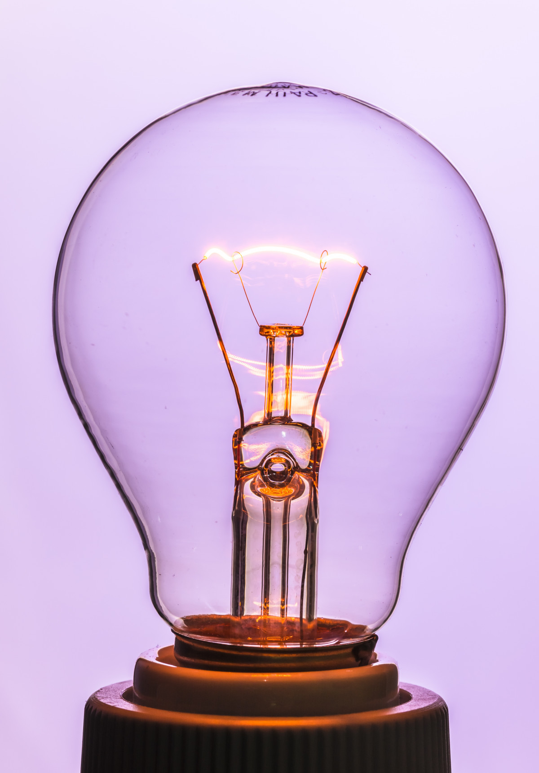
Energy
Energy stores
Food chains
There are different types of energy stores. Two examples are:
chemical energy store: coal, oil, gas, the Sun, cells, and food are all chemical energy stores.
thermal energy store: if the thermal energy store of the air increases, we will feel it become warmer.
The Sun is a chemical energy store. Light from the Sun travels to Earth, and producers use this light to produce their own food. This is their chemical energy store.
When consumers eat producers and other consumers, not all of the chemical energy is passed on along the food chain.
There are two reasons for this:
Not all of the organism is eaten
Some energy is transferred to the thermal energy store of the air. This happens when we move.
Energy stores and transfers
Energy can be moved from one store to another.
The energy removed from one store will be equal to the energy gained by another store or stores.
Circuits
In a circuit that has a cell, the cell is the chemical store of energy. This store will decrease the longer the circuit is connected.
In a complete circuit with a bulb, the bulb gets hot. Energy is transferred to thermal energy store in the air surrounding it.
Energy store A (before)
Energy store A (after)
Energy store B (after)
Can energy be used up?
Energy cannot be used up. An energy resource can be used up. For example, we will run out of fossil fuels one day.
Physics | Year 5 – Autumn 2 | Knowledge Organiser
Notes:
Energy store images – United Learning
Filament bulb (CC0) - https://pxhere.com/en/photo/1239559

