Slide 1
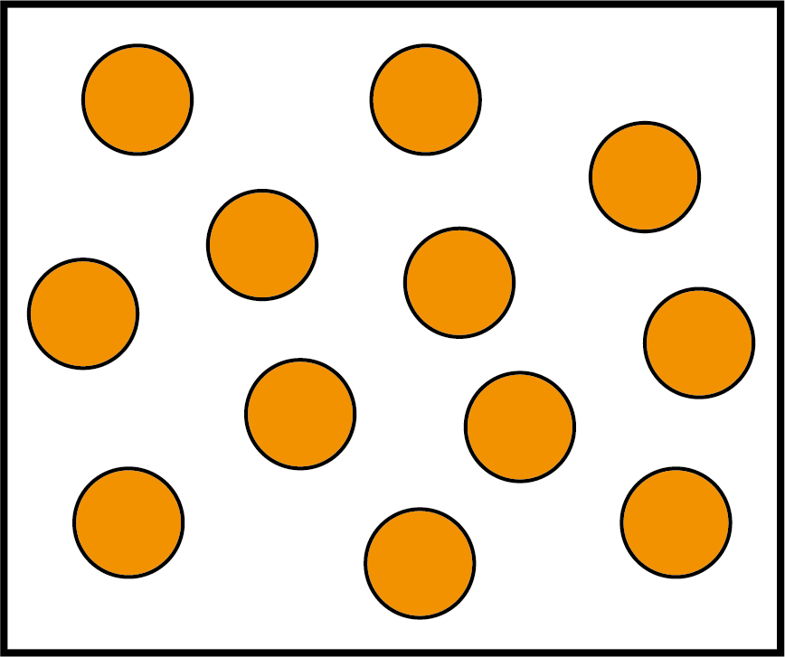
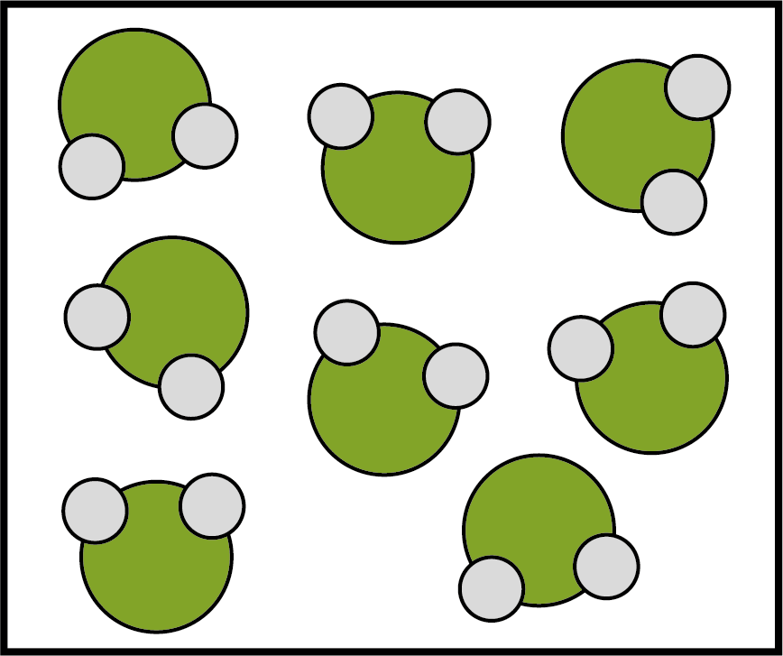
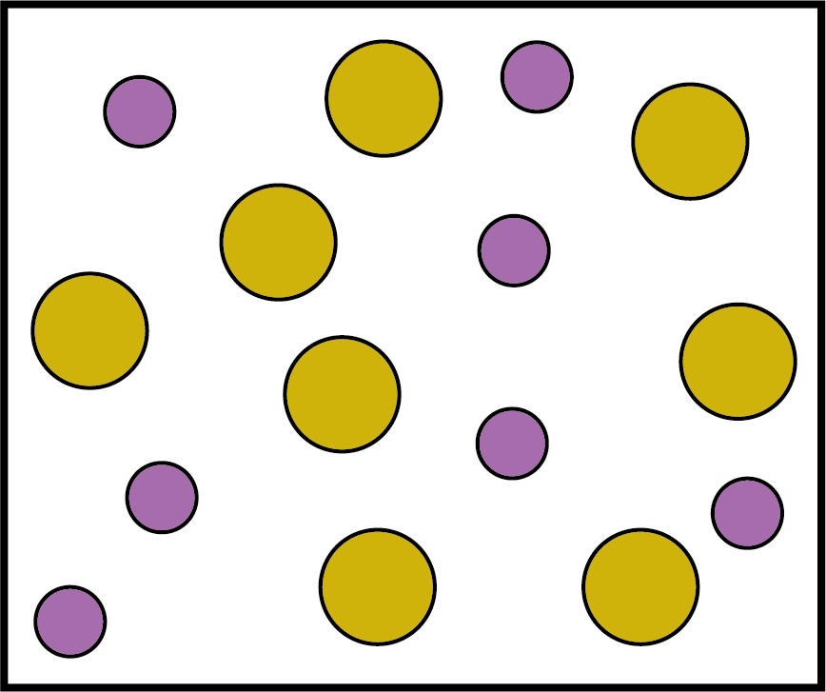
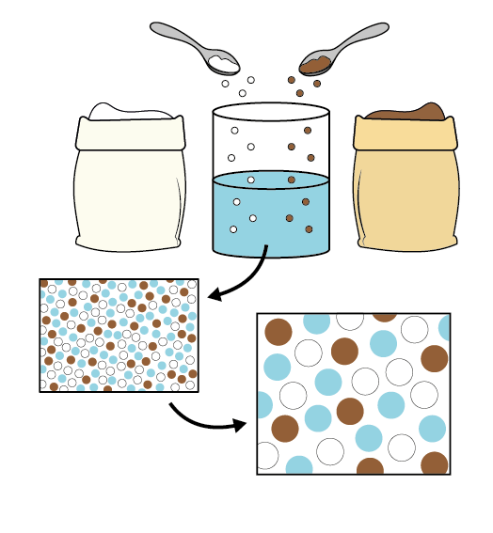
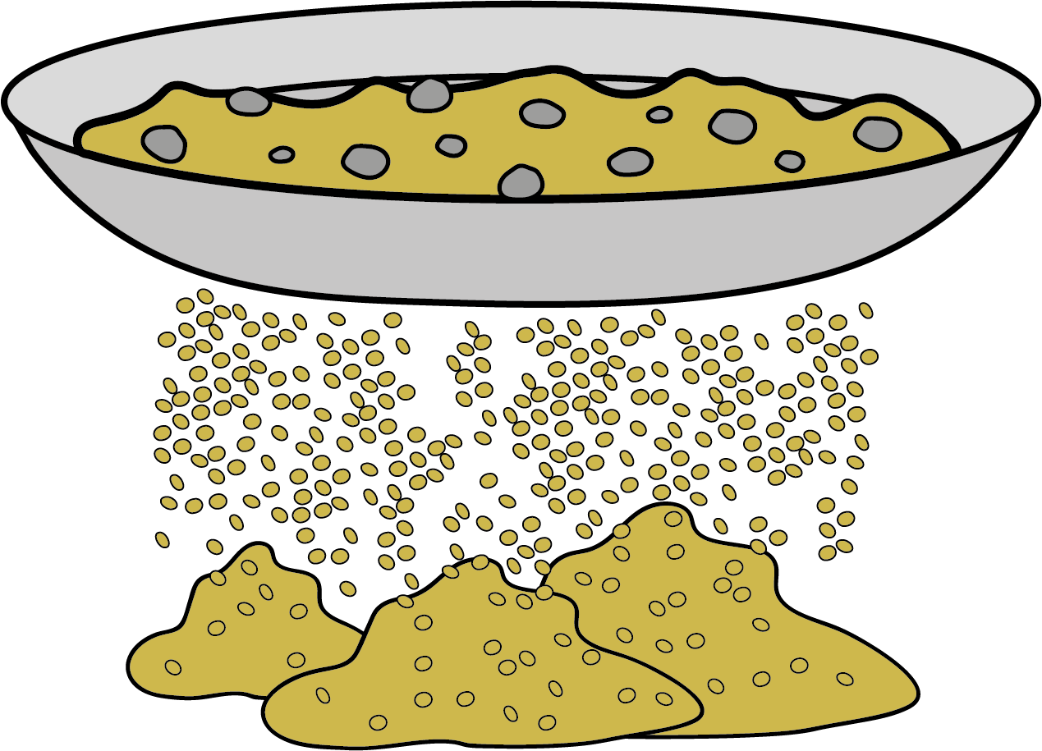

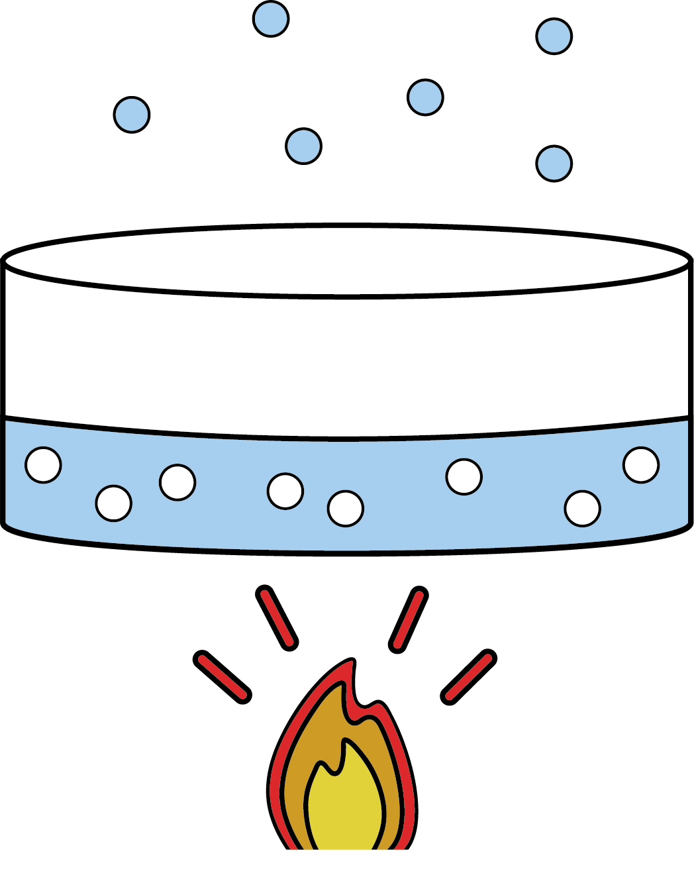
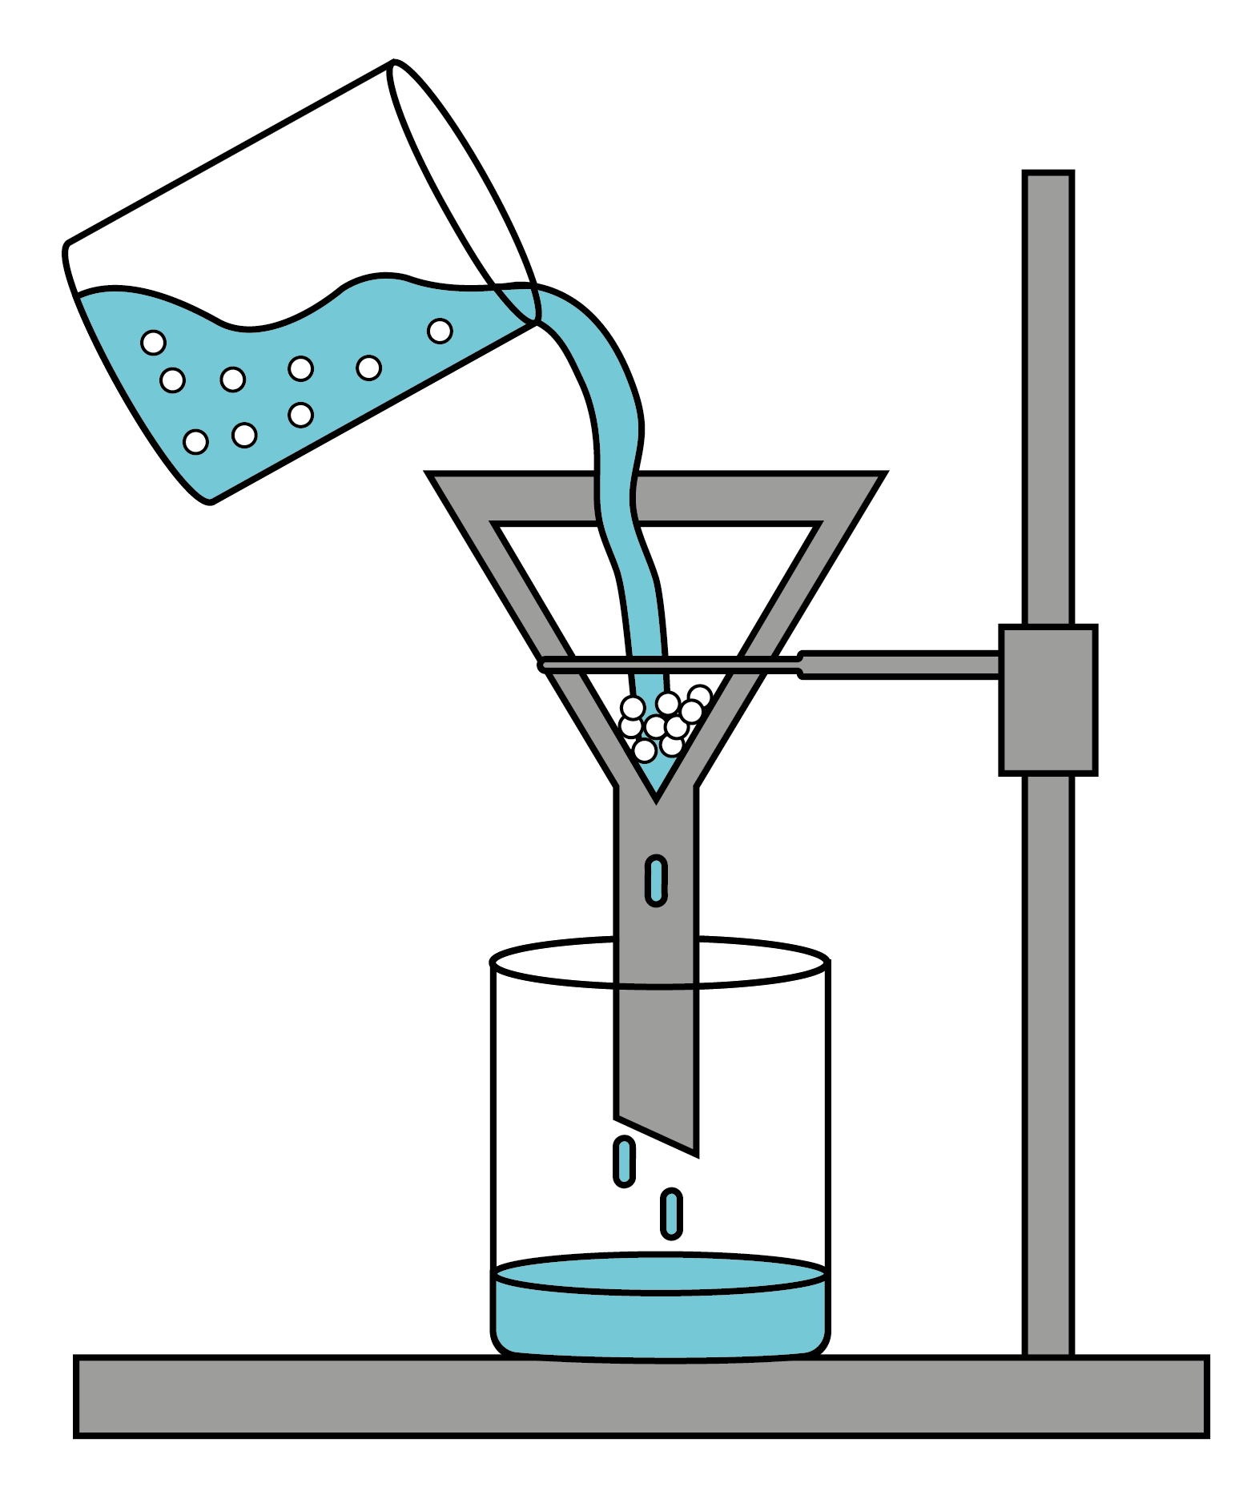
Separating Mixtures
Mixtures and pure substances
A pure substance is one that contains only one substance.
A mixture contains two or more substances that can be separated.
pure substances
mixture
Solutions
Some materials (solutes) can be dissolved in other materials (a solvent). The mixture created is called a solution.
When no more solute can dissolve in the solution, it is a saturated solution.
If a solid does not dissolve in a solvent, it is insoluble.
mixture
Reversible and irreversible changes
An irreversible change is a change that cannot be undone, like burning candles or shredding paper.
A reversible change is a change that can be undone, like dissolving sugar in water. We can separate the solution and get the sugar and water back.
Separating mixtures
There are many techniques that we can use to separate mixtures.
The technique used depends on what you are trying to separate.
Use a sieve to separate different sized solids, or a large insoluble solid and liquid.
Use a magnet to separate magnetic and non-magnetic materials.
Evaporation can separate a soluble substance from the solvent, like sugar and water.
Use filtration equipment to separate small insoluble solids from liquids.
Chemistry | Year 5 – Autumn 1 | Knowledge Organiser
Notes:
All images – United Learning

