Slide 1


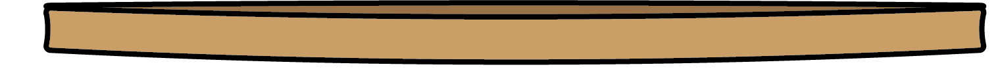
Properties of Materials
All materials have properties. Properties can be physical or chemical.
Physical properties
Chemical properties
Physical properties include electrical conductivity; thermal conductivity; being malleable; absorbent; magnetic; hard/soft; rough/smooth; dull/shiny; and being windproof.
Scientists need to use specialist equipment to measure chemical properties.
Thermal conductivity
Some chemicals are flammable. This means they set on fire easily.
If we see this hazard sign, we know a chemical is flammable.
Some materials are good thermal conductors. This means that they are good at transferring energy from a material that is at a higher temperature to a material that is at a lower temperature. Metal is a good thermal conductor.
A material that is a good thermal insulator is poor at transferring energy. Trapped air and plastic are good thermal insulators.
In homes, we use thermal insulators to reduce energy loss.
Some chemicals are toxic. This means they are harmful to living things.
If we see this hazard sign, we know a chemical is toxic.
Elasticity
Some materials are elastic. Elastic materials can stretch and then return to their original form. An elastic band can be stretched but returns to its original size.
Chemistry | Year 4 – Summer Term | Knowledge Organiser
Notes:
All images – United Learning

