Slide 1
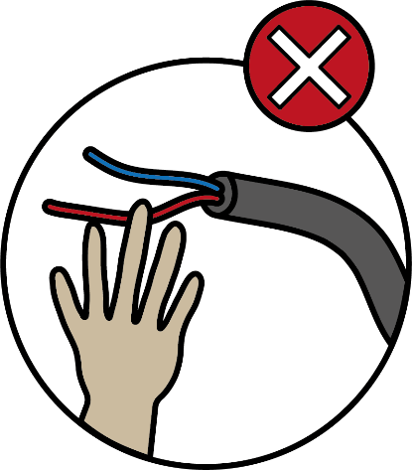
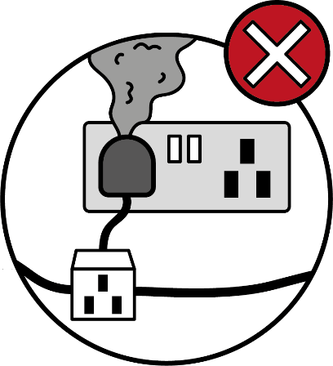
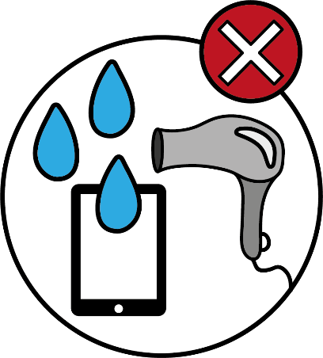
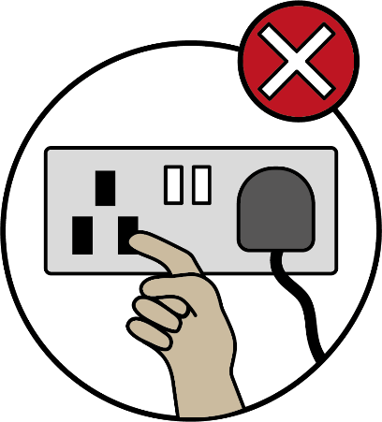

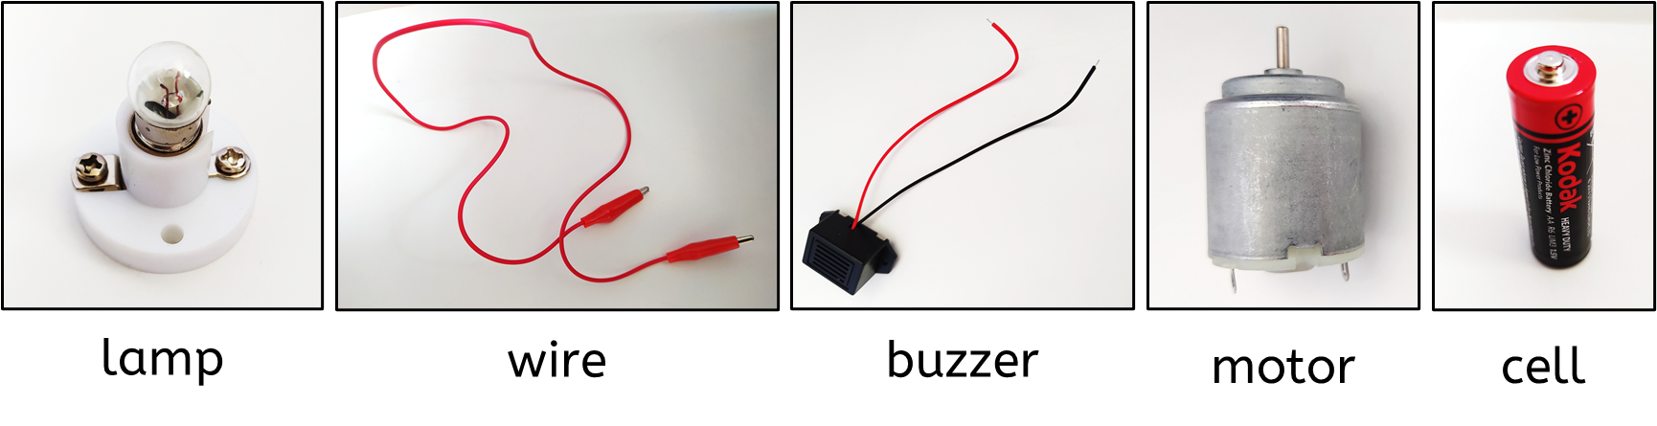
Electricity
Electrical safety
Key vocabulary
It is important to be safe when working with electricity.
electrical appliance/device: something that needs electricity to work, like a kettle or TV.
electrical circuit: a complete loop that electricity can flow through.
Don’t overload sockets.
Don’t use electrical appliances near water.
Don’t pull wires.
Don’t put your fingers in sockets.
Don’t climb trees or fly kites near power lines.
Conductors and insulators
Materials that let electricity pass through them easily are known as good electrical conductors.
Copper, iron and steel are good electrical conductors.
Electrical insulators do not allow electricity to pass though them easily. They are poor electrical conductors.
Wood, plastic, rubber and air are good insulators.
Complete circuits
A complete circuit must have:
at least one cell
at least one component
have all the components connected in a loop.
If any of these things are missing it is an incomplete circuit.
A complete circuit.
A switch can be used to create a break in a circuit.
Physics | Year 4 – Summer 1 | Knowledge Organiser
Notes:
All images – United Learning

