Slide 1
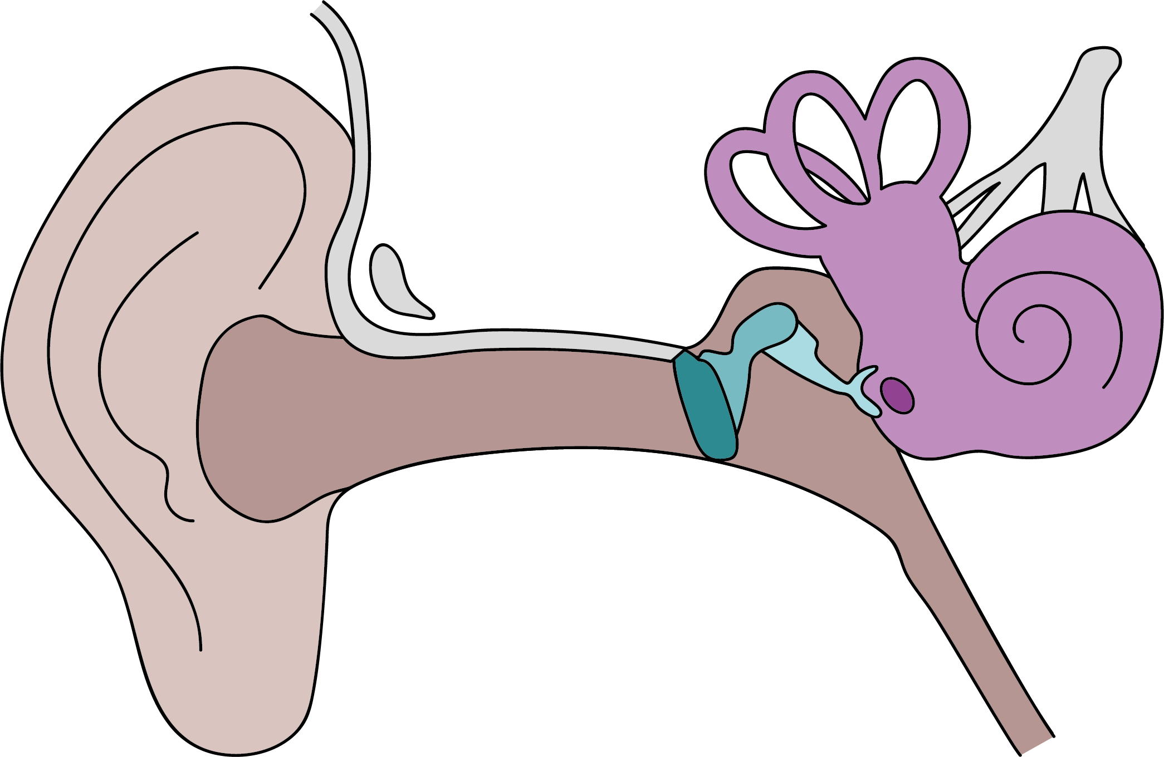
Sound
What is sound?
Changing sounds
Sounds are made when objects vibrate. These vibrations cause the air particles surrounding them to vibrate, causing the vibrations to pass between particles.
For sound to travel, there must be a medium (a solid, liquid or gas).
The source is the object that produces the sound, and the detector detects the sound. Sound is transmitted from the source in all directions.
Sounds get fainter as the distance from the source increases.
Volume is how loud or quiet a sound is. The volume depends on the size of the vibrations. The bigger the vibration, the louder the sound.
Pitch is how high or low a sound is. A mouse’s squeak is high pitched, and a rumble of thunder is low pitched. The pitch depends on the speed of the vibrations. The faster the vibration, the higher the pitch.
The structure of the ear and how we hear
1. Vibrating air enters our ear canal.
3. These vibrations are passed onto the ear bones.
2. This causes our ear drum to vibrate.
4. The ear bones pass the vibrations onto the fluid in the cochlea, which passes impulses to our brain to be interpreted.
Outer Ear
Middle Ear
Inner Ear
Physics | Year 4 – Spring Term | Knowledge Organiser
Notes:
Ear diagram – United Learning

