Slide 1
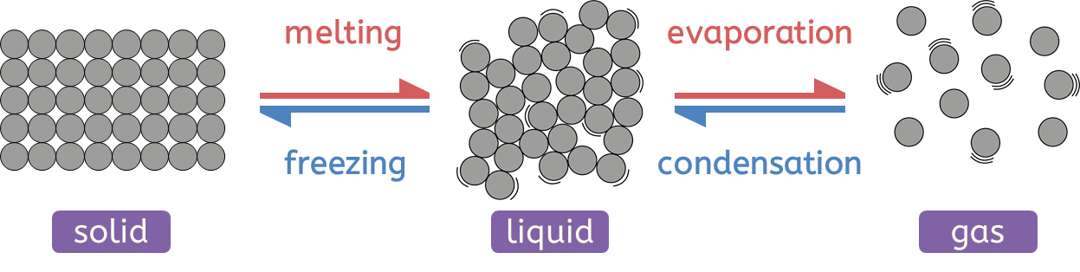
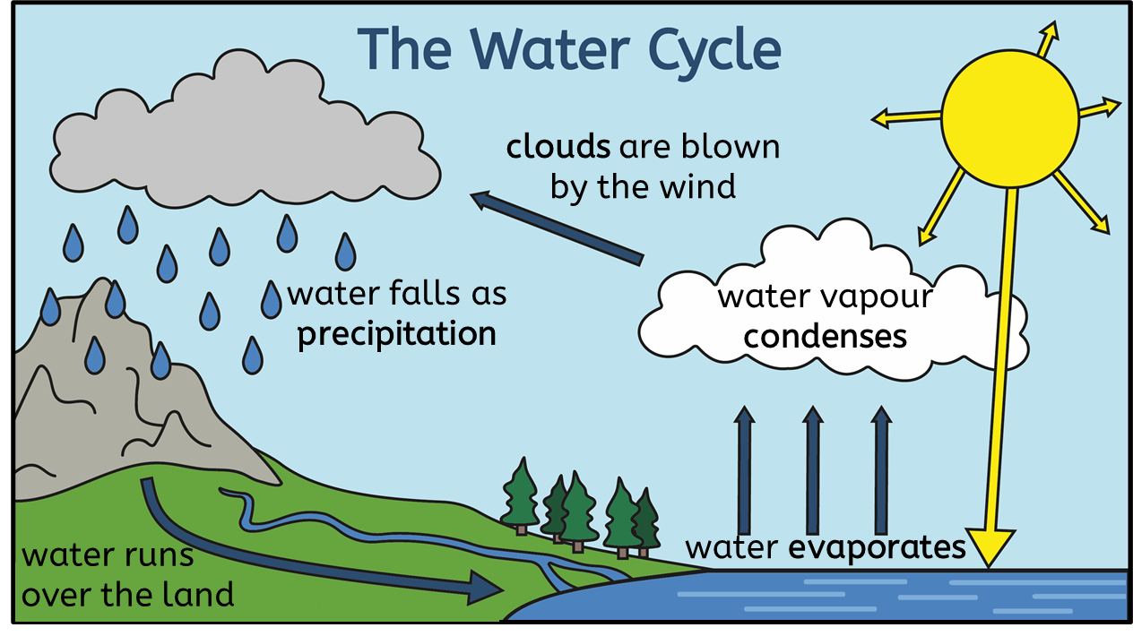
Particle model
Key vocabulary
The big picture
condensation (noun): the process in which a substance changes from a gas to a liquid
evaporation (noun): the process in which a substance changes from a liquid to a gas
freezing (noun): when a liquid turns into a gas
melting (noun): a process by which solids turn into liquids
particle (noun): the smallest parts of matter
precipitation (noun): water falling to the Earth’s surface as rain, snow, sleet or hail
temperature (noun): a measure of how hot or cold something is
Matter is what everything in the world is made of.
Matter exists in one of three states: solids, liquid and gases. Substances can change from one state of matter to another.
All matter is made up of tiny parts called particles.
Changing states
In a solid, the particles are close together and are unable to move away from their neighbors.
In a liquid, the particles are close, but they can slide past each other.
In a gas, the particles are far apart and can move freely.
The water cycle
Solids have a fixed shape; they cannot flow. Solids cannot be compressed.
Liquids can flow and take the shape of the bottom of the container they are in. They cannot be compressed.
Gases can flow and fill the container that they are in. They can be compressed.
Chemistry | Year 4 – Spring Term | Knowledge Organiser
Notes:
All images – United Learning

Slide 2
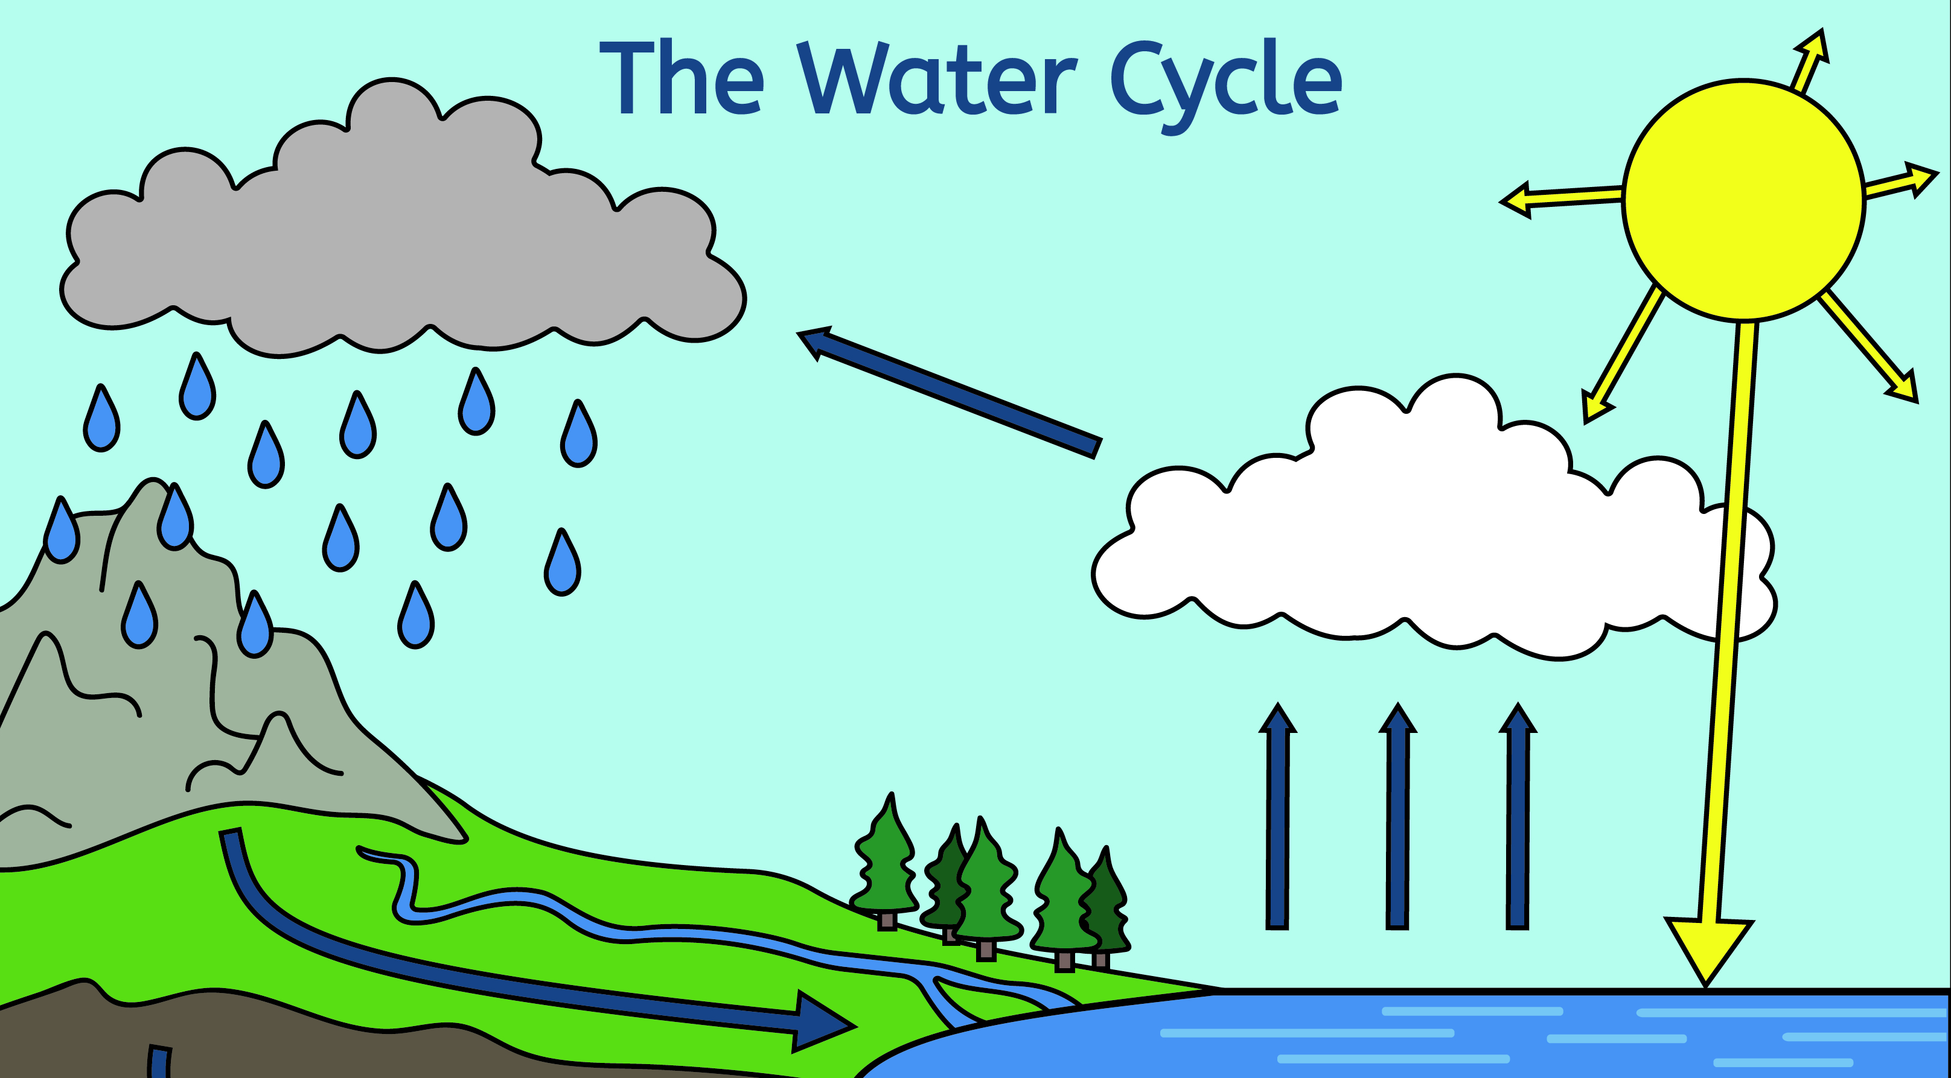
Editable diagram for teachers
clouds are blown by the wind
water falls as precipitation
water vapour condenses
water evaporates
water runs over the land
Notes:
UL image

