Slide 1
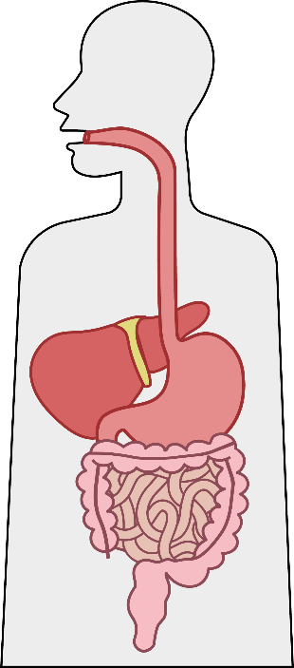
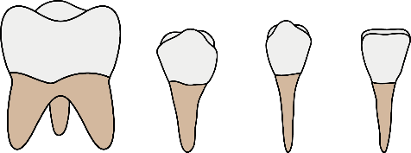
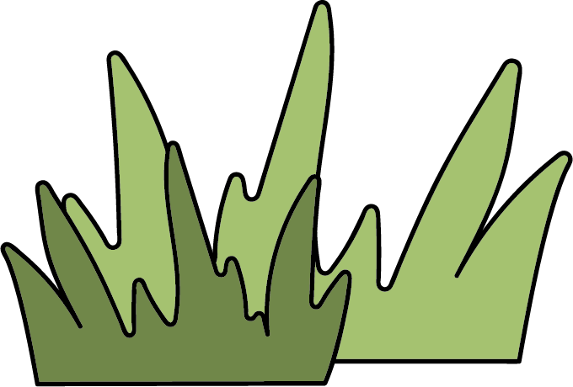
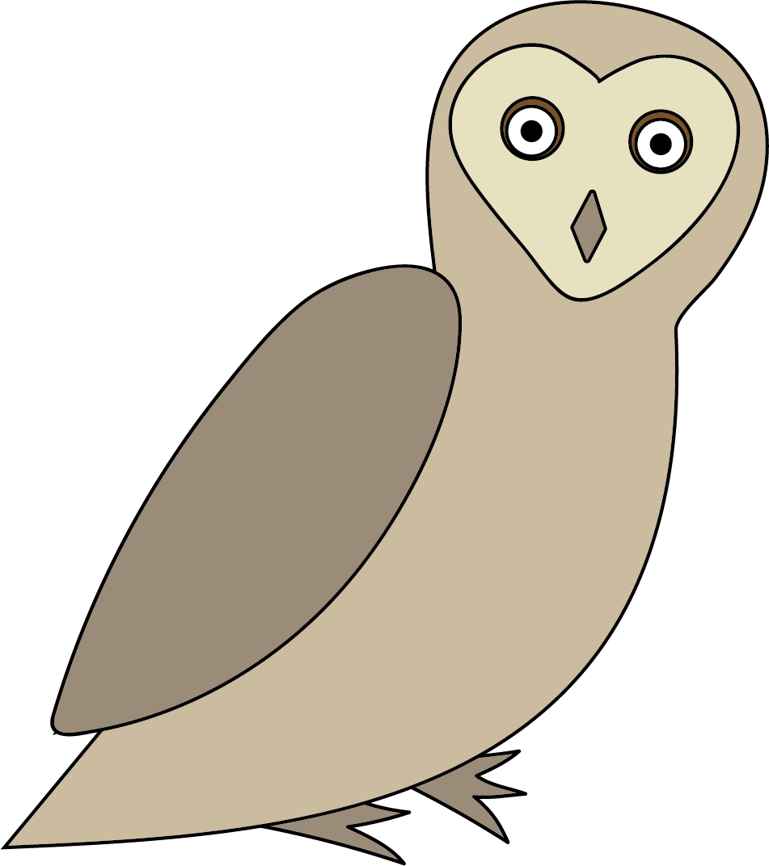
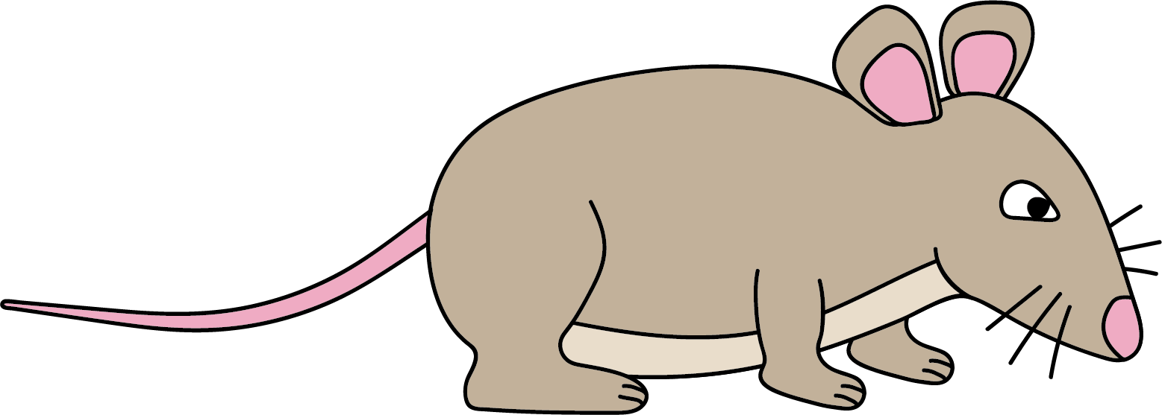
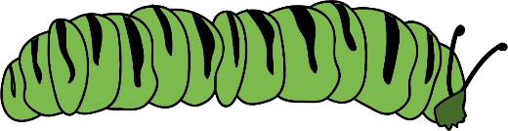
Food & Digestion
Digestion
The food that animals eat needs to be broken down into very small parts, so that they can be absorbed into the blood and used around the body. The process of breaking food down is called digestion.
canines rip and tear
The mouth contains teeth, which start to break down the food.
The oesophagus is a tube that connects mouth and stomach.
The stomach churns food and contains substances that break down the food chemically.
incisors cut
pre-molars and molars crush and grind
The small intestine breaks down food chemically. Here, nutrients are absorbed into the blood.
In the large intestine, water from undigested food is absorbed into the blood.
Undigested food – faeces (poo!) – is stored in the rectum until it is ready to be passed through the anus.
Feeding relationships
An ecosystem is all the organisms living in an area and the non-living features of the environment, such as precipitation, temperature, wind, soil and sunlight.
In an ecosystem, there are many feeding relationships. These can be shown through food chains or food webs.
producer
primary consumer
secondary consumer
tertiary consumer
prey
prey & predator
predator
Biology | Year 4 – Autumn 2 | Knowledge Organiser
Notes:
All images – United Learning

