Slide 1
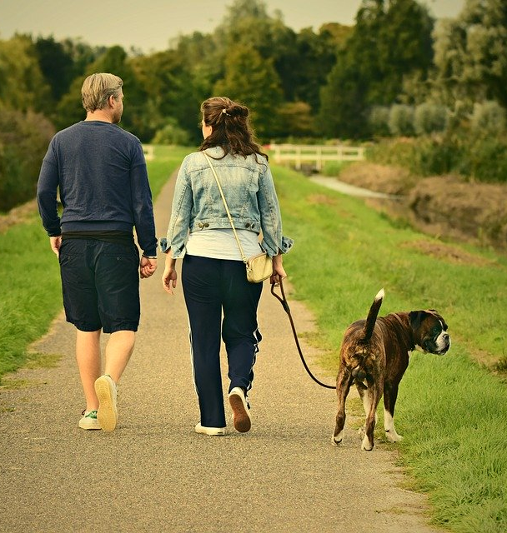
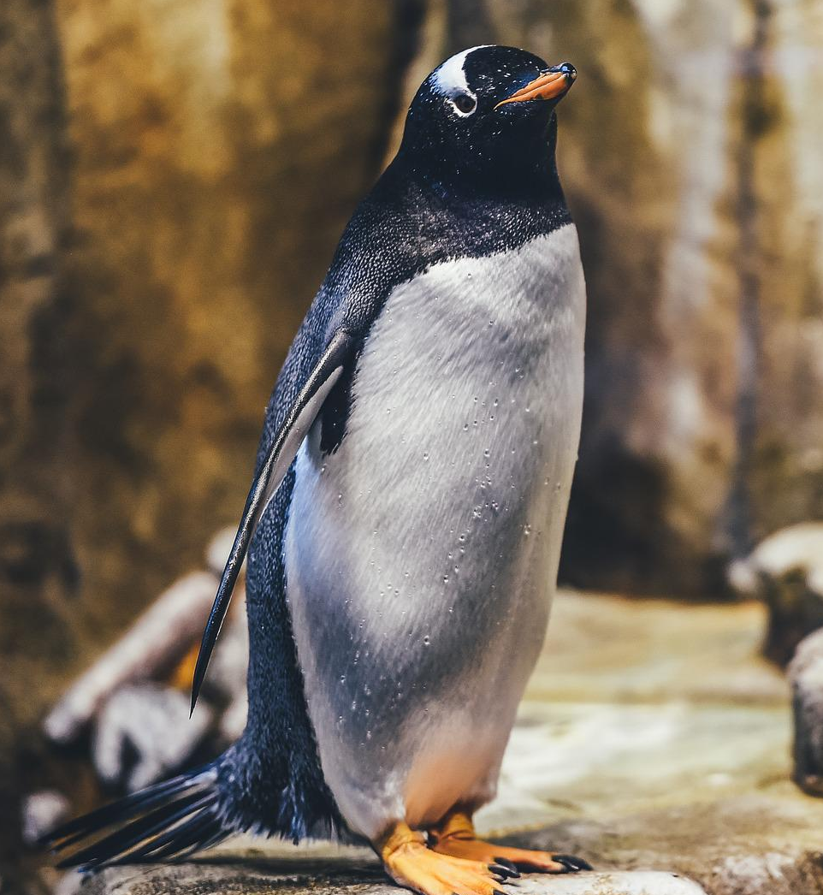
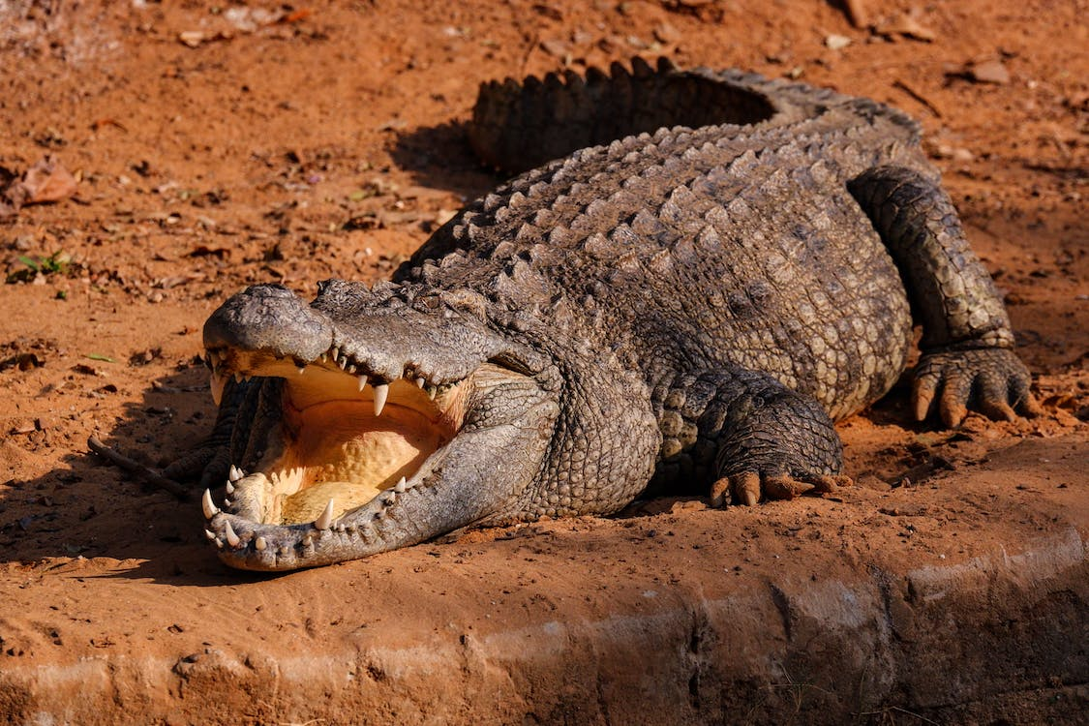
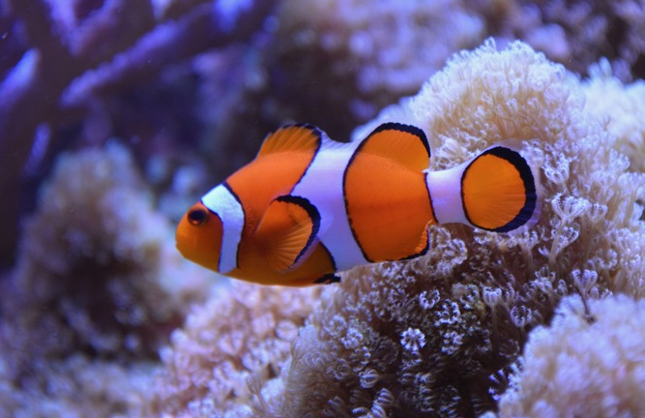
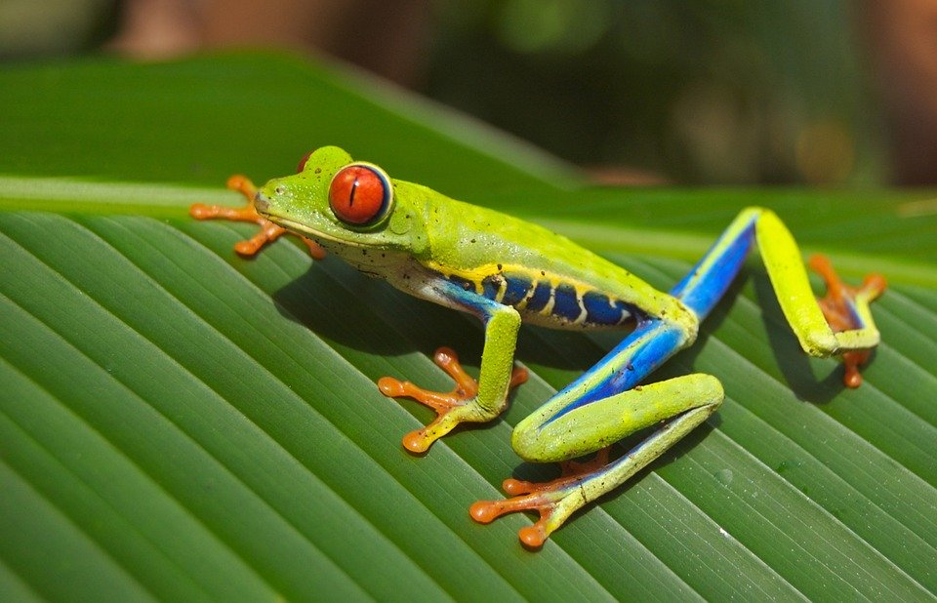
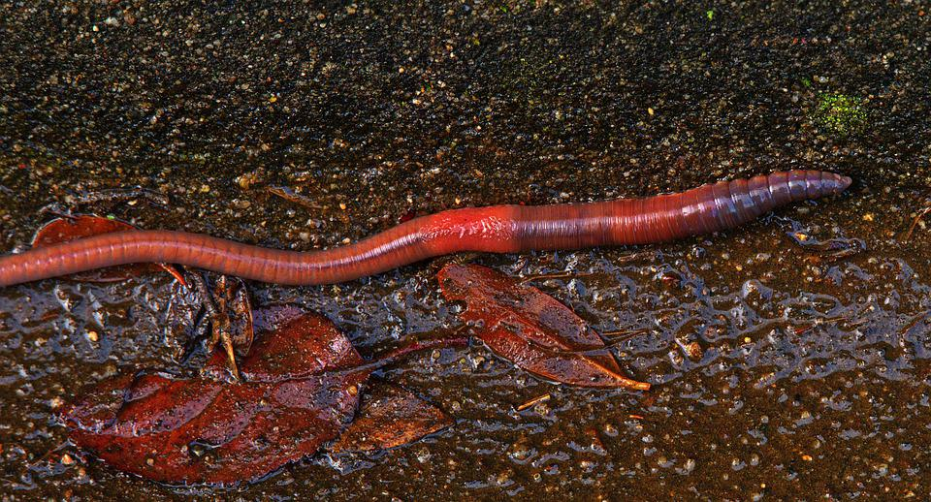
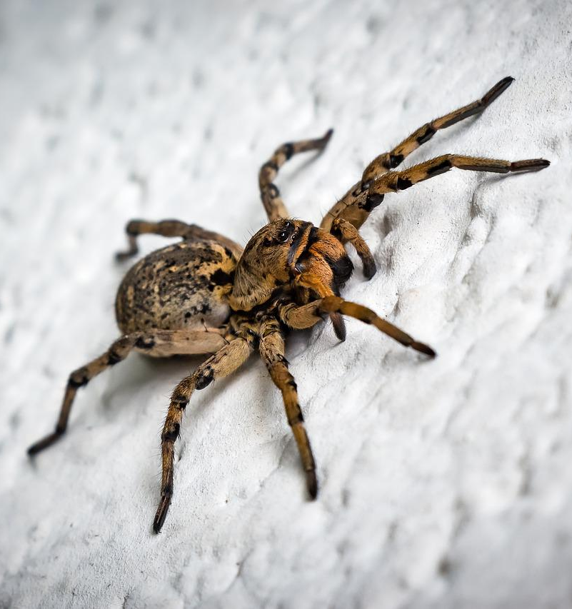
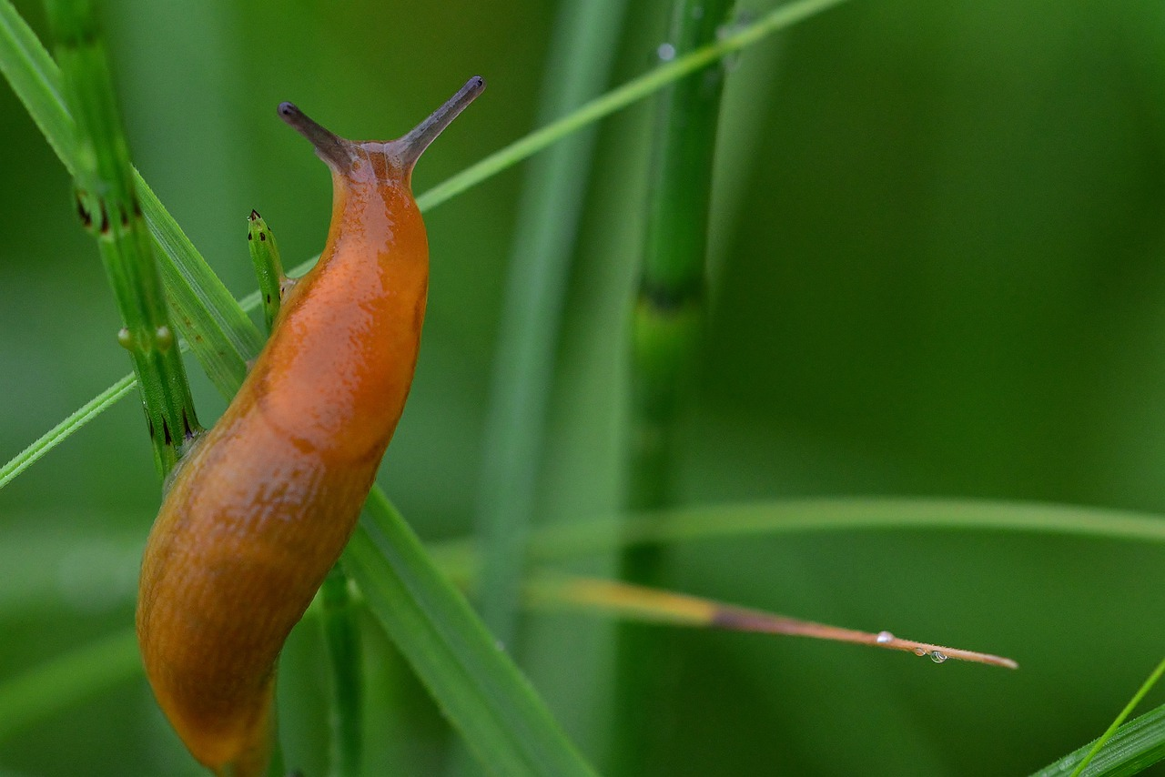
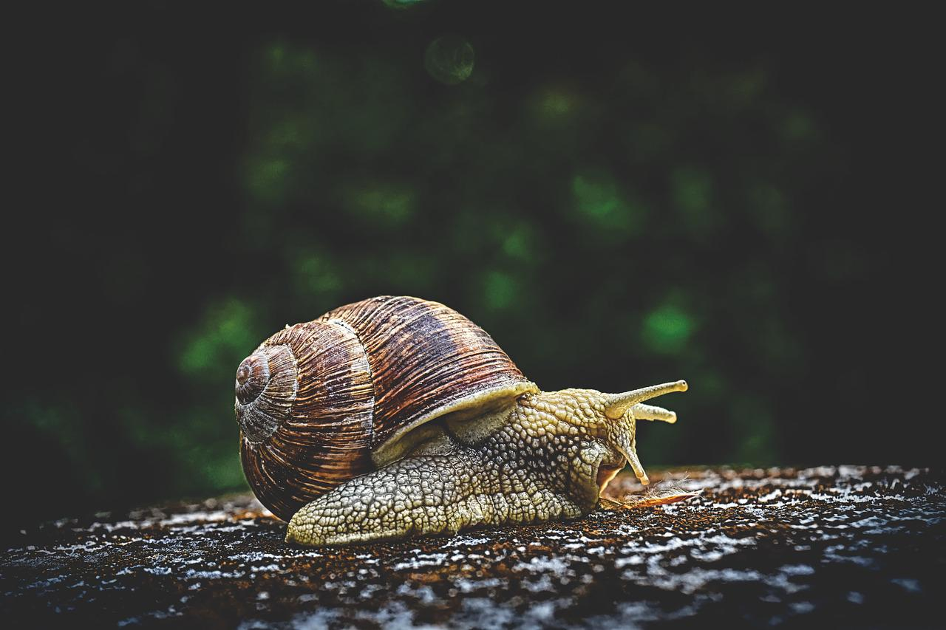
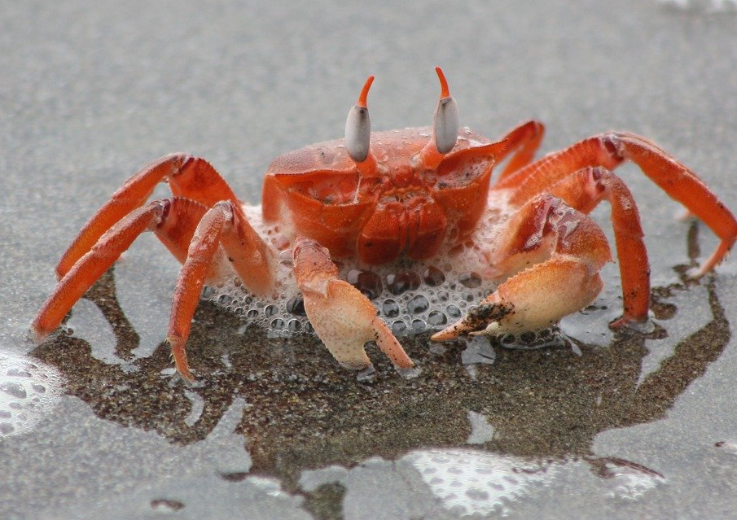
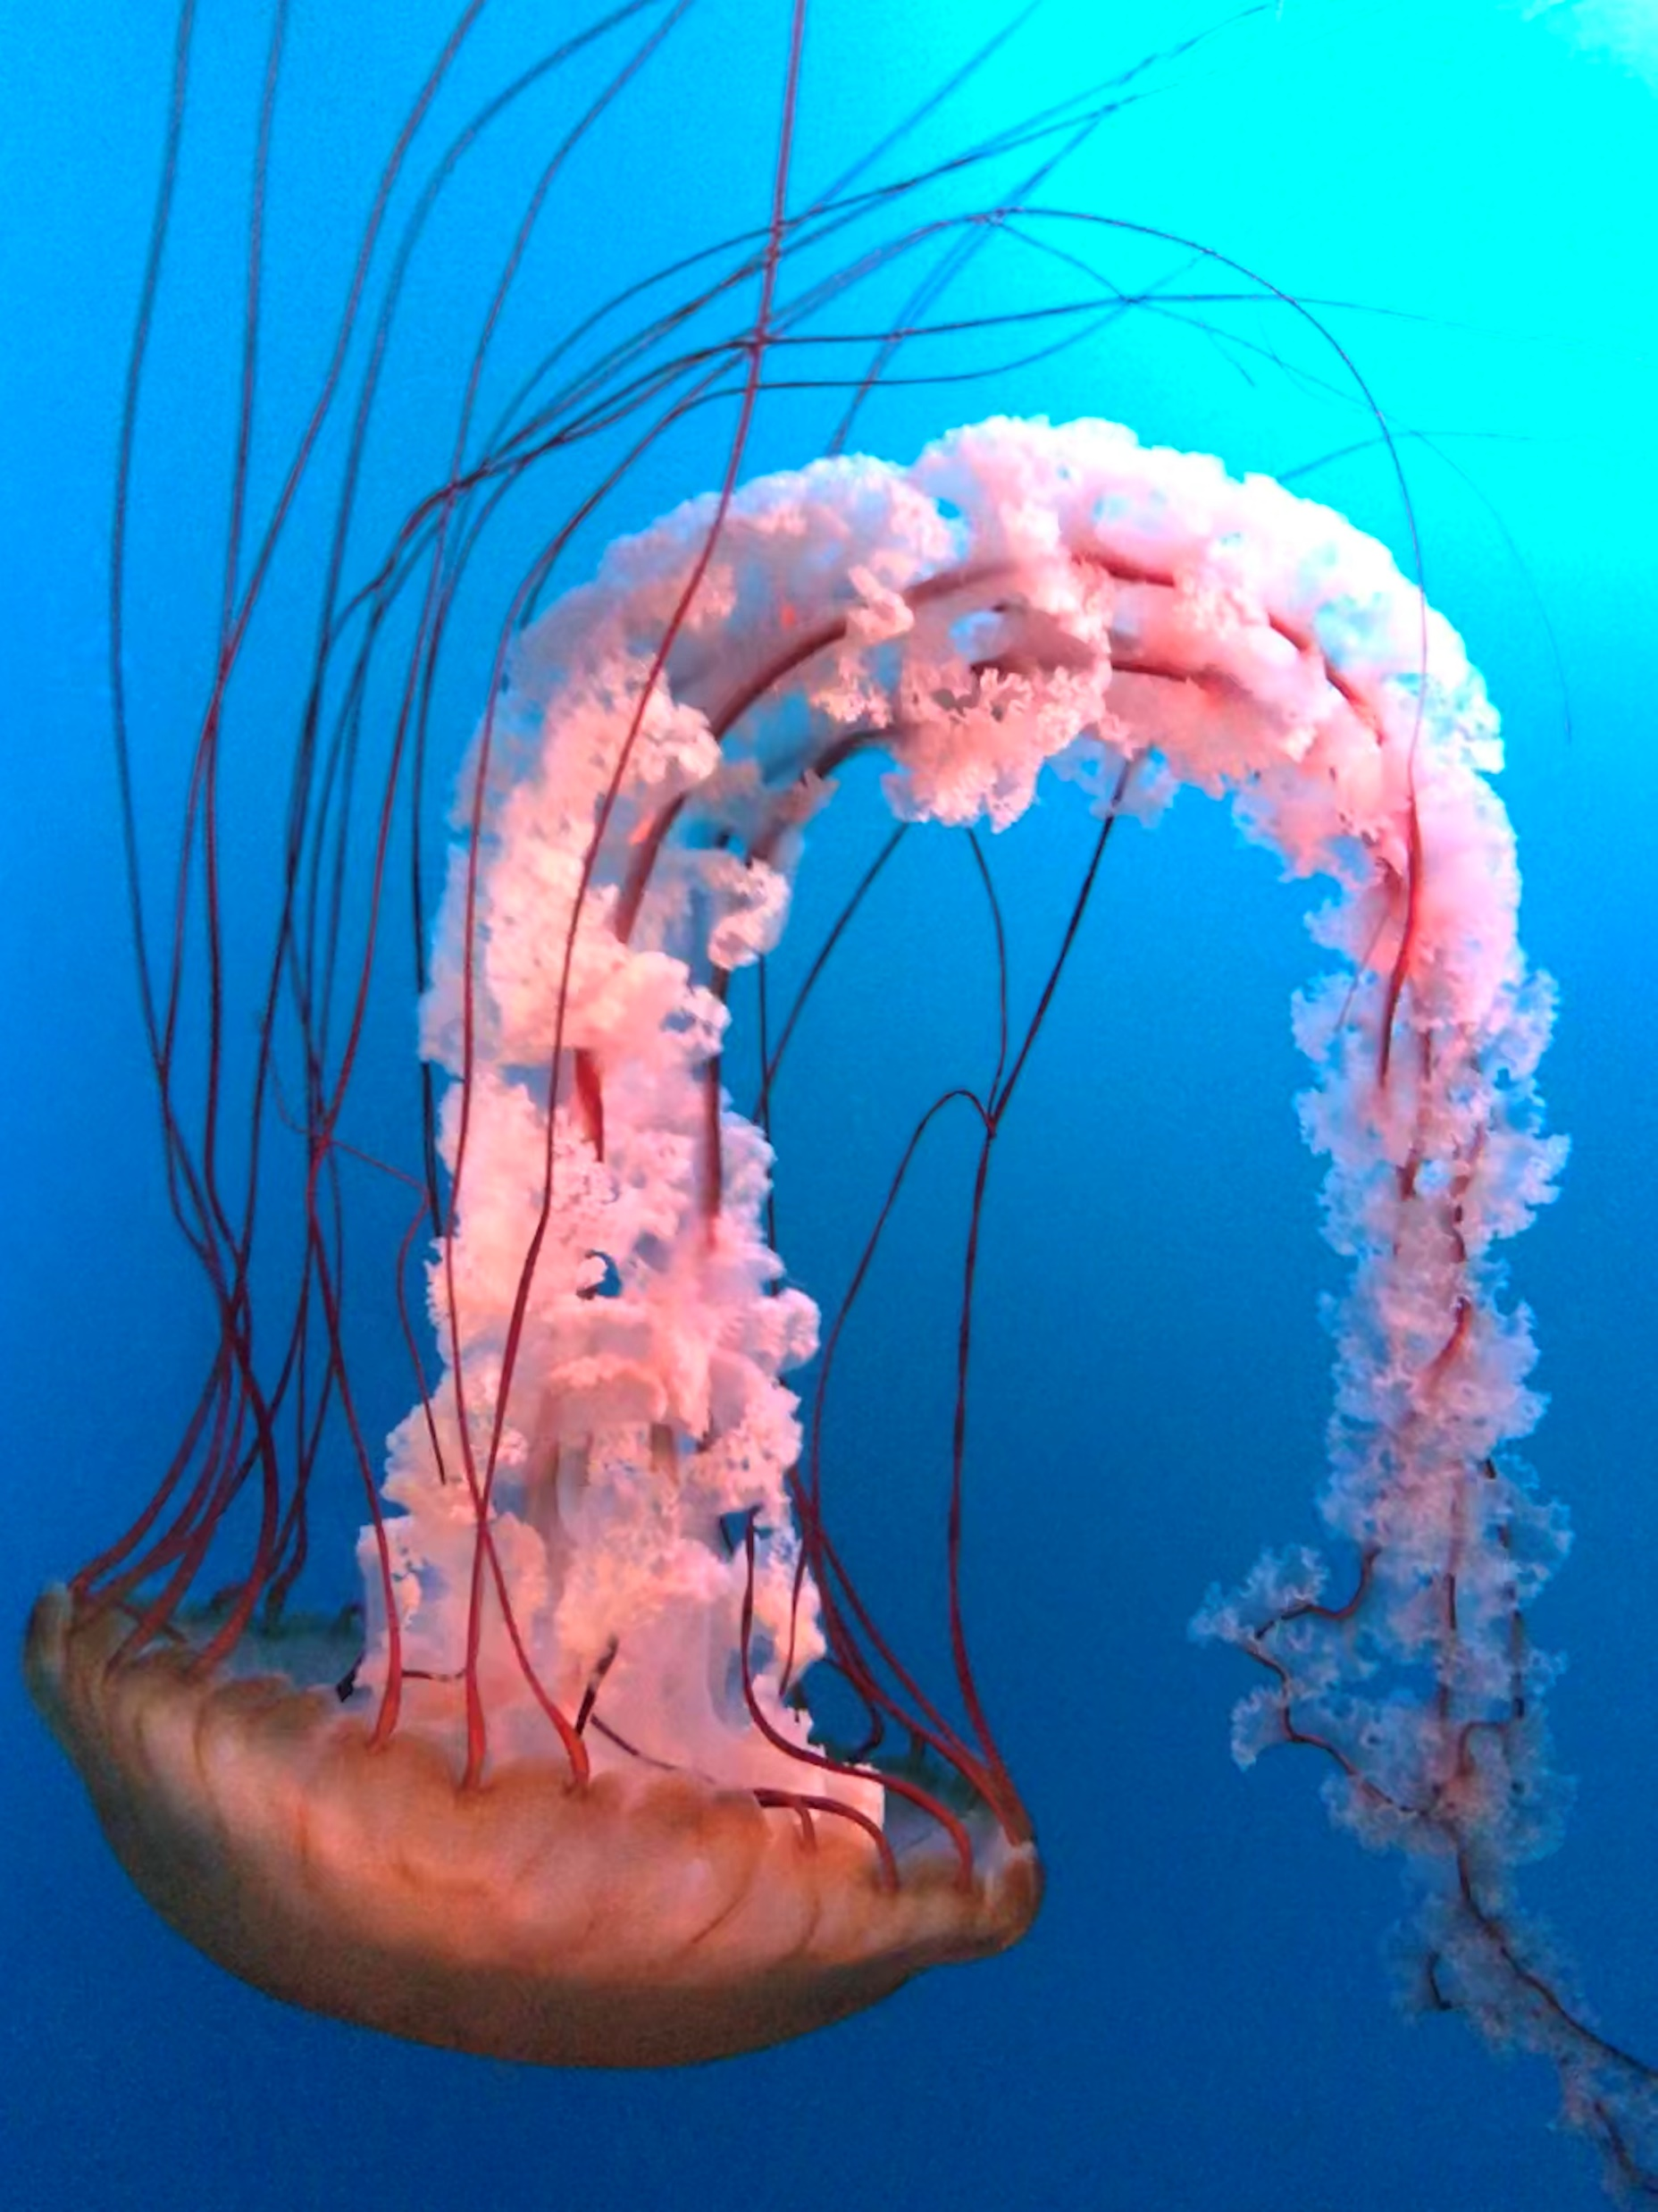
Classifying Organisms
Classification describes how we can sort all organisms (living things) into groups.
Animals and plants belong to different groups.
Plants can be separated into two groups: flowering and nonflowering.
Animals can be separated into vertebrates and invertebrates.
Vertebrates
reptile
Vertebrates have endoskeletons (internal skeletons). Vertebrates can be placed into one of five groups: mammals, birds, fish, reptiles or amphibians.
mammal
bird
fish
amphibian
Invertebrates
worm
spider
Invertebrates do not have endoskeletons. Slugs, snails, insects, worms and spiders are all invertebrates.
Invertebrates have exoskeletons or hydrostatic skeletons.
snail
slug
Exoskeletons are hard, rigid outer coverings on the outside of the body, and can be found in crabs and beetles.
Hydrostatic skeletons are fluid-filled compartments, like those in a worm or a jellyfish.
Biodiversity
Biodiversity is all the different living things in an area.
Biodiversity is important because:
- Humans rely on biodiversity for food, medicines and other resources.
- Living things rely on each other for resources – this is called interdependence.
- It is essential for good soil health.
- It is good for our mental well-being.
Biodiversity is threatened by humans. We remove habitats, cause climate change, hunt animals and reduce biodiversity using some agricultural practices.
Biology | Year 4 – Autumn | Knowledge Organiser
Attribution – "Free flowing jellyfish" (CC BY 4.0) by J young8 on Wikimedia
Notes:
Slug (CC0) - https://pixabay.com/zh/photos/slug-grass-meadow-nature-green-4464126/
Snail (CC0) - https://pixabay.com/fr/photos/escargot-coquille-mollusque-3705324/
Worm (CC0) - https://pixabay.com/photos/worm-earthworm-ringworm-belt-worm-4763219/
Spider (CC0) - https://pixahive.com/photo/spider-33/
Crab (CC0) - https://pixabay.com/fr/photos/crabe-plage-oc%C3%A9an-mer-nature-4887835/
Frog (CC0) - https://pixabay.com/fr/photos/la-grenouille-animal-faune-rainette-69813/
Fish(CC0)- https://pixabay.com/photos/fish-water-sea-clown-fish-water-2241634/
People and dog (CC0)- https://pixabay.com/photos/man-woman-couple-walking-two-3687274/
Penguin (CC0) - https://pixabay.com/zh/photos/penguin-avian-bird-wildlife-1867414/
Jellyfish (CC BY 4.0) - https://commons.wikimedia.org/wiki/File:Free_flowing_jellyfish.jpg
Crocodile (CC0) - https://www.pexels.com/photo/a-big-scary-crocodile-lying-on-brown-soil-7164076/

