Slide 1
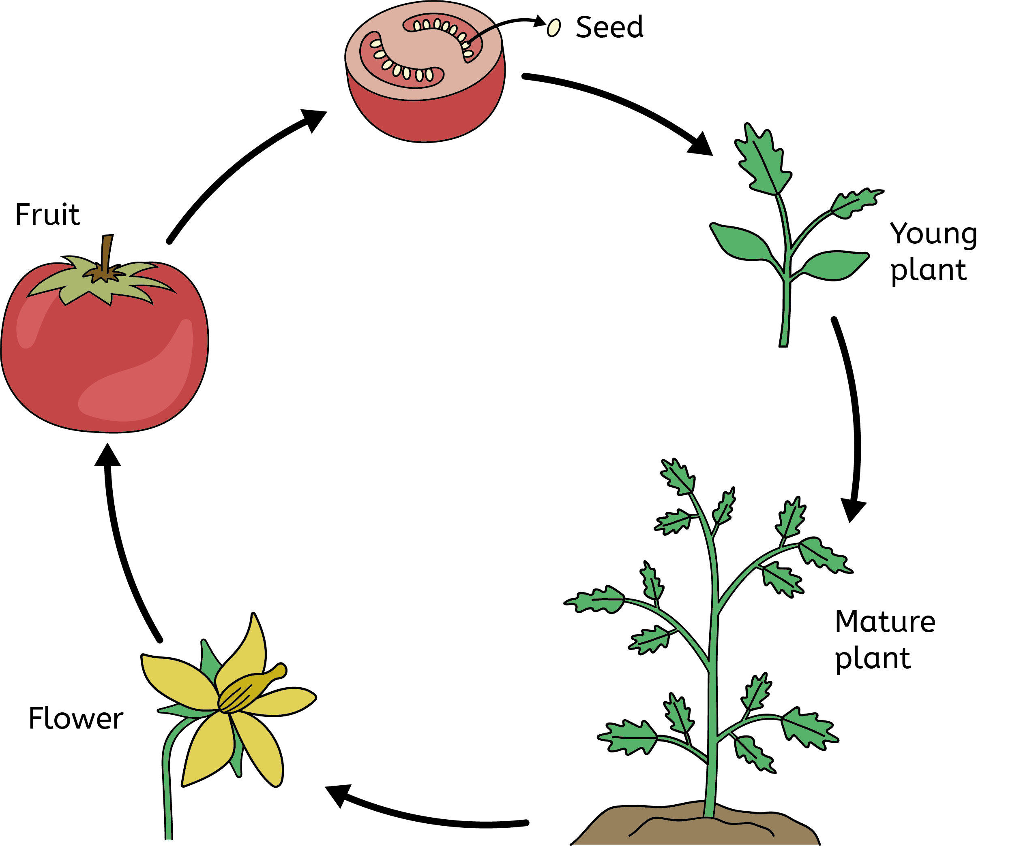
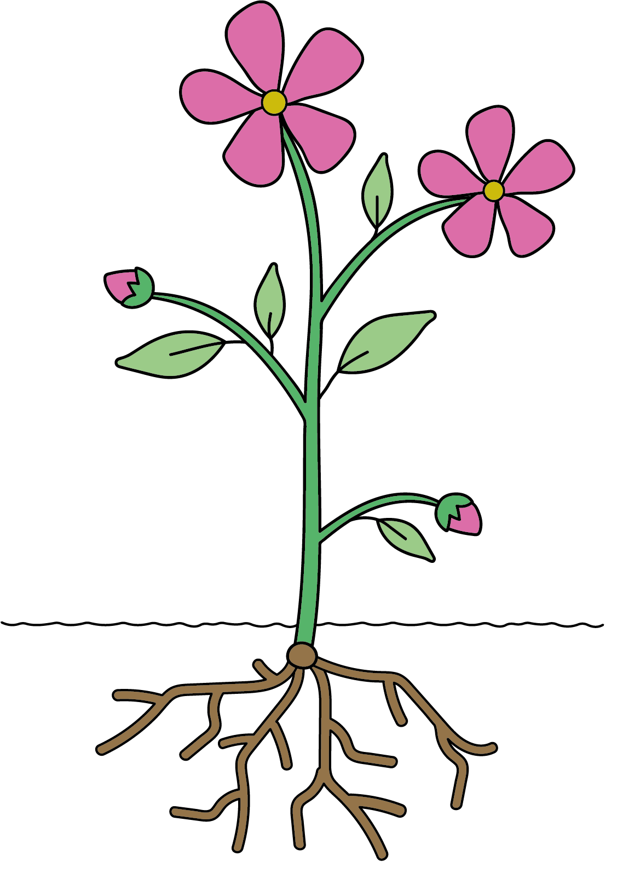
Plants
What do plants need to stay healthy and grow?
Plant life cycle
Plants need oxygen, carbon dioxide, water, light, nutrients from the soil, space, and a suitable temperature to grow.
Different plants have different requirements. This depends on the environment they live in.
A plant’s life cycle has germination, growth, and reproduction (pollination, fertilisation and seed dispersal).
Pollination and fertilisation usually take place in flowers.
Seeds can be dispersed by wind, by animals (attached to animal fur), or seeds can be self-propelled.
Seed dispersal is important to make sure there is enough space, water and other things for the seeds to germinate and plants to grow.
Leaves use sunlight, carbon dioxide from the air and water to make their own food.
The stem/trunk supports the plant. The xylem transports water and nutrients from the roots, and the phloem transports food from the leaves to the all parts of the plant.
Key vocabulary
fertilisation (noun): this forms a seed in a plant.
germination (noun): the process of a plant developing from a seed.
pollination (noun): the process of pollen from one flower being transferred to another.
dispersal (noun): The process of spreading out. In this case, the process of seeds being spread out by animals and wind.
Roots absorb nutrients from the soil and help anchor the plant.
Biology | Year Plants – Spring Term | Knowledge Organiser
Notes:
All images – United Learning

