Slide 1
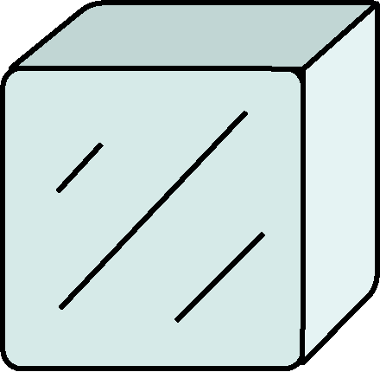

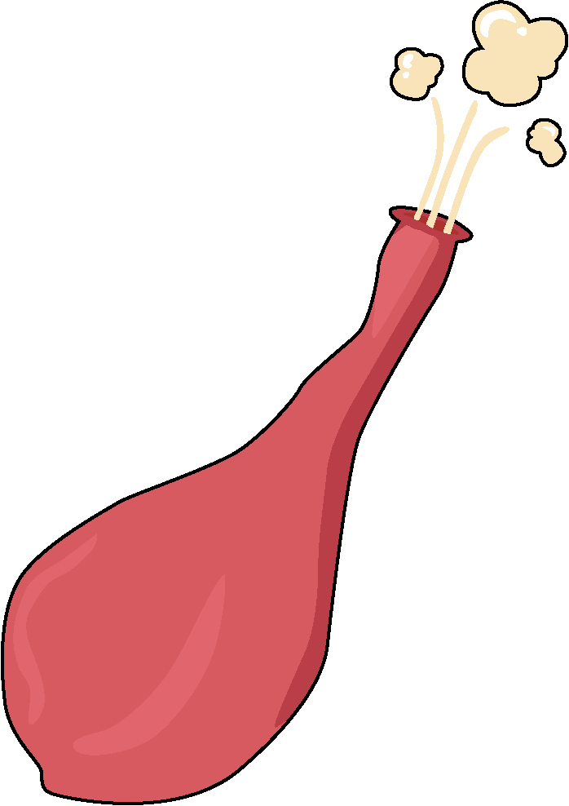


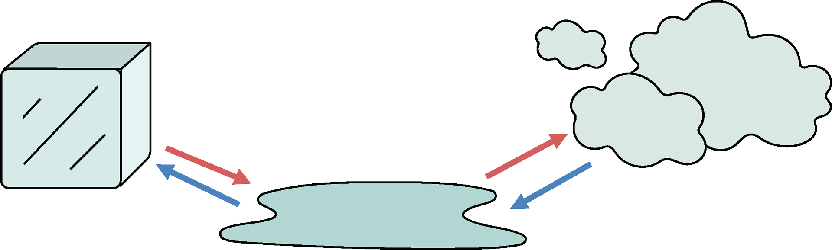
Solids, Liquids and Gases
1. The big picture
Matter is what everything is made of. Matter exists in one of three states: solids, liquids and gases.
2. Properties of Solids, Liquids and Gases
 | solids | liquids | gases
They have a fixed shape (unless pushed or pulled).
They take the shape of the container they are in.
They can flow.
They can be compressed.
3. Changing States
Substances can change from one state to another.
Water can change from a liquid to a solid. Water in a solid state is called ice.
Water can also turn into a gas. Water, when a gas, is called water vapour.
melt
water
water vapour
freeze
ice
Science | Year 2 – Summer Term | Knowledge Organiser
Notes:
All images United Learning

