Slide 1

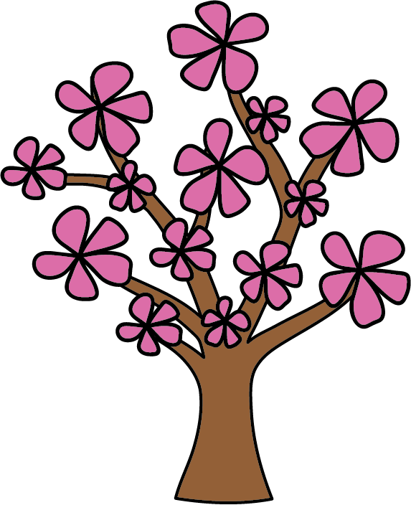
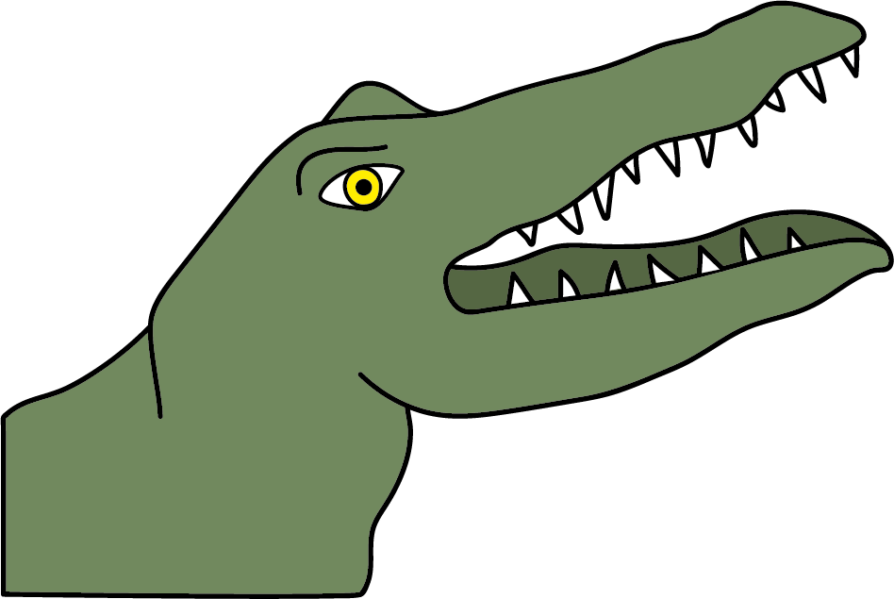
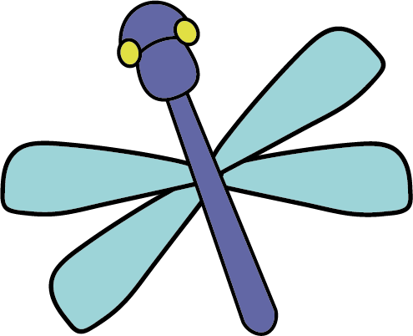
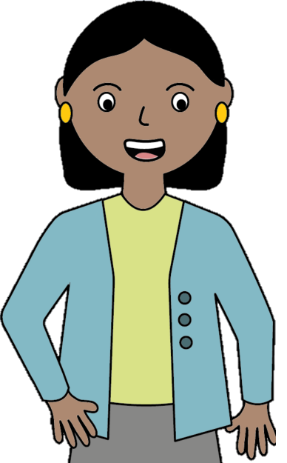
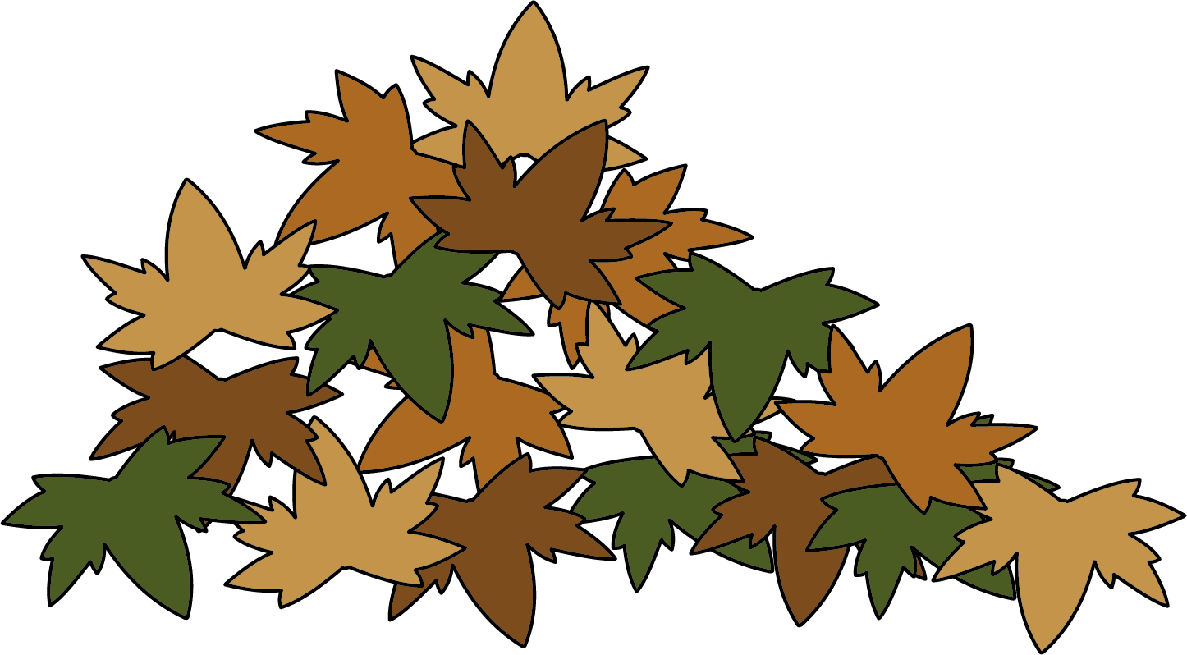
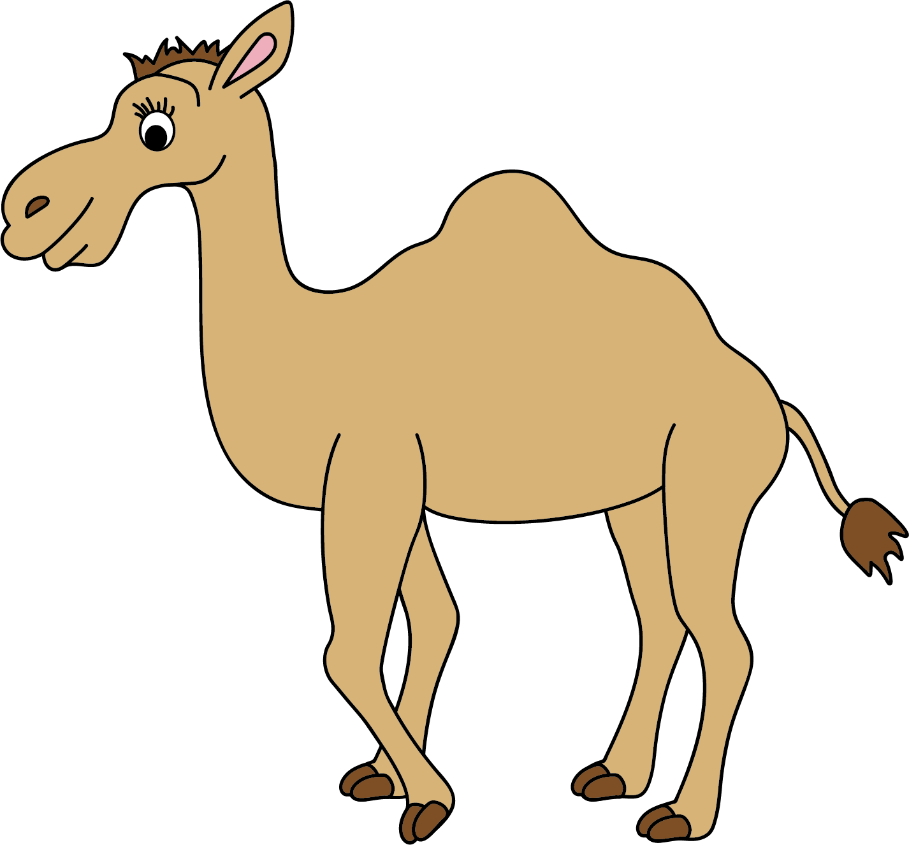
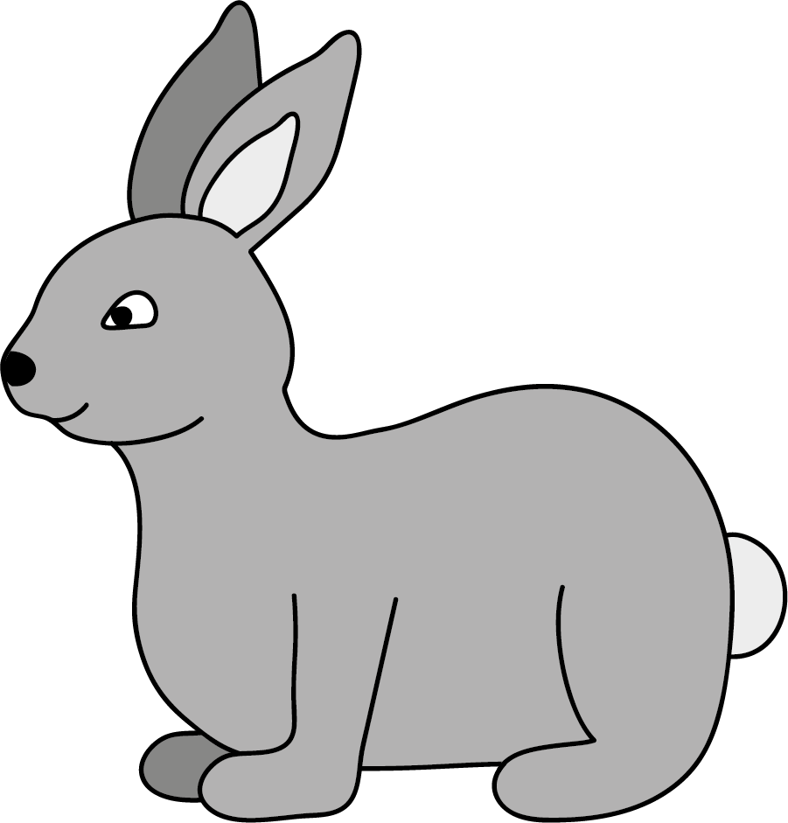
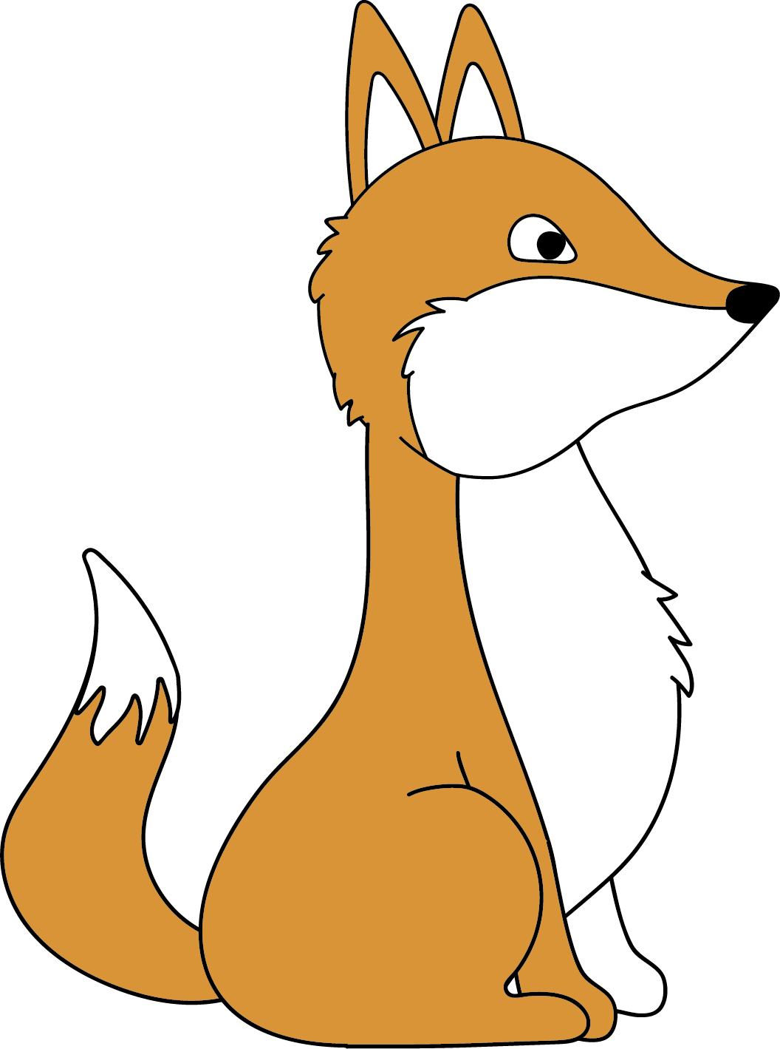
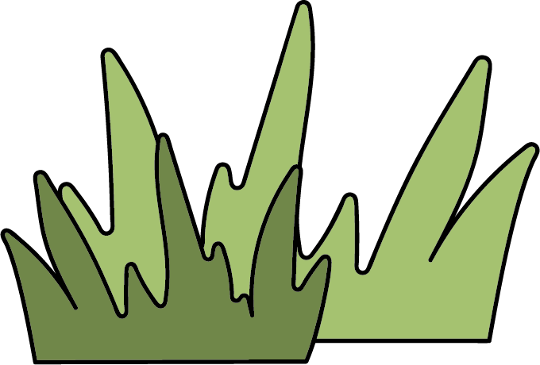
Living Things and their Habitats
1. Organisms
2. What do all organisms do?
M
R
S
G
O
W
N
They move.
They reproduce (make young, or offspring).
They are sensitive to their surroundings.
They grow (get bigger).
They need oxygen.
They get rid of waste.
They need nutrition (food).
All living things are called organisms.
All plants and animals are organisms.
3. Habitats
A habitat is a place where an organism lives, like a woodland.
4. Food
Very small habitats - called microhabitats - are found in big habitats. Leaf litter is a microhabitat in the woodland habitat.
All living things need food. Food provides energy.
Plants make their own food. They are called producers. Animals need to eat food.
A food chain shows the energy being transferred from one organism to another.
Animals are adapted to live in different environments.
Camels can live in a hot desert. They have thick skin on their feet, so they do not get burnt on the hot ground.
producer
consumer
consumer
Science | Year 2 – Spring Term | Knowledge Organiser
Notes:
All images – United Learning

