Slide 1
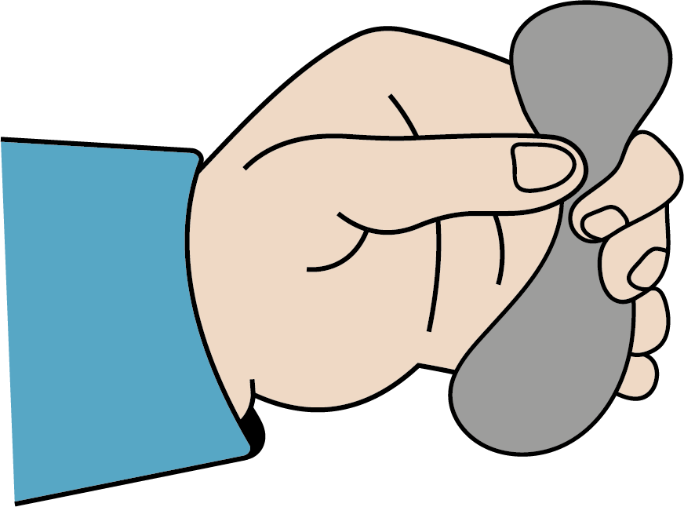
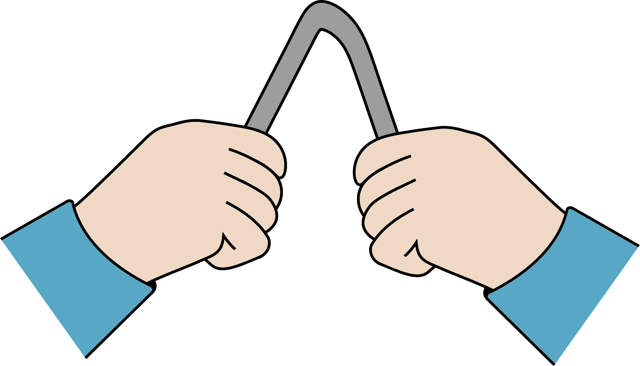
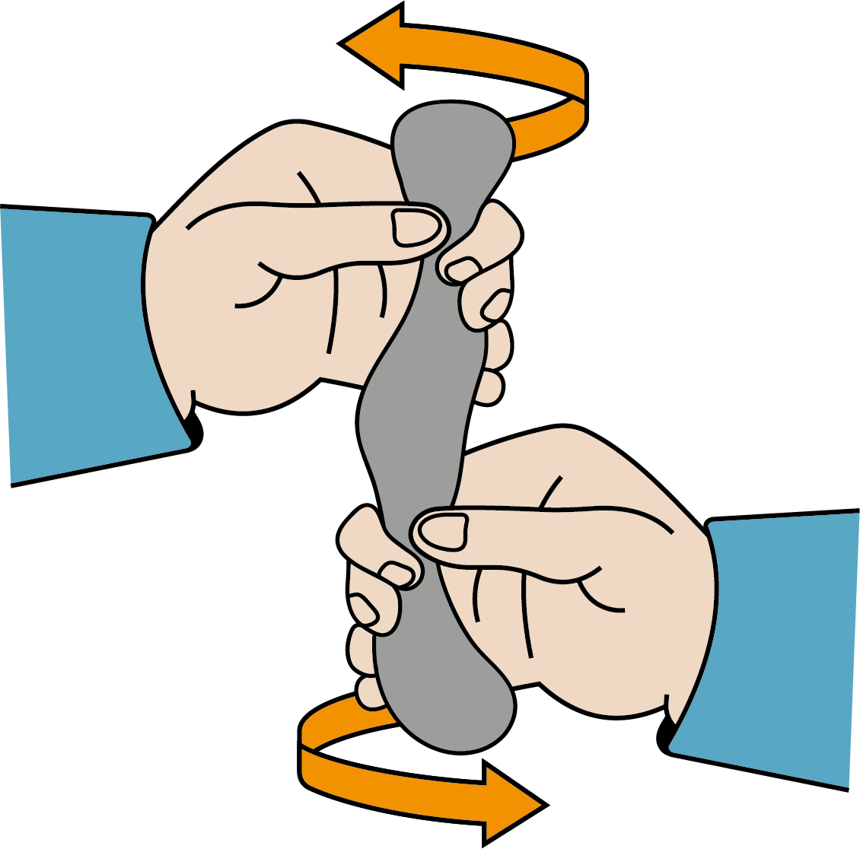
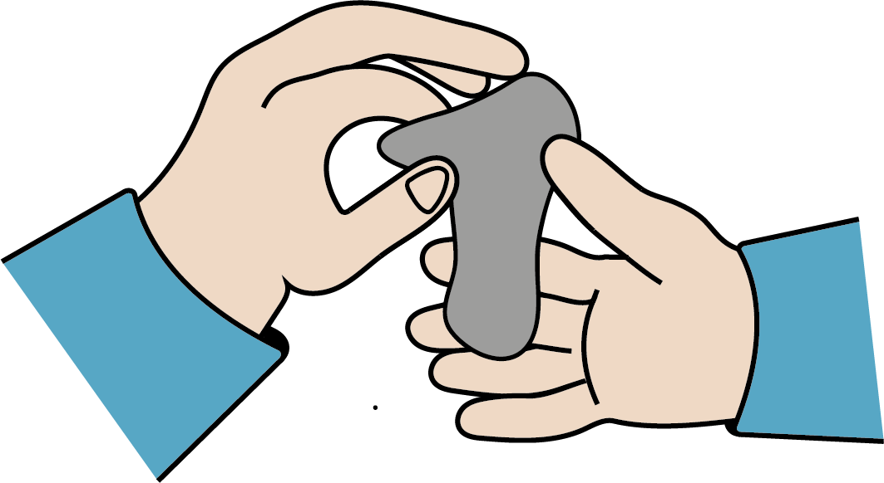
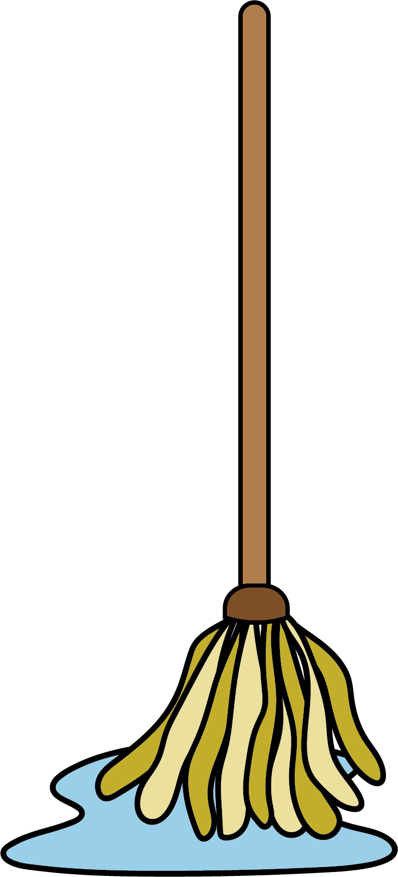
Uses of everyday materials
Some materials can change shape
Physical properties of everyday materials
Materials like wood, plastic, metal, brick, paper and carboard have different physical properties.
absorbent: a material that soaks up liquid
heatproof: a material that does not allow heat through
malleable: a material that is easy to shape
waterproof: a material that does not allow water through
windproof: a material that does not allow wind through
they can be squashed
they can be bent
they can be twisted
they can be stretched
Using materials to make objects
Some objects are made from one type of material, but other objects are made from a combination of materials.
Different parts of the object need different properties, and using two materials solves this problem.
The handle of this mop is made from wood; it is hard and you can push it along the floor.
The head is made from an absorbent material.
Science | Year 2 – Spring Term | Knowledge Organiser
Notes:
All images – United Learning

