Slide 1
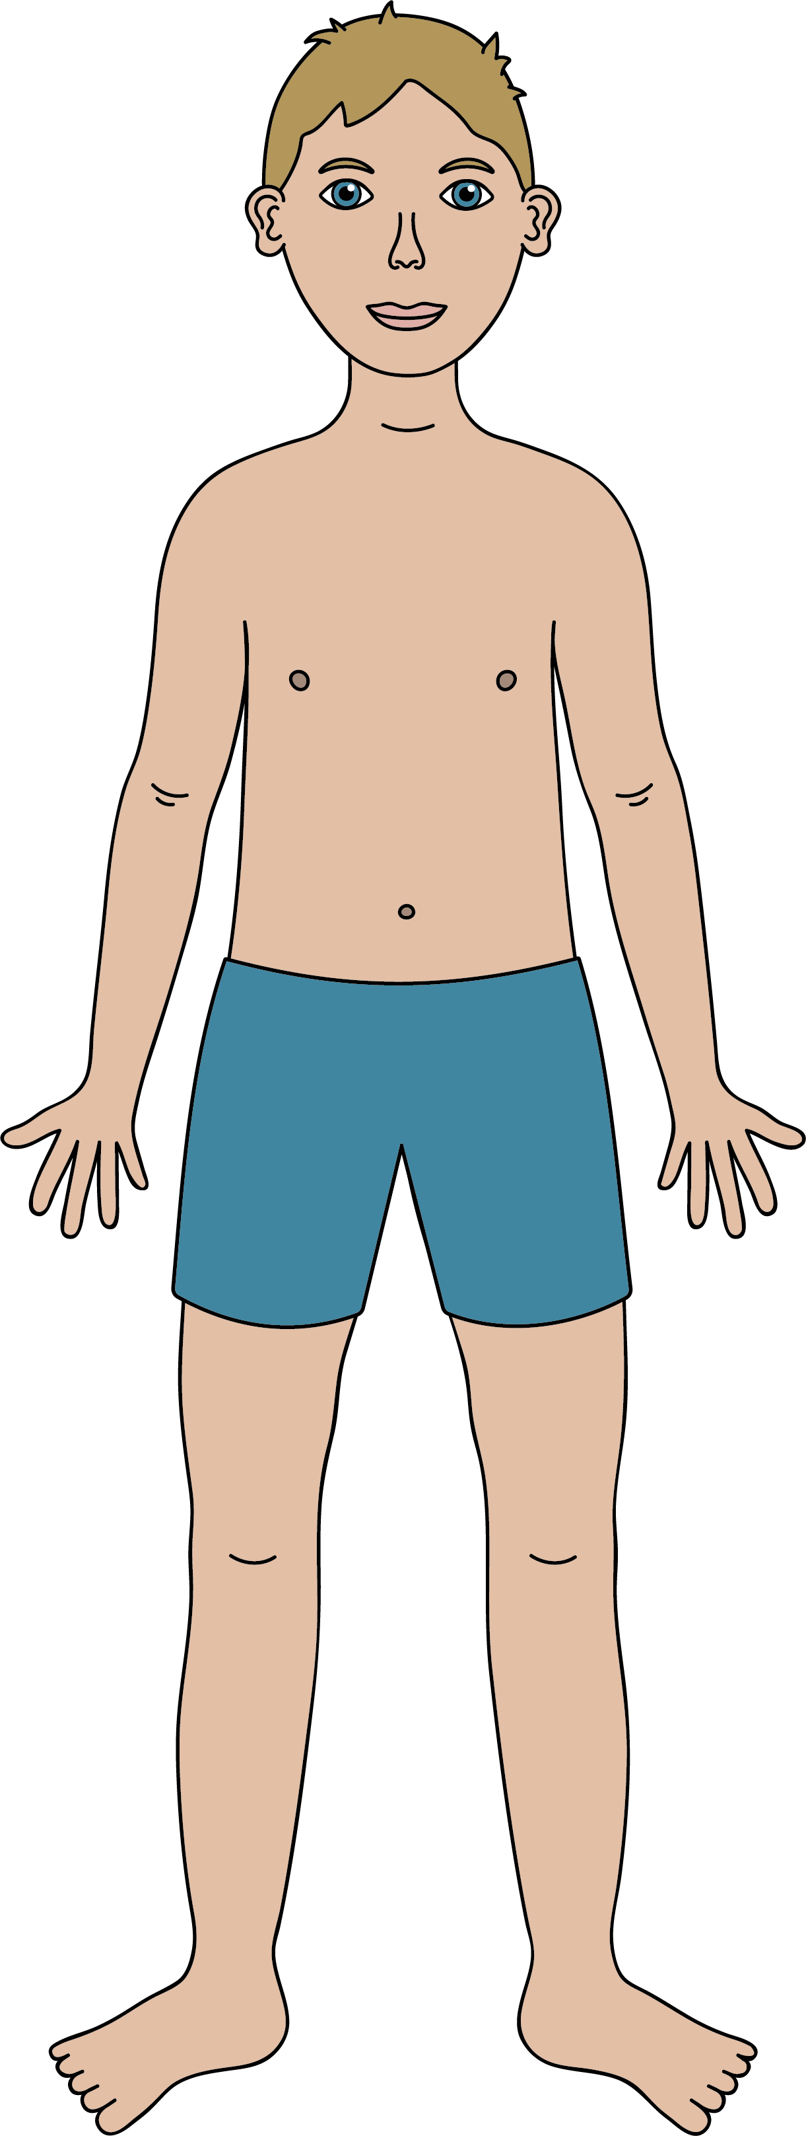





Humans
Parts of the Human Body
head
eyes
face
neck
shoulder
ears
elbow
nose
arm
finger
mouth
hand
knee
What do humans eat?
leg
Humans are omnivores, which means they can eat plants and animals.
Some humans choose to eat only plants.
foot
toe
The Five Senses
Humans have five senses: smell, taste, touch, sight and hearing.
We see with our eyes.
We smell with our nose.
We taste with our tongue.
We hear with our ears.
We sense touch with our skin.
Science | Year 1 – Humans | Knowledge Organiser
Notes:
All images – United Learning

