Slide 1
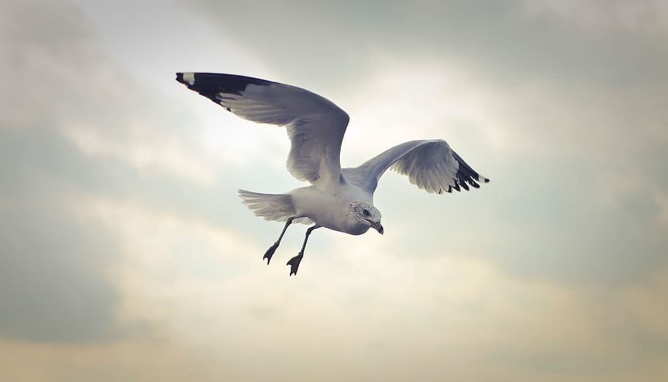
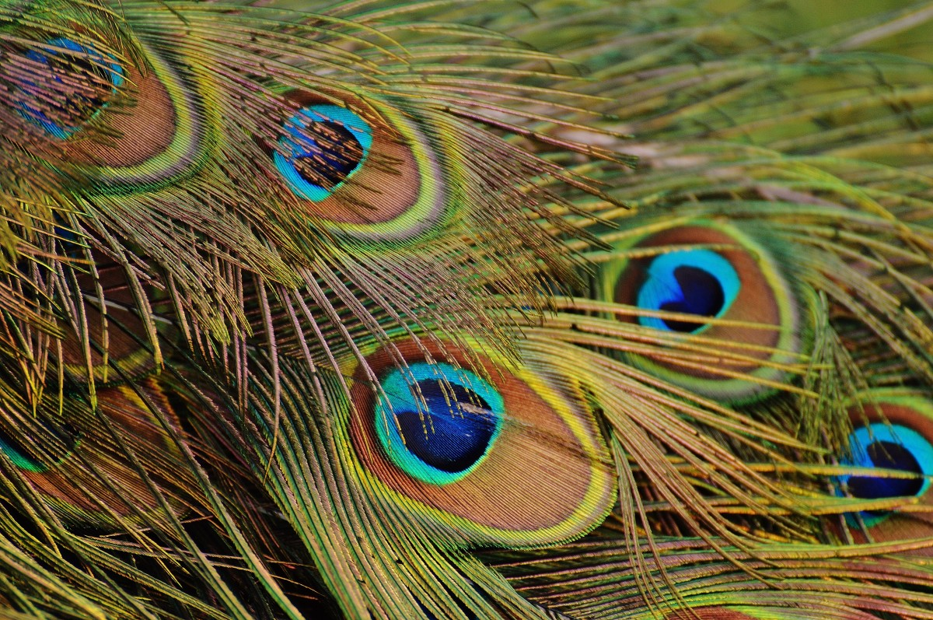
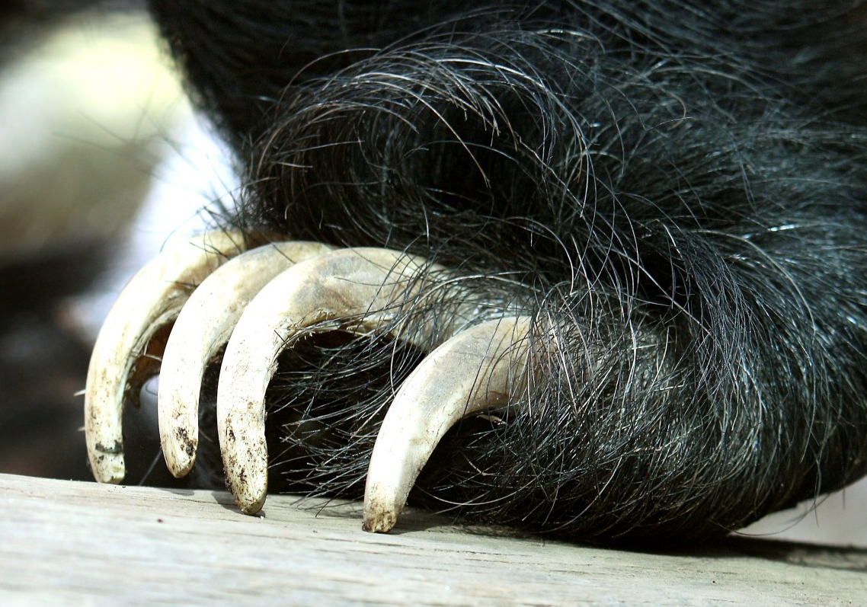
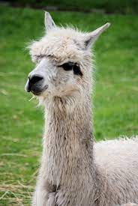
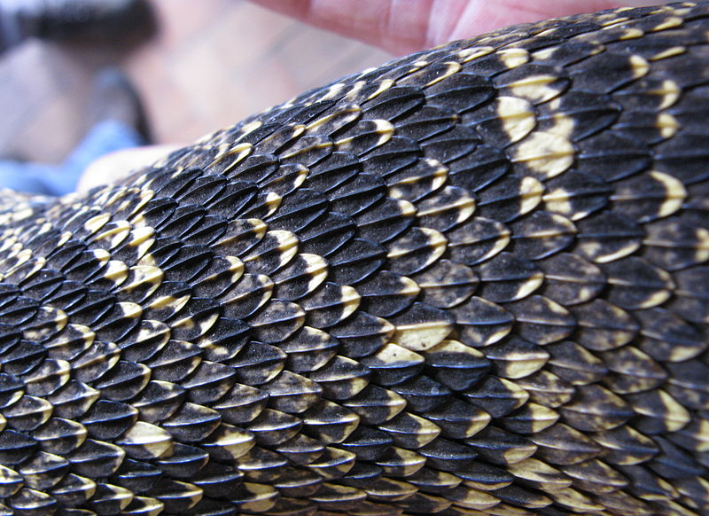
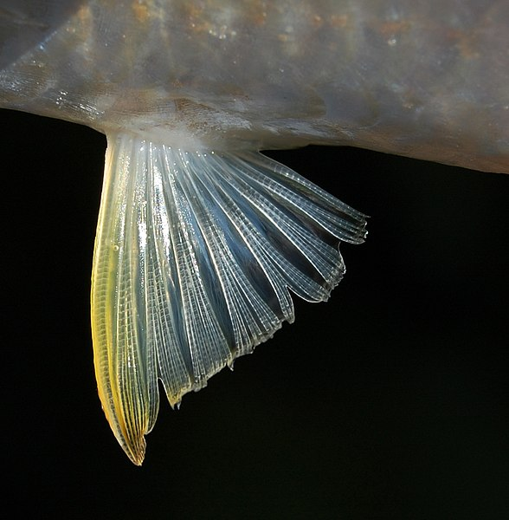
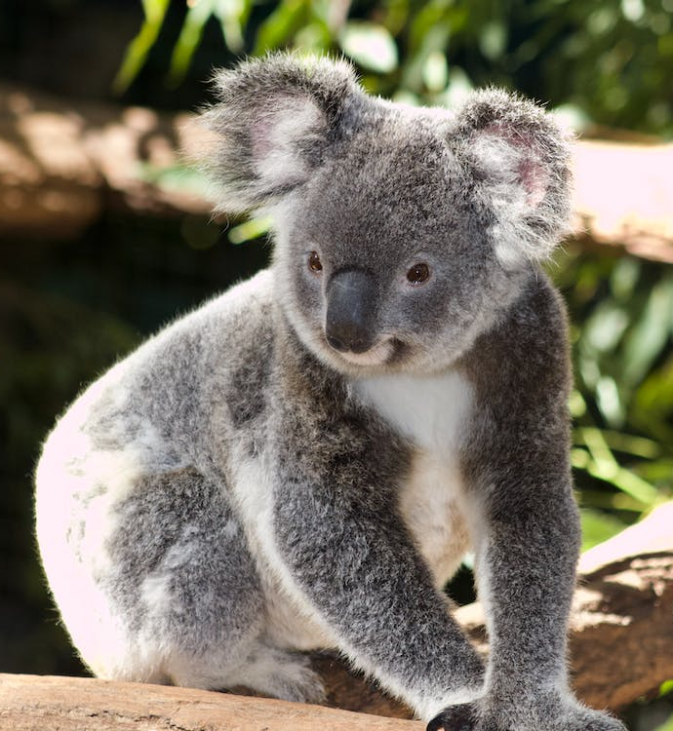
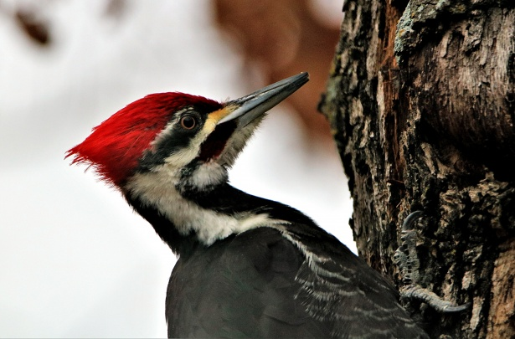
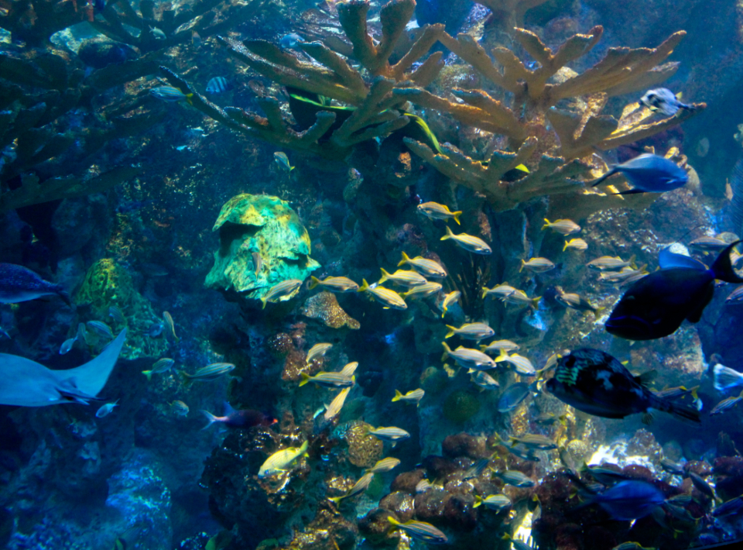
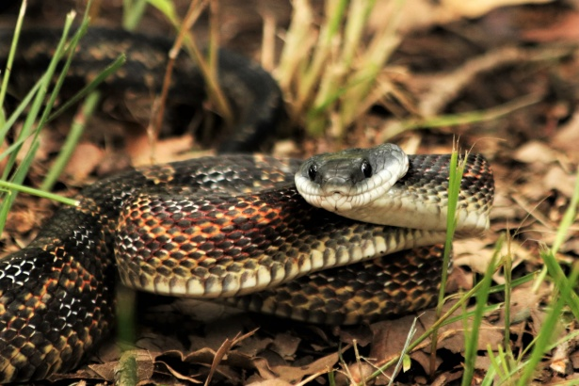
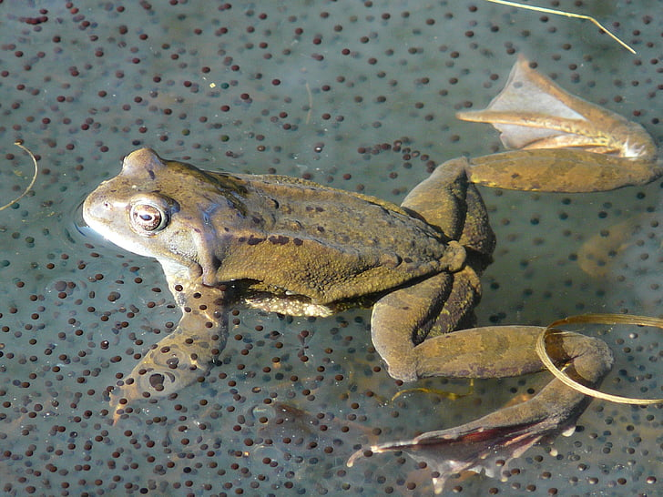
Animals
Features
Animals have many different features. Some have wings and feathers, others have paws and claws, some have fur, and some have scales and fins.
wings
feathers
claws
hair
scales
fins
Groups
Animals belong to one of 5 different groups: mammals, birds, fish, reptiles and amphibians.
mammal
bird
fish
reptile
amphibian
Animals eat different foods.
Some animals only eat plants. They are called herbivores.
Some animals only eat other animals. They are called carnivores.
Some animals eat plants and animals. They are called omnivores.
Food
JonRichfield, CC BY-SA 3.0, via Wikimedia Commons
W.A. Djatmiko (Wie146), CC BY-SA 3.0, via Wikimedia Commons
Science | Year 1 – Summer Term | Knowledge Organiser
Notes:
Camel (CC0) - https://pxhere.com/en/photo/992632
Seagull (CC0) - https://p0.pxfuel.com/preview/592/719/674/sky-wildlife-wing-background.jpg
Peacock feathers (CC0) - https://pxhere.com/en/photo/810756
Claws (CC0) - https://www.publicdomainpictures.net/en/view-image.php?image=83870&picture=sloth-bear-claws
Fur (CC0) - https://pxhere.com/en/photo/961802
Scales - JonRichfield, CC BY-SA 3.0, via Wikimedia Commons
Fish fin - W.A. Djatmiko (Wie146), CC BY-SA 3.0, via Wikimedia Commons
Woodpecker (CC0) - https://www.publicdomainpictures.net/en/view-image.php?image=243213&picture=pileated-woodpecker-close-up
Fish (CC0) - https://stocksnap.io/photo/tropical-fish-YJ3ZPYNTH0
Snake (CC0) - https://www.publicdomainpictures.net/en/view-image.php?image=293792&picture=chicken-snake-close-up-2
Koala (CC0) - https://www.pexels.com/photo/close-up-photo-of-grey-koala-bear-2590768/
Frogspawn (CC0) - https://www.hippopx.com/en/query?q=spawn

