Slide 1


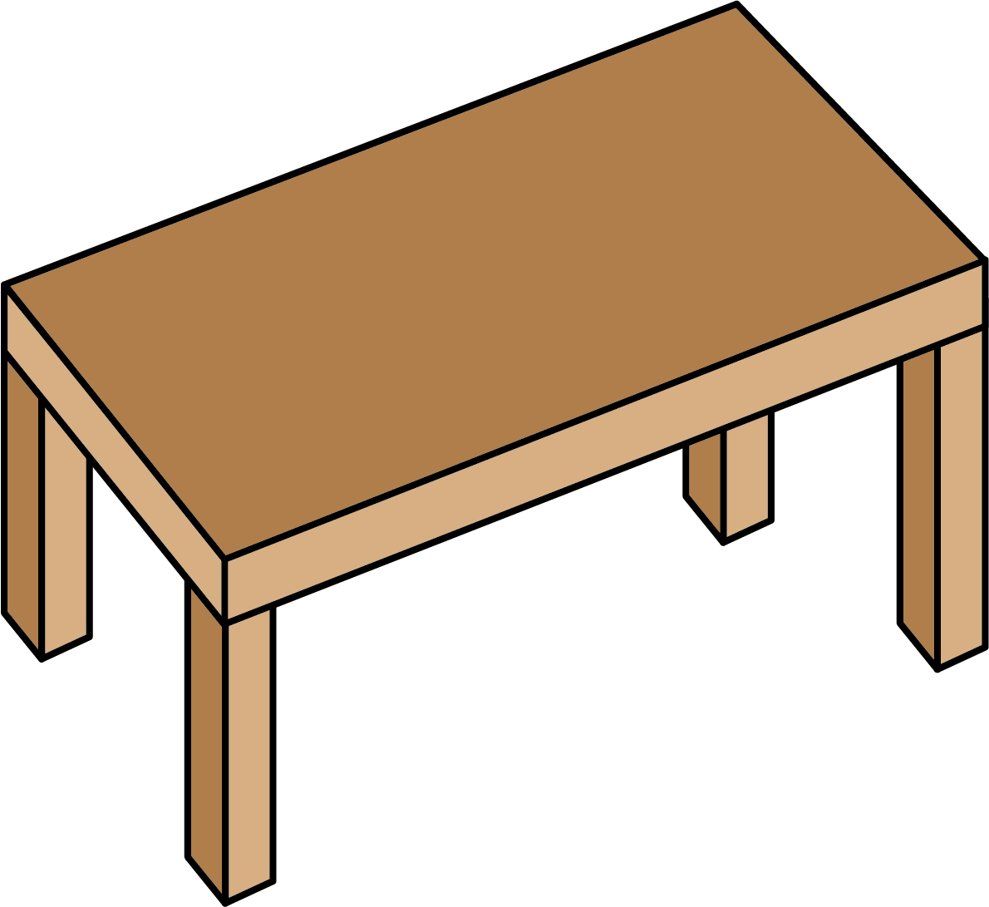
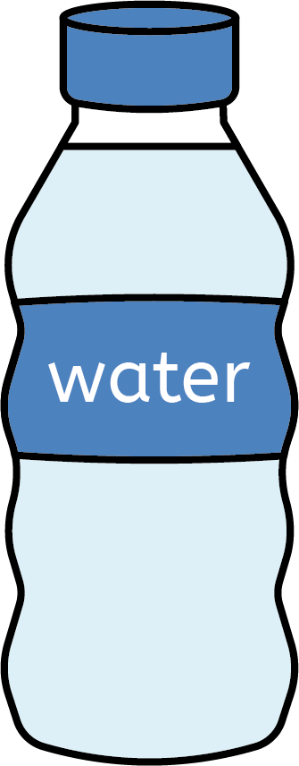
Everyday materials
Physical properties of materials
Objects and their purpose
dull: something that is not clear, bright or shiny.
hard: describes something that is firm. If you push it, it will not change shape.
rough: describes something that feels bumpy to touch.
shiny: describes something that appears bright because it reflects light.
soft: describes something that is not firm, that you can push your fingers into.
smooth: describes something that does not feel bumpy to touch, fingers slide easily over it.
An object is something that can be seen or touched.
An object’s purpose is what we use it for.
Object: spoon
Purpose: to eat with
Object: hat
Purpose: keep head warm
Materials
Objects can be made of different materials.
Object: table
Material: wood
Object: bottle
Material: plastic
Materials can be natural or man-made (humans made them):
Natural materials:
metal
wood
cotton
rubber
Man-made materials:
paper
plastic
glass
Science | Year 1 – Spring Term | Knowledge Organiser
Notes:
All images – United Learning

