Slide 1





Welcome to Year 1!
Launde Primary School
Notes:
Heather

Slide 2




The Year 1 Team
Miss Stewart
Mrs Pyne
Miss Johnson
Miss Cox
Mrs Spencer
Notes:
Heather

Slide 3


Working Together
We hope your child is excited to join us in Year One!
Your child’s wellbeing is our first priority and we want to ensure that they feel happy and safe coming back to school after the summer holidays.
We are here to support you and your child. You are always welcome to speak with us.
Notes:
Heather

Slide 4
At Launde we create Curious Minds, Kind Hearts, Bright Futures
Notes:
Heather

Slide 5





Our School Values
Respect
Confidence
Kindness
Curiosity
Resilience
Notes:
Heather

Slide 6

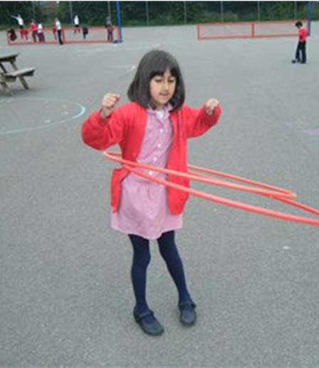
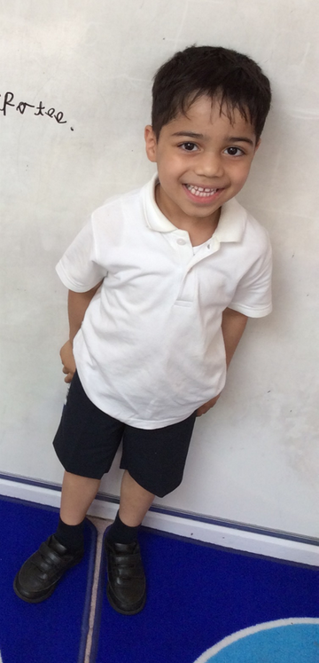
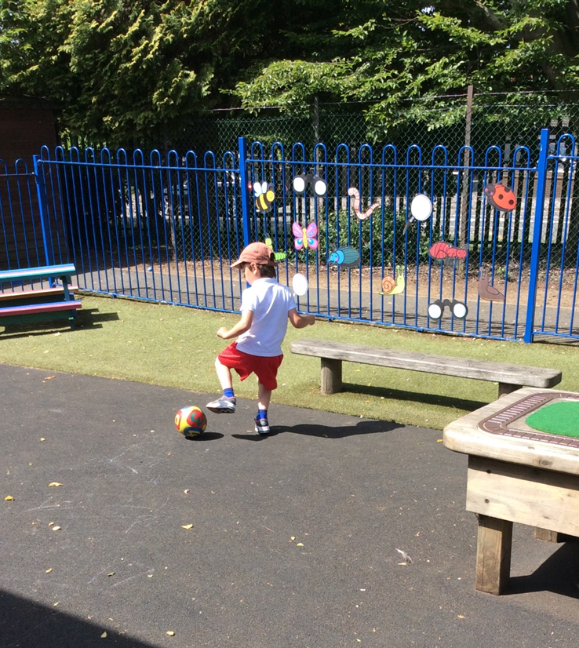
School Uniform
Tops: white polo shirt, red jumper/cardigan
Bottoms: black or grey trousers/shorts
Shoes: black school shoes or plain black trainers
Summer dresses: red gingham
Shoulder length hair should be tied up.
For PE, children should wear:
  black (or red) jogging bottoms or shorts
  white (or red) t-shirts
  white or black trainers
On PE days, earrings should either not be worn or be covered with tape. Religious jewellery should be covered with a sweatband.
Notes:
Eleanor

Slide 7



Outdoors
As in EYFS, we will always try to get children outdoors during the school day, so please ensure that your child is appropriately dressed for the weather. Please ensure any additional items of clothing are named.
Children should bring in their book bag and a named water bottle every day.
Notes:
Eleanor

Slide 8


A Typical Day
Children should arrive at school at 8:40am. The gates close at 8:45am.
Children will take part in daily:
  phonics lessons
  writing lessons
  maths lessons
In the Autumn term, children will continue to access continuous provision to help them with the transition from EYFS.
Notes:
Lucy

Slide 9




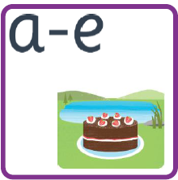
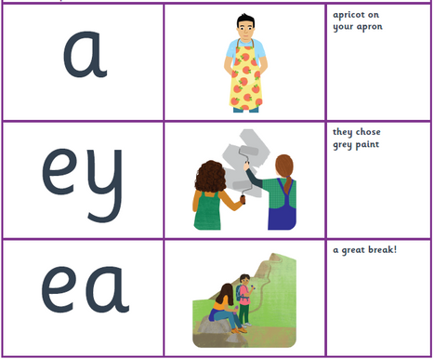
Phonics
Your child will be learning how to read using Essential Letters and Sounds. This phonics programme supports your children to develop the skills and knowledge needed for reading.
Children will start by revising phase three and phase five sounds, before learning new phase 5 sounds, including lesser known and alternative GPCs.
Notes:
Lucy

Slide 10
Reading
In Year One, we teach children to read during:
  Daily phonics lessons
  Whole class reading lessons
  1:1 reading sessions
  Whole class story time
Our writing curriculum is also book-based, so your child will have the opportunity to read and enjoy hundreds of high-quality texts during their time in Year One!
If a child is read to 1-2 times per week, they will have heard approximately 63,570 words by the time they are 5 years old.
If a child is read to every day, they will have heard approximately 296,660 words by the time they are 5 years old.
Notes:
Lucy

Slide 11


Writing
Children will build on the writing skills that they developed in EYFS during:
  Daily phonics lessons
  Daily writing lessons
  Handwriting sessions
They will have the opportunity to write a range of text types, including:
  Letters
  Stories
  Diary entries
  Descriptions
  Instructions
Notes:
Lucy

Slide 12


Maths
In daily maths lessons, children will explore:
  Place value (tens and ones)
  Addition and subtraction
  Multiplication and division
  Fractions
  2D and 3D shapes
  Measurement - including length, mass, capacity, volume, time and temperature
  Position and direction
Children will have their own Power Maths workbooks, where they will complete their maths work.
Notes:
Sarah

Slide 13




Wider Curriculum
Over the year, children will have the chance to explore a number of exciting topics in a range of subjects, including:
  History
  Geography
  Science
  Computing
  Art
  DT
  RE
  PE
  Music
Notes:
Sarah

Slide 14
Wider Curriculum
Some of our topics will include:
Our weather
How have toys changed?
How have explorers changed the world?
Digital painting
Plants
Notes:
Sarah

Slide 15

Date for your Diary
Phonics Information Event
For all EYFS and Year 1 parents
Thursday 11th September
2:45 – 3:15
Notes:
Lucy

Slide 16
Homework
Reading: 10-15 minutes of reading per night and ticked off in your child’s reading records.
Maths: 20 minutes of My Maths per week.
Wider curriculum: Knowledge organisers will be available for you to view on the school website along with revision strategies should you wish to support your child.
Notes:
Lucy

Slide 17


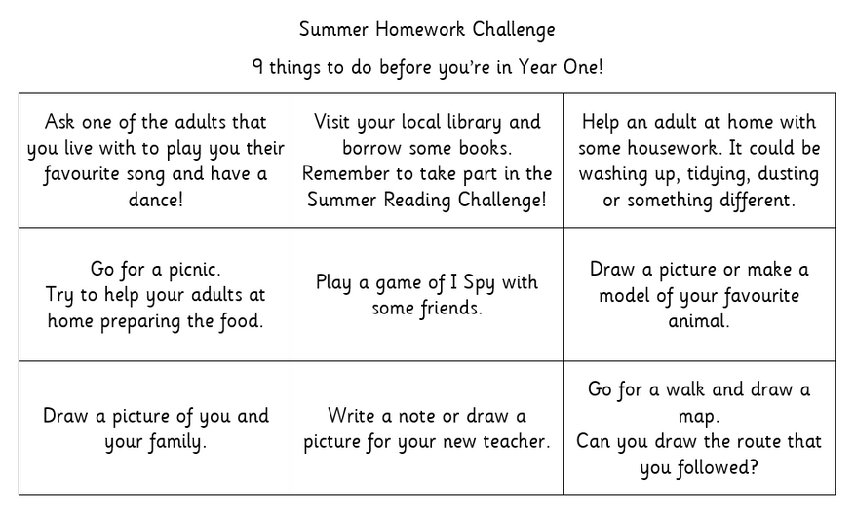

Holiday Homework
Notes:
Heather

Slide 18

Pupil Premium Offer
Notes:
Heather

