Slide 1

Welcome Afternoon
Welcome to Year 6 at Launde Primary School
2025-26

Slide 2
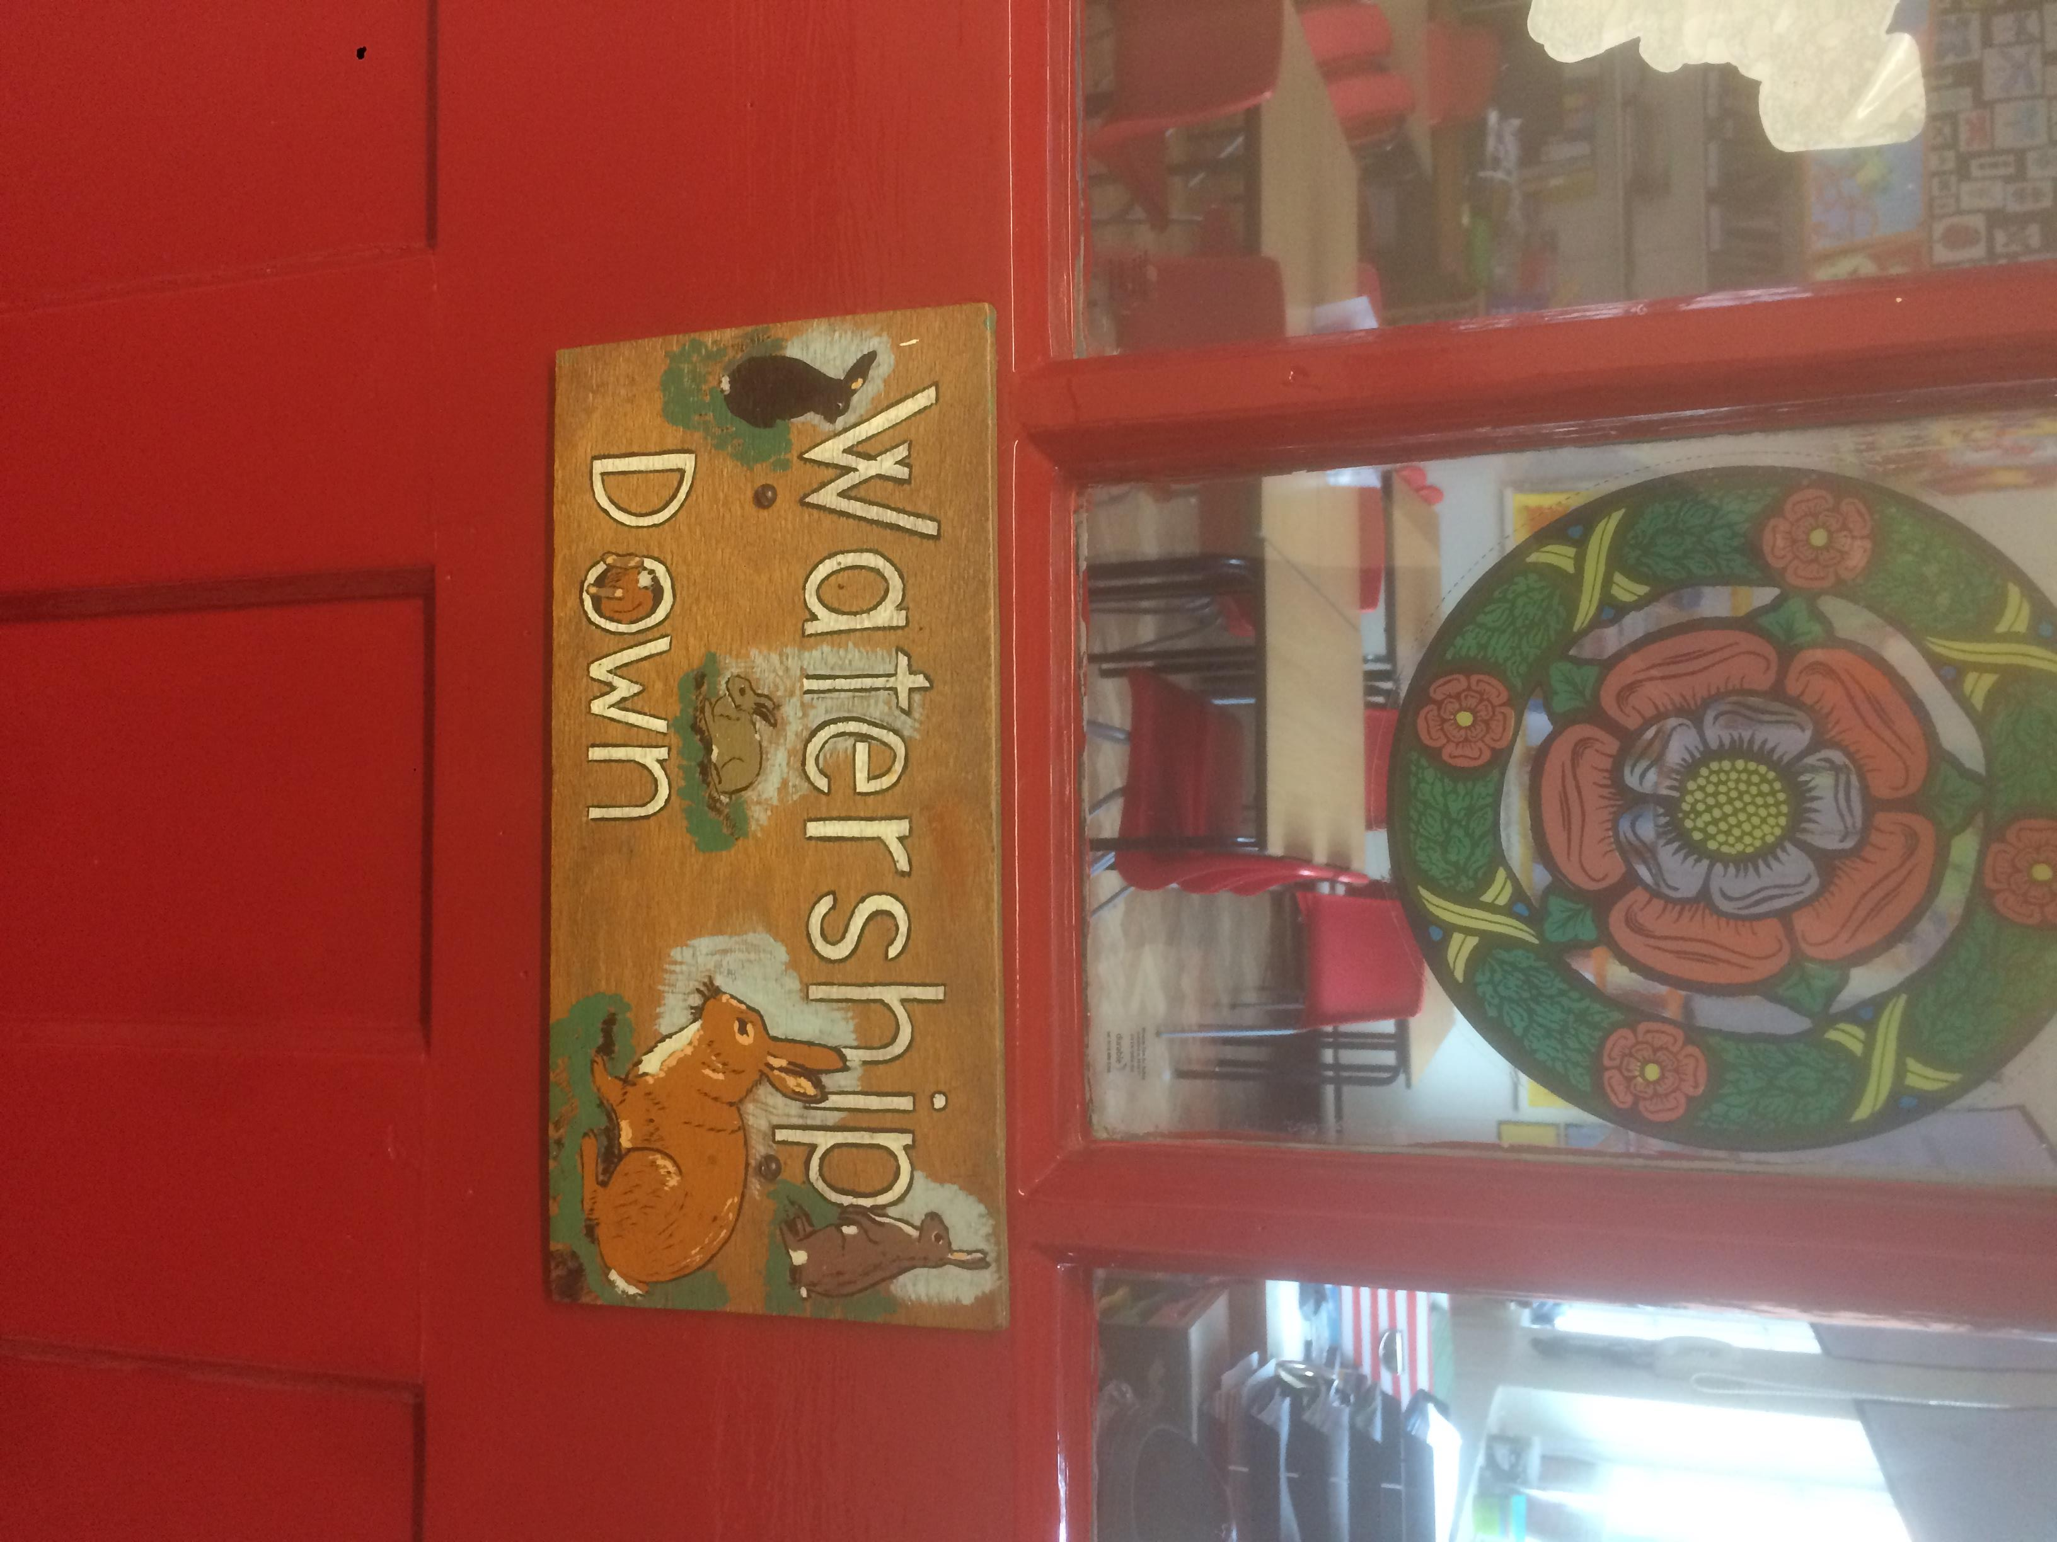
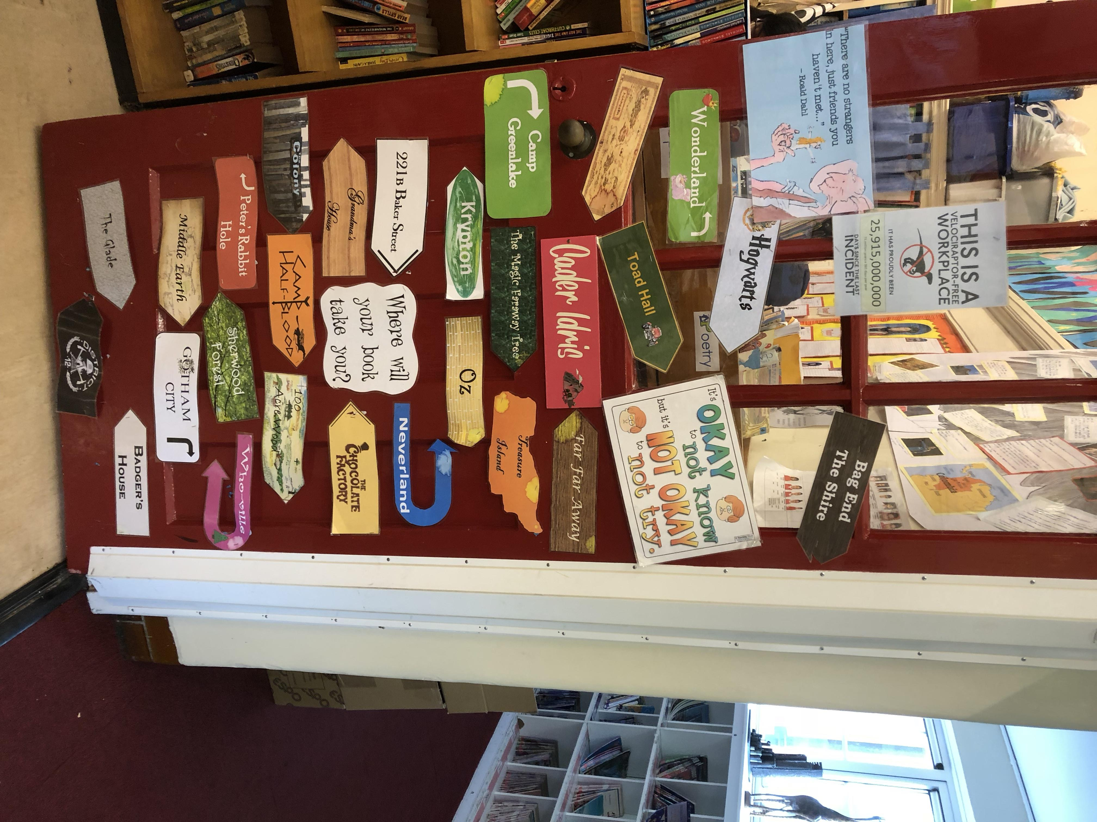
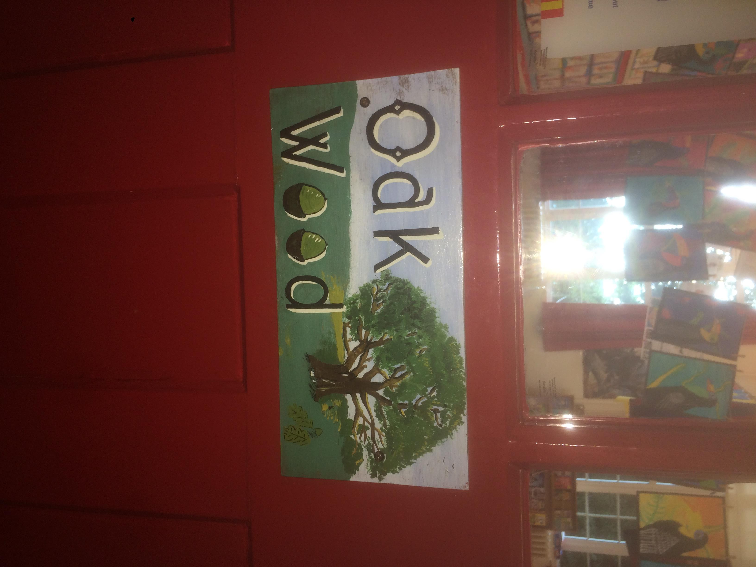
Mr Woodhead
Mr Mukadam
Miss Parker

Slide 3

Our School’s Aims
At Launde we create Curious Minds, Kind Hearts, Bright Futures
This statement reflects our commitment to nurturing compassionate individuals, fostering a love of learning and exploration and empowering our children to achieve their full potential.
The staff at Launde look forward to working alongside parents to meet this ambition.
Notes:
Sharn

Slide 4





Our School Values
Recently, our school community identified 5 values that will underpin our school culture, our interactions and empower our pupils to become well-rounded, successful individuals.
Respect
Kindness
Resilience
Curiosity
Confidence
We believe that by working together, parents and school staff can create an environment where these values are not just words, but are integral to everything we do and how we treat each other. These values will be present and discussed within every part of our school’s curriculum.
Notes:
Kindness: Our children show kindness to each other at all times.
Confidence: Our children show confidence in being themselves, to speak up for themselves, try new things and handle adversity.
Resilience: Our children embrace mistakes as learning opportunities and they stay positive in difficult situations.
Respect: Our children treat others kindly, value differences and listen to everyone’s ideas and opinions, even if this is different to their own.
Curiosity: Our children are excited by their learning and are eager to explore new ideas.

Slide 5
Ethos and expectations for the year
Linked to school values
Independence
Adaptation to different and new situations and learning – confidence and resilience
Good communication – respect and kindness
Sense of pride
Taking responsibility for own learning within and outside of school
Attendance: 96% and above
Partnership (after school is best rather than at the beginning of the day so we can give your queries the time they deserve).

Slide 6
Focus on reading
Essential for future academic success
Whole class reading lessons (comprehension skills)
Class books related to writing curriculum
Reading buddies
Celebration of books and authors through curriculum
Book week
Regular comprehension homework from January onwards.

Slide 7
Literacy
Writing curriculum in second full year, all linked to texts.
Several text types over the year:
Diary entries, persuasive letters/speech, narrative, non-chronological reports, formal/informal letters, journalistic, balanced discussion, biography and recounts.
Assessed pieces within each unit, building up to final writing grade.
Focus on KS2 spellings through writing curriculum.

Slide 8
Maths
All children will sit the same test so all children must cover the same curriculum.
Morning tasks: 5 a day and mixed arithmetic practice –questions that revisit skills
Arithmetic – speed, accuracy
Reasoning – application of skills
Through Power Maths and additional material towards statutory testing.
Support at home
Multiplication facts and number bonds (access to Times Tables Rockstar)
Checking answers (redoing solutions or using the inverse)
Pace
Formal methods

Slide 9
Curriculum
Geography and history:
What does the census tell us about our local area?
Why does population change?
What was the impact of World War Two on the people of Britain?
Where does our energy come from?
Unheard histories: Who should feature on the £10 banknote?
Can I carry out an independent fieldwork enquiry?
Art and design:
Craft and design: photo opportunities
Textiles: waistcoats
Drawing: make my voice heard
Structures: playgrounds
Sculpture and 3d: memory museums
Digital world: navigating the world
Science:
Electricity
Evolution
Further classification
Light (science week)
Functions of the human body
Physical and chemical changes.
Curriculum weeks:
Science week: based on national science week focus
Cooking and nutrition (Come dine with me)
Book week (book swap and other related activities)

Slide 10
Statutory Assessment – WB 11th May
Grammar and spelling
Reading
Arithmetic and reasoning
Results for 2024/25
Reading: 92% pass rate
Writing: 94%
Maths: 92%
Combined (achieved ARE in R, Wr & M): 86%
GD combined: 19%

Slide 11
Trips
Twycross Zoo – October
Warning Zone - November
Young Voices – January
WWII workshop – February
Visit to Leicester Cathedral - May
Pizza in the park - May
Skern Lodge – June
First aid - January

Slide 12
Homework
Reading: 10-15 minutes every evening
Times table rockstars: 20 mins per week
Presentation project – topic to be confirmed
Knowledge organisers accessible from school website to support your child with wider curriculum learning.
From January onwards:
Comprehension based activities
Weekly maths and revision packs
Grammar
Spellings and vocabulary

Slide 13
Transition to secondary
Gartree, Beauchamp and Manor – catchment schools
Apply though Leicestershire admissions online from 1st September until 31st October
Open evenings/days
Preparatory work to support the change – expectation, independence and organisation
Transition days during summer term.

Slide 14
Equipment and uniform
All items should be named clearly.
An adult shirt to be used as a painting overall;
A Launde book bag
Uniform (as per the website)
Tops: White Polo Shirt, Red Jumper/Cardigan (logo optional - from School Wear Solutions, plain red available anywhere)
Bottoms: Black or grey trousers/shorts (available anywhere), black or grey skirts or pinafore dresses
Shoes: Black school shoes or plain black trainers (including soles) – no sports logos unless the logo is all black
Summer Dresses: Red Gingham (available anywhere)

Slide 15
PE kit
PE Kit:
· black joggers/shorts
· white t-shirts
· sports trainers (white or black)
PE days to be confirmed via WEDUC closer to the beginning of the new year – please download WEDUC if you don’t already have access.

Slide 16
Equipment to be kept at home
Pair of compasses
Protractor
Set of colouring pencils
Rubber
Dictionary and thesaurus

Slide 17

Pupil Premium offer 2025-6
As a school, we want all children to be successful, empowered to learn and happy and excited to come to school. We feel strongly that school should be a place of opportunities and recognise that we can make a significant difference if we individually target the needs of children. To achieve this, we have adapted the pupil premium offer to ensure it is more personalised to provide individual support to each child.
Next year, each class will have a TA during the morning sessions to support the children in their class. In the afternoon, we plan to use these TAs to run sessions to target the needs of any child that needs support.
Should you feel that you could be eligible for free school meals then please contact the office.

Slide 18
Over the holidays…
If your child is an avid reader or you are looking for something for your child to read, may we recommend Holes by Louis Sacher or Skellig by David Almond.
Please encourage them to read over the holidays. Can be other forms of text too – current affairs.
Relax, enjoy family time, and be ready and refreshed for the new year.

