Slide 1

Welcome Afternoon
Welcome to Year 3 at Launde Primary School
2025-2026

Slide 2
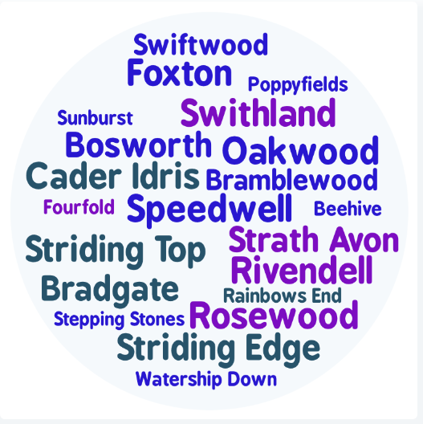
Our School’s Aims
At Launde we create Curious Minds, Kind Hearts, Bright Futures
This statement reflects our commitment to nurturing compassionate individuals, fostering a love of learning and exploration and empowering our children to achieve their full potential.
The staff at Launde look forward to working alongside parents to meet this ambition.
Notes:
Sharn

Slide 3





Our School Values
Recently, our school community identified 5 values that will underpin our school culture, our interactions and empower our pupils to become well-rounded, successful individuals.
Respect
Kindness
Resilience
Curiosity
Confidence
We believe that by working together, parents and school staff can create an environment where these values are not just words, but are integral to everything we do and how we treat each other. These values will be present and discussed within every part of our school’s curriculum.
Notes:
Kindness: Our children show kindness to each other at all times.
Confidence: Our children show confidence in being themselves, to speak up for themselves, try new things and handle adversity.
Resilience: Our children embrace mistakes as learning opportunities and they stay positive in difficult situations.
Respect: Our children treat others kindly, value differences and listen to everyone’s ideas and opinions, even if this is different to their own.
Curiosity: Our children are excited by their learning and are eager to explore new ideas.

Slide 4
Routines
School starts prompt at 8:40am. Doors will be open from 8:40am
Children line up outside the Year 3 corridor in the morning
Classes will be dismissed in the same area
Break and Lunch times
Children will need to bring their own fruit for breaktimes
Children having hot school dinners will now need to pay for their lunches- KS2 children do not have government funded free school meals

Slide 5
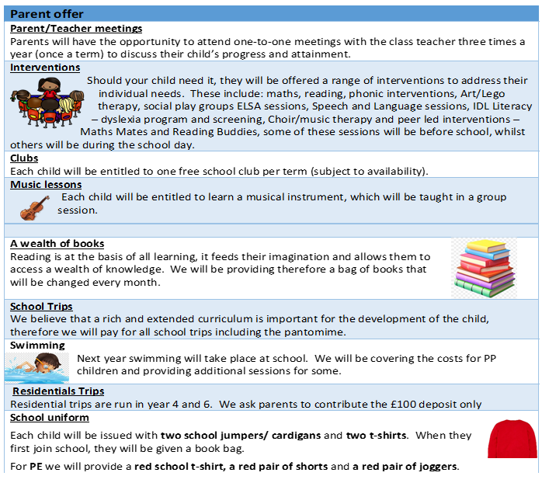
Pupil Premium offer 2025-6
As a school, we want all children to be successful, empowered to learn and happy and excited to come to school. We feel strongly that school should be a place of opportunities and recognise that we can make a significant difference if we individually target the needs of children. To achieve this, we have adapted the pupil premium offer to ensure it is more personalised to provide individual support to each child.
Next year, each class will have a TA during the morning sessions to support the children in their class. In the afternoon, we plan to use these TAs to run sessions to target the needs of any child that needs support.
Should you feel that you could be eligible for free school meals then please contact the office.

Slide 6

Pen to Paper writing curriculum
Our Pen to Paper curriculum provides a broad and balanced approach to the teaching of writing, which ensures that pupils are exposed to a variety of text-types and genres. Each unit of writing includes the following opportunities.
Language structure
Using vocabulary for effect
Grammar
Spelling
Editing and proofreading

Slide 7
Writing units
Autumn | Spring | Summer
Narrative- Retelling a story from a characters view point Narrative- Travelling to another world Narrative- Character description Non-chronological report- About an imaginary monsters Narrative – Action scenes Poetry- About monsters | Recount- Diary entries Narrative- Setting description Narrative- Dialogue Letter- Responding to an incident Instructions- Recipe Narrative- Story sequel Poetry- descriptive | Non-chronological report- African animals Biography- Wildlife expert Narrative- Setting description Narrative- Action scenes Letter- Formal letter writing Poetry- verb based

Slide 8
Maths
Power Maths
Autumn Term
Place Value (within 1000)
Addition / Subtraction (up to 3-digit numbers)
Multiplication / Division (3x, 4x, and 8x tables with problem solving)
Spring Term
Multiplication / Division (2-digit by 1-digit number)
Measurement - Length & Perimeter
Fractions (understanding and comparing)
Measurement – Mass (Comparing and using measures)
Measurement – Capacity (Comparing and using measures)

Slide 9
Maths
Summer Term
Fractions (Adding/ subtracting fractions with the same denominator)
Measurement – Money (convert, add and subtracting money)
Measurement – Time (Telling the time to the nearest minutes, pm & am, calendar)
Geometry – Angles & Properties of Shape (2D & 3D shapes and different angles)
Statistics (interpreting pictograms and bar charts)
5 a day – daily Maths sheet
Support at home
X-tables (TT Rockstars)
Number bonds to 10 and 100

Slide 10
Curriculum
Science – Rocks, Light, Organisms, Plants, Forces & Motion and Magnetism.
History –Prehistoric Britain, The Romans and The Ancient Egyptians
Geography – Why do people live near volcanoes? Are all settlements the same? Who lives in Antarctica?
PE –fitness/ netball, multi-skills/ football, gymnastics/ dodgeball, self-defence/quick sticks, dance/tennis, athletics/ swimming (TBC)
Computing- E- safety, Connecting computers, stop frame animation, Sequencing sounds and branching databases

Slide 11
Creative Curriculum
Design and technology – Structures: Constructing a castle and Digital world: Wearable technology
Food Technology – Eating seasonally- seasonal tarts
Music – untuned percussion, voice, music technology form and structure and recorders
Art – Prehistoric painting, Drawing: Growing artists, Craft & Design: Ancient Egyptian scrolls and Sculpture and 3D: Abstract shape and space
RE- Hindu Gods, Christianity- The Story of Creation, What is like to follow God? What kind of world did Jesus want? How do we make the world a better place?

Slide 12
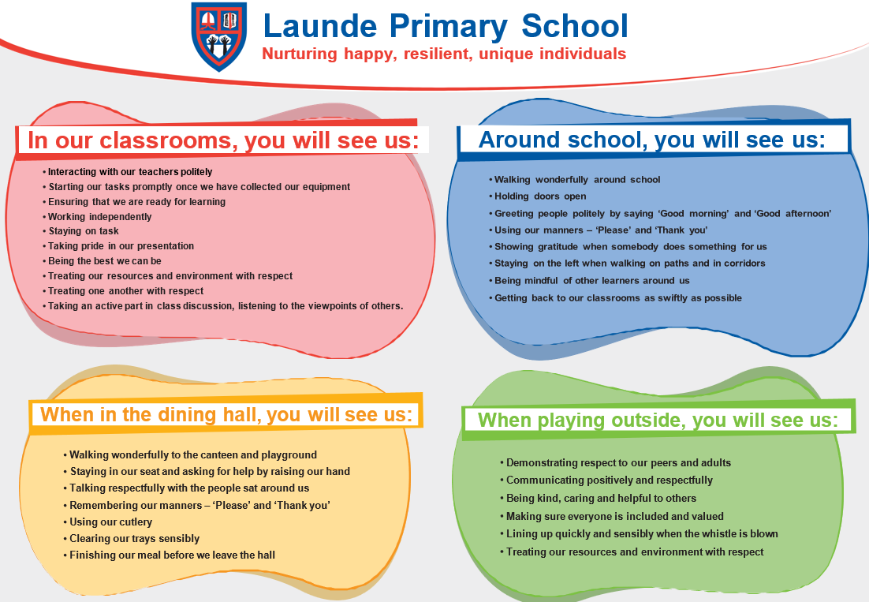
Behaviour Curriculum
Launde has a fully implemented behaviour curriculum to support children in developing good habits and to help foster an inclusive, nurturing environment where every child feels safe and valued.
We achieve this by teaching three fundamental principles:
Be Ready
Be Respectful
Be Brave
These principles are then rewarded when we see them in school, in a number of different ways.
Notes:
Sam

Slide 13
Trips
Visitor to school for our science topic on ‘Rocks’
Beaumanor Hall The Celts
The Mandir trip- RE
Jewel Wall– Roman topic
Walk around Oadby- Geography
Visitor to school for our Egyptian topic

Slide 14

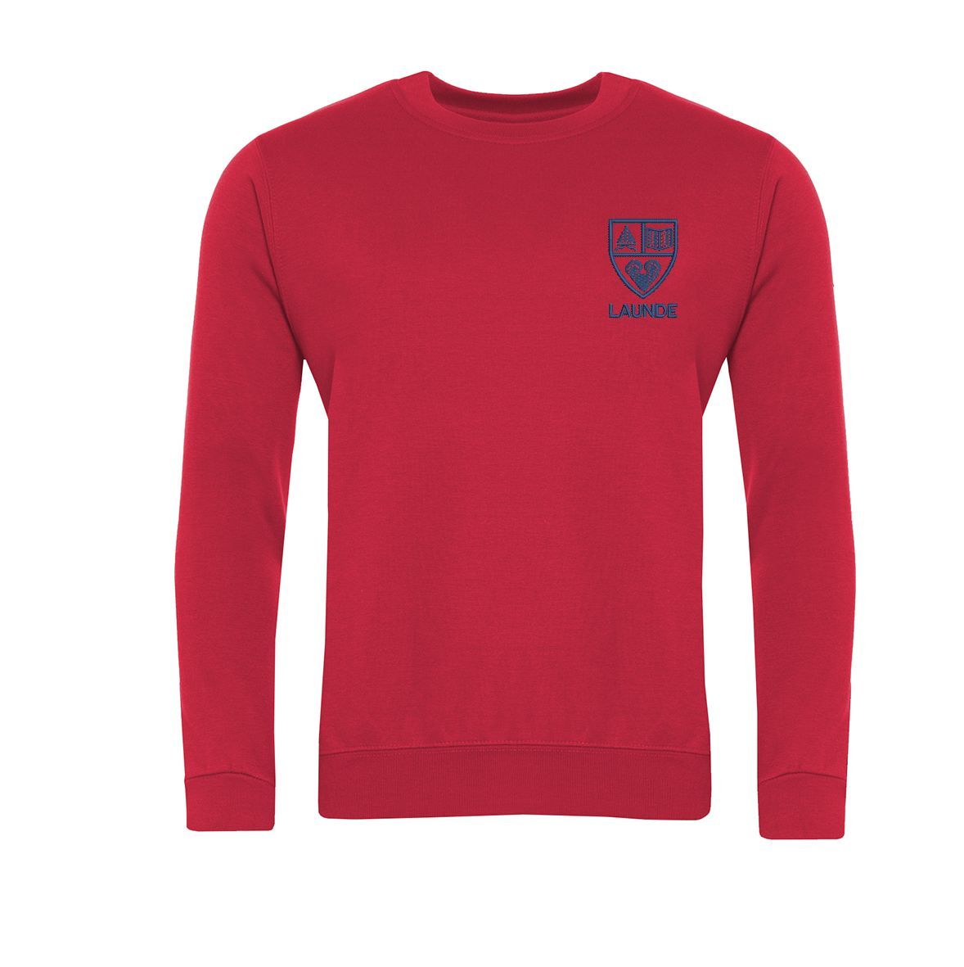
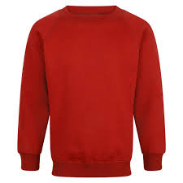
Equipment and uniform
White shirt or
t-shirt
All items should be named clearly.
A Launde book bag.
Children will continue to wear plain, black shoes to school next year.
Uniform – please ensure your child conforms to the school’s rules and is free from makeup, jewellery and hair accessories. All hair, if it is long enough, should be tied up.
Please ensure jumpers or cardigans are clearly labelled.
Black or Grey skirt, trousers or shorts
Red jumper or cardigan. With or without logo

Slide 15

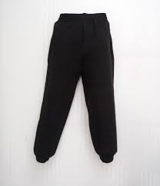
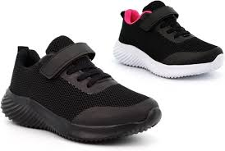
PE kit
White t-shirt and red sweatshirt
Children will need to come to school in P.E. kits on their P.E days.
You will be informed of these days
at the beginning of the year.
White T-Shirt / Polo shirt
Black shorts
Black joggers
Black trainers
Please ensure every item is
clearly labelled.
IMPORTANT – Please ensure that your child has their hair tied back and is not wearing earrings on their PE days
Black/ red shorts or joggers
Trainers

Slide 16
Homework
Daily reading to an adult.
21 minutes of Times Table Rockstars (Recommended that this is 3 minutes per day)
Knowledge organisers will all be shared on WEDUC and the school website for you to discuss and encourage your children to read before we begin our new topics.
One oracy presentation to be complete during the year.

Slide 17
Over the holidays…
You may want to:
Visit the Oadby library. Take part in the summer reading challenge.
Try to read together with your child from a variety of sources (e.g. comics, newspapers, fiction, non-fiction, poems, etc.) – you could even try finding new and fun places to read.
Regularly practise the 2, 5, and 10 times tables (TT Rockstars). They could also begin to practise their 3, 4 and 8 times tables. And related division facts.
Keep a scrapbook of things they have done/visited in the summer, which should include small pieces of writing to summarise their visit.
Write a letter or postcard to their new class teacher or friends towards the end of the holidays explaining the fun things they have done.
BUT remember to relax and have a good rest!

