Slide 1
Condover Residential
2026

Slide 2
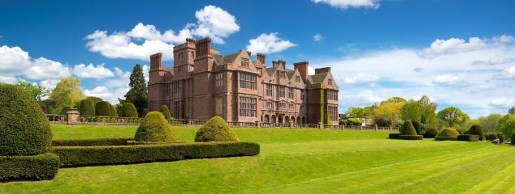
What is it like?
Watch video Condover Hall
Website Condover Hall, Shropshire | JCA Adventure

Slide 3
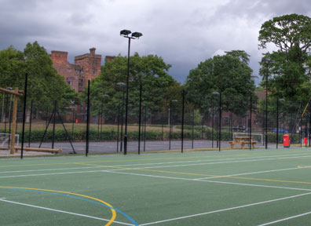
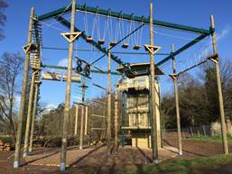
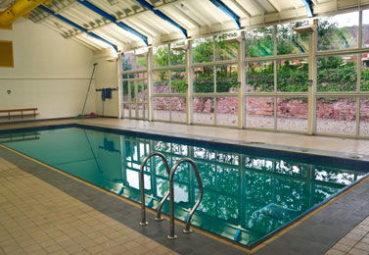
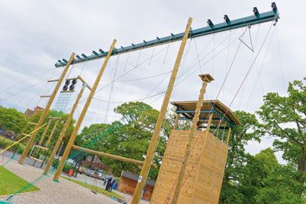
What will the day be like?
Breakfast
2 learning sessions
Lunch
2 learning sessions
Evening meal
Entertainment – campfire and film night
Bed

Slide 4
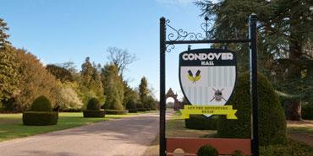
What will my child do?
A possible schedule:
 | Morning |  |  |  | Afternoon |  | Evening
Sessions | 1 | 2 |  |  | 3 | 4 | 5
Tuesday | Travel to Condover Hall |  |  | Tour of Condover | Circus Skills | Abseiling | Camp Fire
Wednesday | Archery |  | Low Ropes |  | Swimming | Laser Conquest | Film Night
Thursday | Initiative Exercises |  | Fencing |  | Climbing Wall | Rocket Launch | Film Night
Friday | Sensory Trail |  | Travel back to school
12 children maximum per activity group
1 Condover instructor and 1 teacher per group
Short breaks in between to return to dorms

Slide 5
Will my child have enough food?
Yes a cooked breakfast, lunch and evening meal are all included within the price.
They will have snacks during the film night.
When they arrive, they will be given a wristband to wear for the duration of the trip. The colour will indicate to the kitchen staff whether they are vegetarian, vegan, meat eaters, halal etc. If the wristband is lost/falls off then the children immediately get a new one.

Slide 6
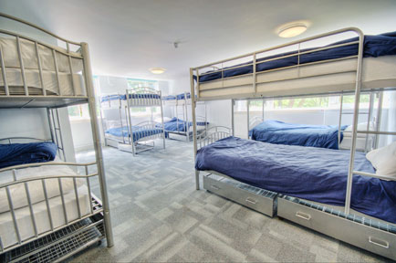
Sleeping arrangements
Separate areas for boys and girls with staff next door on each side
Children in dorms of between 4 and 12
Rooms are mainly bunkbeds with a few single beds
All bedding provided
Most dorms have an en suite or a toilet/shower room just next door
Launde staff members are on duty each evening to ensure the children are sleeping
Condover staff members are patrolling the grounds each night
Bed time usually around 9pm but could change depending on the breakfast time/activity time the following day

Slide 7
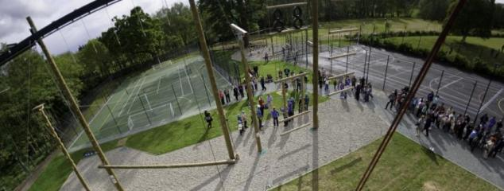
What does my child need to take?
A full kit list is available
Please do not buy new clothes as they will only get muddy!

Slide 8
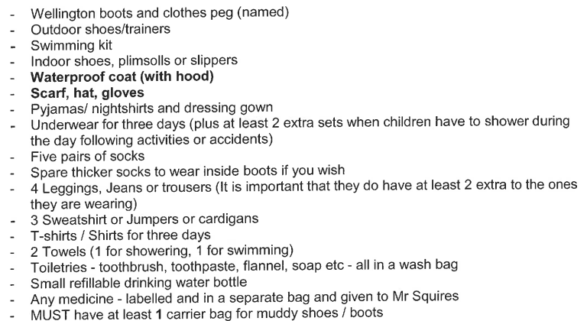
Sample kit list – weather dependent

Slide 9
What am I paying for?
Full board accommodation
Full activity programme
Full holiday insurance
Evening entertainment programme
1:8 free places for accompanying adults
One dedicated multi-trained instructor per activity group for the duration of your trip, helping students to reach their full potential through trust and support
Achievement certificates
Coach travel to and from venue

Slide 10
Times and dates
We will leave school on ????????????
Will return back to school on ?????????

Slide 11
Health and safety
Have carried an investigation of the site and been on visit
Have received a risk assessment from the centre and coach companies
Security within the site is very high
Children will have clear guidelines for safety when carrying out the activities
Clear behaviour boundaries – we will not take children who cannot behave in school

Slide 12
Medicines
Parents to fill in questionnaires about medical needs and a first aider will be on the visit with the school.
Site has own first aider
Prescribed medicines will be administered
Others e.g. travel sick tablets can be stored with us

Slide 13
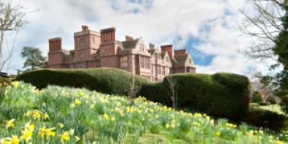
JCA are governed by, affiliated to and accredited with:
British Activity Providers Association (BAPA)
Institute for Outdoor Learning (IOL)
Adventure Activities Licensing Authority (AALA)
Association of British Travel Agents (ABTA)
Learning Outside the Classroom (LOtC)
Adventuremark (AAIAC)
Investor in People
The company’s website is:
http://www.condoverhall.com/

Slide 14
Any questions?

