Slide 1
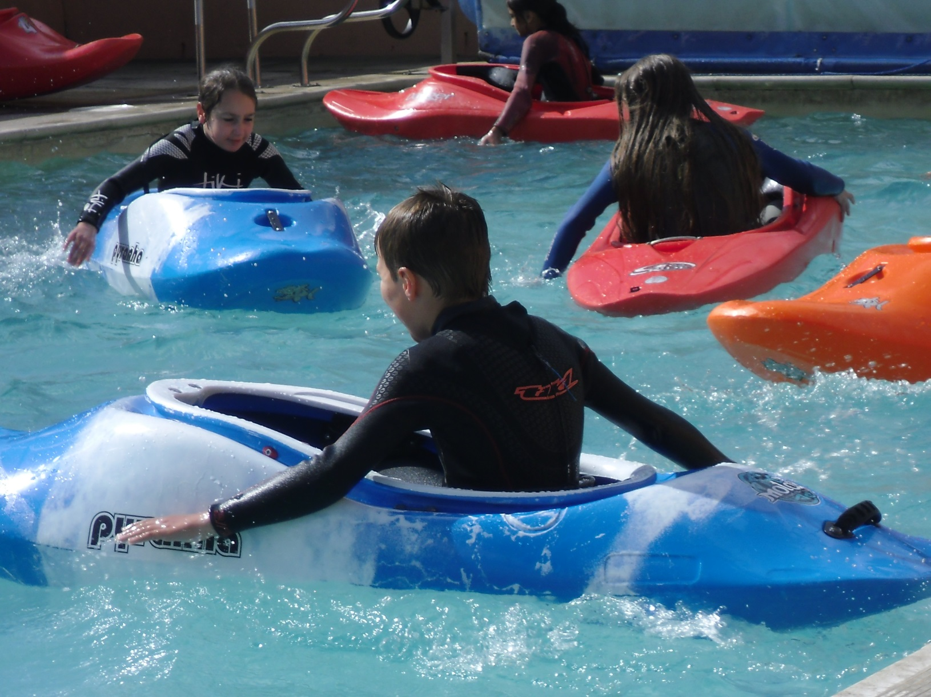
Launde’s Skern Trip 2025

Slide 2
Why return to Skern Lodge?
Tried, tested and trusted
Facilities above and beyond
Value for money
Experience
High standards
Rewarding

Slide 3
Aims
Team building
Self confidence
Organisation
Maturity
Leadership skills
Test themselves and meet challenges
Look after themselves and each other

Slide 4
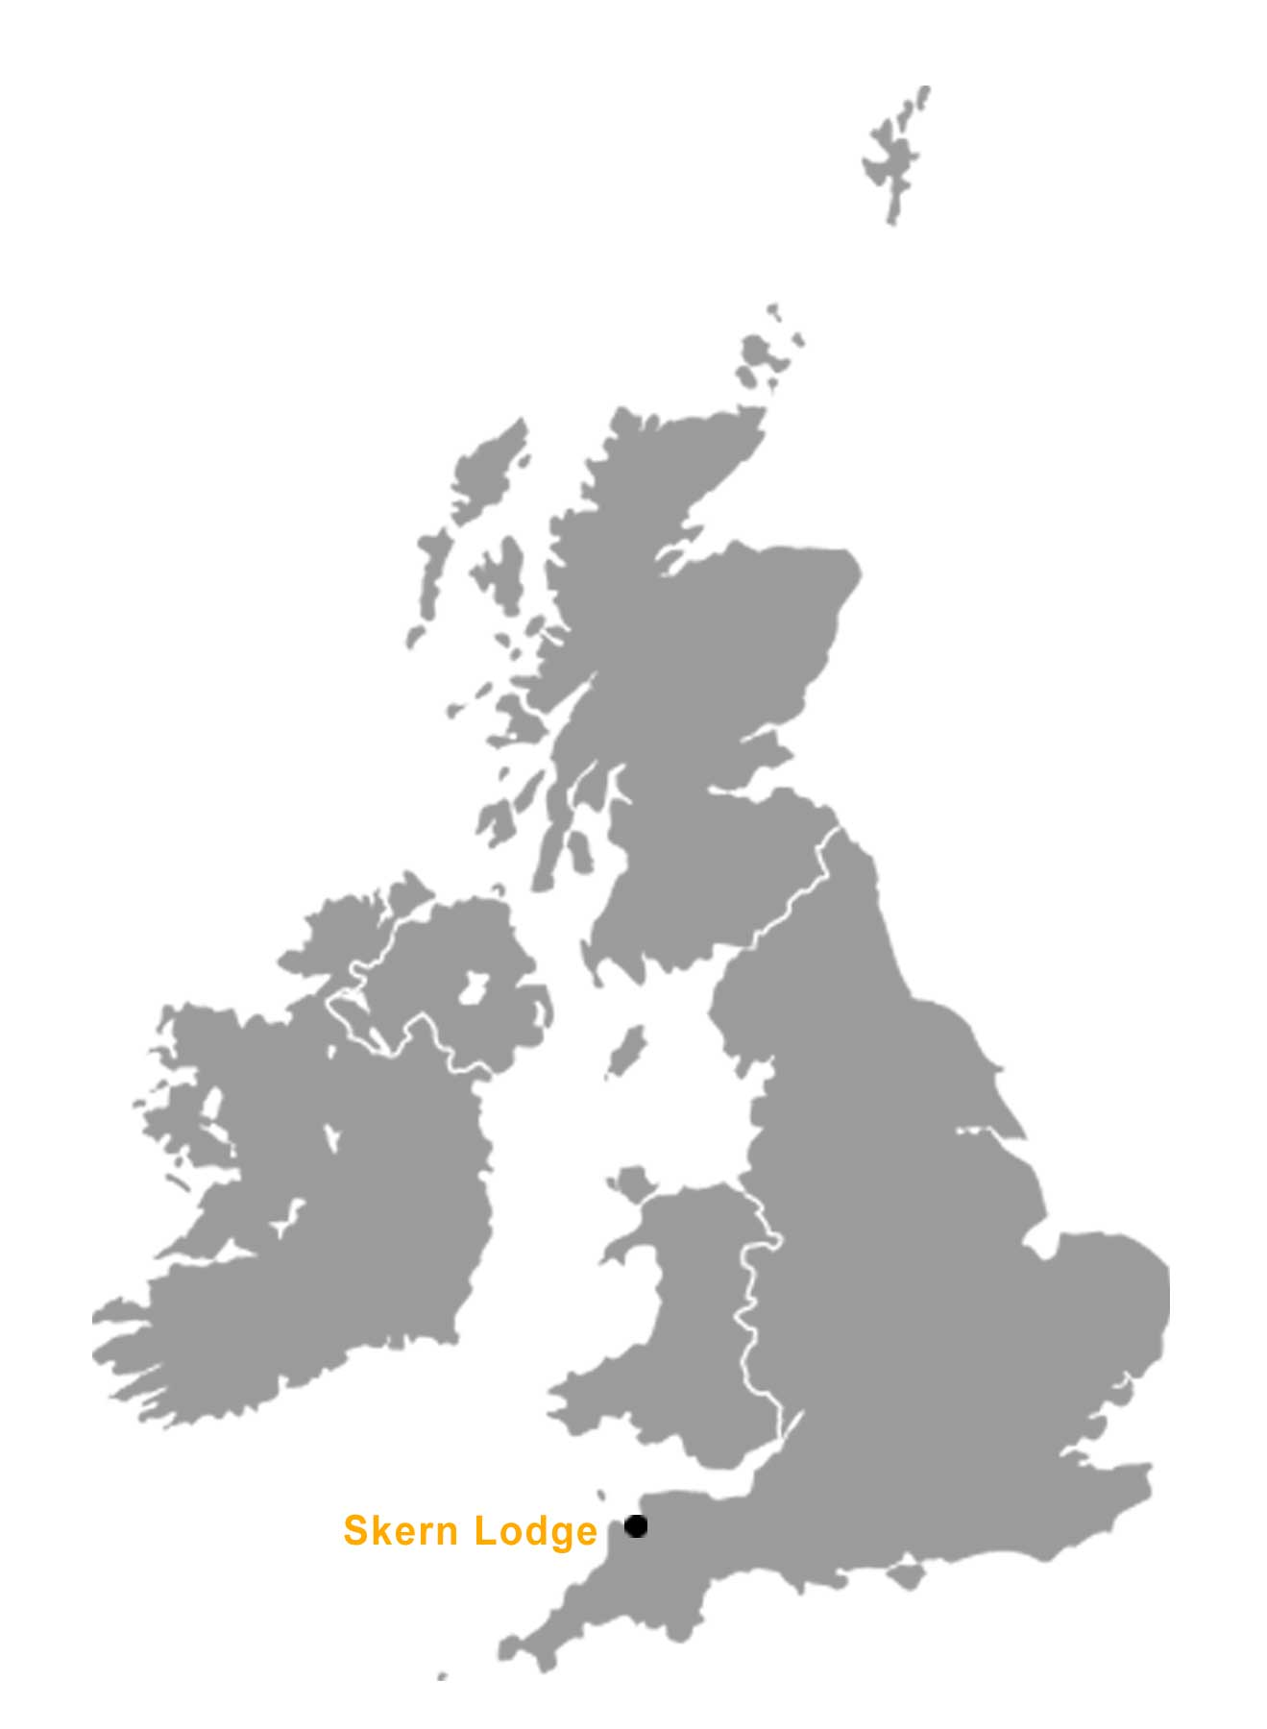
Where is Skern Lodge?

Slide 5
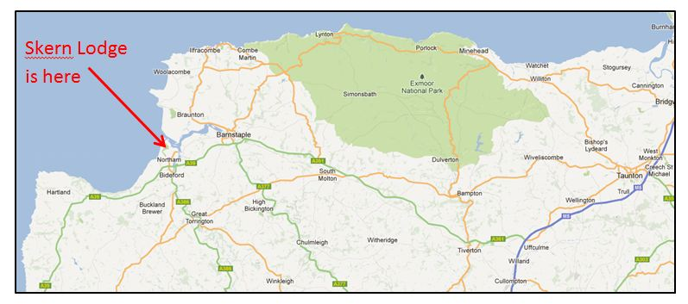
North Devon, Appledore, Bideford.
Skern Lodge
Notes:
We are located on the North Devon coast on the shores of the Taw and Torridge Estuary. Situated on the site of the old Watertown Farm, the buildings have been developed and added to; incorporating the elder 1705 stonework into the purpose built residential facilities.

Slide 6
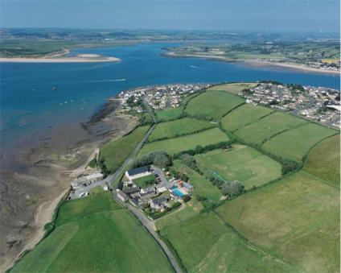
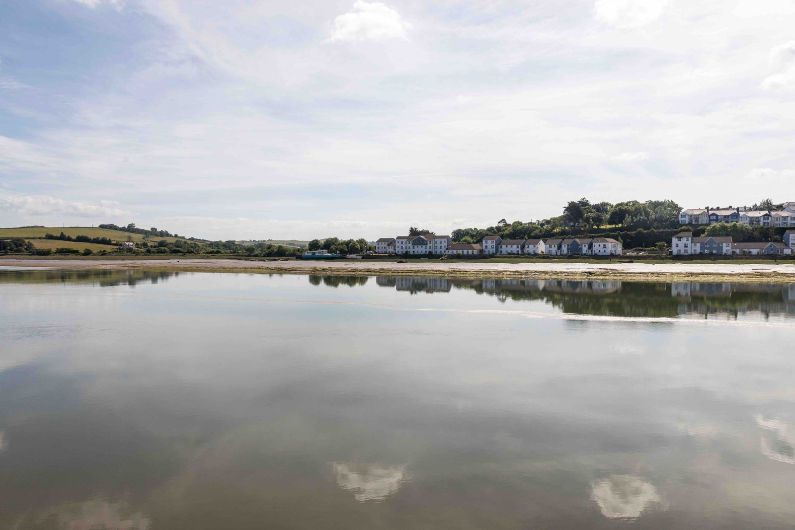
What is Skern Lodge?
Established in 1976, Skern was set up by two PE teachers and is now a very successful company, who provides education, learning and fun through adventure.

Slide 7
Skern’s philosophy is simple - guests should have fun and adventure, whilst learning something new and enjoying themselves safely.
Adventure - comes from daring enterprise and exploring new limits
Enjoyment - comes through the extensive range of exciting activities
Learning - comes through the whole experience of challenge
Safety - comes from the excellent staff and equipment together with tried and well established procedures

Slide 8
Why do we choose Skern?
Safety
Equipment
Instructors and instruction
Accommodation and catering
Opportunities Devon provides for our children - beach
Notes:
Safety is the prime consideration at Skern Lodge. Licensed by the Adventure Activities Licensing Authority to provide specified activities under the following headings: Watersports, Climbing and Trekking.
Not all the activities at Skern Lodge come under the scope of the licence. However, as with all activities at the Lodge, every member of the staff is fully trained and qualified to conduct the activities that they instruct. If there is no national certificate they create their own.
Not only the instructional staff but also most support staff are first aid trained and DBS checked. This includes maintenance, cleaning, catering and office staff.
All the catering staff have Health & Hygiene certificates and the catering is regularly appraised by the local Environmental Health Department to ensure catering and domestic standards are the highest.
What about transport to activities?
Many of the activities are on-site. For those off-site then the children are transported in a minibus. These are checked regularly replaced and checked daily and all drivers have PCV licences.
What is the ratio on activities?
On the majority of activities the ratio is 1:8 but they never exceed the ratio advised by the Governing Body of that sport.

Slide 9
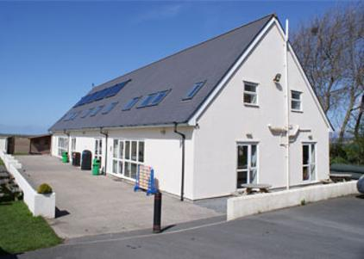
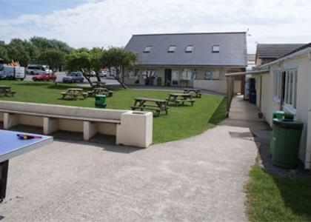
The Centre
Notes:
Domestic
Originally Skern Lodge was a farm dating back to 1705. Over the years the old buildings have been developed and new ones added to form today's centre.
The Lodge is a comfortable and practical centre and our accommodation reflects this. There are three separate accommodation areas, all will central heating, plenty of showers, good drying facilities, lounges, meeting rooms and staff facilities. Many of the rooms have expansive views across Northam Burrows and over the water and all rooms have pine beds and duvets and bedding ready for you, but you do have to remember to bring your own towels.

Slide 10
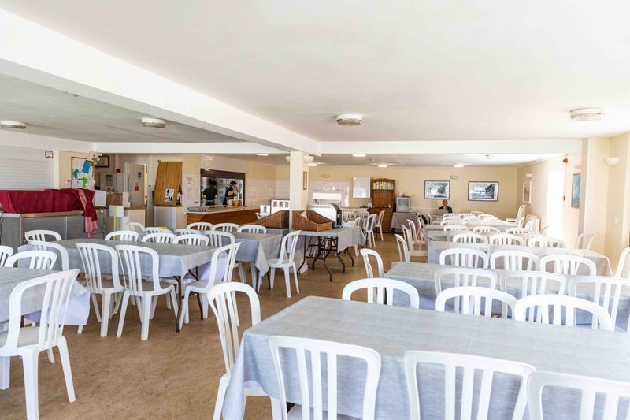
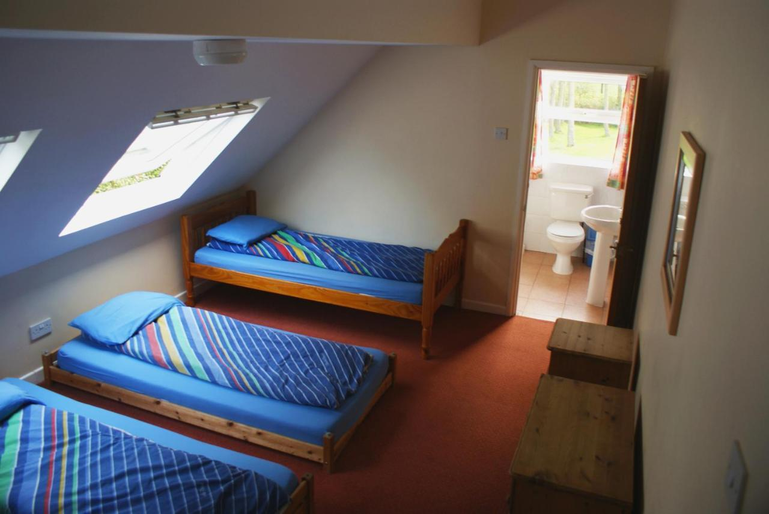
The canteen
Accommodation
Notes:
A modern dining facility seating 110 is at the centre of the site providing excellent catering. Any dietary requirements can be catered for and there are plenty of healthy options.
Well balanced and plentiful meals
There are three separate accommodation areas, all will central heating, plenty of showers, good drying facilities, lounges, meeting rooms and staff facilities. Many of the rooms have expansive views across Northern Burrows and over the water and all rooms have pine beds and duvets and bedding ready, the only thing you do have to remember to bring is your own towels.

Slide 11
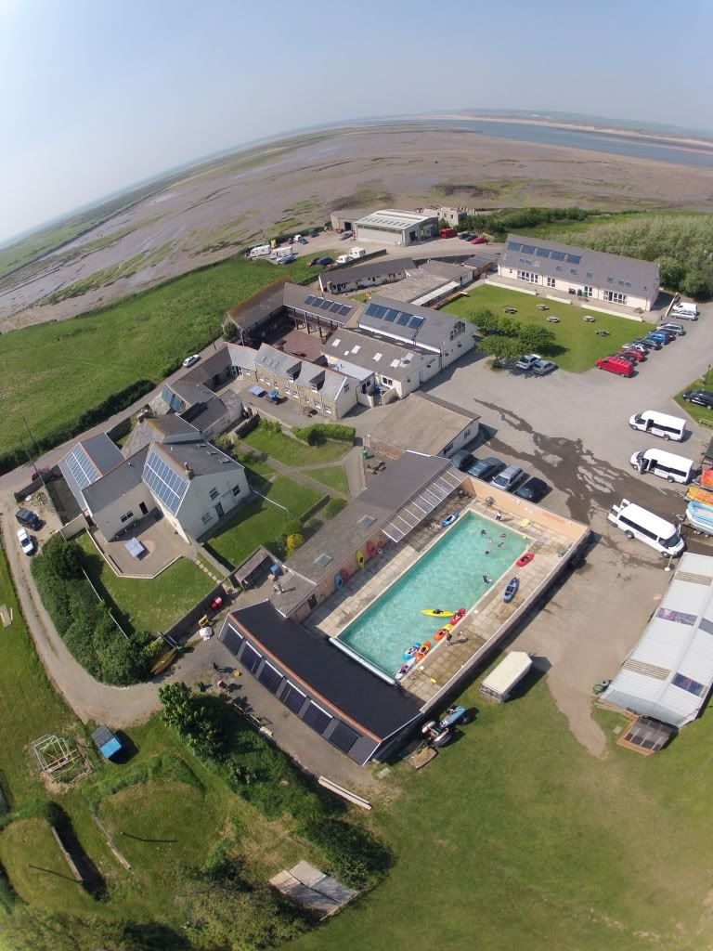
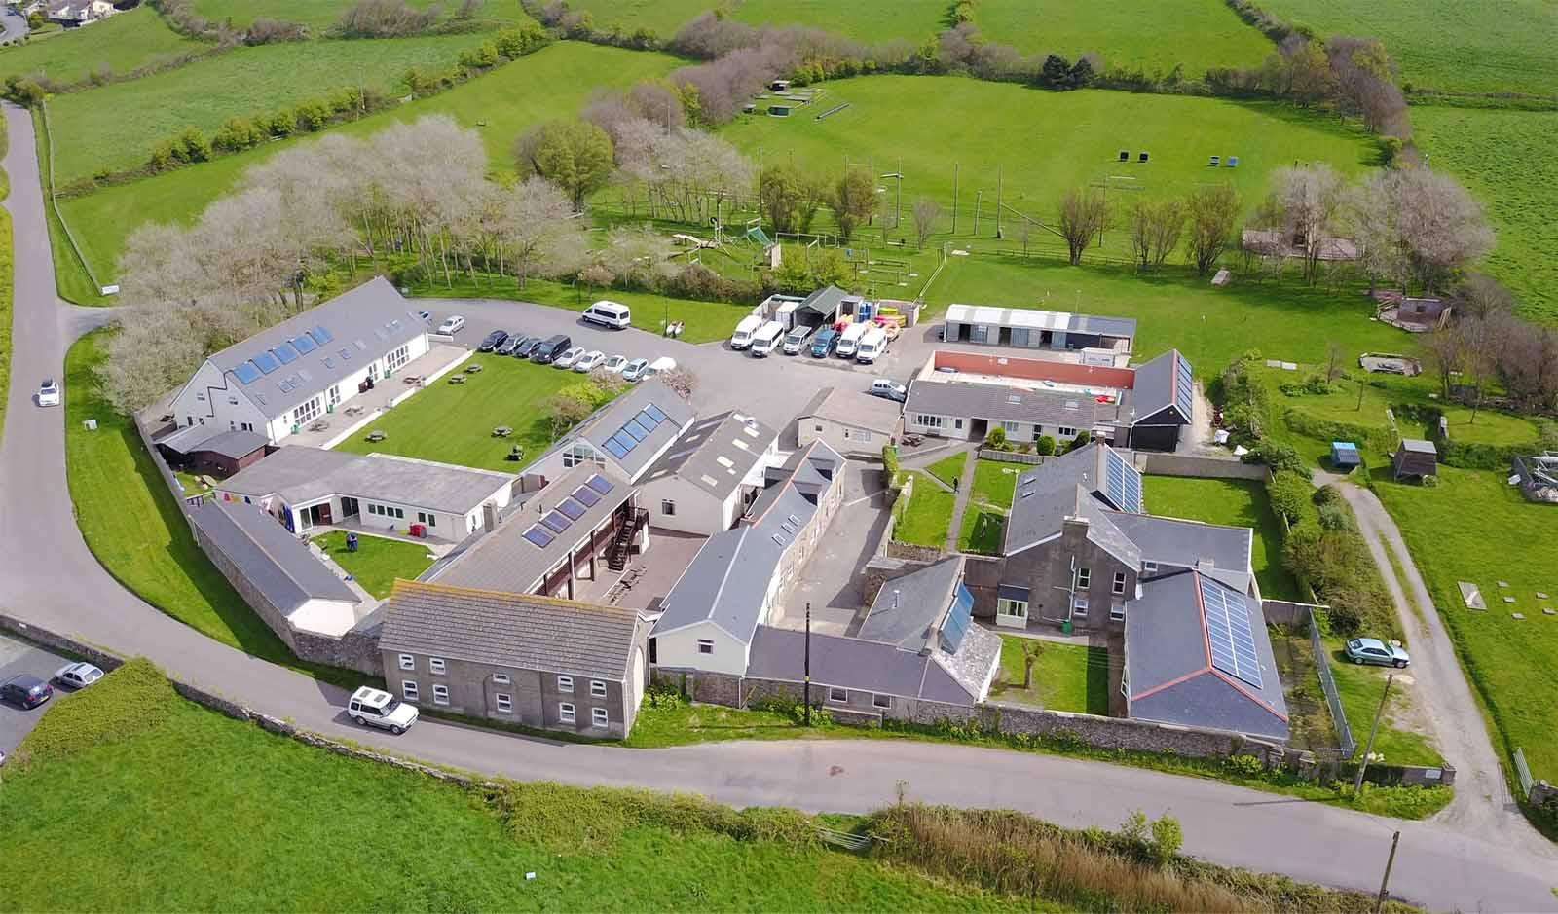
Around Site
Outside there are grounds extending to 22 acres, a launderette, games room, lots of activity areas.

Slide 12
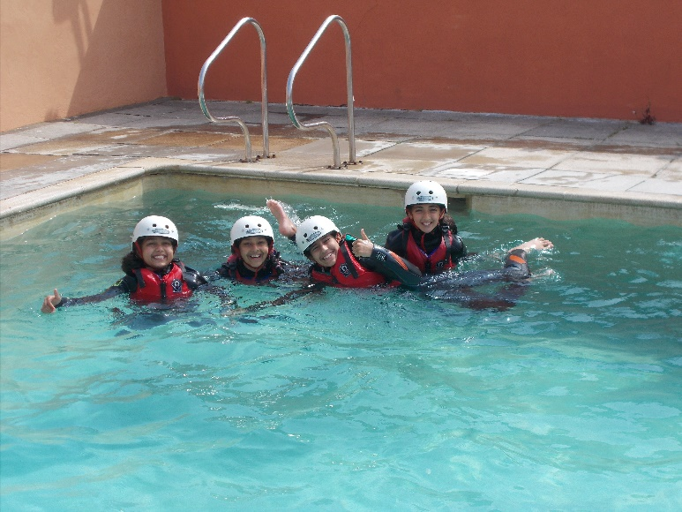
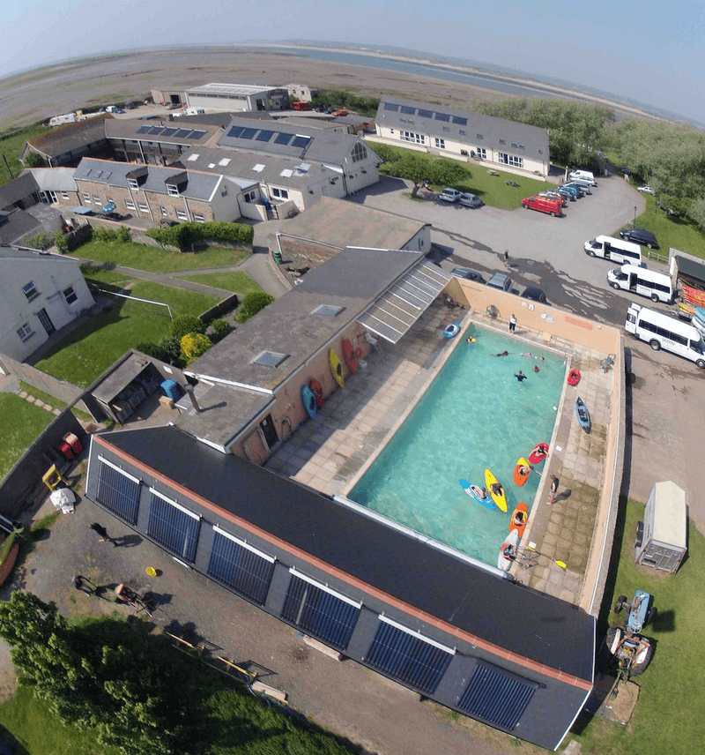
Around the site
Added to this there is a heated outdoor swimming pool that is used for swimming, pool games and kayak training.
Notes:
Around Site
Outside we have grounds extending to 22 acres, a launderette, games room, lots of activity areas and plenty of space for the more traditional games such as football. Added to this a heated outdoor swimming pool completes the complex.

Slide 13
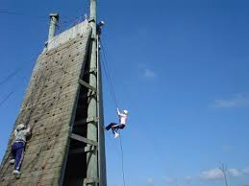
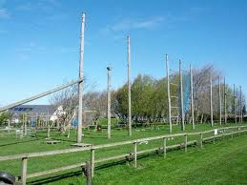
High ropes course
Climbing and abseil walls
Tunnels
Assault course
Archery course

Slide 14
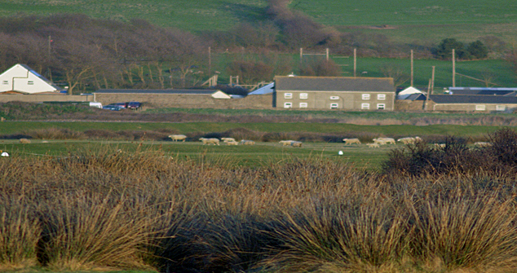
The local area – the Northern Burrows
Just opposite the centre, a beautiful area the children scramble through during evening activities.

Slide 15
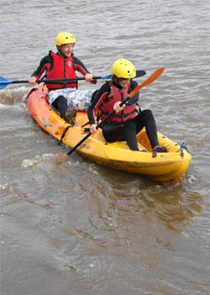
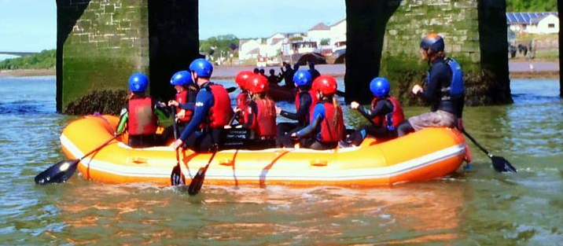
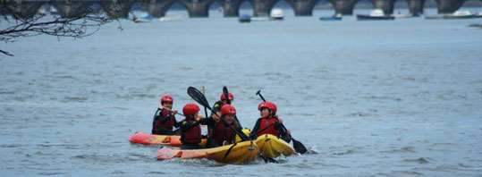
Kayaking and rafting
We take groups onto the River Torridge, which is a sheltered estuary. You will have had an introduction beforehand and all the relevant safety equipment is provided.
Notes:
Pool
Learn the basic skills needed and practise some kayaking techniques in our outdoor heated swimming pool. You can also join in some fun kayak games.
Learn to Roll
Often referred to as an "Eskimo roll", learning to roll means you are able to right your capsized kayak so you never have to leave your boat. We offer 2 hour evening kayak rolling clinicin our outdoor heated swimming pool.

Slide 16
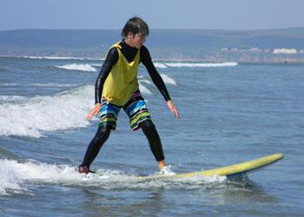
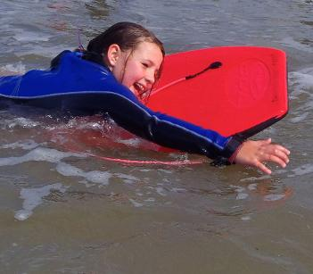
Surfing and body boarding at Westward Ho! beach

Slide 17
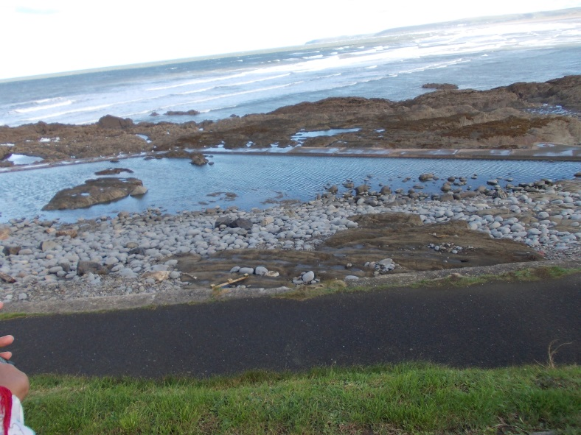
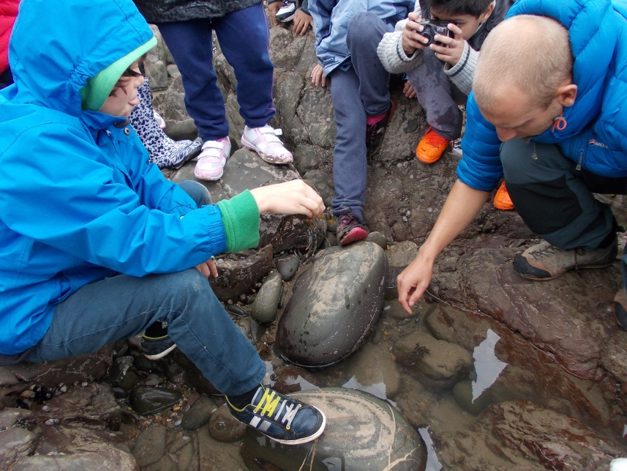
Seashore Trail
The diverse shoreline at Westward Ho! is an ideal place to investigate the many weird, wonderful creatures and organisms found on the coast.

Slide 18
Normal Day
8am - Breakfast
9am - Activity one
12.30pm Lunch – packed lunch
1.30pm - Activity Two
5.30pm - Evening Meal
7pm - Evening Activity
9pm - Hot chocolate
9.15pm - Bed

Slide 19
Activities
Day time
Seashore Trail
Kayaking
Rafting
Surfing
Pool Kayak
Tunnels
High Ropes
Assault course
Climb and Abseil
Team building
Ratio 1:8
Evening Activity
Night walk
Swimming
Skern Lodge Olympics
Scavenger hunt/ crabbing

Slide 20
Details…..
Monday 8th June 2026
Leave school by 6.45am and arrive at Skern at around 12- 12.30 ready to start our first activity in afternoon.
Return home will be Friday 14th^{th} June. We will leave the centre by 10am, hoping to arrive back to school by 3pm. Text messages will be sent to confirm arrival home time.
Cost – approximately £480 - £520(depending on numbers) which includes around £5 - £10 pocket money. This will be divided up into a payment plan. (September, October, November, February and March)
Maximum number - 60
Deposit - £100 to be paid by the morning of Friday 4th July to secure your child’s place.
Full amount to be paid by the end of April via the Schoolgateway.
Full kit list to be provided nearer the time.

