Slide 1
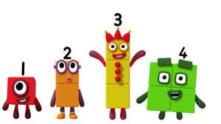
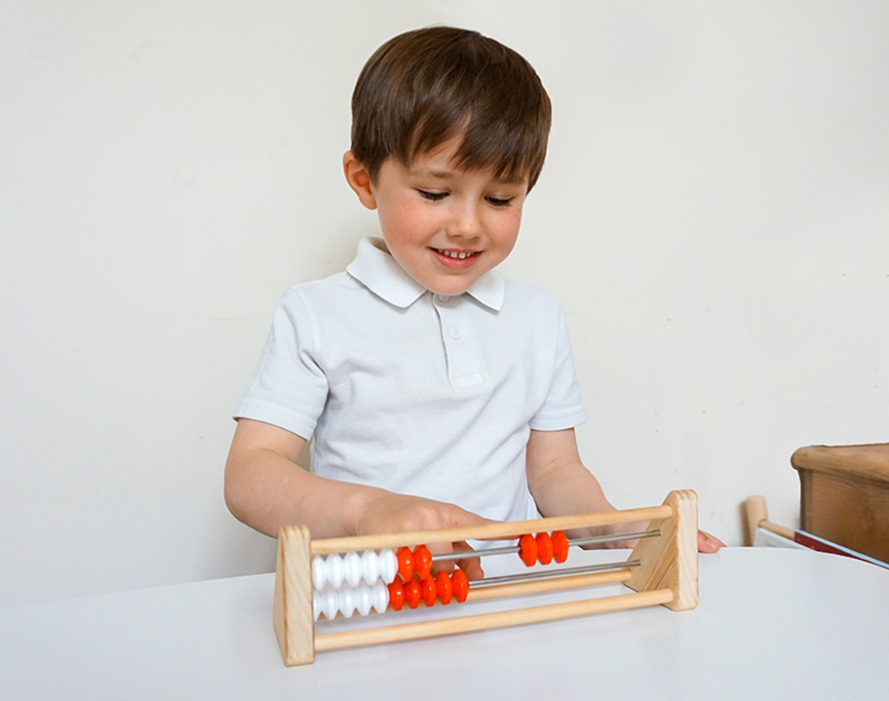

Mastery of Number
EYFS and Key Stage 1
Notes:
Title slide

Slide 2
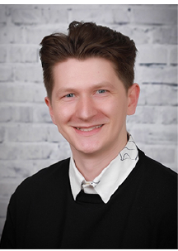

Welcome and introduction!
Mr Frost
Maths Lead
Mrs Lynch
EYFS Lead
Notes:
Intro slides inc. photos

Slide 3
Aims of the session
Provide an explanation of the mastery approach in maths
Explain what the Mastery of Number programme consists of
Demonstrate examples of what a Mastery of Number lesson includes
Notes:
Aims – what is mastery of number?

Slide 4

What is ‘Teaching for Mastery’?
Evidence-based approach to teaching maths
Helps pupils develop a deep, long-term and adaptable understanding of maths
Mathematical learning behaviours are developed such that pupils focus and engage fully as learners who reason and seek to make connections
Inclusive approach where all children achieve
Slower pace which results in greater progress
Reflected in the 2014 English national curriculum for mathematics
Endorsed by the Department for Education, NCETM and OFSTED
Notes:
In the classroom
Pupils are taught through whole-class interactive teaching, enabling all to master the concepts necessary for the next part of the curriculum sequence.
In a typical lesson, the teacher leads back and forth interaction, including questioning, short tasks, explanation, demonstration, and discussion, enabling pupils to think, reason and apply their knowledge to solve problems.
Examples, representations and models are carefully selected to expose the structure of mathematical concepts and emphasise connections, enabling pupils to develop a deep knowledge of mathematics.
Use of precise mathematical language enables all pupils to communicate their reasoning and thinking effectively.
If a pupil fails to grasp a concept or procedure, this is identified quickly, and gaps in understanding are addressed systematically to prevent them falling behind.
Significant time is spent developing deep understanding of the key ideas that are needed to underpin future learning.
Key number facts are learnt to automaticity, and other key mathematical facts are learned deeply and practised regularly, to avoid cognitive overload in working memory and enable pupils to focus on new learning.

Slide 5
Mastery of Number
Programme created by the NCETM
The main maths scheme for EYFS and a supplementary session in KS1
Why?
Supporting pupils to develop good number sense
The aim over time is that children will leave Key Stage 1 with fluency in calculation and a confidence and flexibility with number
Automaticity of facts is important because it frees the mind to think about concepts
Develop a mathematical mindset and look for the mathematical structure and relationships
Children to be confident in communicating their ideas
Develop a positive attitude towards maths and a willingness to ‘have a go’
Notes:
Brief summary of mastery of number
It is a limited access scheme, that our school has recently been given early access to. We will be using the EYFS/KS1 scheme, with a view to expanding it into KS2 next year
Due to our work with NCETM
Numbersense = considers the relationship between numbers and how numbers work

Slide 6
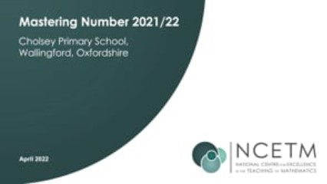
Notes:
Video

Slide 7
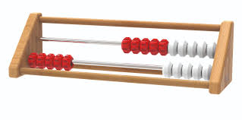

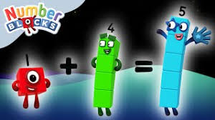
What will the children learn?
Each week will develop and build on a different mathematical skill:
Subitising (EYFS)
Counting, ordinality and cardinality
Composition
Comparison
Number facts and arithmetic (Key Stage 1)
Notes:
What will children learn?

Slide 8
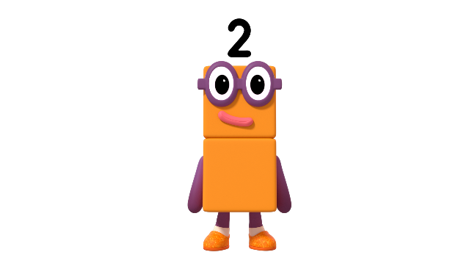
Can you show me ‘how many dots’ using your fingers?
Image © 2021 Alphablocks Ltd. All rights reserved. Mastering Number 2021/22 ncetm.org.uk
Notes:
EYFS counting lesson example

Slide 9
Mastering Number 2021/22 ncetm.org.uk

Slide 10
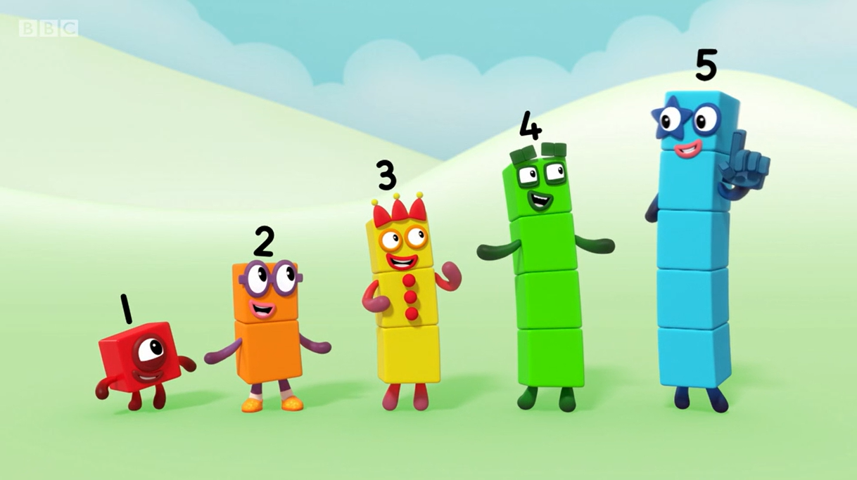
What do you notice about the pattern we make when we stand in this order?
Why do we look like a staircase?
Image © 2021 Alphablocks Ltd. All rights reserved. Mastering Number 2021/22 ncetm.org.uk
Notes:
Year 1 - counting

Slide 11
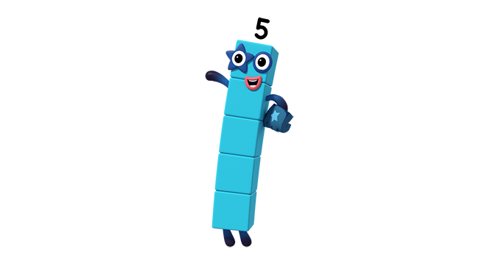





Can you make a staircase with ‘steps’ using some cubes?
I can make a staircase with some cubes…
How will I know how many cubes I need for each next step?
1
2
3
4
5
Image © 2021 Alphablocks Ltd. All rights reserved. Mastering Number 2021/22 ncetm.org.uk

Slide 12
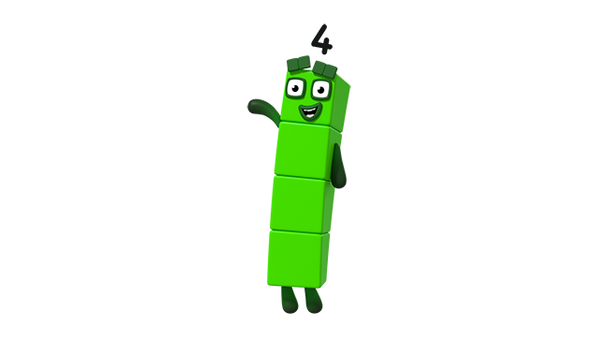
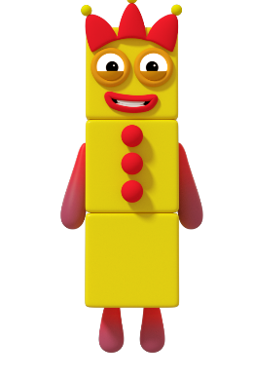

Three and One can make me!
Images © 2021 Alphablocks Ltd. All rights reserved. Mastering Number 2021/22 ncetm.org.uk
Notes:
Composition - EYFS

Slide 13

Can you make Four with lots of me?
Image © 2021 Alphablocks Ltd. All rights reserved. Mastering Number 2021/22 ncetm.org.uk

Slide 14
Use your rekenrek to show what 5 needs to make 6, 7, 8 and 9.
5 needs _____ to make _____ ; _____ is made of 5 and _____ .
Image © 2021 Alphablocks Ltd. All rights reserved. Mastering Number 2021/22 ncetm.org.uk
Notes:
Year 2 - composition

Slide 15

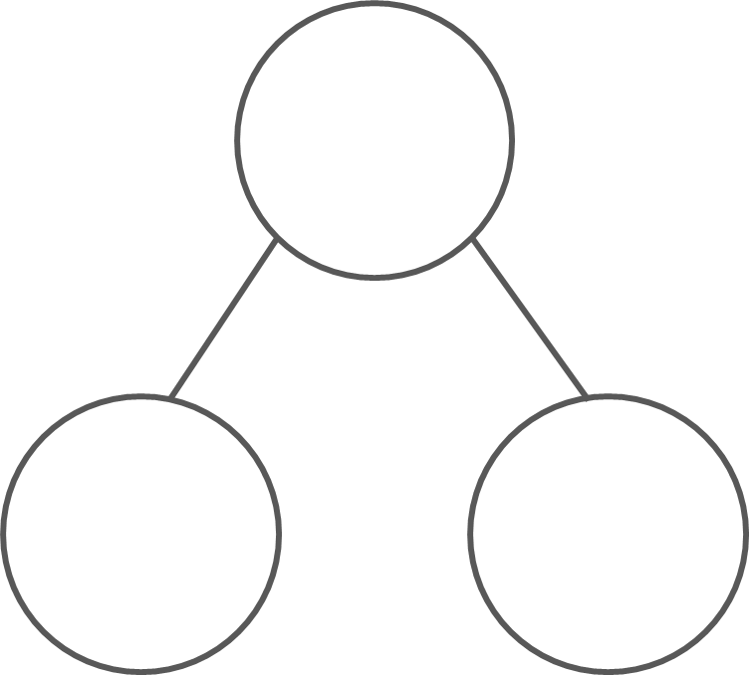

3 | + | 2 | = | 5
5
2 | + | 3 | = | 5
3
2
5 | = | 3 | + | 2
5 | = | 2 | + | 3
Mastering Number 2021/22 ncetm.org.uk

Slide 16
Any Questions?
Thank you for listening
Notes:
How can you support at home?

