Slide 1
Welcome to Launde Primary School
Foundation Stage Induction Evening

Slide 2
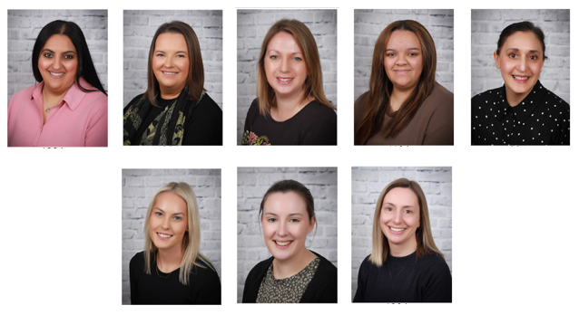
Our Foundation Team

Slide 3
Welcome to the Launde Family
Our mission statement is:
Nurturing happy, resilient and unique individuals

Slide 4

Our Aims here at Launde
In foundation at Launde, we believe that each child deserves the best possible start and the opportunity to achieve their full potential. We aim to work alongside parents and carers and other professionals to create a safe, secure and stimulating environment. Finally, we believe every child will become a respectful, confident and independent member of the community.

Slide 5
Routine of the day
Please ensure that you arrive at school at the start time. The main gates will open at 8:30am. Your classroom gates will open at 8:40am and close at 8:45am.
Fourfold and Poppyfield children will wait at the blue gate near reception area. Your child’s teacher will be outside in the playground ready to meet and welcome you.
Beehive will go straight to the classroom door. Your child’s teacher will be at the class door ready to meet and welcome you.
If you are arriving after the start of the school day, you must take your child to the office to sign in so we know they are on site.
The children will come into their classrooms and they will do a morning activity.
Gates open | 8.40
Day begins | 8.45
Lunchtime | 11.30-12.30
Day ends | 3.15

Slide 6
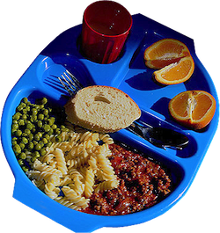
Dinner time
Every child is entitled to a free school meal
Meals will be served in the hall during the Autumn term and then transition into the Canteen.
Special menus are only available for specific medical requirements.
If you haven’t already please notify the office of any other dietary issues.
Allergies – we need to be informed of any as soon as possible
There will be an opportunity to talk to your child’s teacher about dinner times at parent interviews.
Children wear coloured bands to help the dinner staff know which foods your child can have. They are put on by class teacher before the lunchtime and then taken off at meal times.
On the next slide there is an example of our menu and the coloured band system.

Slide 7

Example of our Menu

Slide 8



Healthy me!
We provide free milk until your child turns 5.
We ask that your child brings a water bottle with them every day and that it is clearly labelled.
Children will have a snack provided in the afternoon, which will be a piece of fruit.
We are a nut free school.
We ask that you don’t bring in birthday treats.

Slide 9
Independent Skills
They need to be able to:
Take their shoes and socks off
Take their jumpers off and put them back on
If they have an accident we encourage children to change themselves, with an adult supporting if needed
We expect children to be independent when going to the toilet, including being able to clean themselves and wash their hands
Children are encouraged to ask to use the toilet, however we do remind them throughout the day
Being able to use a knife, fork and spoon

Slide 10
School Uniform
Tops: White Polo Shirt, Red Jumper/Cardigan (logo optional - from School Wear Solutions, plain red available anywhere)
Bottoms: Black or grey trousers/shorts (available anywhere)
Shoes: Black school shoes or plain black trainers (including soles) – no sports logo’s unless the logo is all black
Summer Dresses: Red Gingham (available anywhere)
New Uniform Retailer:
To streamline the buying process and ensure consistent quality, we've partnered with "School Wear Solutions" in Oadby village, and will be available to purchase online or in store. Starting from now, they will be the exclusive seller of our red logo jumper, cardigan, and bookbag.

Slide 11
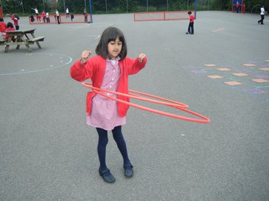
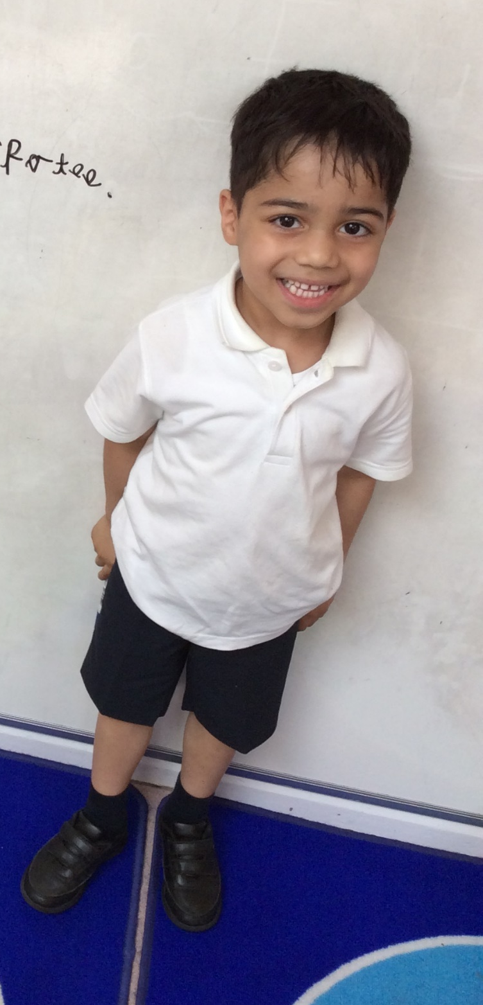

School Uniform
We always encourage children to dress and undress themselves
Shoes need to be black and they need to be suitable for indoors and outdoors
All clothing needs to be clearly labelled
Shoulder length hair needs to be tied back
Hair bands and ties in school uniform colours. No colourful hair bands or hair bands with teeth please
Jewellery – on PE days jewellery needs to be removed. Earrings can be covered with micropore tape.
If they wear earrings they need to be studs
We encourage all children to have a spare bag of clothes in school

Slide 12
Book bags
Children will need to bring their book bags everyday!
Book bags can be purchased from our retailer and details are in your packs on where to purchase uniform.
No key chains on the book bags please.

Slide 13
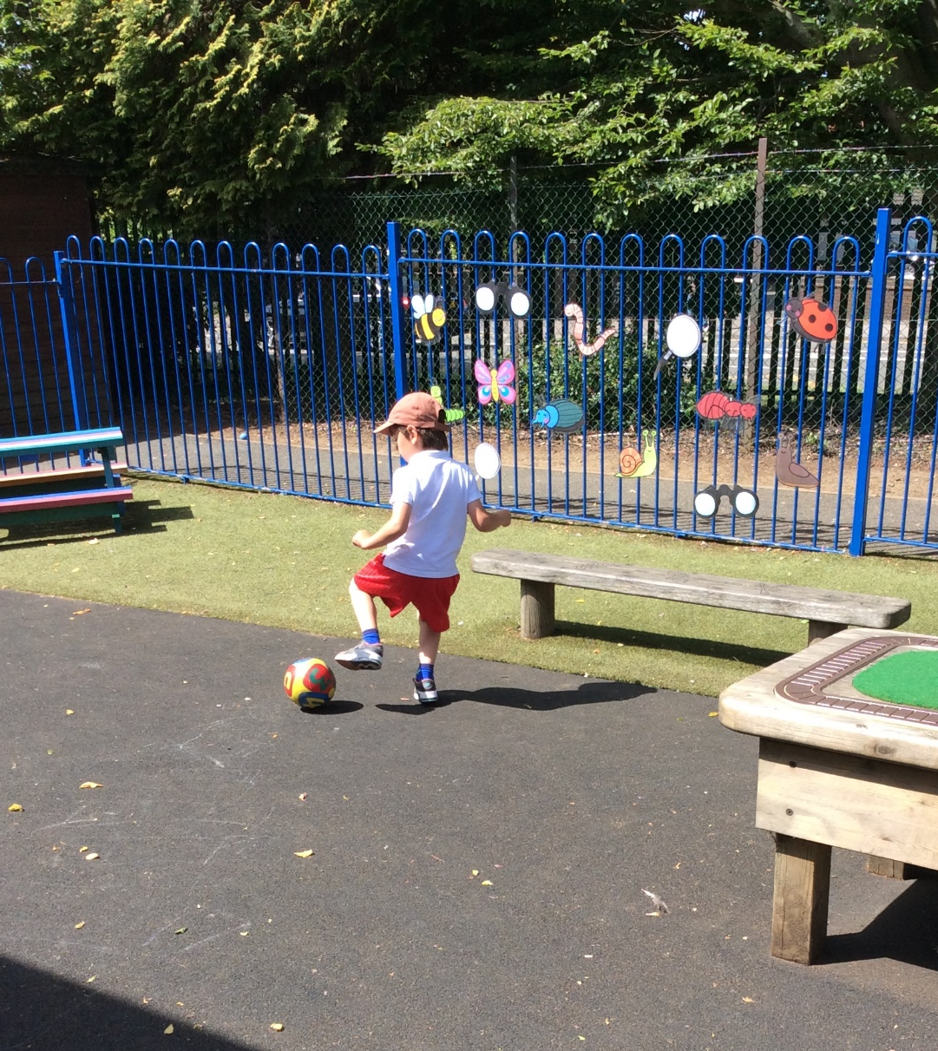
PE
Children will need to come to school in there PE kits on their PE days.
PE days – you will know on parent interview day.
We again ask that their PE kit is clearly labelled.
Children will do indoor and outdoor PE
If your child has earrings then these must be covered up or taken out. If they are needed to be covered up then we recommend to use micropore tape. Parents please provide this.
Black joggers/shorts
White t-shirts
Sports trainers (white or black)
All items can be found at supermarkets like Asda or Sainsbury's.

Slide 14
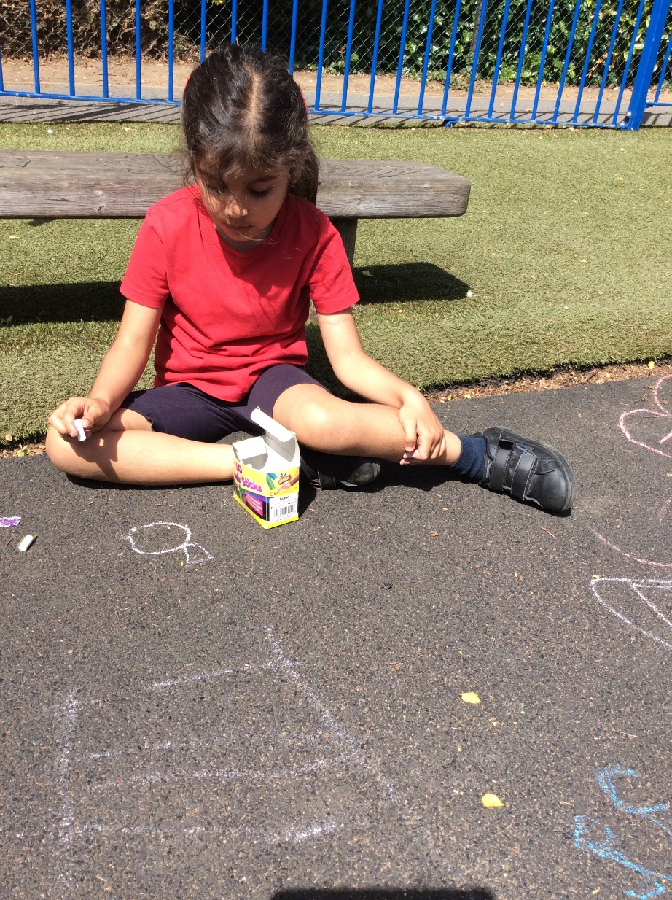
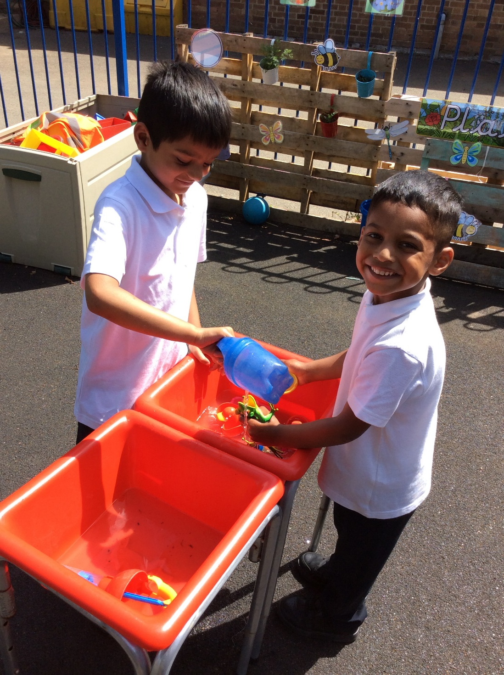
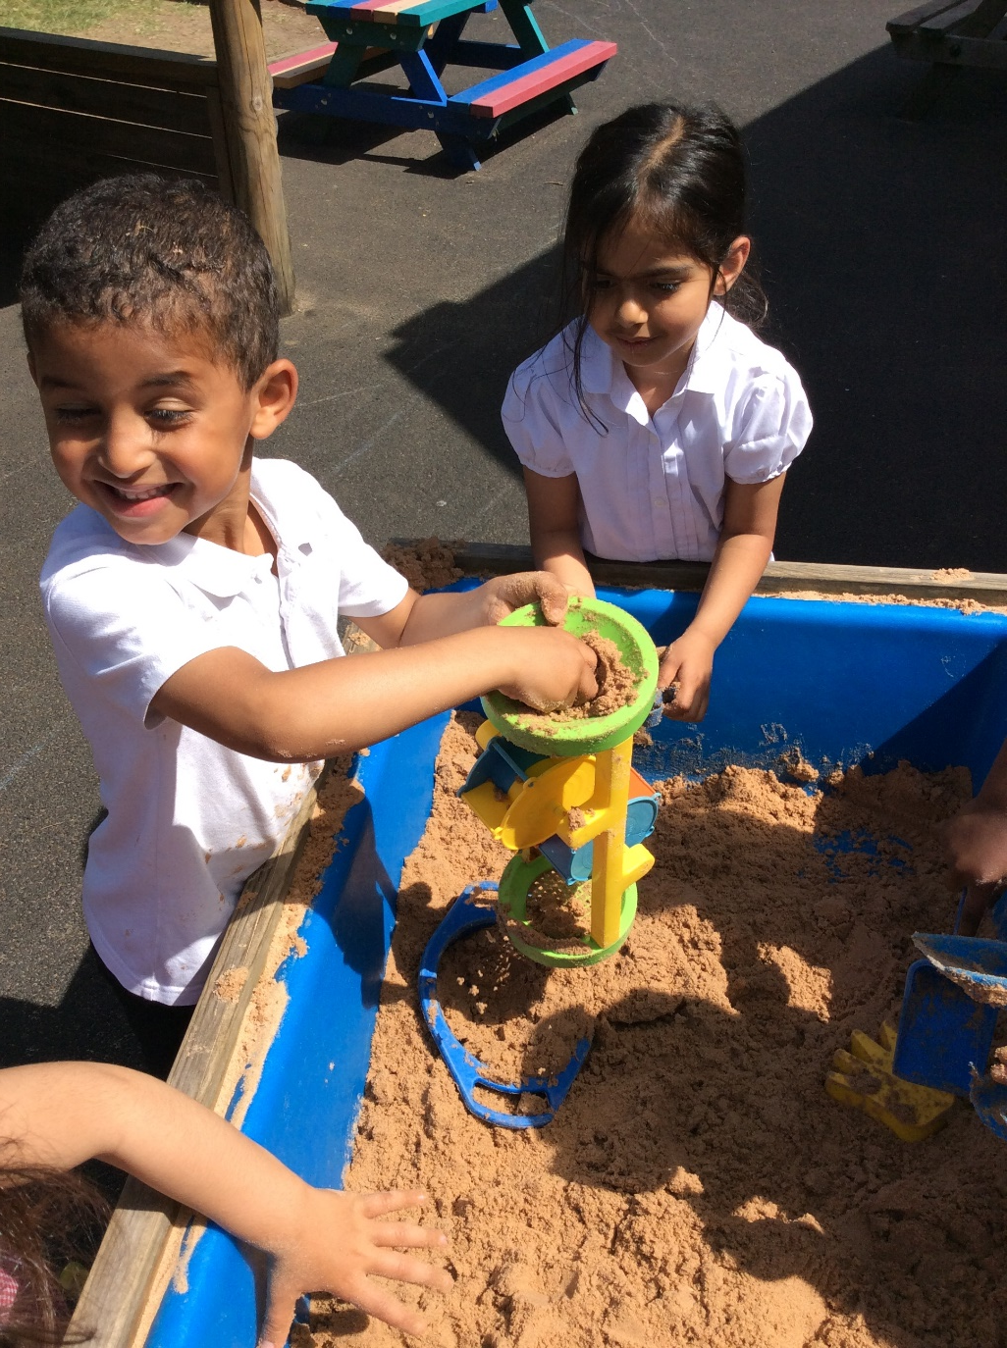
Outdoor Learning
We use the outdoor area for learning all year round.
In warmer weather please make sure that your child has a sun hat and you apply sun cream in the morning.
In the colder weather please make sure that they have a warm coat, hat, scarf, gloves and in wet weather wellies.
Children are recommended to always bring a waterproof coat to school as well as we will be outside what ever the weather.

Slide 15
The Foundation Curriculum
Areas of Learning and Development
The curriculum is split into prime and specific areas of learning
Specific Areas
Literacy
Mathematics
Understanding the world
Expressive Arts and Design
Prime Areas
Personal, Social and Emotional Development
Physical Development
Communication and Language
The prime areas are embedded across the whole curriculum and are key to children’s development.

Slide 16
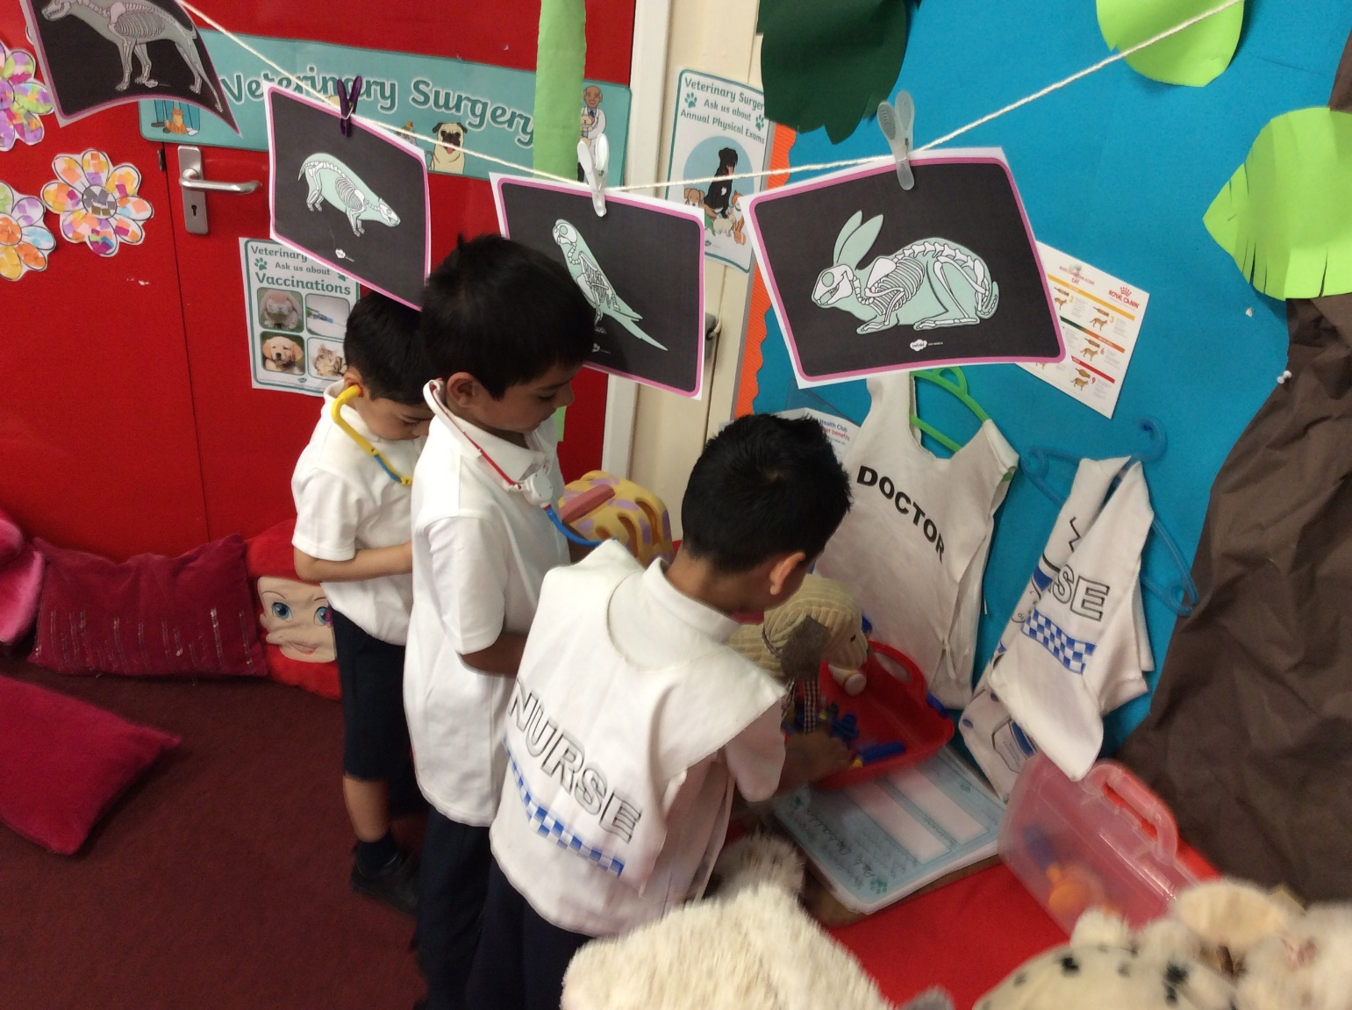
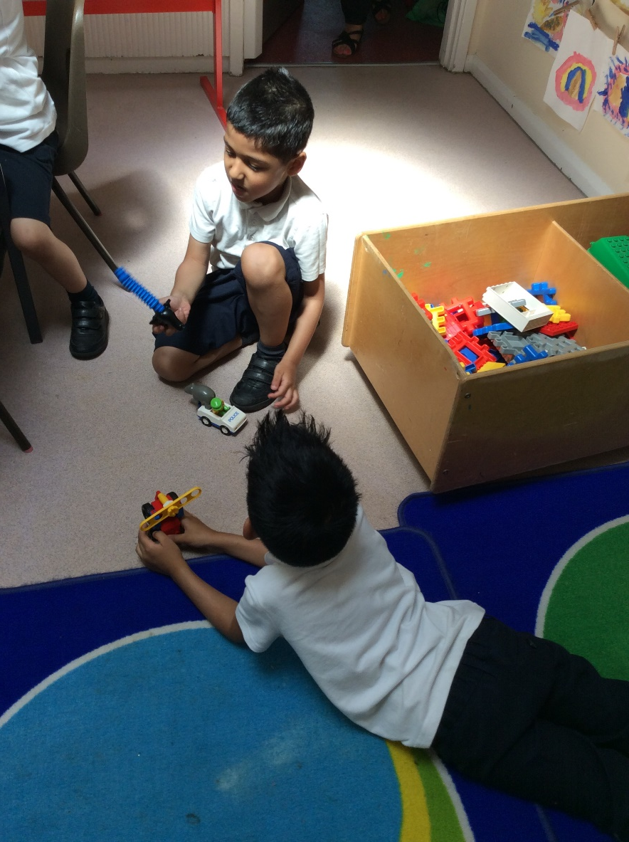
Personal, Social and Emotional
Development
To be able to see themselves as a valuable individual
Build constructive and respectful relationships
Express their feelings and consider the feelings of others
Show resilience and perseverance in the face of challenge
Identify and moderate their own feelings
Manage their own needs

Slide 17
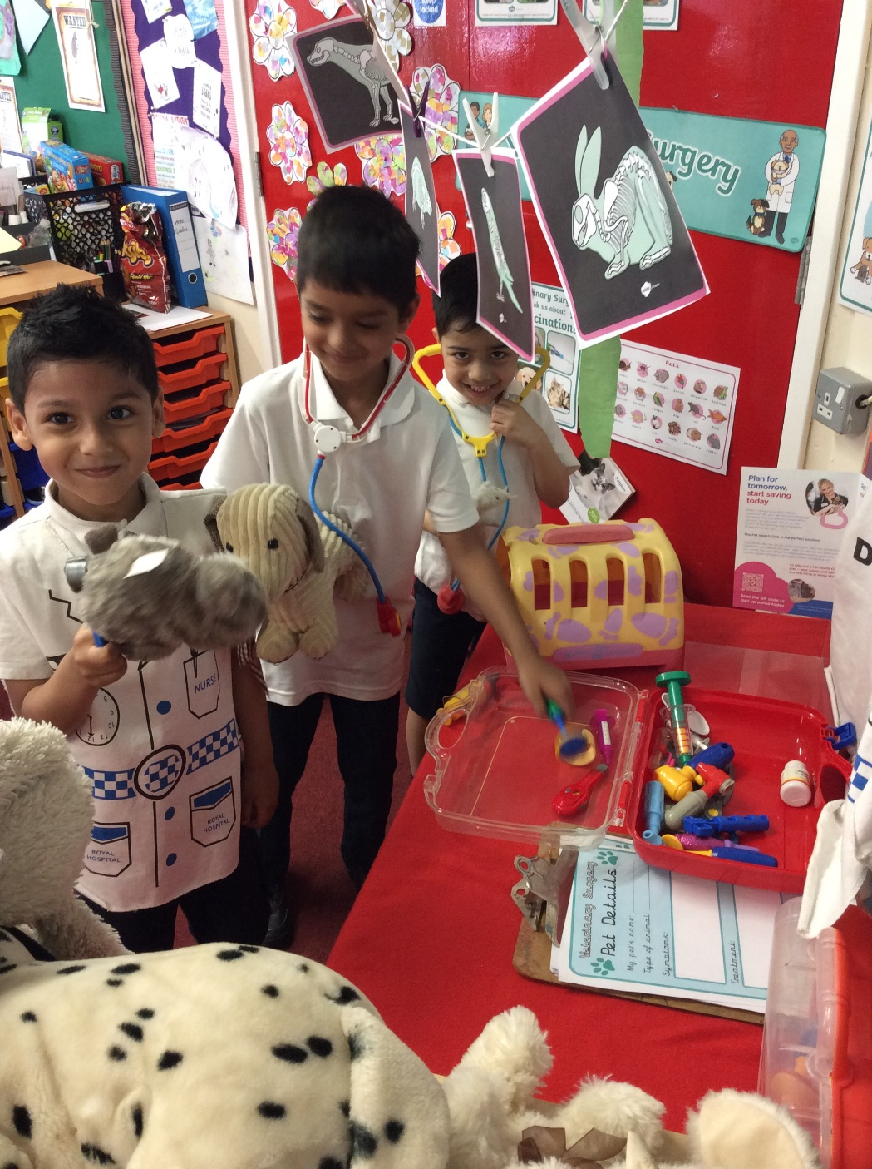
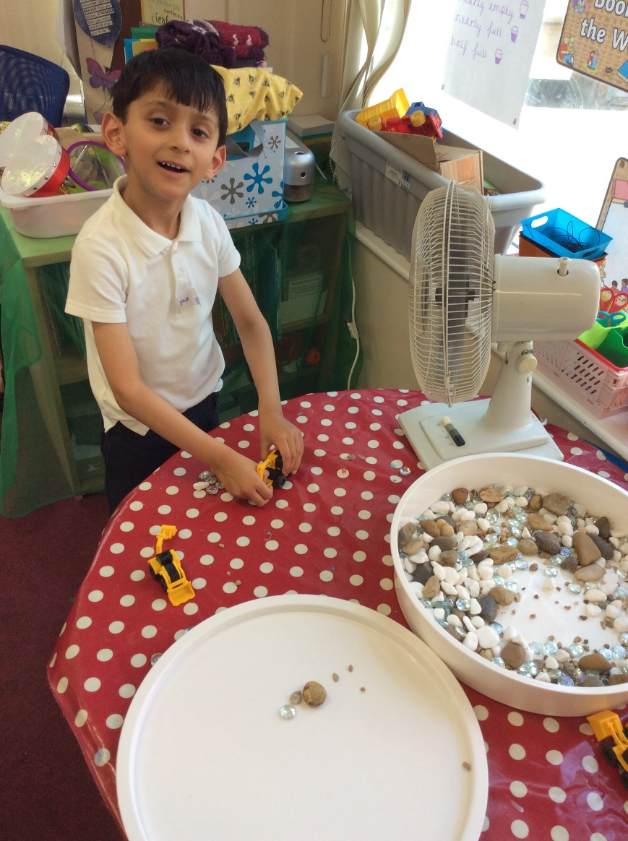

Communication and Language
To be able to listen carefully and know why listening is important
Learn and use new vocabulary, talking about the meaning of new words
Encourage children to ask questions and be curious learners
To be able to articulate their ideas and thoughts
Use talk to help work out problems and organise their thinking
Engage in story times
Listen and talk about stories to build up familiarity and understanding
Retell stories and begin to use new vocabulary to tell stories

Slide 18
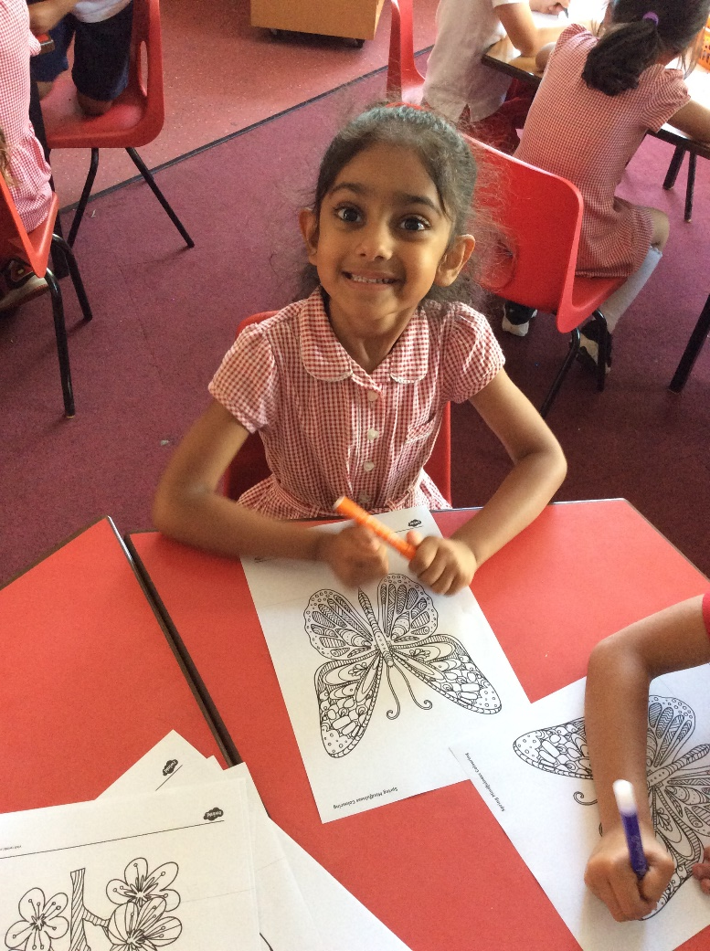
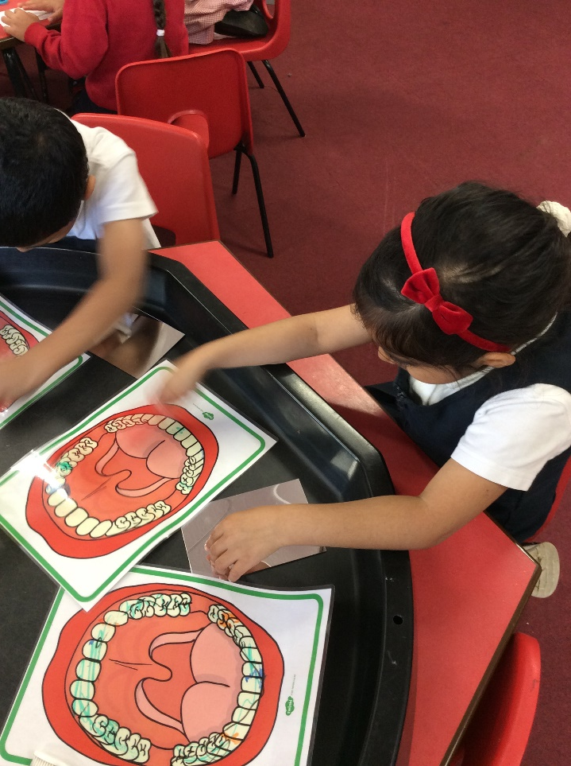
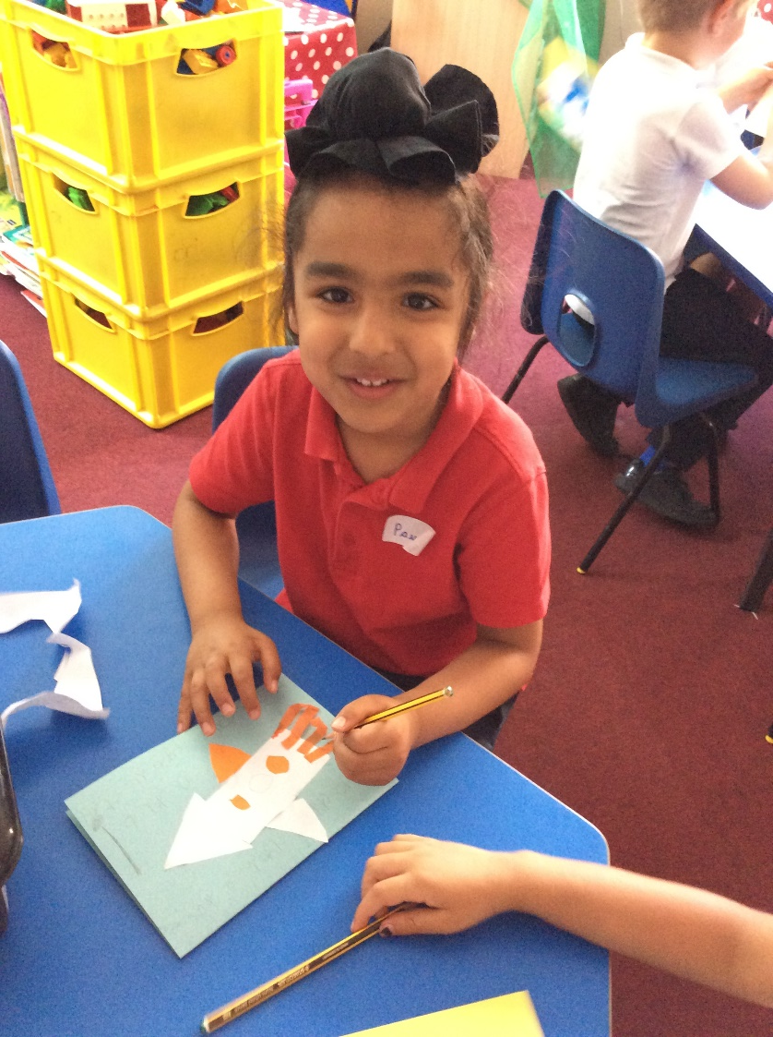
Physical Development
Develop their overall body strength, balance, coordination and agility through various activities
Children to build confidence and develop a range of different ball skills
Talk about healthy eating, exercise and wellbeing
Further develop the skills that they need to manage the school day successfully

Slide 19

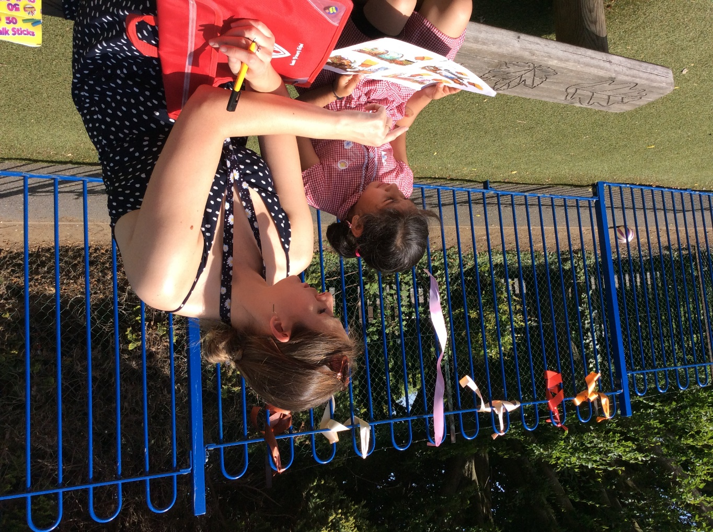

Literacy
Through guided reading and individual reading we will discuss key concepts about print
Develop their phonological awareness through the teaching of phonics.
Children to mark make in a variety of ways and use some of their print and letter knowledge in their early writing.

Slide 20
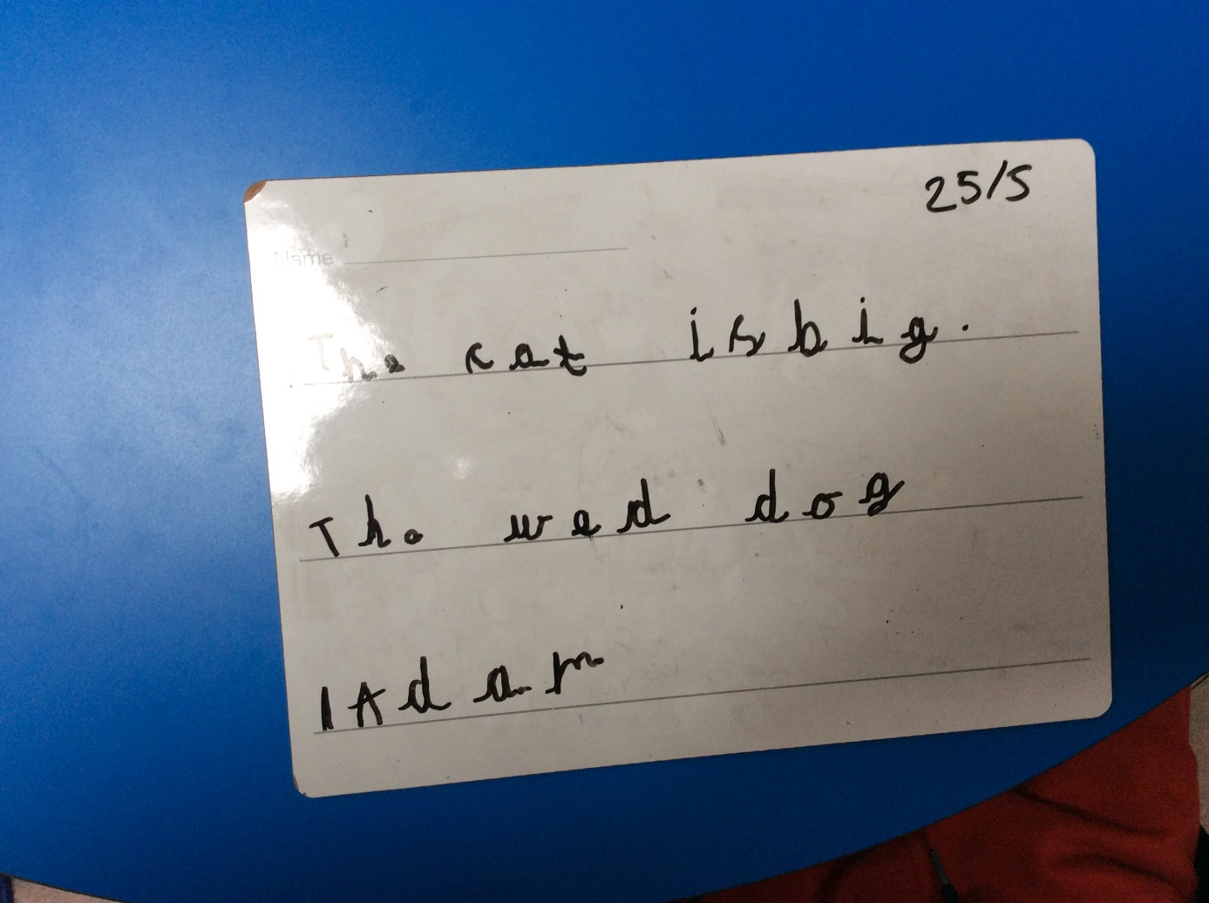

Literacy
To write letters that are linked to their phonics sessions
We teach ELS phonics
To write their name
Through the teaching of phonics children will be begin to read individual letters and blend sounds into words
Children will begin to write initial sounds and words
They will then begin to write simple sentences

Slide 21
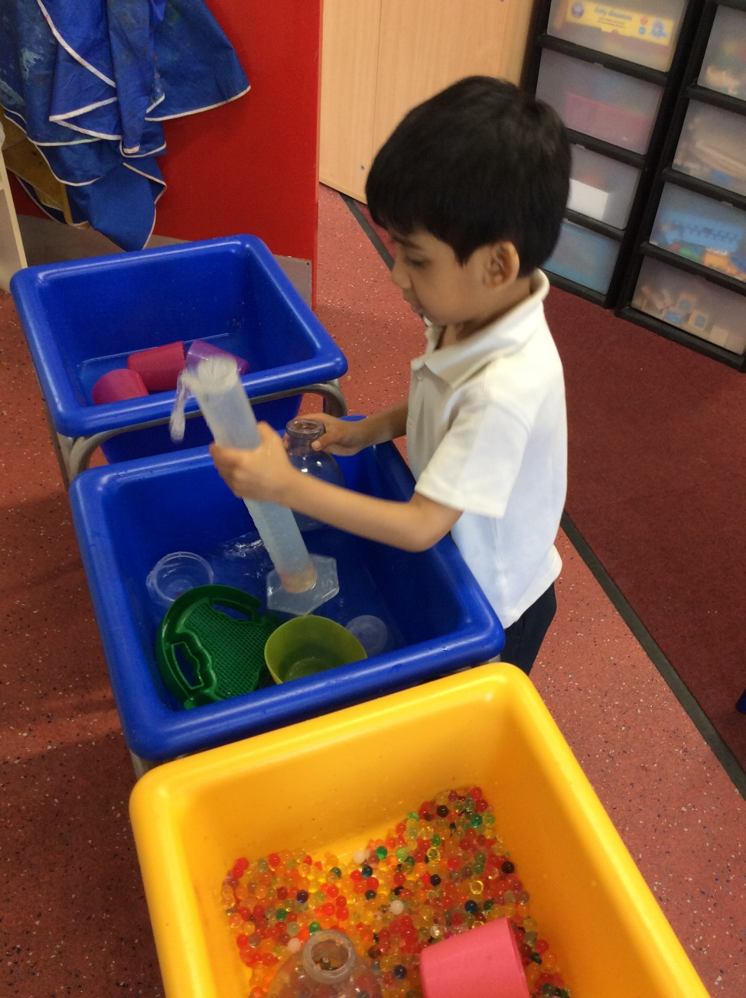
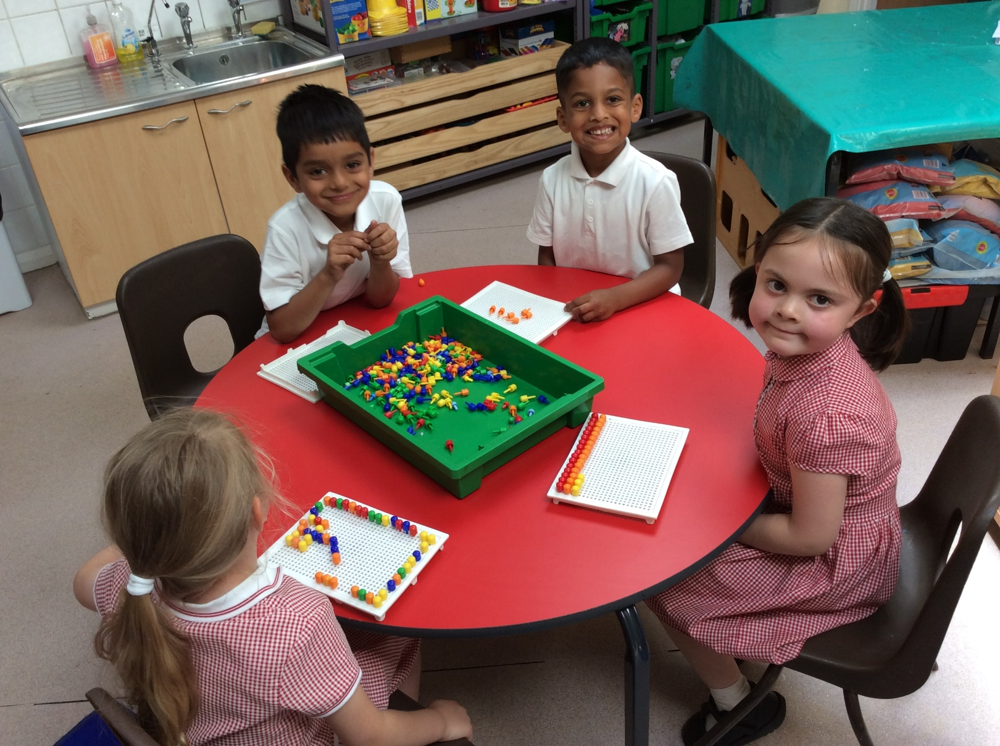
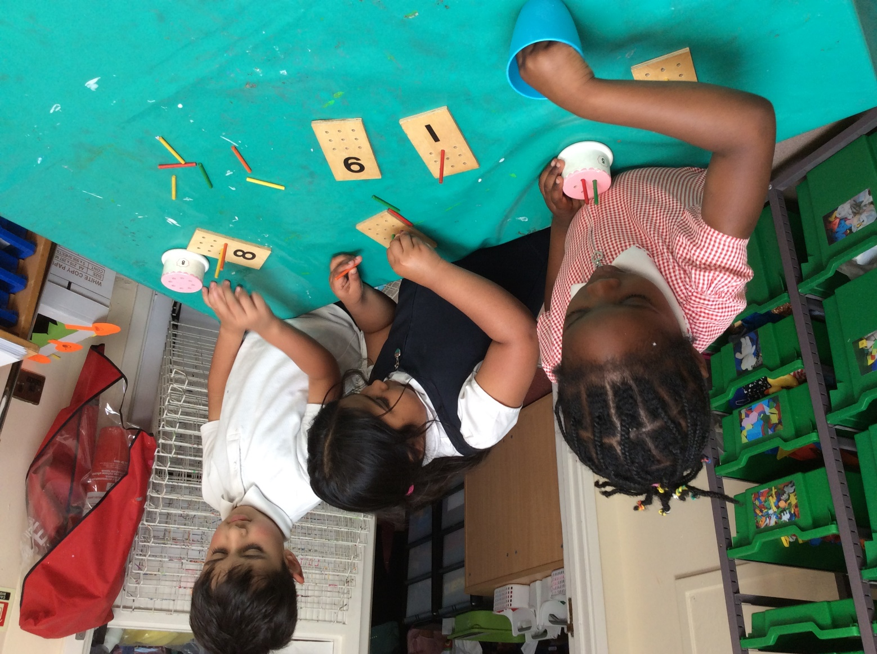
Mathematics
Count objects, actions and sounds
Link the numbers and objects
Count beyond 10
Compare numbers
Understand 1 more and 1 less
Explore the composition of numbers to 10
Recall number bonds to 10
Explore 2D and 3D shapes
Repeating patterns
Compare length, weight, capacity and size

Slide 22
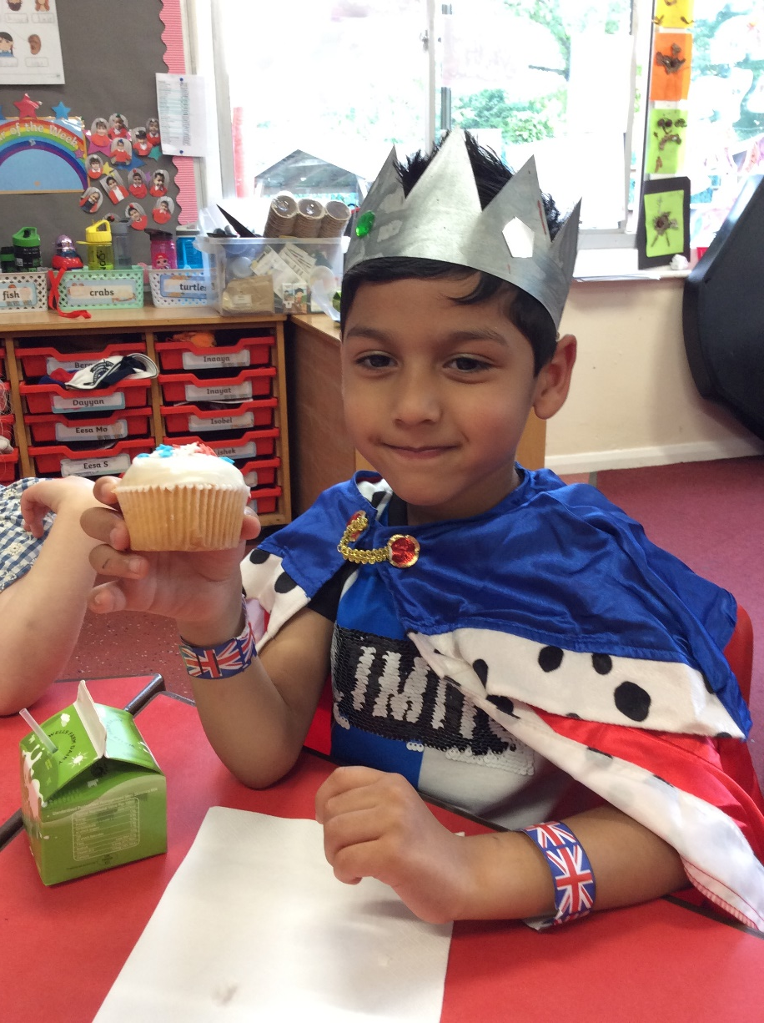
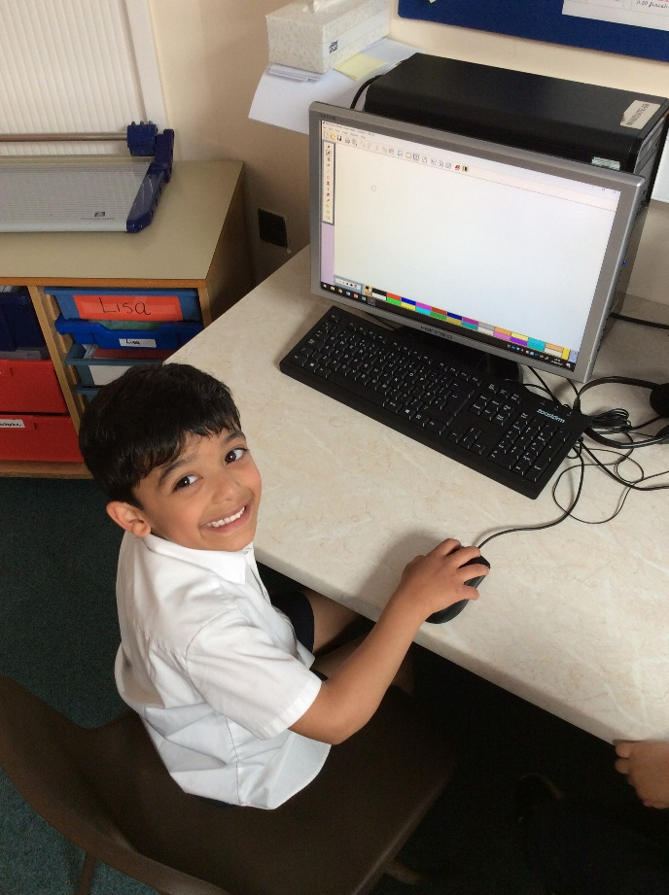
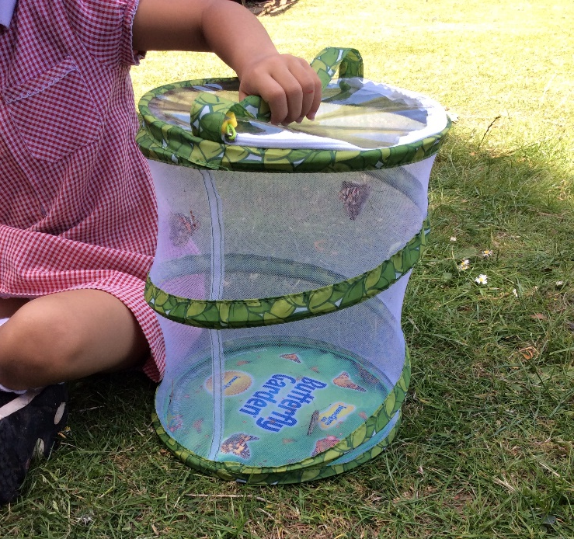
Understanding the World
To talk about their family and community and what places are special to their family
We will be looking at stories, which will include figures from the past
Draw information from simple maps
Learn about different beliefs and how people celebrate special times in different ways
Look at similarities and differences between where they live and other countries
To explore the world around them, using their senses to describe the environment
Learn about the seasons and observe changes that happen throughout the year

Slide 23
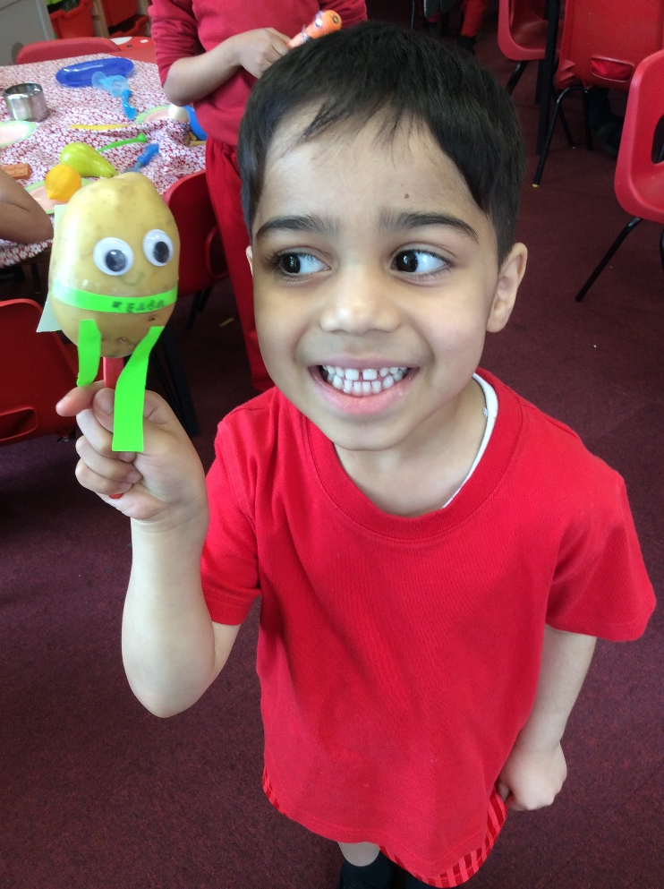
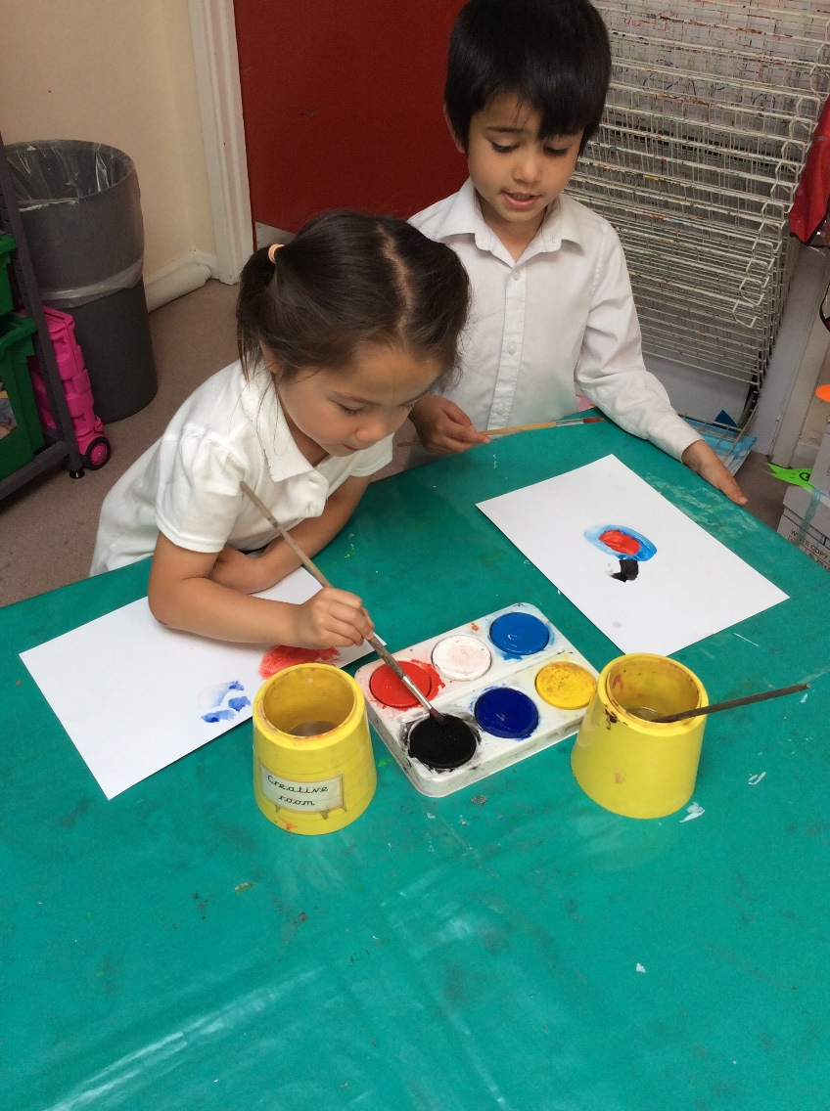
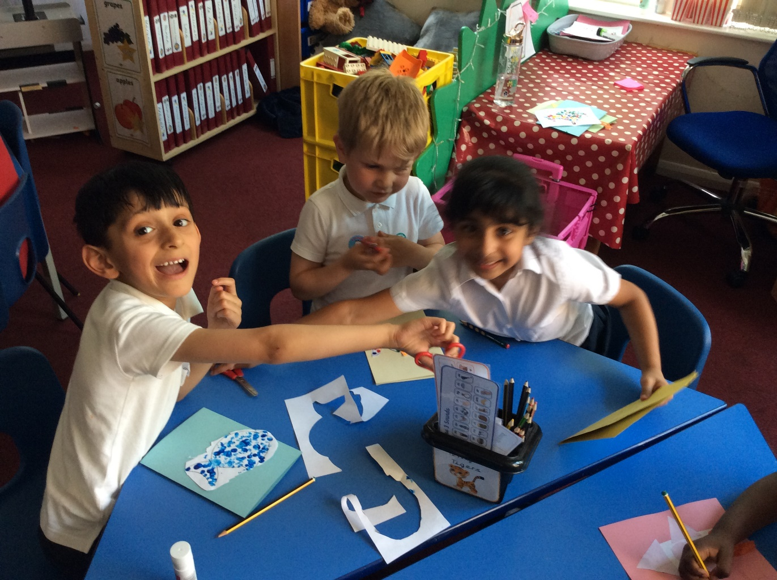
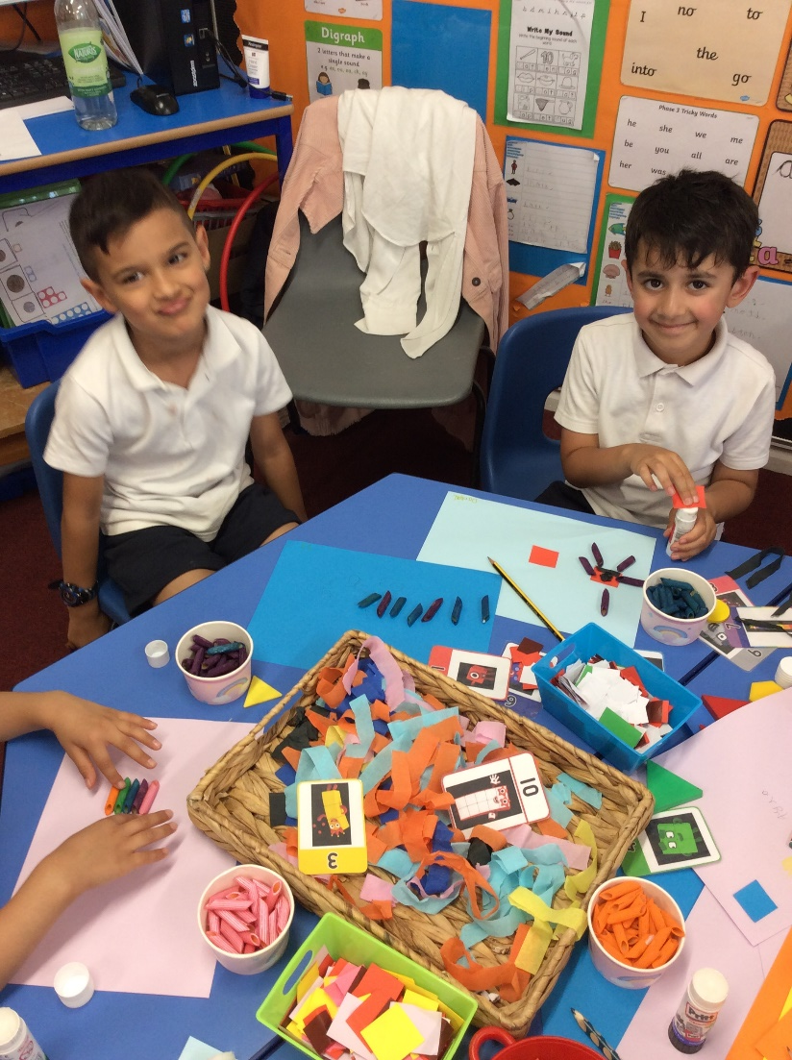
Expressive Arts and Design
To use a variety of artistic effects to express their ideas and feelings
Create collaboratively sharing ideas, resources and skills
Listen attentively, move and talk about music, expressing their feelings
Watch and talk about dance and performance art, perform in with class and year group assemblies
Develop their storylines in their pretend play
Explore and engage in music making and dance

Slide 24
In school we also…
We help the children build confidence in different ways:
Class assemblies on the main stage
Talking in class and group discussions
Role play
Oracy skills are developed in all areas of learning
We will also provide opportunities for:
School visits
Outside learning
Theatre trips

Slide 25
Home-School links
Termly curriculum letter
Homework - set on Teams
Parents evenings
Learning journey and book look evenings
School website
Parents group
Email or phone
Weduc – main communication app

Slide 26
Important Information
Up to date address and phone numbers
Health concerns, medical information or dietary needs
Family situation, any important details about your family (especially if they affect your child)
Learning needs, any diagnosed special educational needs or concerns that you have about your child
Sharing information helps us care for your child and support their learning.
We are happy to answer your questions about any of this information

Slide 27
Pupil Premium Offer
Pupil Premium information can be found within your induction pack, if you require more information then please phone the school office.
Pupil Premium children are eligible for: free school meals, support with buying uniform, school trips amongst other things, iPad.
To sign up to Pupil Premium there is a website that you apply on and information can be found in your pack or you can always ring the office and they will be able to give you advice
If you children further up the school who are already Pupil Premium, you will need to register your new child.

Slide 28
What next?
Getting ready for school workshop - Friday 28th June at 2:15pm until 3pm. This will take place at school in the hall. Parents only!
Monday 8th July - transition morning for your child (no parents at this session) 9:45 – 10:45am
Induction pack – please make sure you have you pack before you leave, includes important information about your child’s class and our Foundation Stage
Parent interviews will take place on 27th and 28th August. These are individual sessions for you and your child and the class teachers. Your time is included in your pack.
The children's first few days at school will be part time. They will be having lunch on both days, and it will be all of the children:
Thursday 29th August 9:00-12:30pm
Friday 30th September 9:00-12:30pm
Children will start full time on the week beginning 2nd September 2024

Slide 29
Thank you for listening!
Class teachers and classes:
Fourfold – Miss Finemoore & Mrs Panacer
Poppyfield – Miss Moore & Miss Botterill
Beehive – Mrs Williams, Mrs Wilkinson & Mrs Gashi

