Slide 1

Welcome Evening
Welcome to Year 5 at Launde Primary School
2024-25
Notes:
Sam

Slide 2
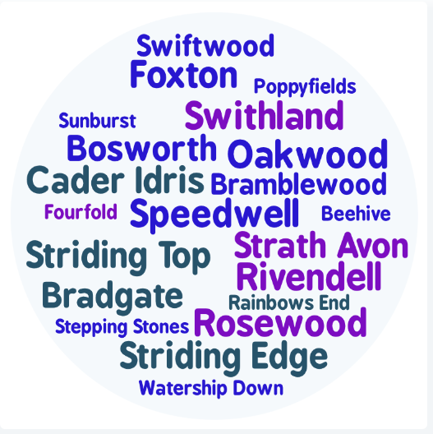
Staff Introductions
Speedwell Miss Patel
Rivendell Mrs Johal
Strath Avon Mr Frost
Notes:
All

Slide 3

Partnership
We hope your child is looking forward to their transition into Year 5.
Your child’s wellbeing is our first priority and we want to ensure that they feel happy and safe coming into school.
You are always welcome to speak with us. We are here to support you and your child.
Notes:
Sharn

Slide 4
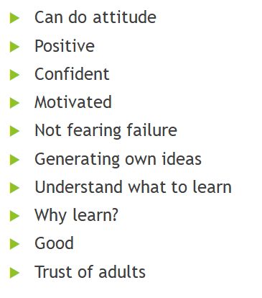
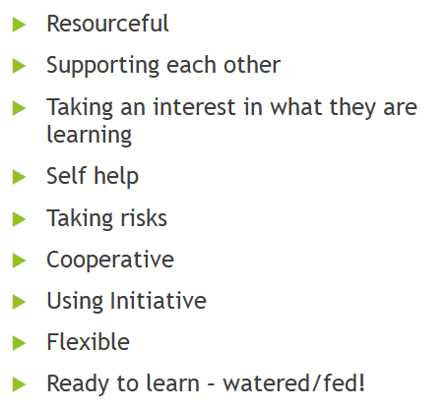
Developing their Character
It is important to develop the children’s characters through the curriculum we teach.
These are some of the personality traits endeavour to develop:
Independence
Positive attitude to learning
Adaptation to different situations
Good communication
Sense of pride
Resilience
Taking responsibility
Notes:
Sharn

Slide 5
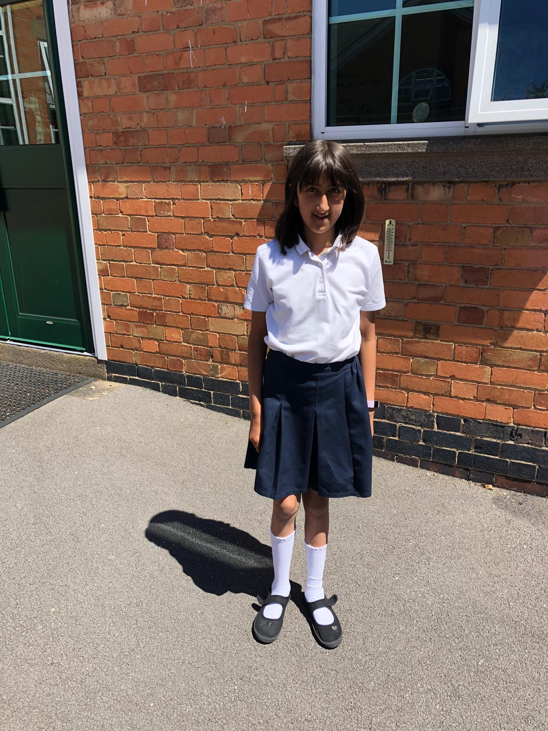
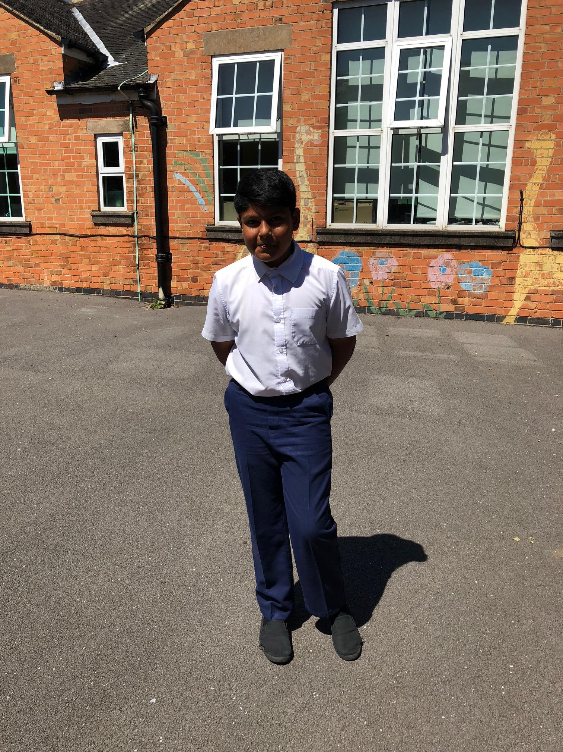
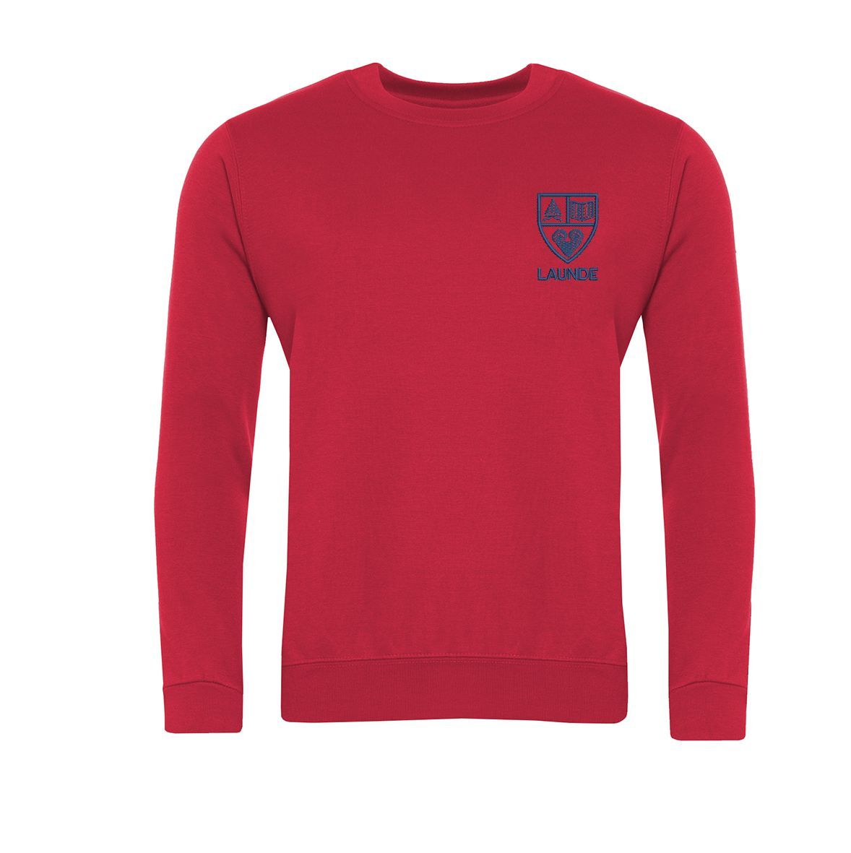
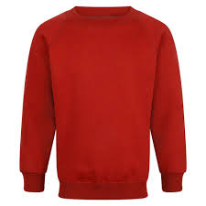
Equipment and Uniform
School uniform has been updated – white polo t-shirts, red jumpers or cardigans and trousers/skirts can be black, grey or navy.
Each child will have access to equipment and resources at school, nothing needs to be brought in from home
Please ensure all clothes are labelled with your child’s name – very important!
Book bags (not backpacks please)
Black shoes - branded trainers are not to be worn
There should be no jewellery, nail varnish or hair accessories worn
All long hair should be tied up with a simple bobble
Notes:
Raheema

Slide 6
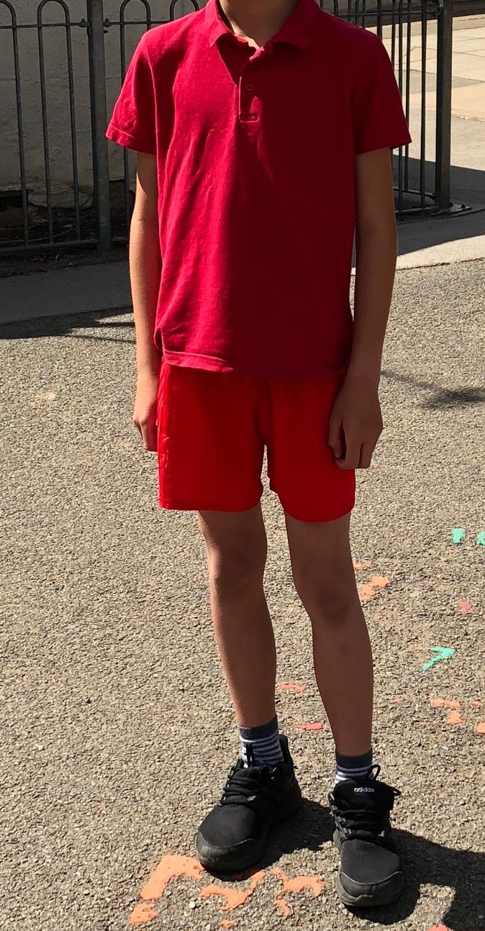

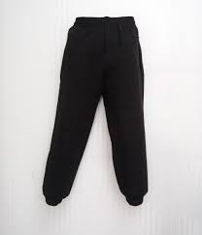
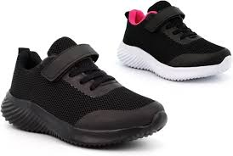
PE Kit
P.E. kit will need to be worn on the days that your child has PE.
The children should come to school in their PE kits:
Red/white T/polo shirt, sweat shirt
Red/black joggers or shorts
White or black trainers (not school shoes or branded trainers)
Earrings to be removed or earring tape to be worn
Please make sure that your child is dressed appropriately for the weather on the day of their PE.
Notes:
Raheema

Slide 7

Year 5 Curriculum Content
In Year 5 we have selected a variety of fun, interesting and exciting topics for our lessons.
We will teach a variety of subjects including Reading, Writing, Maths, Science, Geography, History, RE, PE, Art, D&T, Computing and Music.
Each term, parents will be provided with a termly overview with more details about which topics will be taught.
Notes:
Sam

Slide 8
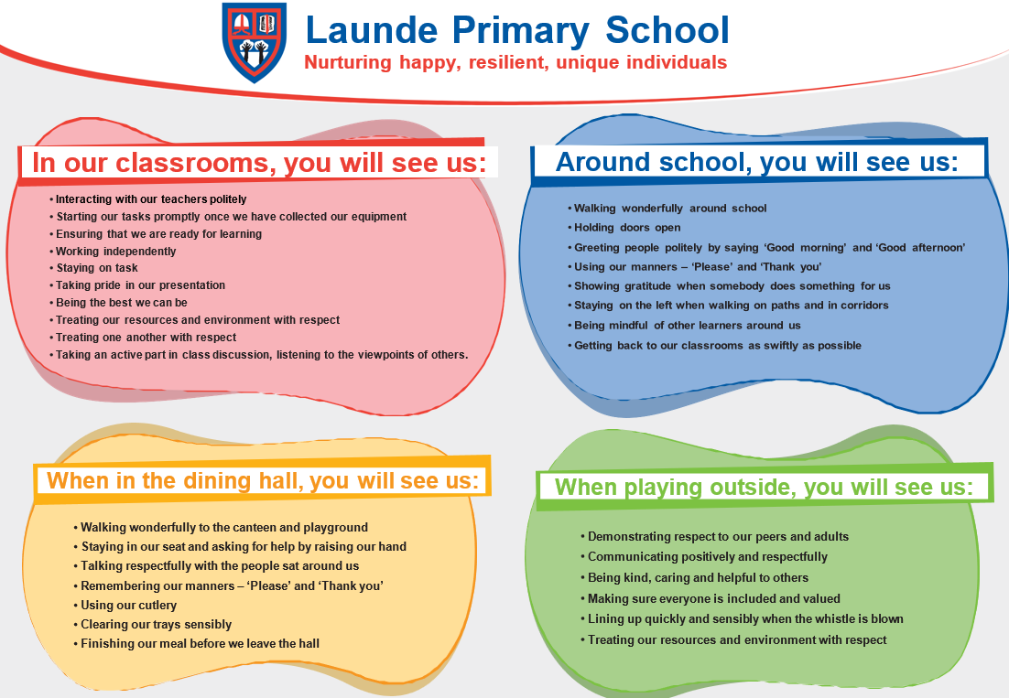
Behaviour Curriculum
Launde has a fully implemented behaviour curriculum to support children in developing good habits and to help foster an inclusive, nurturing environment where every child feels safe and valued.
We achieve this by teaching three fundamental principles:
Be Ready
Be Respectful
Be Brave
These principles are then rewarded when we see them in school, in a number of different ways.
Notes:
Sam

Slide 9
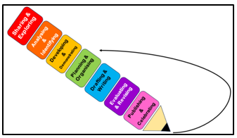
Writing
Throughout the year, the children will write setting and character descriptions, non-chronological reports, comparative reports, diary entries, newspaper reports, biographies and letters.
Autumn
The Golden Horsemen of Baghdad by Saviour Pirotta
Shackleton’s Journey by William Grill
Race to the Frozen North by Catherine Johnson
Spring
The Explorer by Katherine Rundell
Coraline by Neil Giaman
Summer
The Girl Who Stole and Elephant by Nirzana Farook
The Boy in the Tower by Polly Ho-Yen
Some skills we will teach them to use include:
Prepositional phrases
Relative clauses
Figurative language (similes, metaphors)
Semi-colons
Varied sentence openers
All past tense forms
Formal and informal language
Notes:
Sharn

Slide 10
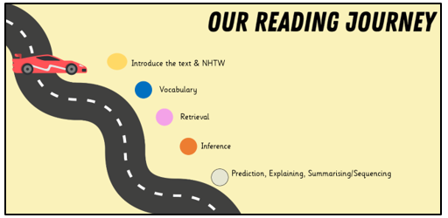
Reading
Daily whole class reading lessons
Builds fluency
Answer questions related to the key areas of comprehension (VIPERS)
New vocabulary is explicitly taught.
Notes:
Sharn

Slide 11


Maths
Place value of numbers up to 6-digits, including decimals
Written methods of the four operations, including long multiplication
Recall of times tables (practised through 100 club)
Fractions, decimals and percentages
Converting between units of measure
Telling the time – 24 hour clock, time tables, time intervals
2D and 3D shapes, including angles, translation, symmetry and coordinates
Handling data – interpreting line graphs and pie charts
Arithmetic (weekly)- speed, fluency and accuracy
Daily retrieval- 5 a Day to sharpen skills
Notes:
Raheema

Slide 12
Deepening Mathematical Reasoning
Reasoning and problem solving
Applying their knowledge and strategies
Explaining how they have calculated an answer
Explaining why an answer is correct or incorrect and how they know that
Notes:
Raheema

Slide 13

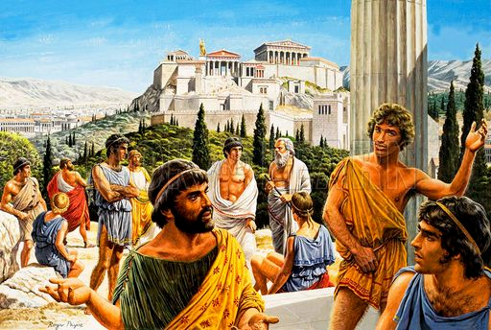
Wider Curriculum
Science – Earth and Space, Forces, Seperating Mixtures, Energy, Life Cycles and Human Development
History – What was life like in Tudor England? What did the Greeks ever do for us? How did the Maya Civilisation compare to the Anglo-Saxons?
Geography – What is life like in the Alps? Why do oceans matter? Would you like to live in the desert?
Notes:
Sam

Slide 14
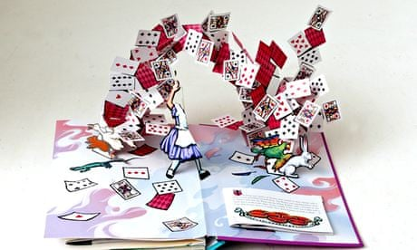

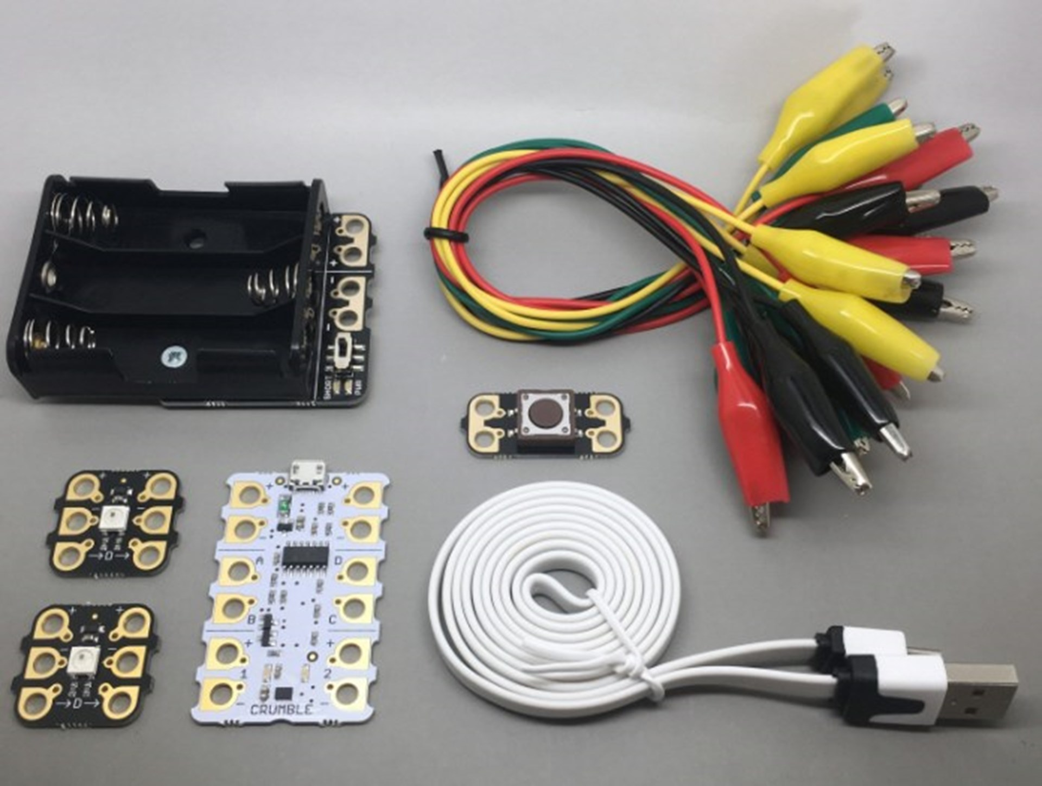
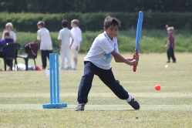
Wider Curriculum
Design and Technology – Electrical Systems: Doodlers, Developing a Recipe: Bolognese, Mechanical Systems: Pop Up Books
Art – Sculpture and 3D: Interactive Installations, Craft and Design: Architecture, Drawing: I Need Space, Mixed Media: Portraits
Computing – Programming, creating media, computing systems and networks
RE – Christianity, Islam and Rites of Passage
PE – Outdoor: Quicksticks, Netball, Tennis, Football, Kwik Cricket, Rounders. Indoor: Gymnastics, Fitness, Dance, Swimming.
Notes:
Sam

Slide 15
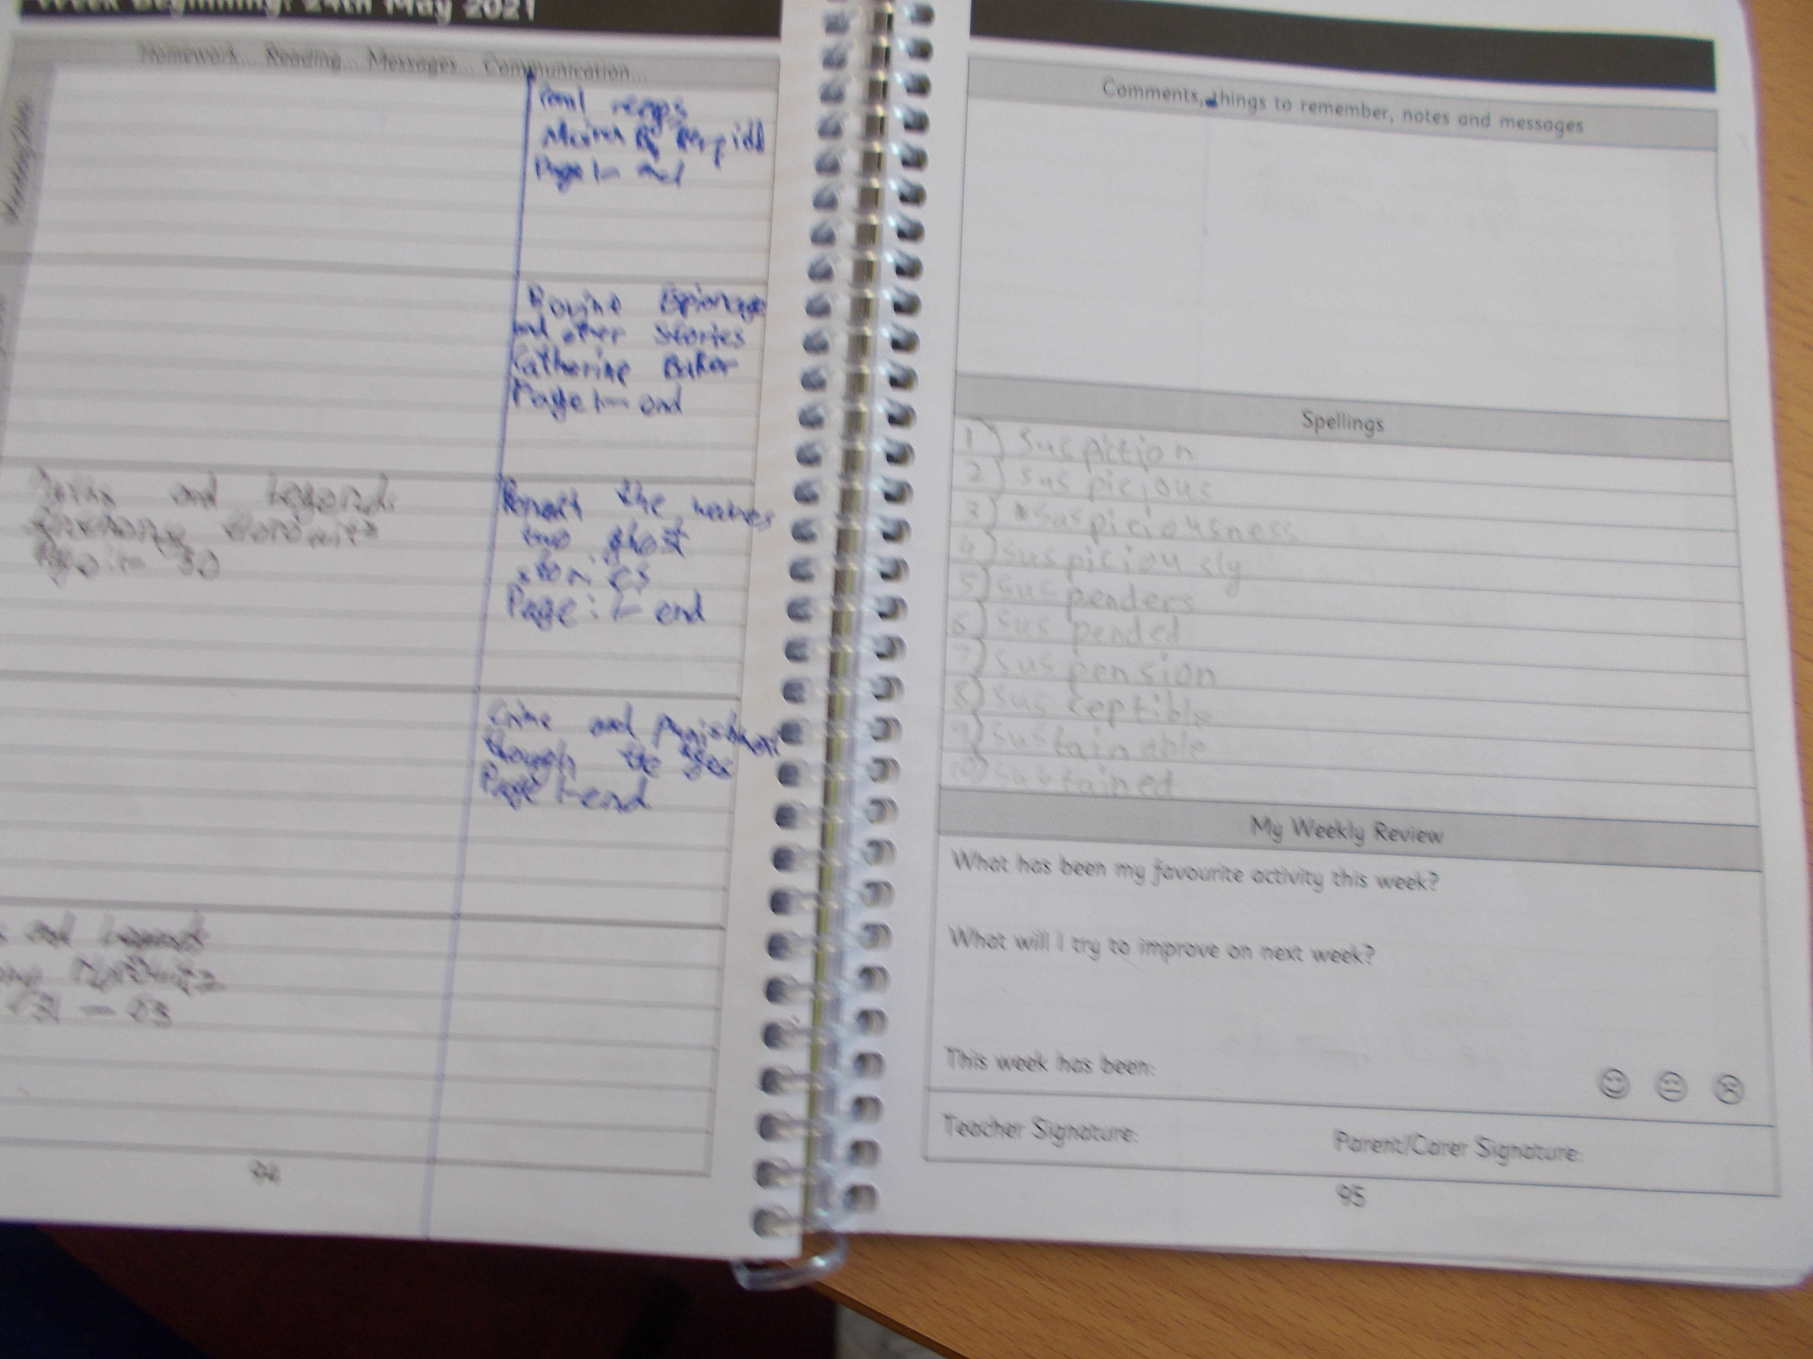
Homework
Homework is normally handed out as paper copies, with electronic versions being made available on Teams.
Daily reading
21 minutes of Times Table Rockstars
Weekly Maths homework
Fortnightly topic homework
Knowledge Organisers are provided to each child at the start of a new topic for further support
Top Tips: Make homework a part of your regular routine;
Provide a quiet working space
Don’t leave it to the last minute!
Notes:
Sam

Slide 16
Pupil Premium
As a school, we want all children to be successful, empowered to learn and happy and excited to come to school. We feel strongly that school should be a place of opportunities and recognise that we can make a significant difference if we individually target the needs of children.
To achieve this, we have adapted the pupil premium offer to ensure it is more personalised to provide individual support to each child.
Next year, each class will have a TA during the morning sessions to support the children in their class. In the afternoon, we plan to use these TAs to run sessions to target the needs of any child that needs support.
Should you feel that you could be eligible for free school meals then please contact the office.
Notes:
Clare?

Slide 17



Over the holidays you could…
Things to practise over the holidays….
Try to read together with your child from a variety of sources (books- fiction/non-fiction, comics, newspapers, poems, etc.)
Regularly practise times tables up to 12 x 12 through online games or flash cards - TTRS.
Take part in the Summer Reading Challenge- https://summerreadingchallenge.org.uk/
Complete as many objectives from the list of “50 things to do before you’re 11$\frac{3}{4}$”.
Write a post card to your new teacher from an exciting location or keep a diary of how you have spent your summer holidays.
Notes:
Sharn

