Slide 1

Welcome Meeting
Welcome to Year 2 at Launde Primary School
2024-2025
Notes:
Heather

Slide 2
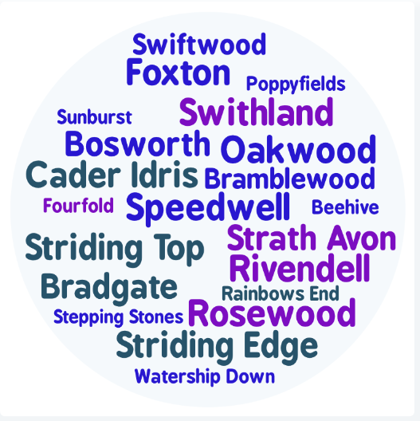
Staff introductions
Bramblewood Mrs Allen
Swiftwood Miss Stewart
Bosworth Miss Tobin
Notes:
Everyone

Slide 3

Partnership
We hope your child is looking forward to their transition into Year 2.
Your child’s wellbeing is our first priority and we want to ensure that they feel happy and safe coming into school.
You are always welcome to speak with us. We are here to support you and your child.
Notes:
Kate

Slide 4
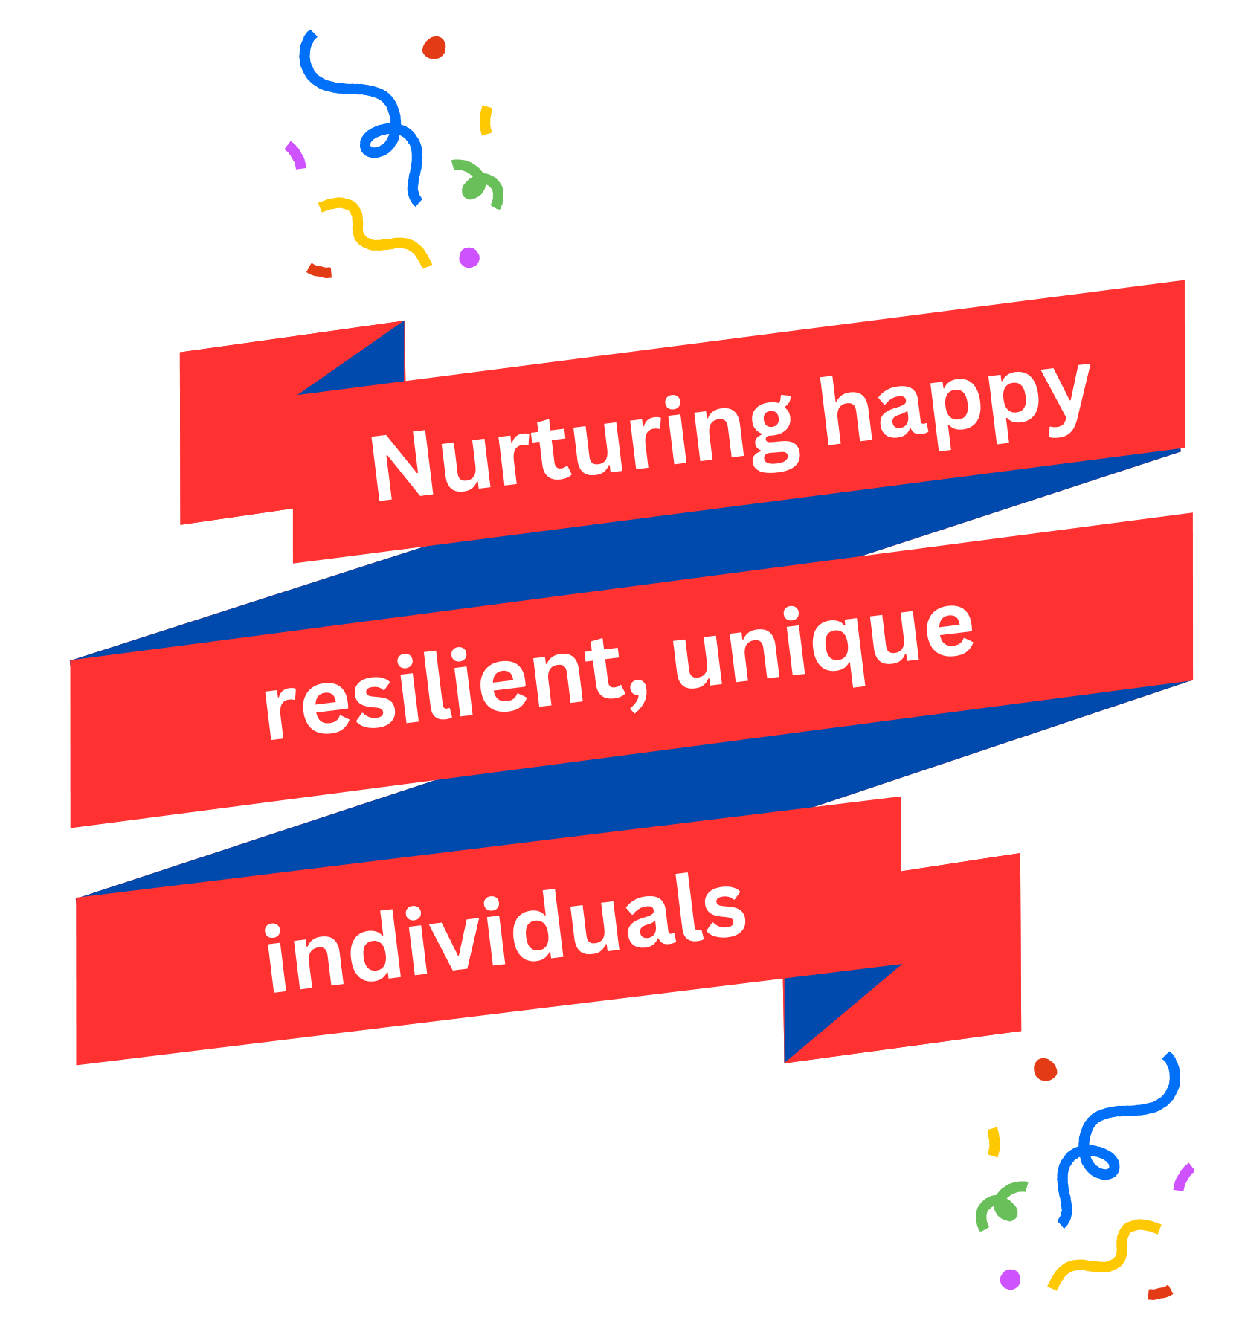
Developing their characters
Be Ready
Independence
Positive attitude to learning
Be Respectful
Good communication skills
Ability to work together
Be Brave
Resilience
Willing to make and learn from mistakes
Notes:
Kate

Slide 5
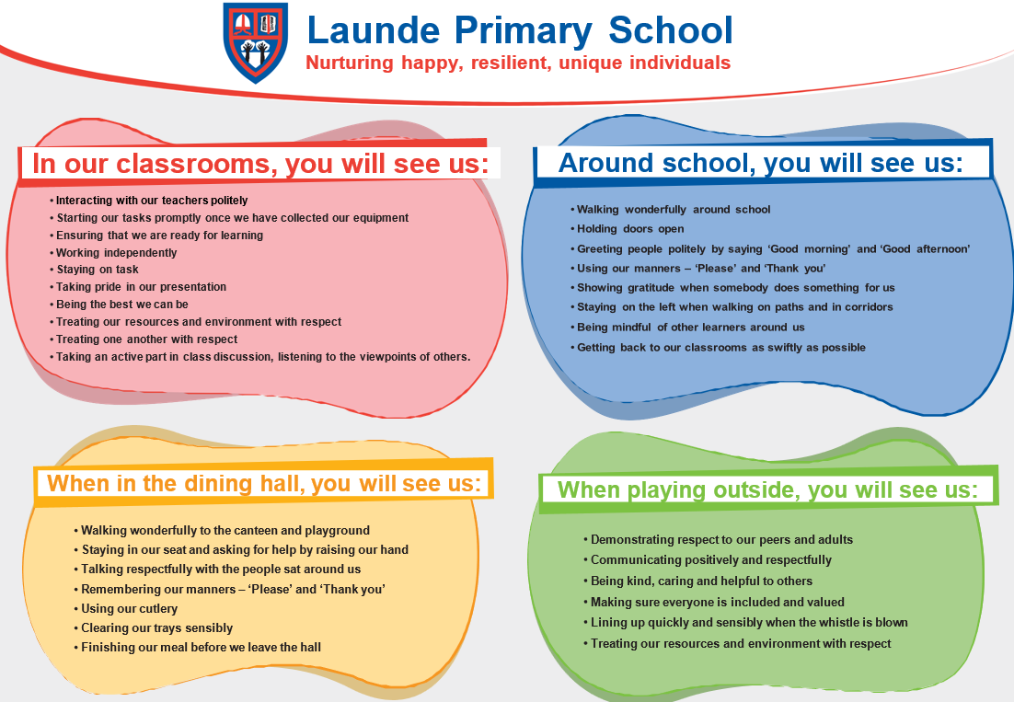
Behaviour Curriculum
Launde has a fully implemented behaviour curriculum to support children in developing good habits and to help foster an inclusive, nurturing environment where every child feels safe and valued.
We achieve this by teaching three fundamental principles:
Be Ready
Be Respectful
Be Brave
These principles are then rewarded when we see them in school, in a number of different ways.
Notes:
Heather

Slide 6
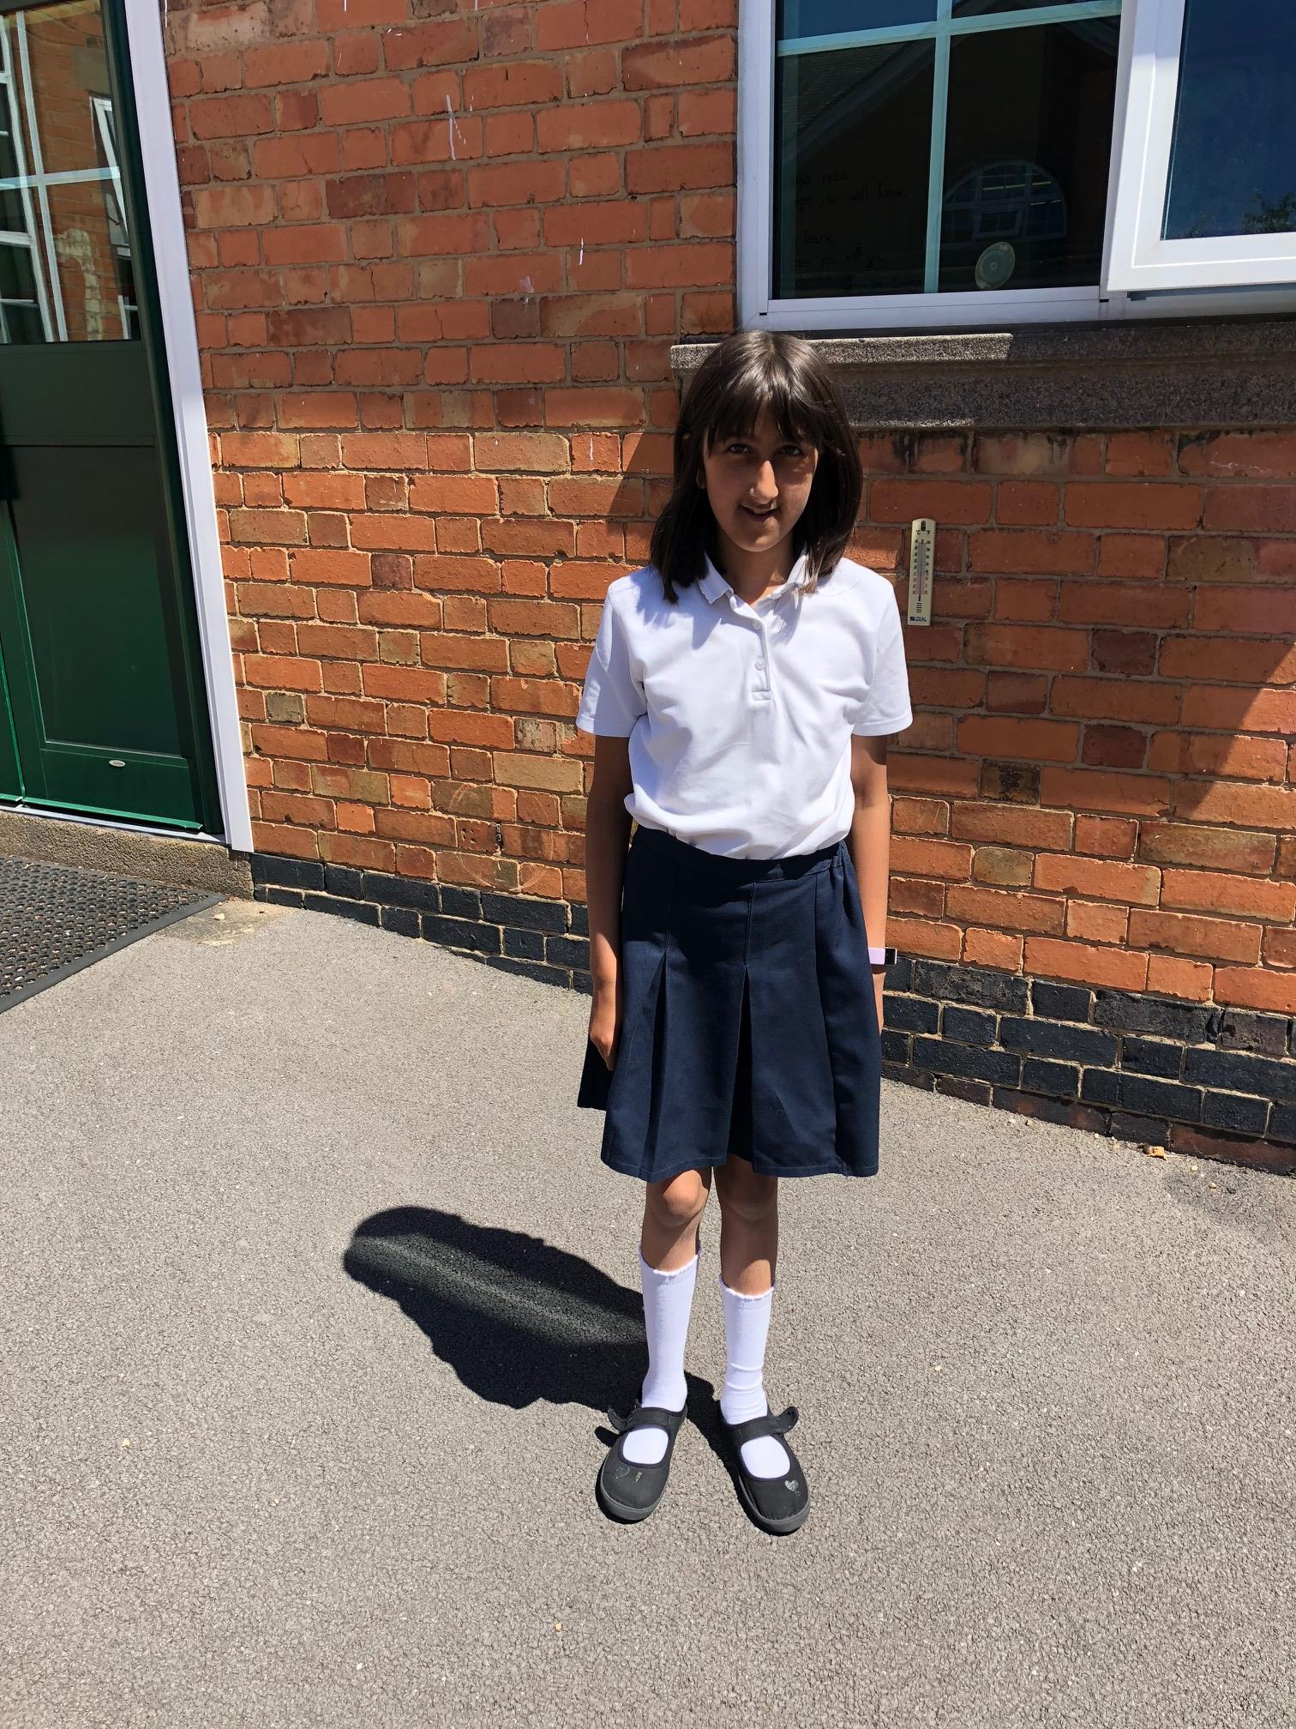
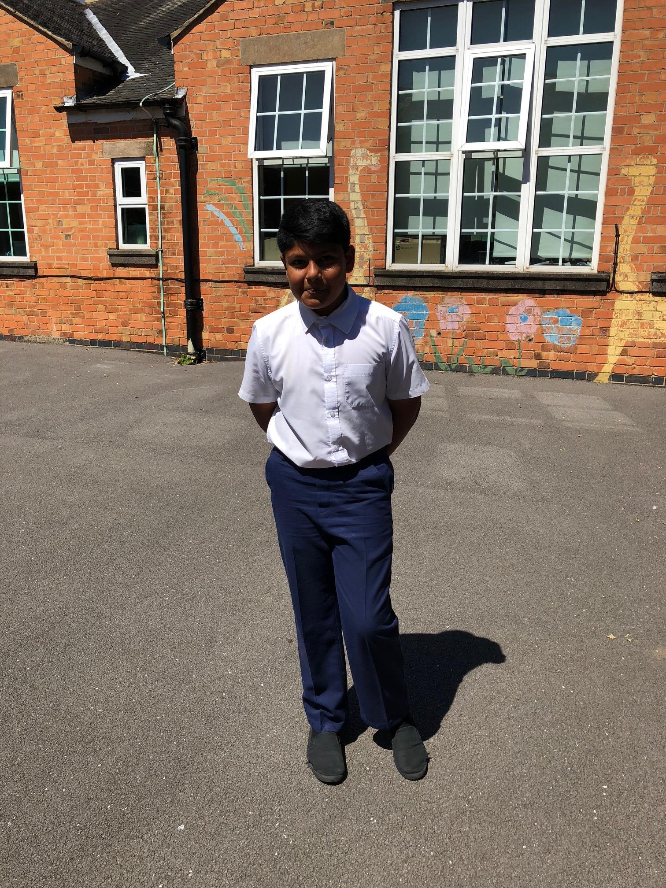
Uniform
White polo shirt
Uniform – please ensure your child conforms to the school uniform rules
Children will not need to change their shoes during the day.
Red Jumper/Cardigan (logo optional - from School Wear Solutions, plain red available anywhere)
Summer Dresses: Red Gingham (available anywhere)
All long hair should be tied up.
Black or grey skirt, trousers or shorts
Plain, black shoes or trainers with black sole and no logo.
Notes:
Jo

Slide 7
PE Kit
P.E. kit to be worn on the day that your child has PE for the day.
black joggers/shorts
white t-shirts
sports trainers (white or black)
Please make sure that your child is dressed appropriately for the weather on the day of their PE.
Notes:
Jo

Slide 8
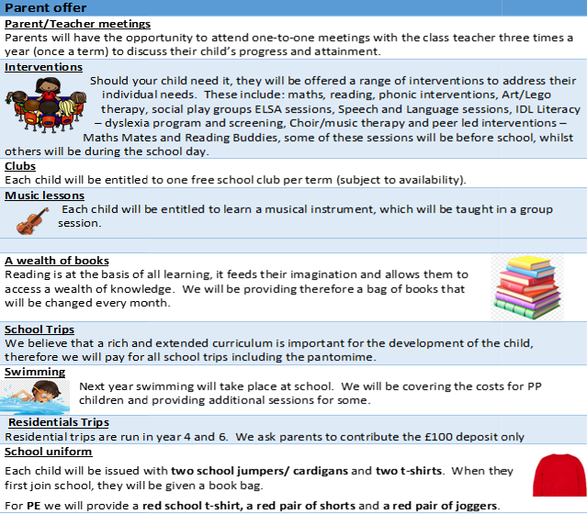
Pupil Premium Offer 2024-2025
As a school, we want all children to be successful, empowered to learn and happy and excited to come to school. We feel strongly that school should be a place of opportunities and recognise that we can make a significant difference if we individually target the needs of children. To achieve this, we have adapted the pupil premium offer to ensure it is more personalised to provide individual support to each child.
Next year, each class will have a TA during the morning sessions to support the children in their class. In the afternoon, we plan to use these TAs to run sessions to target the needs of any child that needs support.
Should you feel that you could be eligible for free school meals then please contact the office
Notes:
Heather

Slide 9
Our school day
Daily timetable
One hour Mathematics
Fifteen minutes of mastery of number
One hour English
Thirty minutes reading
Twenty minutes spelling three times a week
8:40am Meet and Greet
8:45am Register and morning work
10:10am Break
11:45am Lunch time
15:15pm Home time
Notes:
Jo

Slide 10
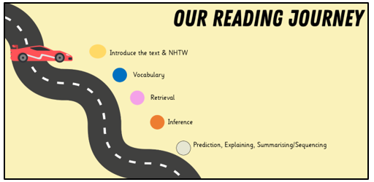
Reading
Daily whole class reading following our reading journey
Please read every day with your child, two reading books are given each week
Ask questions to check their understanding
Children are expected to read aloud
with fluency, pace and expression
Notes:
Kate

Slide 11

Keep reading with the library challenge!
6th July – 7th September
Notes:
Kate

Slide 12
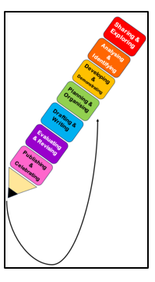
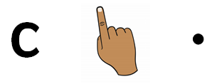
Writing
Text types
Setting descriptions
Character descriptions
Story innovation
Recounts-Diary
Letter
Instructions
Non-chronological reports
Action scenes
Key skills
Sentence punctuation
. ! , ?
Grammar- Nouns, Adjectives, Verbs and Adverbs.
Conjunctions
Sequencing and organisation
Notes:
Heather

Slide 13
Spelling Lessons
Children will continue to develop their phonological awareness through three weekly spelling lessons.
Revising Phase 3, 4 and 5 including the alternative spellings and split digraphs.
Introducing Phase 6 – suffixes, plurals, homophones.
Common exception words (“tricky” words) e.g. would, improve, many, wild.
Target spellings as part of English lessons.
Notes:
Heather

Slide 14

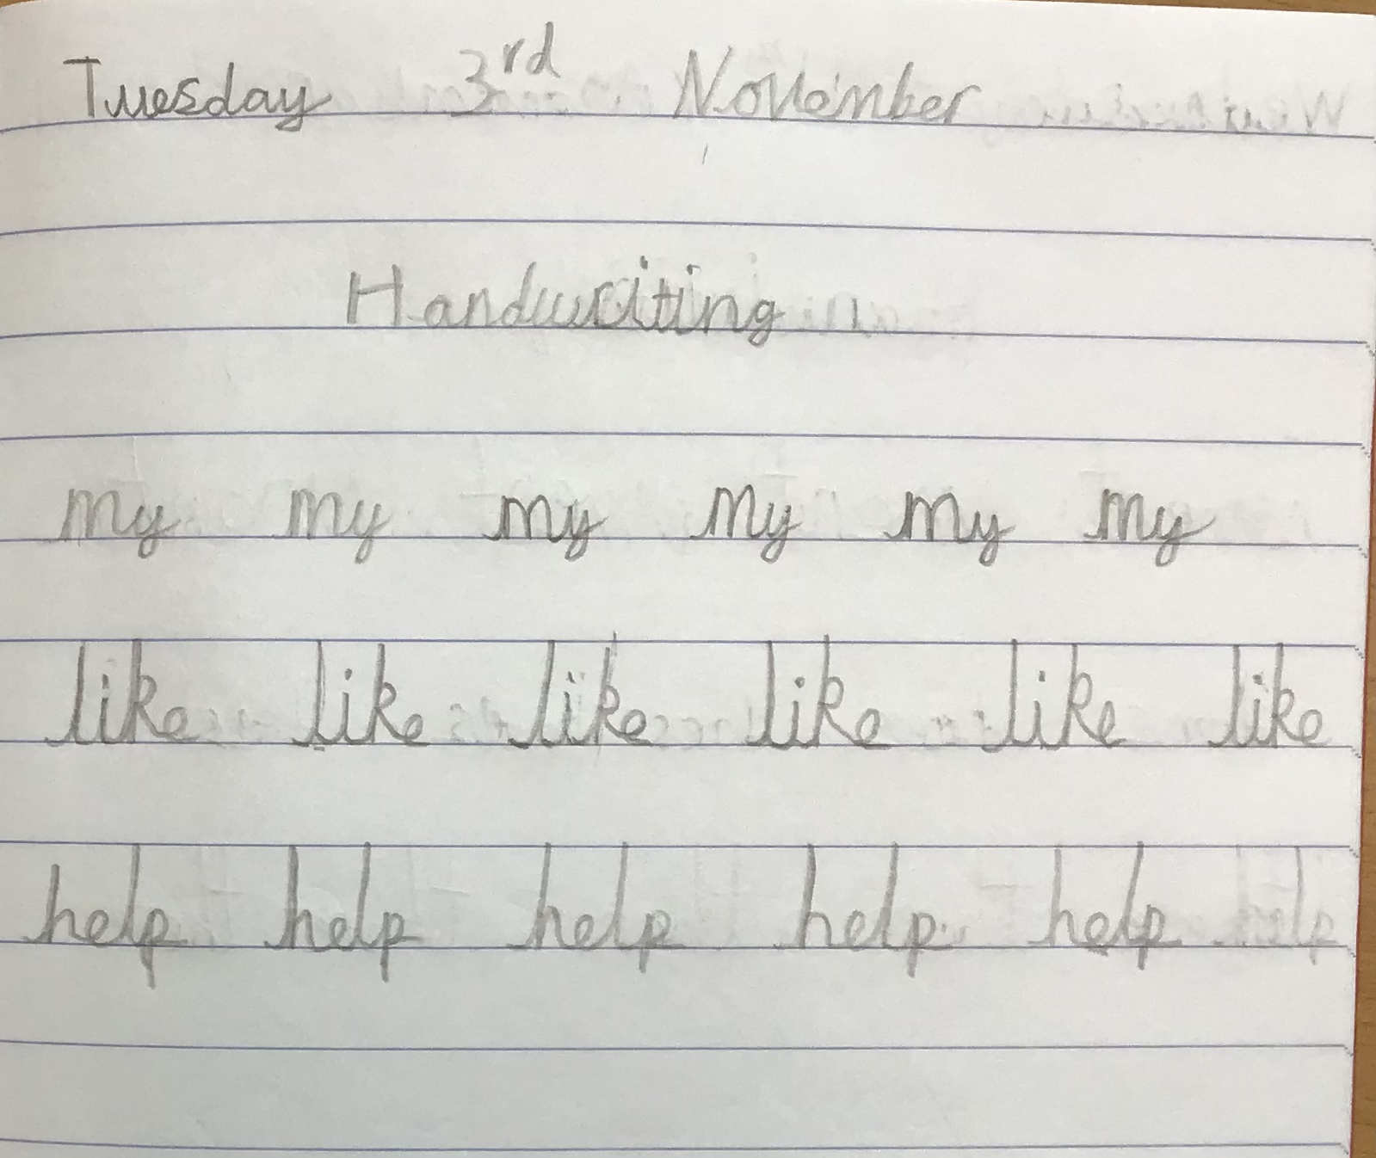
Handwriting
Focus
Continue to develop continuous cursive handwriting
Focus on lowercase and capital letters
Show clear ascenders and descenders
Introduce the different letter joins
Encourage children to join when they are ready
Notes:
Heather

Slide 15


Maths
Counting and number sequences to 100
Place value of any 2-digit number
+ - x ÷
Times tables- 10, 5 and 2 times tables
Fractions – ½, ¼, 1/3, ¾
Measuring length, height, mass, capacity, volume, time and temperature.
Telling the time – o'clock, half past, quarter to and quarter past.
2D and 3D shapes
Handling data
Problem solving relating to all areas.
Notes:
Jo

Slide 16

Year 2 Curriculum Content
In Year 2 we have selected a variety of fun, interesting and exciting topics for our lessons.
We will teach a variety of subjects including Reading, Writing, Maths, Science, Geography, History, PSHE, RE, PE, Art, D&T, Computing and Music.
Notes:
Jo

Slide 17
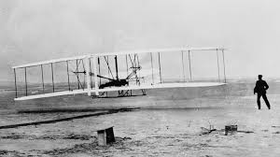

Other Subjects
Science: living things and their habitats, solids, liquids and gases, materials, plants
History: what was school like in the past? How did we learn to fly? What is a monarch?
Geography: Would you prefer to live in a hot or cold place? Why is our world wonderful? What is it like to live by the coast?
Notes:
Jo

Slide 18
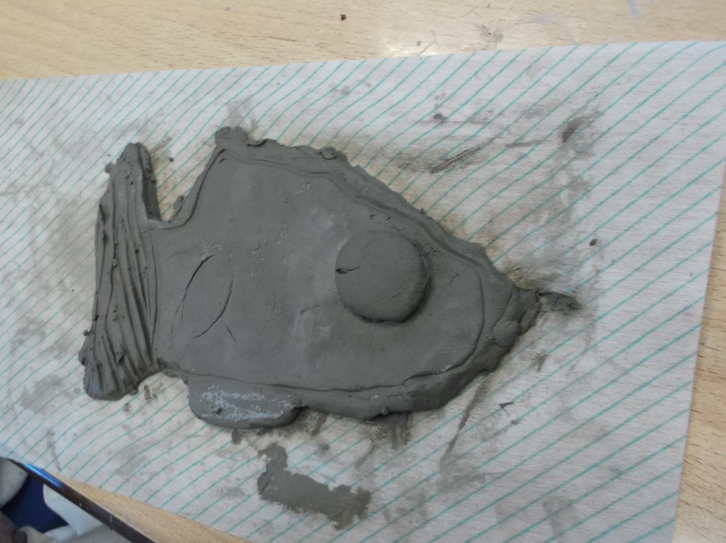
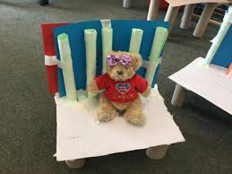
Other Subjects
Art: map it out, mixed media and sculpture- clay
Design and technology: mechanical moving monsters, textile pouches, cooking, structures- baby bear’s chair
Physical Education: dance; gymnastics; athletics; ball skills; yoga
Religious Education: Islam; Judaism; caring for others and our world
Notes:
Jo

Slide 19
Helpful Websites
www.topmarks.co.uk – Interactive, fun maths games.
www.teachhandwriting.co.uk – Video demonstrations of how to form letters, and fine motor skill exercises.
www.phonicsplay.co.uk – Interactive phonics games for phases 3-5.
www.oxfordowl.co.uk – Online reading and phonics resources.
Notes:
Kate

