Slide 1





Welcome to Year 1!
Launde Primary School

Slide 2




The Year 1 Team
Mrs Smith
Mrs Merz
Mrs Majid
Miss Cox
Miss Frost
Miss Bedford

Slide 3


Working Together
We hope your child is excited to join us in Year One!
Your child’s wellbeing is our first priority and we want to ensure that they feel happy and safe coming back to school after the summer holidays.
We are here to support you and your child. You are always welcome to speak with us.

Slide 4



Behaviour
Be Ready
Independence
Positive attitude
Be Respectful
Good communication skills
Teamwork
Be Brave
Resilience
Learning from mistakes

Slide 5

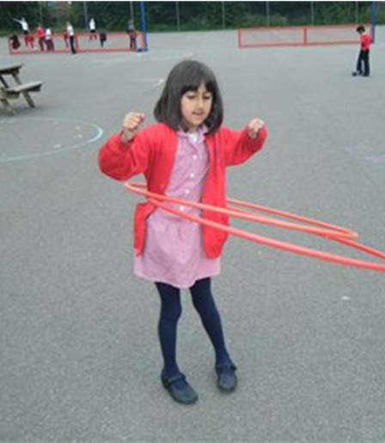
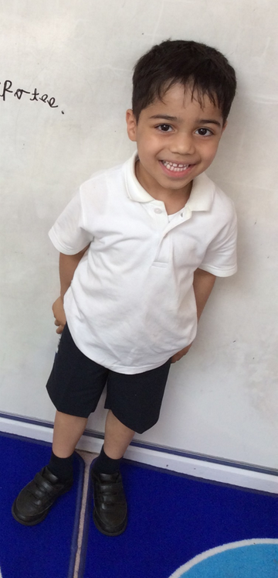
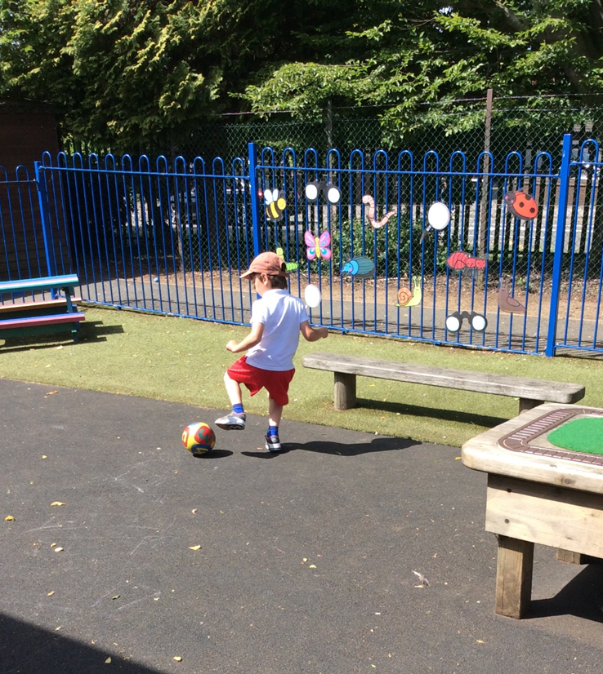
School Uniform
Tops: white polo shirt, red jumper/cardigan
Bottoms: black or grey trousers/shorts
Shoes: black school shoes or plain black trainers
Summer dresses: red gingham
Shoulder length hair should be tied up.
For PE, children should wear:
  black (or red) jogging bottoms or shorts
  white (or red) t-shirts
  white or black trainers
On PE days, earrings should either not be worn or be covered with tape. Religious jewellery should be covered with a sweatband.

Slide 6



Outdoors
As in EYFS, we will always try to get children outdoors during the school day, so please ensure that your child is appropriately dressed for the weather. Please ensure any additional items of clothing are named.
Children should bring in their book bag and a named water bottle every day.

Slide 7


A Typical Day
Children should arrive at school at 8:40am. The gates close at 8:45am.
Children will take part in daily:
  phonics lessons
  reading lessons
  writing lessons
  maths lessons
In the Autumn term, children will continue to access continuous provision to help them with the transition from EYFS.

Slide 8




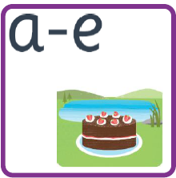
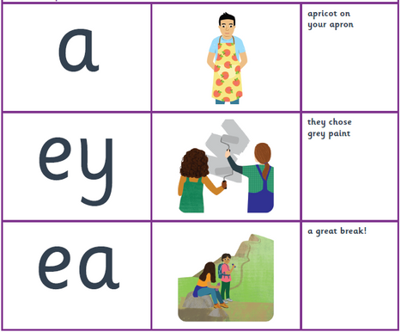
Phonics
Your child will be learning how to read using Essential Letters and Sounds. This phonics programme supports your children to develop the skills and knowledge needed for reading.
Children will continue to revise phase three sounds (digraphs and trigraphs) and will learn new phase 5 sounds, including lesser known and alternative GPCs. .

Slide 9
Reading
In Year One, we teach children to read during:
  Daily phonics lessons
  Whole class reading lessons
  1:1 reading sessions
  Whole class story time
Our writing curriculum is also book-based, so your child will have the opportunity to read and enjoy hundreds of high-quality texts during their time in Year One!
If a child is read to 1-2 times per week, they will have heard approximately 63,570 words by the time they are 5 years old.
If a child is read to every day, they will have heard approximately 296,660 words by the time they are 5 years old.

Slide 10


Writing
Children will build on the writing skills that they developed in EYFS during:
  Daily phonics lessons
  Daily writing lessons
  Handwriting sessions
They will have the opportunity to write a range of text types, including:
  Letters
  Stories
  Diary entries
  Descriptions
  Instructions

Slide 11

Maths
In daily maths lessons, children will explore:
  Place value (tens and ones)
  Addition and subtraction
  Multiplication and division
  Fractions
  2D and 3D shapes
  Measurement - including length, mass, capacity, volume, time and temperature
  Position and direction
Children will have their own Power Maths workbooks, where they will complete their maths work.

Slide 12




Wider Curriculum
Over the year, children will have the chance to explore a number of exciting topics in a range of subjects, including:
  History
  Geography
  Science
  Computing
  Art
  DT
  RE
  PE
  Music

Slide 13
Wider Curriculum
Some of our topics will include:
Our weather
How have toys changed?
How have explorers changed the world?
Digital painting
Plants

Slide 14

Date for your Diary
Phonics Information Event
For all EYFS and Year 1 parents
Wednesday 4th September
2:45 – 3:15

Slide 15

Homework
Homework tasks will be posted on Teams and/or handed out in class.
Children should be reading their school books daily with an adult at home.
Children will have topic-based homework activities, as well as tasks related to maths, reading, writing and oracy.
If you’re having a busy week, please prioritise reading.

Slide 16


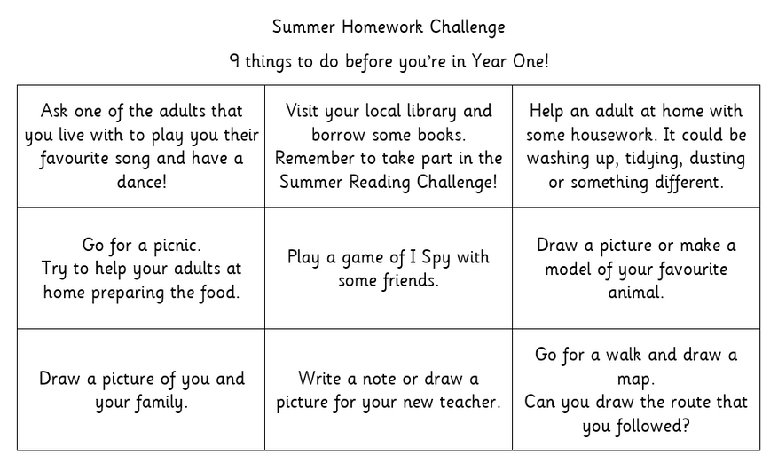

Holiday Homework

Slide 17
Pupil Premium Offer
As a school, we want all children to be successful, empowered to learn and happy and excited to come to school. We feel strongly that school should be a place of opportunities and recognise that we can make a significant difference if we individually target the needs of children. To achieve this, we have adapted the pupil premium offer to ensure it is more personalised to provide individual support to each child.
Next year, each class will have a TA during the morning sessions to support the children in their class. In the afternoon, we plan to use these TAs to run sessions to target the needs of any child that needs support.
Should you feel that you could be eligible for free school meals then please contact the office.

